Slide 1




Top Azure Features Every ASP.NET Developer Should Know About
Or… A bunch of ways to use the Microsoft Azure cloud w/o going all in
Groupe Azure Montréal
28-April-2014 (6:30-8:30)
Bill Wilder
@codingoutloud
codingoutloud@gmail.com
blog.codingoutloud.com
linkedin.com/in/billwilder
• Except where noted, slide deck is © 2014 Development Partners Software Corporation • http://www.devpartners.com •
Notes:
Lundi le 28 Avril 2014, nous sommes heureux d’accueillir Bill Wilder, auteur du livre « Cloud Architecture Patterns: Using Microsoft Azure », pour une présentation qui nous fera découvrir les meilleures facettes de la plateforme Microsoft Azure tout en mettent l’emphase sur le développement ASP.NET.
Bill adore partager et apprendre sur une multitude de sujets. Profitez-en pour lui poser vos questions à propos des patterns, des meilleur pratiques et des technologies qui en tour le cloud.
Inscrivez-vous sur notre page Meetup http://www.meetup.com/dotnetmontreal/events/135071842/
NOTE: Cette présentation sera en anglais
Sujet: Top Azure Features Every ASP.NET Developer Should Know About
Let’s face it: as technologists, “the cloud” is in the future for all of us, and resistance is futile. For many of us who predominantly develop on Microsoft technologies, adopting the Microsoft Azure cloud platform will be a natural progression.
How to get started? In this talk we will cover some easy ways to get started with the cloud, progressing from simple ideas to more ambitious ones as we go. Similar to how learning a new programming paradigm tends to stretch the mind (e.g., a C# developer learning functional programming with F#), you will also see that learning how to develop for the cloud will inform and shape how you go about developing day to day – even if not (yet) for the cloud.
Some of the topics we will cover (in varying depths) include devops, dev-test, non-.NET tool stacks, federated identity, semantic logging, and cloud-friendly architecture patterns – all while touching on a variety of Azure features and services on the way.
Conférencier: Bill Wilder, MVP Azure, Boston USA
Bill Wilder (Principal Cloud Architect for Development Partners Software Corporation) is a hands-on developer, architect, consultant, trainer, speaker, writer, and community leader focused on helping companies and individuals succeed with the cloud using the Microsoft Azure Platform. Bill began working with Microsoft Azure when it was unveiled at the Microsoft PDC in 2008 and subsequently founded Boston Azure, the first/oldest Microsoft Azure user group in the world in October 2009. Bill is recognized by Microsoft as a Microsoft Azure MVP and an Azure Insider, and is the author of the book Cloud Architecture Patterns, published by O’Reilly in September 2012. Bill can be found blogging at blog.codingoutloud.com and on Twitter at @codingoutloud. You can also check out the Boston Azure cloud user group at www.bostonazure.org and@bostonazure.

Slide 2
Some of the topics we will cover (in varying depths) include devops, dev-test, non-.NET tool stacks, federated identity, semantic logging, and cloud-friendly architecture patterns - all while touching on a variety of Azure features and services on the way.
· Azure Active Directory (directory creation, application authentication, authorization, claims, maybe graph API)
· ETW with Semantic Logging Application Block (SLAB) that streams log messages off to Azure Tables.
· Queue-Centric Workflow pattern with Web Jobs
· Blob Storage and the Azure CDN
· MSDN account for dev-test
DevOps: SCRIPTING – Chef and Puppet
Priced for Test-Dev.

Slide 3
My name is Bill Wilder
HELLO
my name is
Bill Wilder
codingoutloud@gmail.com
blog.codingoutloud.com
@codingoutloud
www.devpartners.com
Notes:
http://azuremap.azurewebsites.net
http://bit.ly/10trillion

Slide 4


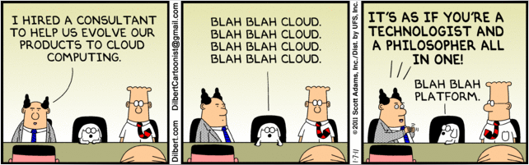
Who is this guy???
www.cloudarchitecturepatterns.com
www.bostonazure.org
http://www.dilbert.com/2011-01-07/
www.devpartners.com

Slide 5


Slide 6


Slide 7
Base64-encoding

Slide 8
Je ne parle pas français
I am an American

Slide 9
Overview
A brief history of Azure
A bunch of demos
Time permitting:
ETW
Storage

Slide 10
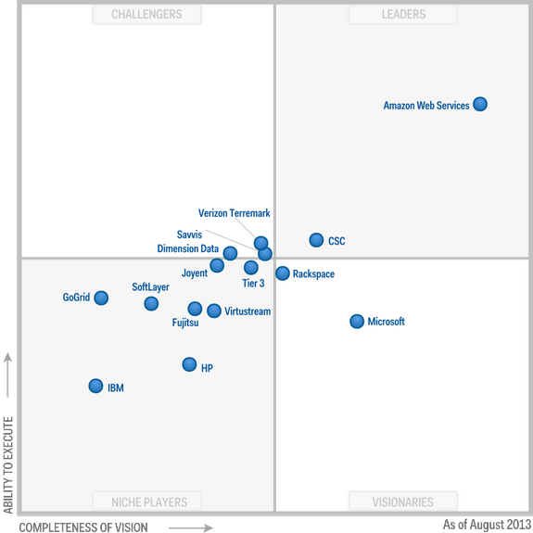
IaaS According to Gartner http://www.gartner.com/technology/reprints.do?id=1-1IMDMZ8&ct=130819&st=sb
Aug
2013
Notes:
Magic Quadrant for IaaS:
http://www.gartner.com/technology/reprints.do?id=1-1IMDMZ8&ct=130819&st=sb
Magic Quadrant for PaaS:
http://www.gartner.com/technology/reprints.do?ct=140108&id=1-1P502BX&st=sb

Slide 11
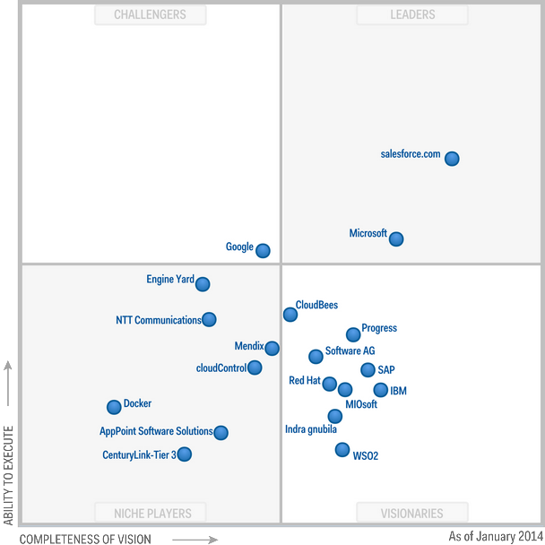
PaaS According to Gartner http://www.gartner.com/technology/reprints.do?ct=140108&id=1-1P502BX&st=sb
Jan
2014
Notes:
Magic Quadrant for IaaS:
http://www.gartner.com/technology/reprints.do?id=1-1IMDMZ8&ct=130819&st=sb
Magic Quadrant for PaaS:
http://www.gartner.com/technology/reprints.do?ct=140108&id=1-1P502BX&st=sb

Slide 12
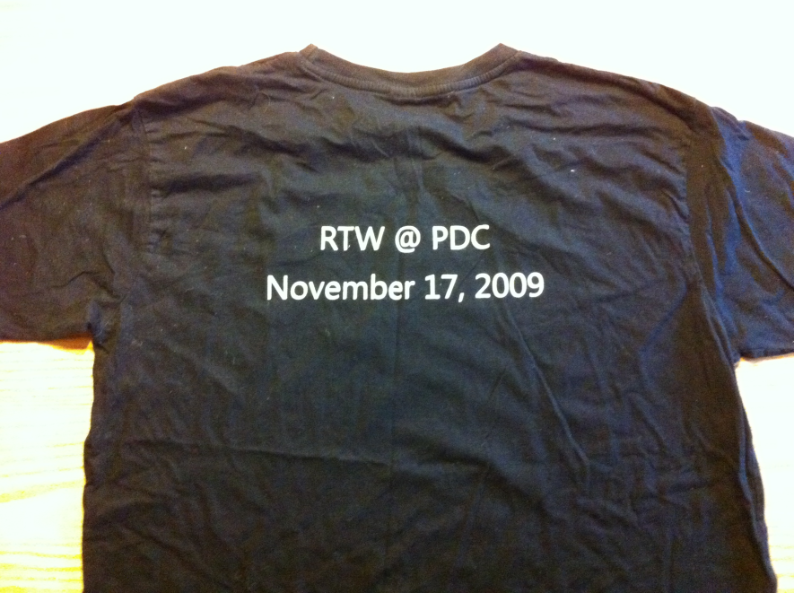
Original PaaS-focused S+S Vision
Cloud
Services
2008-2012

Slide 13
Web
Sites
Virtual
Machines
Cloud
Services
2012

Slide 14
Web
Sites
Virtual
Machines
Cloud
Services
2013

Slide 15
Web
Sites
Virtual
Machines
Cloud
Services
RDP
Full Admin
Networking
Endpoint ACLs
C++
Stateless Nodes
HA
Internet Scale
Linux/Win2k
Java
.NET
PHP
Python
Node.js
Mgmt API
Portal
On-prem
equivalents
Gallery
Persistent Disks
Enterprise Scale
Auto-
Patching
Continuous
Delivery
2014
Most new features show up here first
If you outgrow Web Sites, migrate to Cloud Services
Rapid Deploy & Scale
Sticky LB

Slide 16
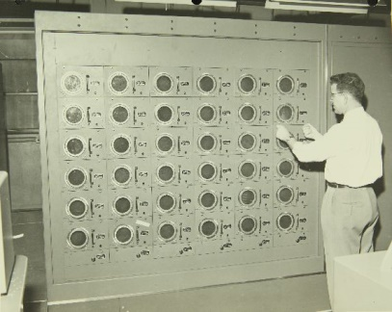


















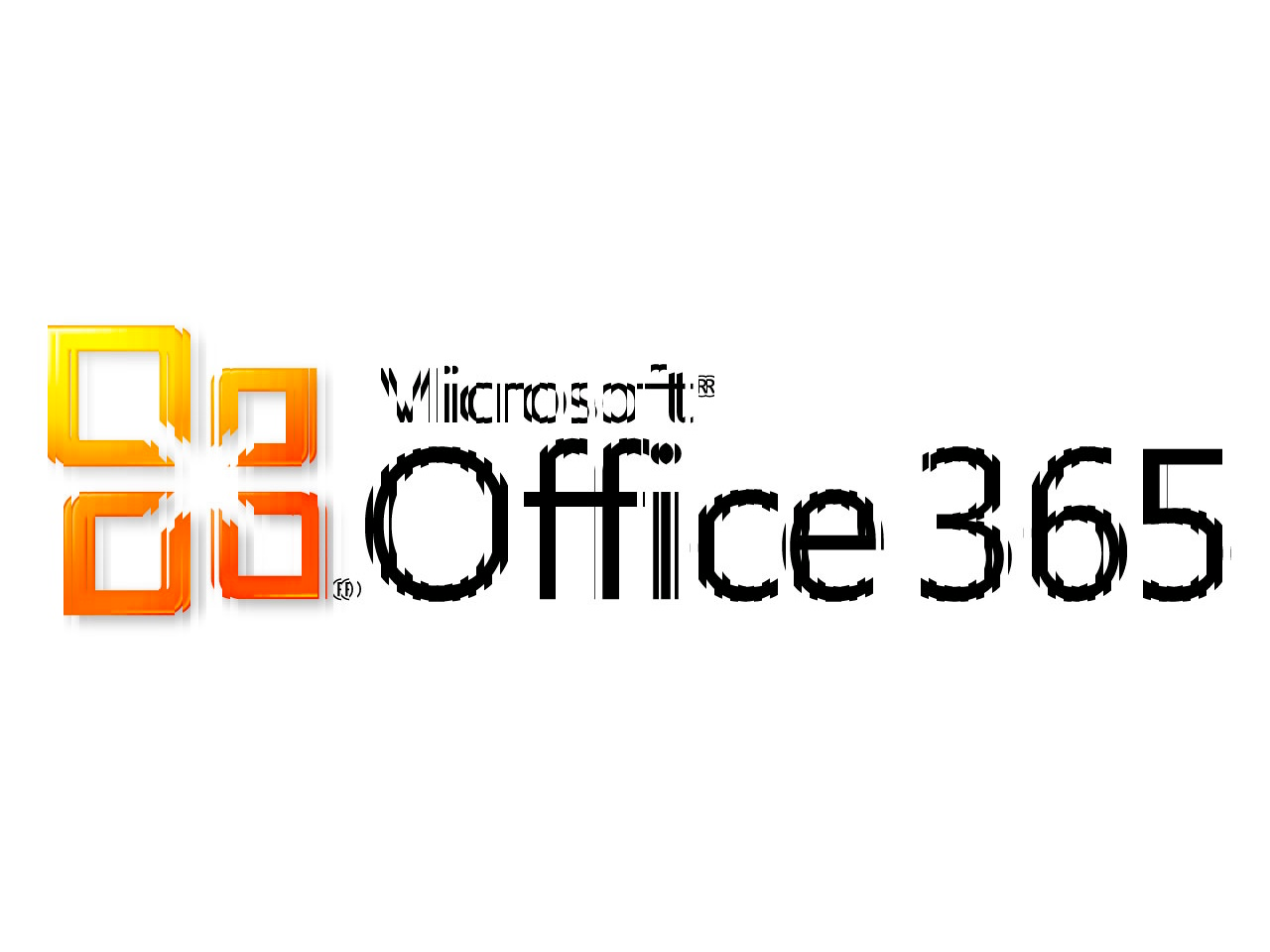



Software + Services
Windows Azure Active Directory
MySQL
WA SQL Database
Service Bus
PaaS
Websites
IaaS VM
PaaS VM
Caching
Blob Storage
NoSQL Table Storage
Reliable Queue
Autoscaling
Alerting
Traffic Manager
Marketplace
Notes:
Run yourself vs. Rent as a Service
Services available from Microsoft and Partners

Slide 17
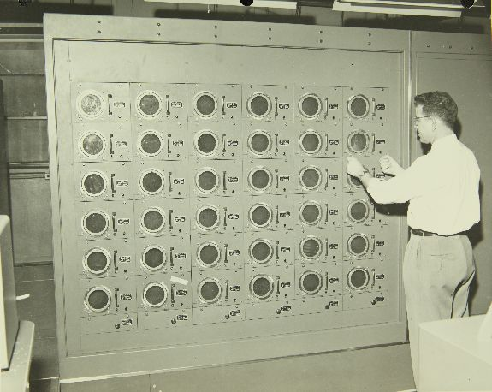

Notes:
http://www.flickr.com/photos/49487266@N07/5018418143
Remington Rand Computer : Consolidated/Convair Aircraft Factory San Diego Equipment
Call No.: 10-000939
Notes: Remington Rand Computer
Title: Consolidated/Convair Aircraft Factory San Diego Equipment
Year: 1950s
Corp. Name: Convair/Consolidated
Description: 8 x 10 Black and White Glossy Print
Repository: San Diego Air and Space Museum Archive

Slide 18
The Azure Portal
Manually perform some operation
Could also automate
View what’s happening
Good overview of capabilities
https://manage.windowsazure.com

Slide 19
des questions?

Slide 20
Demos
Azure Web Site #1 – Gallery
Azure Web Site #2 – Flasky
VM #1 – Ubuntu
VM #2 – MSDN for DevTest
Azure Web Site #3 – ASP.NET
Azure Web Site #4 – … + AAD
  Log streaming
Azure Web Site #5 – … + ETW + Table Storage
Azure Management Studio
Storage #1 – Click, Click, Ta-Da!
Notes:
Subscription: bostonaz.onmicrosoft.com – codingoutloud@gmail.com
https://manage.windowsazure.com/@bostonaz.onmicrosoft.com#Workspaces/All/dashboard
bostonaz-vspro.cloudapp.net

Slide 21
Let’s get into demo mode
..
……

Slide 22
des questions?

Slide 23
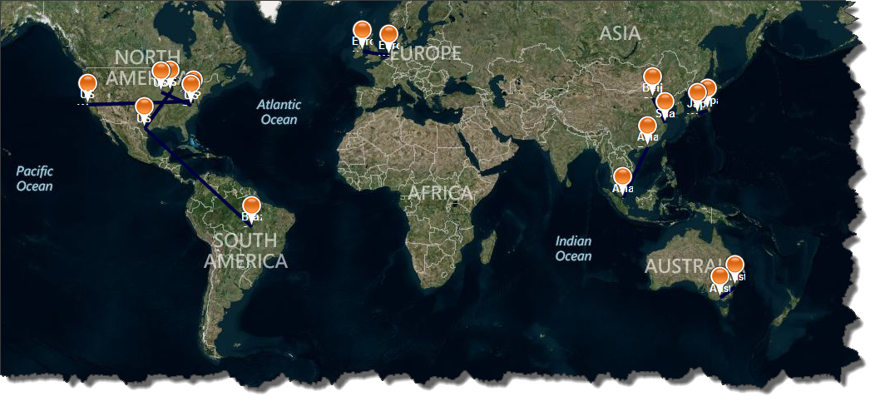
Microsoft Azure
Data Center Regions
http://azuremap.blob.core.windows.net/apps/bingmap-geojson-display.html
http://blog.codingoutloud.com/2014/02/01/mapping-windows-azure-4-years-after-full-general-availability/
Notes:
Had only 6 data center regions 4 years ago when they went into full production
Value for global teams
Teams traveling
Customers in

Slide 24
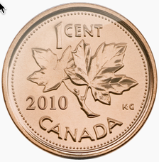
Azure Map Monthly Costs?
Assume 1000 hits per day

Slide 25
Each Storage Account (ns)...
200 TB capacity
CDN-enabled
20,000 entities or message per second
Geo-replicated
http://msdn.microsoft.com/en-us/library/azure/dn249410.aspx

Slide 26
Valet Key Pattern
var queueValetKeyUrl = "https://bost......
var cloudQueue =
new CloudQueue(new Uri(queueValetKeyUrl));
var name = "Bill Wilder";
var msg = new CloudQueueMessage(name);
cloudQueue.AddMessage(msg);
// cloudQueue.PeekMessage().AsString;
// cloudQueue.DeleteMessage(…);

Slide 27
Valet Key Pattern
var
queueValetKeyUrl =
"https://bostonazureboot.queue.core.
windows.net/attendees?sv=2012-02-12&
st=2014-03-28T00%3A37%3A28Z&
se=2014-04-04T01%3A37%3A28Z&
sp=ra&
sig=Jeb%2F8QmpuuPBWBp3hW5MXnQZ2NK8GXyuwJ4R1qNl9ew%3D";

Slide 28
des questions?

Slide 29
ETW, EventSource, and SLAB for Logging, Instrumentation, and Telemetry

Slide 30
In Distributed Systems…
Cloud Services are Distributed Systems
Gathering and Aggregating information on Distributed Systems is HARD
Insight via telemetry more critical than ever to debug, monitor, diagnose, track QoS (SLA), …

Slide 31
Logging Today
The term “cloud” is nebulous…

Slide 32
Most Common Logging Today
int x = foo.DoSomething();
// what could go wrong?

Slide 33
2nd Most Common Logging Today
try
{
int x = foo.DoSomething();
}
catch (Exception ex)
{
// Let's hope this never happens
}

Slide 34
3rd Most Common Logging Today
try
{
int x = foo.DoSomething();
}
catch (Exception ex)
{
// “Handle” the exception
Logger.Error(ex.ToString());
}

Slide 35
Logging Challenge:
Reactive: something unexpected happened
Not solution-oriented: why am I logging this and what do I hope to learn from it? who is the audience?
The term “cloud” is nebulous…

Slide 36
Proactive Instrumentation (Telemetry?)
var stopwatch = Stopwatch.StartNew();
// … call FooApi
stopwatch.Stop();
var duration = (int)stopwatch.ElapsedMilliseconds;
Logger.Info(
String.Format(
"User {0} accessed method {1} (took {2} ms)",
Thread.CurrentPrincipal.Identity.Name,
"FooApi",
duration);
Can you spot
any problems??

Slide 37
Some Challenges from Prior Slide…
Formatting done at logging site
  Unstructured
  Performance hit
  Not centralized / coordinated
Severity Level decided at logging site
Who is the customer of this logging statement?
Who is using this code? (Distributed System)

Slide 38
Event Tracing for Windows
ETW
The term “cloud” is nebulous…

Slide 39
ETW Background
Integrated into Windows Desktop and Server
Used by Microsoft (.NET, ASP.NET, IIS, …)
  Your data side-by-side (by time, activity id)
Wicked fast (kernel-level buffers)
Semantically rich (time, stack, custom)
Standardized tooling support (more coming)
But…
Hard to use for .NET developers (<= .NET 4.0)

Slide 40


Slide 41
EventSource class (.NET 4.5)
Makes ETW available to .NET developers
  “worth the effort”
Steps to PRODUCE ETW events
Derive class from EventSource
  System.Diagnostics.Tracing namespace
Create methods for each kind of event
  Annotate appropriately
Log through these methods
FAMILIAR: superset of logging frameworks
  e.g, levels (Error, Info, etc.), other attributes

Slide 42
Consuming ETW Events
Custom Code (Event Listener, such as in SLAB)
PerfView tool
Else…
ETW event “fall on the floor”

Slide 43
Demo
Custom EventSource +
PerfView +
Web API Application Scenario +
SLAB Listener +
Unit Test
The term “cloud” is nebulous…
Notes:
Warm up Storage Emulator
Prepare PerfView in its own directory (for files)
Fire up Cerebrata with local Dev Storage
Build Web API sample and log explicitly from Get method
Add hook to log all web methods

Slide 44
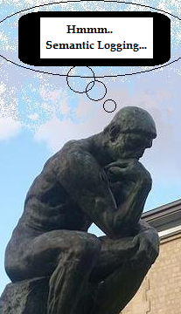
How is this better than log4net?
Log4net
Can log to Azure Table synchronously
Distributed string formatting, severity determination at log location
Encourages variable log formats + parsing
Very Simple
ES + SL + SLAB + Azure
Can do it with buffering, out-of-proc, and with RX
Centralized string formatting, severity determination – more flexible, DRY*
Encourages structured log formats
Just as simple?

Slide 45
How is this WAY BETTER than log4net?
Activity Id
Correlation across calls and tiers
See: http://blogs.msdn.com/b/agile/archive/2014/03/27/semantic-logging-application-block-now-supports-activity-tracing-and-elasticsearch.aspx
Notes:
http://msdn.microsoft.com/en-us/library/system.diagnostics.tracing.eventsource.currentthreadactivityid.aspx

Slide 46
Limitations of ETW
Old, but new
Repetitive, boilerplate for EventSource
Finicky! (Keywords, Event Id, …)
  SLAB helps
Limited Data Type - no TimeSpan, no user-defined
Auto-augment with Process Id, Thread Id, Current Principal (Claims)
Activity Id Correlation has tricky cases w/ async

Slide 47
ETW Tips & Tricks
Use >1 EventSource 1:N Event Trace
Use Table vs. File vs. SQL
Consider RX (in-proc only!)
Focus first on ‘seams’ in architecture
Use Activity Id and think about correlation across tiers
Continually improve telemetry – see TDD later

Slide 48
Semantic Logging Application Block
SLAB Augments ETW with:
Easy wire-up Listeners to move events somewhere interesting
  Windows Azure Storage Table (NoSQL, K/V, W/C)
  Windows Azure or SQL Database
  File (JSON)
Unit testing support
  Note “Finicky!” bullet on prior slide

Slide 49
When does
Logging become
Telemetry
The term “cloud” is nebulous…
Notes:
Warm up Storage Emulator
Prepare PerfView in its own directory (for files)
Fire up Cerebrata with local Dev Storage
Build Web API sample and log explicitly from Get method
Add hook to log all web methods

Slide 50
“It is a capital mistake to theorize before one has data.”
Sherlock Holmes, DevOps Team Leader

Slide 51
Telemetry
Automatic transmission and measurement of data from remote sources.
Data
Facts and statistics collected for reference or analysis.
SOURCE: The Internet

Slide 52
TDD
Test-Driven Dev
Need new feature or change in behavior
Bug was reported
So we…
Write a test for it
See the test fail
Then proceed to…
Write code to implement new feature or fix bug
Telemetry-Driven Dev
Need to know how long a Web API call is taking
Need to diagnose error
So we…
Instrument the code
Observe the data
Then proceed to…
Answer questions & explain issues using data

Slide 53
Semantic Logging is a Mindset
Planning – dev, ops, business are all potential customers
Move effort to earlier in development process – better-thought-out logging (instrumentation), rather than more effort in log parsing
Think about what your application requires:
  Pattern: FooStart, FooEnd, FooException

Slide 54
Questions Telemetry Can Answer
How long, on average, do my APIs take?
Are my APIs meeting SLA?
Is my site responding?
How many users are currently on my site?
Is everything going well?
  Code exceptions
Is my current capacity optimal
  Cloud Services

Slide 55
Better-Defined ➔ Automatable
Some questions have answers that can be automated
  SLA performance compliance
  Up or Not
Do X if Y – example, SLA
  SLA violations > 5% in past hour, alert human
  At end of month, create report and apply credit
MUST HAVE STRUCTURED DATA to be possible
  Processing the data exercise for reader ☺

Slide 56
Tools for Answering Questions
ETW, SLAB, PerfView
Windows Azure Diagnostics (WAD)
  (quick demo if there’s time)
Log4net, nlog, Enterprise Library Logging AB
…
But wait – there’s more!

Slide 57
The Right Tool for the Job
Windows Azure Portal
Windows Azure Diagnostics
ELMAH
Glimpse
Google Analytics Real Time
(some for money like…)
AppDyanmics, New Relic, Azure Watch, …

Slide 58
ELMAH email
From: <monitor@pageofphotos.com>
Date: Wed, Sep 11, 2013 at 2:09 PM
Subject: ELMAH-PageOfPhotos-Error
To: codingoutloud@gmail.com
System.Web.HttpException: The controller for path '/create-error' was not found or does not implement IController.
Generated: Wed, 21 Nov 2012 19:08:59 GMT
System.Web.HttpException (0x80004005): The controller for path '/create-error' was not found or does not implement IController. at System.Web.Mvc.DefaultControllerFactory.GetControllerInstance(RequestContext requestContext, Type controllerType) at System.Web.Mvc.DefaultControllerFactory.CreateController(RequestContext requestContext, String controllerName) at System.Web.Mvc.MvcHandler.ProcessRequestInit(HttpContextBase httpContext, IController& controller, IControllerFactory& factory) at System.Web.Mvc.MvcHandler.BeginProcessRequest(HttpContextBase httpContext, AsyncCallback callback, Object state) at System.Web.HttpApplication.CallHandlerExecutionStep.System.Web.HttpApplication.IExecutionStep.Execute() at System.Web.HttpApplication.ExecuteStep(IExecutionStep step, Boolean& completedSynchronously)
Server Variables
Name
Value
ALL_HTTP
HTTP_CONNECTION:keep-alive HTTP_ACCEPT:text/html,application/xhtml+xml,application/xml;q=0.9,*/*;q=0.8 HTTP_ACCEPT_ENCODING:gzip, deflate HTTP_ACCEPT_LANGUAGE:en-US,en;q=0.5 HTTP_COOKIE:ASP.NET_SessionId=ishz5hhymltvtzwvz54gvble HTTP_HOST:pageofphotos.cloudapp.net HTTP_USER_AGENT:Mozilla/5.0 (Windows NT 6.2; WOW64; rv:16.0) Gecko/20100101 Firefox/16.0 HTTP_DNT:1 HTTP_X_CLICKONCESUPPORT:( .NET CLR 3.5.30729; .NET4.0E)
ALL_RAW
Connection: keep-alive Accept: text/html,application/xhtml+xml,application/xml;q=0.9,*/*;q=0.8 Accept-Encoding: gzip, deflate Accept-Language: en-US,en;q=0.5 Cookie: ASP.NET_SessionId=ishz5hhymltvtzwvz54gvble Host: pageofphotos.cloudapp.net User-Agent: Mozilla/5.0 (Windows NT 6.2; WOW64; rv:16.0) Gecko/20100101 Firefox/16.0 DNT: 1 X-ClickOnceSupport: ( .NET CLR 3.5.30729; .NET4.0E)
APPL_MD_PATH
/LM/W3SVC/1273337584/ROOT
APPL_PHYSICAL_PATH
F:\sitesroot\0\
AUTH_TYPE
AUTH_USER
AUTH_PASSWORD
*****
LOGON_USER
… … …
INSTANCE_META_PATH
/LM/W3SVC/1273337584
LOCAL_ADDR
10.207.192.38
PATH_INFO
/create-error
PATH_TRANSLATED
F:\sitesroot\0\create-error
QUERY_STRING
REMOTE_ADDR
108.49.97.48
REMOTE_HOST
108.49.97.48
REMOTE_PORT
7102
REQUEST_METHOD
GET
SCRIPT_NAME
/create-error
SERVER_NAME
pageofphotos.cloudapp.net
SERVER_PORT
80
SERVER_PORT_SECURE
0
SERVER_PROTOCOL
HTTP/1.1
SERVER_SOFTWARE
Microsoft-IIS/8.0
URL
/create-error
HTTP_CONNECTION
keep-alive
HTTP_ACCEPT
text/html,application/xhtml+xml,application/xml;q=0.9,*/*;q=0.8
HTTP_ACCEPT_ENCODING
gzip, deflate
HTTP_ACCEPT_LANGUAGE
en-US,en;q=0.5
HTTP_COOKIE
ASP.NET_SessionId=ishz5hhymltvtzwvz54gvble
HTTP_HOST
pageofphotos.cloudapp.net
HTTP_USER_AGENT
Mozilla/5.0 (Windows NT 6.2; WOW64; rv:16.0) Gecko/20100101 Firefox/16.0
HTTP_DNT
1
HTTP_X_CLICKONCESUPPORT
( .NET CLR 3.5.30729; .NET4.0E)

Slide 59
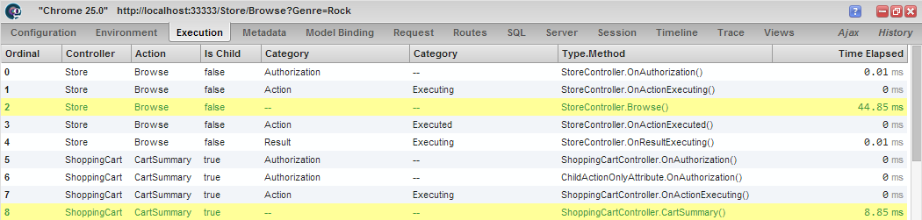
Glimpse
www.getglimpse.com

Slide 60
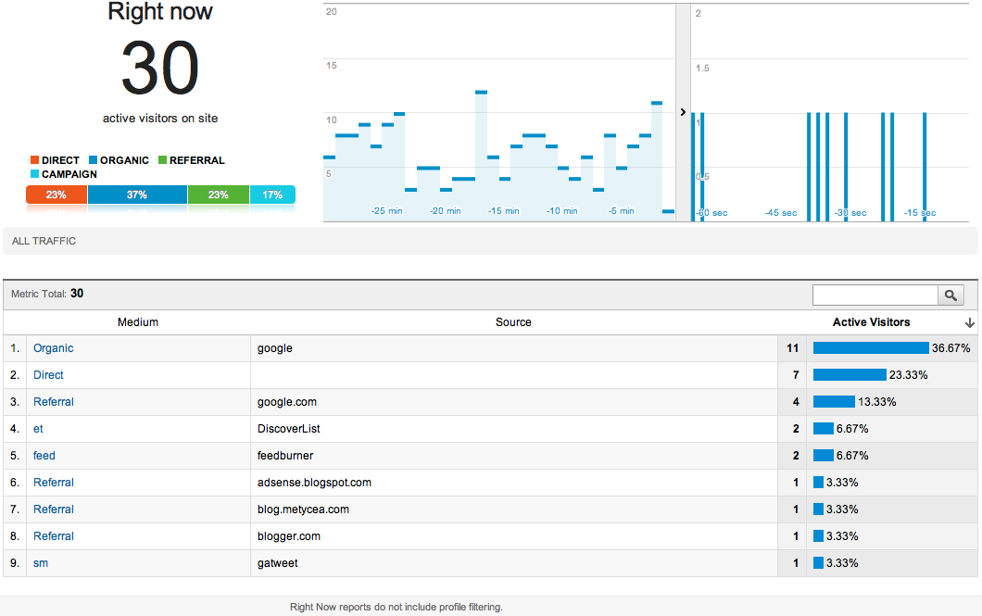
Google Analytics Real Time
Notes:
http://analytics.blogspot.com/2011/09/whats-happening-on-your-site-right-now.html

Slide 61
Bill’s Logging & Telemetry Stack
+
OLD – still used/useful
Log4net, nlog,
entlib logging block
IIS logs
Windows Events
  Event Viewer
Existing logging from existing services
NEWER – distributed apps
Event Tracing for Windows (ETW)
Semantic Logging mindset
TDD (Telemetry-Driven Dev)
  Continual incremental Improvements
SLAB
Platform Services: Windows Azure Portal, Windows Azure Diagnostics
Third-Party Services: ELMAH, Glimpse, Google Analytics Real Time, New Relic, Application Insights within Azure…

Slide 62
So Now What?
Realize old-school logging will be here for a loooong time
Realize ETW has rough edges, but is still the best we have for holistic analysis, kernel-mode performance, and standardized approach
Embrace Semantic Logging – move the effort to where it has most leverage
Embrace “TDD” and continually elevate your logging to telemetry
Don’t be a snob - use multiple tools if you can

Slide 63
Resources
EventSource Class (in .NET 4.5) - http://msdn.microsoft.com/en-us/library/system.diagnostics.tracing.eventsource.aspx
SLAB (part of EntLib 6) - http://msdn.microsoft.com/en-us/library/dn169621.aspx
PerfView - http://www.microsoft.com/en-us/download/details.aspx?id=28567
Telemetry defined - http://en.wikipedia.org/wiki/Telemetry
Telemetry Basics from CAT team -
http://social.technet.microsoft.com/wiki/contents/articles/17987.cloud-service-fundamentals.aspx#Telemetry_Basics_and_Troubleshooting
Notes:
http://msdn.microsoft.com/en-us/library/windowsazure/jj853352.aspx

Slide 64
More Resources
Activity Id in.NET 4.5.1
  https://github.com/jonwagner/EventSourceProxy/wiki/Implementing-an-EventSource
TOOL Tutorial: https://github.com/jonwagner/EventSourceProxy/wiki/Using-LogMan-for-ETW-Tracing

Slide 65
Look at (if time)
More Interesting EventSource
https://github.com/codingoutloud/Pronounce.io/blob/master/Pronounce.Logging/PronounceEventSource.cs
Web API Tracing Action Filter
https://gist.github.com/codingoutloud/9109e67e10aa2e97e7b6

Slide 66
des questions?

Slide 67
des questions?

Slide 68

Notes:
Subliminal … 0.25

Slide 69
How to Contact Bill
Looking for …
consulting help with Windows Azure Platform?
someone to bounce Azure or cloud questions off?
a speaker for your user group or
company technology event?
Just Ask!
Bill Wilder
@codingoutloud
http://blog.codingoutloud.com
community inquiries: codingoutloud@gmail.com
business inquiries: www.devpartners.com
book: www.cloudarchitecturepatterns.com
Find this slide deck here

