Slide 1
Meet Windows Azure,
Your Next Data Center nearing the tipping point
HELLO
my name is
VirtG Virtualization Deep Dive Day
12-March-2014
(3:00-4:00)
Bill Wilder
Boston Azure User Group
http://www.bostonazure.org
@bostonazure
Bill Wilder
http://blog.codingoutloud.com
@codingoutloud

Slide 2
My name is Bill Wilder
HELLO
my name is
Bill Wilder
@codingoutloud
Notes:
http://azuremap.azurewebsites.net
http://bit.ly/10trillion

Slide 3





www.cloudarchitecturepatterns.com
Who is this guy???
www.bostonazure.org
www.devpartners.com

Slide 4
The case
It just makes economic sense
Resistance is futile: barriers to adoption are increasingly non-technical
Nearing the tipping point
Come on in, the water’s fine!!

Slide 5
What do you mean by “cloud”?
The term “cloud” is nebulous…
Notes:
Why Windows Azure over other options, e.g. RackSpace, Amazon, Google, or my ISP

Slide 6

“The Cloud” – vendor viewpoint
Copyright © 2013 Elizabeth B. O’Connor • used with permission • www.elizabethboconnor.com
Notes:
Magically infinite scale
Lower TCO
All staffers now do “strategic” work

Slide 7
Public Cloud in a Nutshell
Your apps running in someone else’s data center on rented commodity hardware relying on multitenant services.
Resource allocation is typically automated.
Scaling unlimited if horizontal, somewhat limited if vertical, and is bi-directional.
Notes:
Your – SaaS, PaaS, IaaS
Software – no hardware – no racks
Someone else’s data center – that you’ve never seen, and would not be allowed into anyway if you showed up, and couldn’t find your “apps” if you did get in
Rented – not owned
Commodity hardware – value optimized, but not optimized against failure
Relying on – trust!
Multitenant services – noisy neighbors, busy signals, transparent service “incidents”

Slide 8
“The Cloud” – practitioner viewpoint
Using the public cloud (for anything) means:
Taking a dependency on the public Internet
Taking a dependency on a Cloud Vendor
Replaces or augments resources we’d otherwise own
Some loss of control
But many practical uses that work (stay tuned ☺)
As professionals:
New concepts & skills to be learned & applied

Slide 9
NIST – Cloud Platform Taxonomy
http://csrc.nist.gov/publications/nistpubs/800-145/SP800-145.pdf
Private Cloud
Deployment Models
Community Cloud
Public Cloud
Hybrid Cloud
Essential Characteristics
Infrastructure as a Service
IaaS
Platform as a Service
PaaS
Broad network
access
Rapid Elasticity
Software as a Service
SaaS
Service Models
Resource Pooling
On-demand self-service
Measured service
Notes:
I think this may be from Jim O’Neil.

Slide 10
“Bring Your Own” ____ as a Service
BYO
Users
BYO
Applications
BYO
Virtual Machines
App X $
SaaS➔
⬅
less
Expertise
&
Flexibility
ABSTRACTION
App X $$
PaaS➔
more
➔
App X $$$
IaaS➔
NIST: http://csrc.nist.gov/publications/nistpubs/800-145/SP800-145.pdf

Slide 11
Blurring lines
SaaS
PaaS
IaaS

Slide 12
Blurring lines
SaaS
PaaS
IaaS

Slide 13
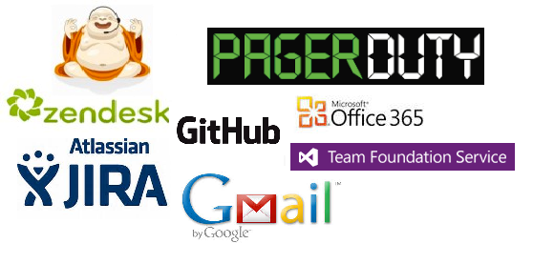

Software as a Service (“SaaS”)
BYO Users (or Test/Dev Team)
Key Concept
Automation (API) Power!
And so many others…

Slide 14
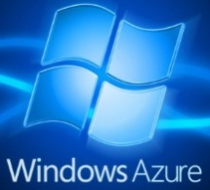



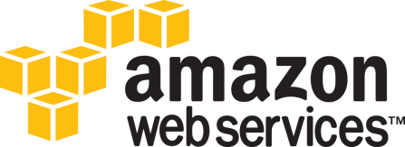
Platform as a Service (“PaaS”)
BYO Apps
Key Concept
AutomationPower!
Databases (e.g., MySQL),
Identity Services (e.g, AD),
Web Sites (e.g., PHP),
Storage (e.g., files, VHD),
Messaging (e.g., queue),
and on and on …
And others…

Slide 15

Infrastructure as a Service (“IaaS”)
BYO VMs (and Admins & DBAs)
Key Concept
AutomationPower!
And others…
Virtual Machines (Linux, Windows)
&
Networking
Notes:
Windows Azure, Google Compute Engine, and Amazon Web Services

Slide 16


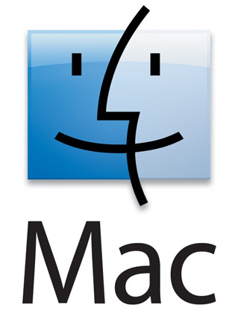
Automation vs. Portal
Windows Azure Portal (show Gallery): https://manage.windowsazure.com
Script Center, Scripting Doc: http://www.windowsazure.com/en-us/documentation/
Simple XPLAT CLI to create Ubuntu VM: https://gist.github.com/codingoutloud/27fba9ffc35678774c9a
More complex PowerShell script example (CS VMs and DB): https://gist.github.com/codingoutloud/e1a904253b94404430a6
Notes:
PowerShell is an important tool
Show script that would create a VM
[optional] Show two VMs running and talking to each other
Script Center, Scripting Doc: http://www.windowsazure.com/en-us/documentation/
Simple XPLAT CLI to create Ubuntu VM: https://gist.github.com/codingoutloud/27fba9ffc35678774c9a
More complex PowerShell script example (CS VMs and DB): https://gist.github.com/codingoutloud/e1a904253b94404430a6

Slide 17
any questions?

Slide 18
Inevitable you say?
The term “cloud” is nebulous…
Notes:
Why Windows Azure over other options, e.g. RackSpace, Amazon, Google, or my ISP

Slide 19
Consider…
What business are you in? Focus
+
Electrical power, fresh water delivery and return, telephone calls Economies of scale
+
1:50 - 1:250
1:25000
+
Investing heavily in efficiency & green(ness?)
+
Peaks and Load Patterns
+
PaaS for Programmers
+
Non-incidents
_______________________________________________
= Business Value

Slide 20
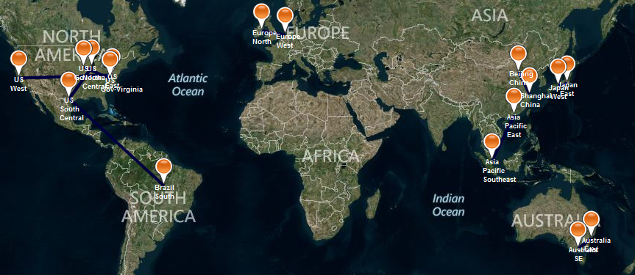
Map of Azure Data Center Regions
http://azuremap.blob.core.windows.net/apps/bingmap-geojson-display.html

Slide 21
Why Windows Azure?
The term “cloud” is nebulous…
Notes:
Why Windows Azure over other options, e.g. RackSpace, Amazon, Google, or my ISP

Slide 22
Evidence
Total Economic Impact http://bit.ly/wazimpact (Forrester)
ROI and NPV and zzzzzz
Azure Case Studies http://www.windowsazure.com/en-us/case-studies/ (Microsoft)
Notes:
Net Present Value

Slide 23
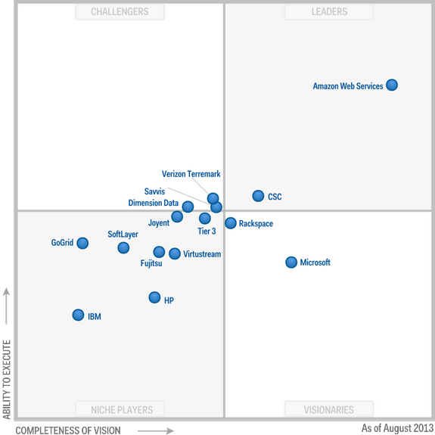
IaaS According to Gartner http://www.gartner.com/technology/reprints.do?id=1-1IMDMZ8&ct=130819&st=sb
Aug
2013
Notes:
Magic Quadrant for IaaS:
http://www.gartner.com/technology/reprints.do?id=1-1IMDMZ8&ct=130819&st=sb
Magic Quadrant for PaaS:
http://www.gartner.com/technology/reprints.do?ct=140108&id=1-1P502BX&st=sb

Slide 24
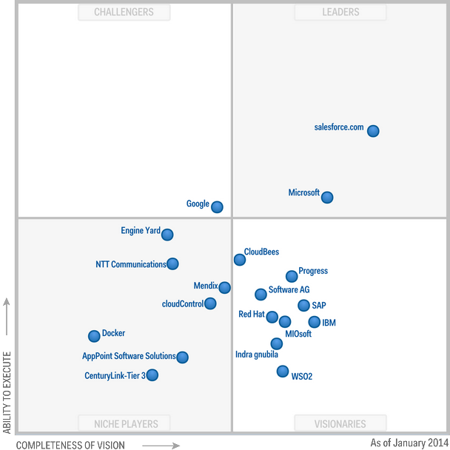
PaaS According to Gartner http://www.gartner.com/technology/reprints.do?ct=140108&id=1-1P502BX&st=sb
Jan
2014
Notes:
Magic Quadrant for IaaS:
http://www.gartner.com/technology/reprints.do?id=1-1IMDMZ8&ct=130819&st=sb
Magic Quadrant for PaaS:
http://www.gartner.com/technology/reprints.do?ct=140108&id=1-1P502BX&st=sb

Slide 25
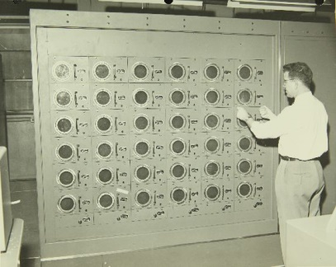




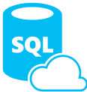
















Software + Services
Windows Azure Active Directory
MySQL
WA SQL Database
Service Bus
PaaS
IaaS
SaaS
Caching
Blob Storage
NoSQL Table Storage
Reliable Queue
Autoscaling
Alerting
Traffic Manager
Marketplace
Notes:
Run yourself vs. Rent as a Service
Services available from Microsoft and Partners

Slide 26
What could go wrong?
The term “cloud” is nebulous…
Notes:
http://www.failsalon.com/wp-content/uploads/2008/06/fail_train_tracks.jpg

Slide 27
Think About…
Backups, DR, HA, BC
Monitoring, Alerting, SLA
Resource Options & Costs
Dev-Test vs. Production
Compliance
Data Sovereignty
Compatibility & Skills
Politics

Slide 28
What’s in it for me?
The term “cloud” is nebulous…
Notes:
Why Windows Azure over other options, e.g. RackSpace, Amazon, Google, or my ISP

Slide 29
A full night of sleep
An ongoing relationship with your career
Higher value focus
Leading rather than following

Slide 30


Join the Party!

Slide 31
Learning About Windows Azure
Follow Dan Stolts
  @ITProGuru
  itproguru.com
Come to Boston Azure bostonazure.org
Check out windowsazure.com
  Compliance
  Scripts
  So. Much. More.
Create a free Azure trial account and play ($200) http://aka.ms/IaaS

Slide 32
any questions?

Slide 33
manage.windowsazure.com
The term “cloud” is nebulous…
Notes:
Why Windows Azure over other options, e.g. RackSpace, Amazon, Google, or my ISP

Slide 34
How to Contact Bill
Looking for …
Expert consulting help with Windows Azure Platform?
Someone to bounce Azure or cloud questions off?
A trainer or speaker for your user group or
company technology event?
Bill Wilder
@codingoutloud
http://blog.codingoutloud.com
community inquiries: codingoutloud@gmail.com
business inquiries: billw@devpartners.com
user group: www.bostonazure.org
Find slide deck here

