Slide 1
7 Things
Software Testing Professionals Should Know About the Public Cloud
• Except where noted, and excluding XBOSoft slides, slide deck is © 2014 Development Partners Software Corporation • http://www.devpartners.com •
Notes:
Are you hearing a lot about the public cloud, but wondering what it is all about and what it means for software testing professionals?
Is testing slowed down because test environments are limited?
As your company’s applications start to migrate to the cloud, are you unsure whether they will need to be tested differently?

Slide 2
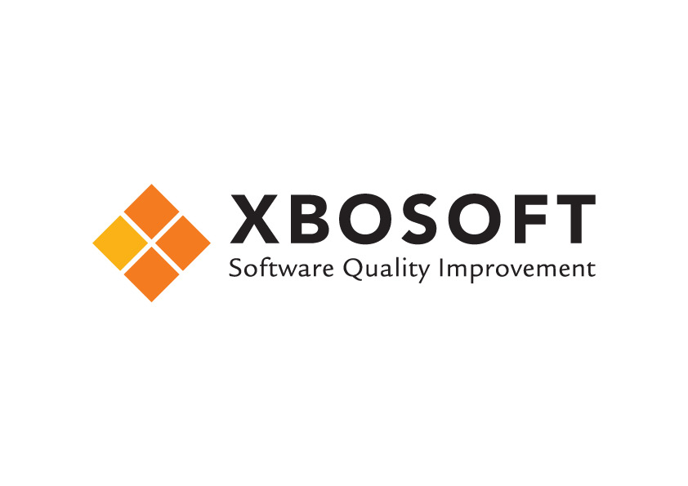

Webinar
March 6 2014 11.00 AM EST
You are at the right place, it’s almost time….10 minute countdown

Slide 3

Welcome!
Jan Princen
Managing Director
XBOSoft
Jan.princen@xbosoft.com

Slide 4
WELCOME
XBOSOFT Software Quality Knowledge Center is proud to partner with and introduce
Bill Wilder
Principal Consultant
Development Partners Software

Slide 5





www.cloudarchitecturepatterns.com
Who is this guy???
www.bostonazure.org
www.devpartners.com

Slide 6
And You?
Software Testing Professional
  QE, QA, Manager
  In charge of Environments or Tools or Builds
  SDET (Software Development Engineer in Test)
    http://blog.codingoutloud.com/2014/01/31/stupid-azure-trick-3-create-a-dev-virtual-machine-in-windows-azure-2/
DevOps role or interest
Notes:
And not a series of “tubes” like US Senator Ted Stevens observed when discussing Net Neutrality Bill in 2006
http://www.youtube.com/watch?v=R8XSo0etBC4
“The cloud” ≠ “gmail”
➔ FAST PACED ⬅

Slide 7
The 7 Things
Key cloud terminology & concepts
SaaS tools are plentiful
PaaS for environments
IaaS for environments
Understanding costs
Public cloud platforms are global
Considerations for cloud-native applications
Notes:
7 Things Software Testing Professionals Should Know About the Public Cloud
Key cloud terminology & concepts
SaaS tools are plentiful
PaaS for environments
IaaS for environments
Understanding costs
The cloud is global (and getting “globalier”)
Considerations for cloud-native applications

Slide 8
Key Cloud Terminology & Concepts
The term “cloud” is nebulous…
1
THING
Notes:
Key cloud terminology & concepts
SaaS tools are plentiful
PaaS for environments
IaaS for environments
Understanding costs
The cloud is global (and getting “globalier”)
Considerations for cloud-native applications

Slide 9
the term “cloud” is nebulous…

Slide 10

“The Cloud” – vendor viewpoint
Copyright © 2013 Elizabeth B. O’Connor • used with permission • www.elizabethboconnor.com
Notes:
Magically infinite scale
Lower TCO
All staffers now do “strategic” work

Slide 11
“The Cloud” – practitioner viewpoint
Using the public cloud (for anything) means:
Taking a dependency on the public Internet
Taking a dependency on a Cloud Vendor
Software resources supported by someone else, running in one or more data centers “in the cloud”
Replaces or augments resources we’d otherwise own
Some loss of control
But many practical uses that work (stay tuned ☺)
As professionals:
New concepts & skills to be learned & applied

Slide 12
NIST – Cloud Platform Taxonomy
http://csrc.nist.gov/publications/nistpubs/800-145/SP800-145.pdf
Private Cloud
Deployment Models
Community Cloud
Public Cloud
Hybrid Cloud
Essential Characteristics
Infrastructure as a Service
IaaS
Platform as a Service
PaaS
Broad network
access
Rapid Elasticity
Software as a Service
SaaS
Service Models
Resource Pooling
On-demand self-service
Measured service

Slide 13
“Bring Your Own” ____ as a Service
BYO
Users
BYO
Applications
BYO
Virtual Machines
SaaS➔
⬅
less
Expertise
&
Flexibility
PaaS➔
more
➔
IaaS➔
NIST: http://csrc.nist.gov/publications/nistpubs/800-145/SP800-145.pdf

Slide 14


Software as a Service (“SaaS”)
BYO Users (or Test/Dev Team)
Key Concept
Automation (API) Power!
And so many others…

Slide 15
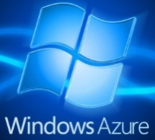



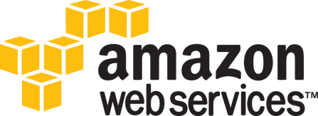
Platform as a Service (“PaaS”)
BYO Apps
Key Concept
AutomationPower!
Databases (e.g., MySQL),
Identity Services (e.g, AD),
Web Sites (e.g., PHP),
Storage
And others…

Slide 16

Infrastructure as a Service (“IaaS”)
BYO VMs (and Admins & DBAs)
Key Concept
AutomationPower!
And others…
Virtual Machines (Linux, Windows)
&
Networking
Notes:
Windows Azure, Google Compute Engine, and Amazon Web Services

Slide 17
SaaS tools are plentiful
The term “cloud” is nebulous…
2
THING
Notes:
Key cloud terminology & concepts
SaaS tools are plentiful
PaaS for environments
IaaS for environments
Understanding costs
The cloud is global (and getting “globalier”)
Considerations for cloud-native applications

Slide 18
Available SaaS Tools
Bug Tracking, and such
  JIRA (atlassian.com)
  Visual Studio Online (http://www.visualstudio.com/products/visual-studio-online-overview-vs)
Load Testing
  Load Storm (loadstorm.com)
  CloudTest (soasta.com)
  Application Insights
  (http://msdn.microsoft.com/en-us/library/dn481095.aspx)

Slide 19
Available SaaS Tools (cont)
Browser and Device Testing
  crossbrowsertesting.com, mogotest.com
  browserling.com, saucelabs.com, browsera.com
Usage Analytics
  Google Analytics (google.com/analytics)
  Clicky (clicky.com)
  Application Insights (http://msdn.microsoft.com/en-us/library/dn481095.aspx)
And more…
Notes:
Most “obvious” stuff
Contrast with remaining 6 things

Slide 20
PaaS for environments
The term “cloud” is nebulous…
3
THING
Notes:
Key cloud terminology & concepts
SaaS tools are plentiful
PaaS for environments
IaaS for environments
Understanding costs
The cloud is global (and getting “globalier”)
Considerations for cloud-native applications

Slide 21
PaaS Tools
Simple scenario: You need an isolated environment for testing a web site
  Could have a database
  Could be internal or public
Perhaps the company’s public web site
How can PaaS help us?

Slide 22


PaaS demo
Windows Azure Portal – (Gallery & Cont Deploy): https://manage.windowsazure.com
Simple flasky web site: http://flasky.azurewebsites.net
Simple flasky source code: https://github.com/codingoutloud/flasky

Slide 23
[Windows Azure] Cloud Platform made it fast & easy to…
Key Concept
Create a new environment for a website
  Web tech: PHP, Python, ASP.NET, Node.js
  Database tech: MySQL, SQL Server, others
Delete environment (when we are done)
Automated Delivery
  Speed up, simplify certain handoffs from dev ➔ test
Caveat: website URL is on public internet
  Public URL can be obscured, but not isolated

Slide 24
any questions?

Slide 25
IaaS for environments
The term “cloud” is nebulous…
4
THING
Notes:
Key cloud terminology & concepts
SaaS tools are plentiful
PaaS for environments
IaaS for environments
Understanding costs
The cloud is global (and getting “globalier”)
Considerations for cloud-native applications

Slide 26
IaaS Tools
Handles complex scenarios
You need an isolated environment for testing an application that:
  Has a Java on Windows Server web tier
  Has an Oracle database on Linux
  Needs network isolation from public Internet
  Logins with Corporate Credentials
How can IaaS help us?

Slide 27
Simple Environments are Simple
Scenario: You need an environment for testing, demo, customer sample, …
Create a Virtual Machine
Install needed software
Use it for testing
Use it for demos
Share it with a customers

Slide 28
Windows Azure Services
Virtual Machines running Windows and Linux
Virtual Networking
Identity management using on-premises Active Directory projected into the cloud

Slide 29



IaaS demo
Windows Azure Portal (show Gallery): https://manage.windowsazure.com
Simple XPLAT CLI to create Ubuntu VM: https://gist.github.com/codingoutloud/27fba9ffc35678774c9a
More complex PowerShell script example (CS VMs and DB): https://gist.github.com/codingoutloud/e1a904253b94404430a6

Slide 30
If you can easily create one environment with a script…
Key Concept
You can create two…
  or twenty…
Or whenever you see the need for another
  On demand, quickly, scripted (automated)
  Create as many environments as you want
    Cloud Resources are unlimited
  But your budget isn’t!
  Next Topic: Thing 5: Understanding Costs
Notes:
Key point: have as many environments as you need RIGHT now… for those you don’t need, either delete them, or put them on ice
Stop using an environment on purpose, just so you can hand it over – say to a dev so they can see for themselves – but what do you do in the mean time? Start a NEW ONE

Slide 31
Understanding costs
The term “cloud” is nebulous…
5
THING
Notes:
Key cloud terminology & concepts
SaaS tools are plentiful
PaaS for environments
IaaS for environments
Understanding costs
The cloud is global (and getting “globalier”)
Considerations for cloud-native applications

Slide 32

NIST – Cloud Platform Taxonomy
http://csrc.nist.gov/publications/nistpubs/800-145/SP800-145.pdf
Private Cloud
Deployment Models
Community Cloud
Public Cloud
Hybrid Cloud
Essential Characteristics
Infrastructure as a Service
IaaS
Platform as a Service
PaaS
Broad network
access
Rapid Elasticity
Software as a Service
SaaS
Service Models
Resource Pooling
On-demand self-service
Measured service
Notes:
Measured Services - I pay for what I use
e.g., in Windows Azure, I get 1 minute granularity on a Virtual Machine and 1 byte granularity on Blob Storage Costs
Rapid Elasticity
Bi-directional
On-demand self-service
You control when

Slide 33
How do I control costs?
Deallocate resources when you don’t need them
Delete test VMs at night, rehydrate in morning
  VM $ >> Storage Cost $
  Even on IaaS VM running a database
That. Is. The. Easiest. Way. To. Save. Money.
There are also cost monitoring tools.

Slide 34
What are the costs?
All platforms have pricing calculators (e.g., http://www.windowsazure.com/en-us/pricing/calculator/)
A FEW EXAMPLE PRICES from Windows Azure
Storage (at rest):
  $0.07 per GB per month ←→ $0.12 per GB per month
XS (shared core, 768 MB) Windows Server or Linux
  $0.02 per hour ($15 per month IYLIOAM)
Small (1 core, 1.75 GB) Windows Server VM:
  $0.09 per hour ($67 per month IYLIOAM)
Large (4 cores, 7 GB) Windows Server VM with SQL Server:
  $0.405 per hour ($301 per month IYLIOAM)
  Licensing is baked into the rental charge
A7 (8 cores, 56 GB) running Oracle Database EE on Linux
  $13.92 per hour (~$10,300 per month IYLIOAM)
➔ This is non-discounted pricing for “regular” accounts (max price)
Notes:
Does server software your company uses or sells have cloud-friendly licensing?

Slide 35
Costs are not fixed
Free Trials are available
  Azure Free Trial: http://aka.ms/IaaS
Some services have a free tier
  e.g., Web Sites
Discounts available:
  Long-term Pricing (Azure)
  Spot Pricing (Amazon Web Services)
Enterprise Agreement discounts for Azure
MSDN has 25-40% discounts for Test-Dev for Azure
  http://www.windowsazure.com/en-us/pricing/member-offers/msdn-benefits-details/
  http://www.windowsazure.com/en-us/offers/ms-azr-0060p

Slide 36
Maximizing value from public cloud platforms
Key Concept
Turn off or delete unused resources
Leverage very aggressive pricing for non-production workloads
Enhance agility & productivity
ASIDE: Will your test team be ahead of – or behind – the curve when your company moves production apps to public cloud?
Notes:
Key point: have as many environments as you need RIGHT now… for those you don’t need, either delete them, or put them on ice
Stop using an environment on purpose, just so you can hand it over – say to a dev so they can see for themselves – but what do you do in the mean time? Start a NEW ONE

Slide 37
Public cloud platforms are global
(and getting “globalier”)
The term “cloud” is nebulous…
6
THING
Notes:
Key cloud terminology & concepts
SaaS tools are plentiful
PaaS for environments
IaaS for environments
Understanding costs
The cloud is global (and getting “globalier”)
Considerations for cloud-native applications

Slide 38
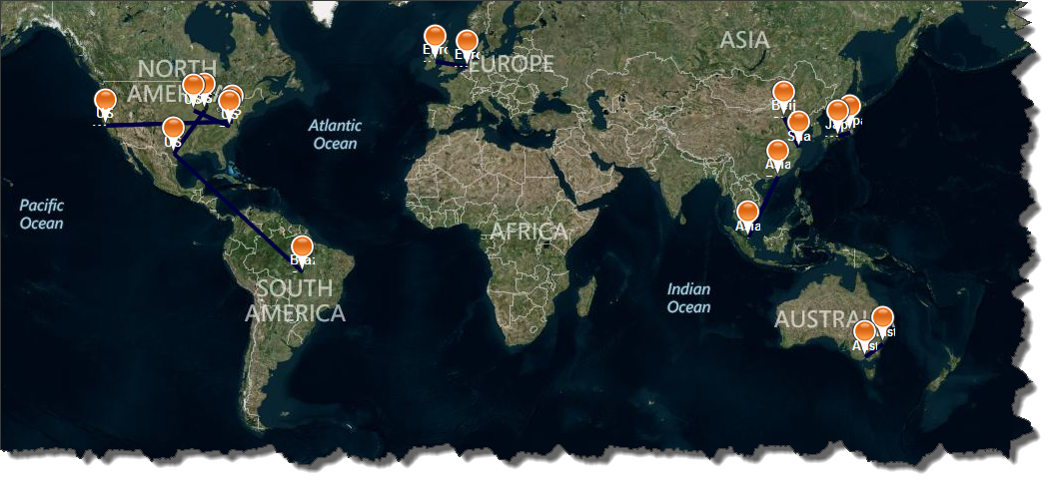
Windows Azure
Data Center Regions
http://azuremap.blob.core.windows.net/apps/bingmap-geojson-display.html
http://blog.codingoutloud.com/2014/02/01/mapping-windows-azure-4-years-after-full-general-availability/
Notes:
Had only 6 data center regions 4 years ago when they went into full production
Value for global teams
Teams traveling
Customers in

Slide 39
Considerations for cloud-native applications
The term “cloud” is nebulous…
7
THING
Notes:
Key cloud terminology & concepts
SaaS tools are plentiful
PaaS for environments
IaaS for environments
Understanding costs
The cloud is global (and getting “globalier”)
Considerations for cloud-native applications

Slide 40
Up to this point, tips can apply equally to testing cloud and non-cloud applications
Key Concept

Slide 41





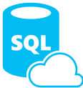









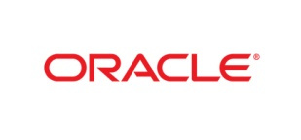






Software + Services
Windows Azure Active Directory
MySQL
WA SQL Database
Service Bus
PaaS
IaaS
SaaS
Caching
Blob Storage
NoSQL Table Storage
Reliable Queue
Autoscaling
Alerting
Traffic Manager
Marketplace

Slide 42
Thing 7 – a Cloud-Native App is different There are new challenges!
Leaning on someone else’s services ecosystem
Failure is more likely
  Multitenancy and Commodity Hardware
  Node Failure Pattern, Busy Signal Pattern
Geography Considerations
  Network Latency
  Where are mobile users? Where is data?
Scaling Models & Challenges
  Horizontal Scaling Pattern
  Database Sharding Pattern
  Queue-Centric Workflow Pattern
  Problem isolation across distributed systems
  Logfile gathering & analysis

Slide 43
ADVANCED TOPICS
(will not be covered)
The term “cloud” is nebulous…
ADVANCED THINGS
∞
Creating custom VM templates
Managing VM templates as a team (across accounts)
Advanced Automation Scripting
Continuous Deployment
Cross-region Considerations
… and many many more …
But go get started with what we covered!
Notes:
Key cloud terminology & concepts
SaaS tools are plentiful
PaaS for environments
IaaS for environments
Understanding costs
The cloud is global (and getting “globalier”)
Considerations for cloud-native applications

Slide 44
How to Contact Bill
Looking for …
Expert consulting help with Windows Azure Platform?
Someone to bounce Azure or cloud questions off?
A trainer or speaker for your user group or
company technology event?
Bill Wilder
@codingoutloud
http://blog.codingoutloud.com
community inquiries: codingoutloud@gmail.com
business inquiries: billw@devpartners.com
user group: www.bostonazure.org
Find slide deck here

Slide 45

any final questions?
Notes:
_______________________________________________________________________________________________________________________________________________________________________________________________________________________________________________________________________________________________________________________________________________________________________________________________________________________________________________________________________________________________________________________________________________________________________________________________________________________________________________________________________________________________________________________________________________________________________________________
Metrics for Managing and
Improving Software Testing Page 45

Slide 46

Follow: @XBOSoft
Questions: services@xbosoft.com
408-350-0508

Slide 47

Thank You!
Bill Wilder
Principal Consultant
Development Partners Software
Jan Princen
Managing Director
XBOSoft
Jan.princen@xbosoft.com

