Slide 1
Windows Azure Web Sites
Second-generation PaaS
HELLO
my name is
Boston Cloud Meetup
14-January-2014
(00:30)
Bill Wilder
Boston Azure User Group
http://www.bostonazure.org
@bostonazure
Bill Wilder
http://blog.codingoutloud.com
@codingoutloud
Notes:
Abstract:
Wednesday, November 13, 2013 - 2:15pm (75m)
Cloud Computing
Make the Cloud Less Cloudy: A Perspective for Software Development Teams With so many technologies branded as “cloud” products, it can be difficult to distinguish good technology from good marketing. The resulting confusion complicates the work of software development teams who are trying not only to architect software effectively but also trying to accelerate building, testing, and delivering software. To cut through this confusion, Bill Wilder defines key cloud terms, compares the different types of clouds, and drills into concrete examples of specific cloud services.
http://bsceast.techwell.com/sme-profiles/bill-wilder
http://bsceast.techwell.com/sessions/better-software-conference-east-2013/make-cloud-less-cloudy-perspective-software-developmen
With so many technologies branded as “cloud” products, it can be difficult to distinguish good technology from good marketing. The resulting confusion complicates the work of software development teams who are trying not only to architect software effectively but also trying to accelerate building, testing, and delivering software. To cut through this confusion, Bill Wilder defines key cloud terms, compares the different types of clouds, and drills into concrete examples of specific cloud services.
SaaS/PaaS/IaaS – pyramid, continuum
Not Hosting – characteristics from
All about Flexibility - $, VM, bandwidth, …
Dev/Test – MSDN benefits, Virtual Networking, …
App Bursting Scenarios –
Scaling horizontally with QCW
API and Scripting Access to Cloud Resources

Slide 2
My name is Bill Wilder
HELLO
my name is
Bill Wilder
codingoutloud@gmail.com
blog.codingoutloud.com
@codingoutloud
www.devpartners.com
Notes:
http://azuremap.azurewebsites.net
http://bit.ly/10trillion

Slide 3



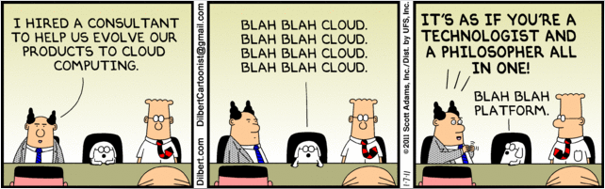


Who is this guy???
www.cloudarchitecturepatterns.com
www.bostonazure.org
http://www.dilbert.com/2011-01-07/
www.devpartners.com

Slide 4
Overview
What is Windows Azure
Why Windows Azure Web Sites is “PaaS 2.0”
Demos

Slide 5
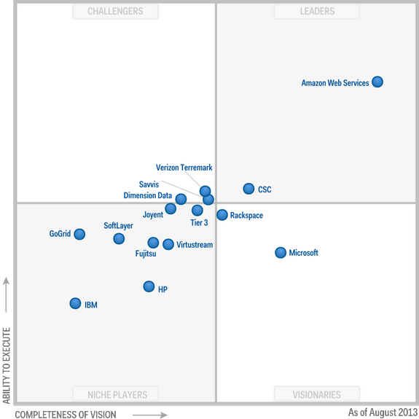
IaaS According to Gartner http://www.gartner.com/technology/reprints.do?id=1-1IMDMZ8&ct=130819&st=sb
Aug
2013
Notes:
Magic Quadrant for IaaS:
http://www.gartner.com/technology/reprints.do?id=1-1IMDMZ8&ct=130819&st=sb
Magic Quadrant for PaaS:
http://www.gartner.com/technology/reprints.do?ct=140108&id=1-1P502BX&st=sb

Slide 6
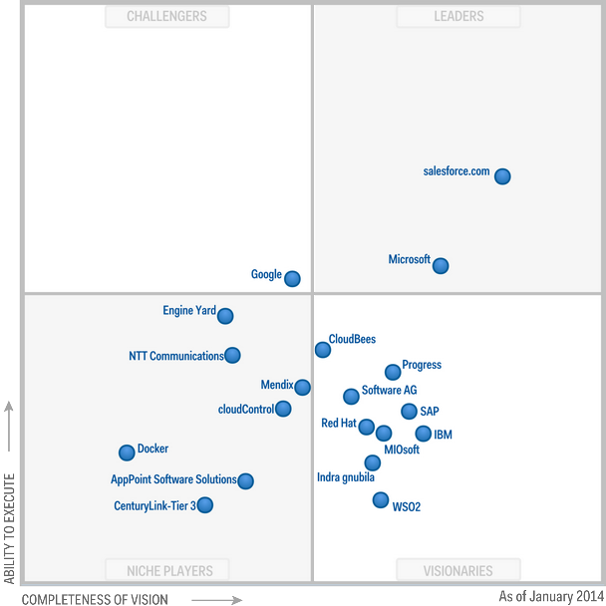
PaaS According to Gartner http://www.gartner.com/technology/reprints.do?ct=140108&id=1-1P502BX&st=sb
Jan
2014
Notes:
Magic Quadrant for IaaS:
http://www.gartner.com/technology/reprints.do?id=1-1IMDMZ8&ct=130819&st=sb
Magic Quadrant for PaaS:
http://www.gartner.com/technology/reprints.do?ct=140108&id=1-1P502BX&st=sb

Slide 7
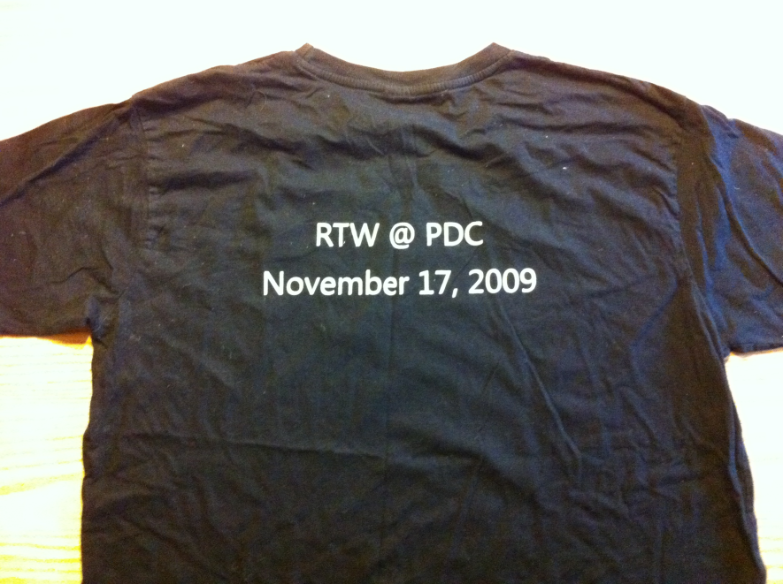
Original PaaS-focused S+S Vision
Cloud
Services
2008-2012

Slide 8
Web
Sites
Virtual
Machines
Cloud
Services
2012

Slide 9
Web
Sites
Virtual
Machines
Cloud
Services
2013

Slide 10
Web
Sites
Virtual
Machines
Cloud
Services
RDP
Full Admin
Java
C++
Stateless Nodes
HA
Internet Scale
Linux/Win2k
Networking
Endpoint ACLs
.NET
PHP
Python
Node.js
Mgmt API
Portal
On-prem
equivalents
Gallery
Persistent Disks
Enterprise Scale
Auto-
Patching
Continuous
Delivery
2014
Innovations & new features show up here first
Rapid Deploy & Scale
Sticky LB

Slide 11
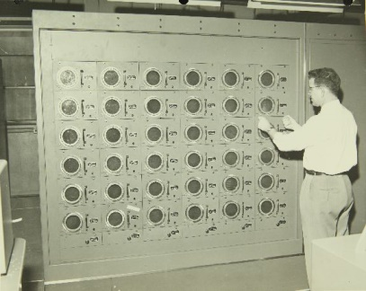





















Software + Services
Windows Azure Active Directory
MySQL
WA SQL Database
Service Bus
WAWS
IaaS VM
PaaS VM
Caching
Blob Storage
NoSQL Table Storage
Reliable Queue
Autoscaling
Alerting
Traffic Manager
Marketplace
Notes:
Run yourself vs. Rent as a Service
Services available from Microsoft and Partners

Slide 12
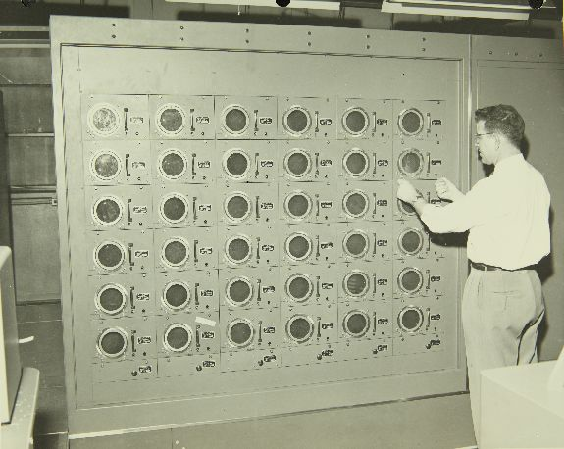

Notes:
http://www.flickr.com/photos/49487266@N07/5018418143
Remington Rand Computer : Consolidated/Convair Aircraft Factory San Diego Equipment
Call No.: 10-000939
Notes: Remington Rand Computer
Title: Consolidated/Convair Aircraft Factory San Diego Equipment
Year: 1950s
Corp. Name: Convair/Consolidated
Description: 8 x 10 Black and White Glossy Print
Repository: San Diego Air and Space Museum Archive

Slide 13
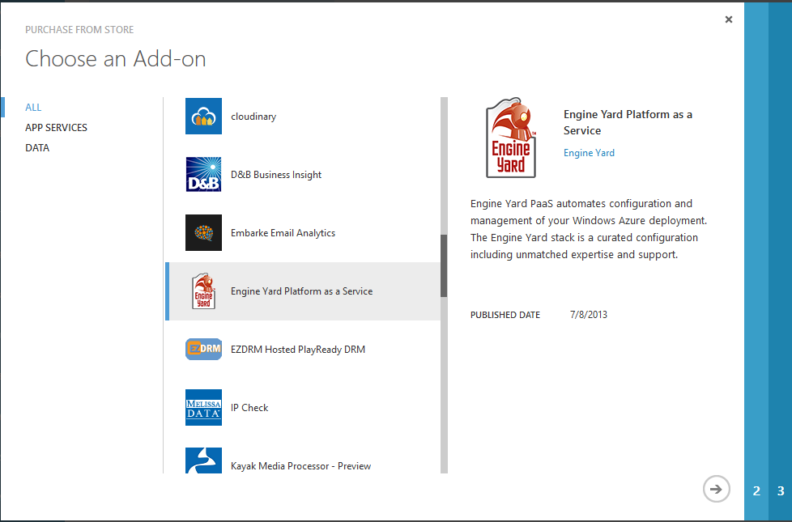
Engine Yard in Windows Azure Store
https://www.engineyard.com/

Slide 14
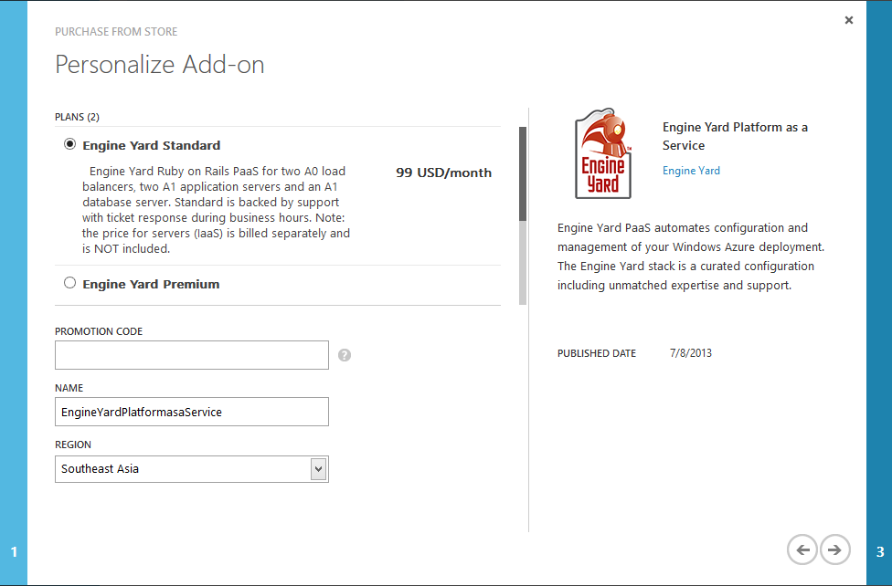

Slide 15
Demo 1
Windows Azure Web Sites
Using Azure Web Site Gallery

Slide 16

What happens to Departmental Web Site…
Business Requirements
Public static web site
15 users
Dynamic pages updated by pulling from API
Control access to some pages w/ login
Add database
Open up to whole company of 40k people
Technical Solution
Simple Web App
Shared, managed VM
Need more memory and CPU
Use Federated Authentication
Need backups
Need more resources + monitoring + DR
Notes:
+ mobile

Slide 17
Demo 2
Python Site
Show Portal Features, Runtimes, Config

Slide 18
Demo 3
Show Python Site
Continuous Delivery
httpS://foo.SCM.azurewebsites.net
Logs
Log tracing via API

Slide 19
Demo 4
Integrated Visual Studio Online
Edit online
Can also use FTP, WebDeploy, others…

Slide 20
Demo 5
Partners Ecosystem
Windows Azure Marketplace

Slide 21
In Closing… WAWS are:
Portable
  Standard runtimes for .NET, Python, Node, PHP
  Lock in? (AzurePack, Linux, “just code”)
Enterprise
  Global, TM, http://azuremap.azurewebsites.net
  Scale to 40 cores per site instance
  SLA, monitoring, alerting, auto-scaling, …
Productive
  Runtime management for .NET, Python, Node, PHP
  Room to grow (IaaS, WAAD, tons of services)
  DevOps ready – APIs, PowerShell, xPlat CLI, etc. …

Slide 22
How to Contact Bill
Looking for …
consulting help with Windows Azure Platform?
someone to bounce Azure or cloud questions off?
a speaker for your user group or
company technology event?
Just Ask!
Bill Wilder
@codingoutloud
http://blog.codingoutloud.com
community inquiries: codingoutloud@gmail.com
business inquiries: www.devpartners.com
book: www.cloudarchitecturepatterns.com
Find this slide deck here

