Slide 1
Make the Cloud Less Cloudy
A Perspective for
Software Development Teams
It’s all about Productivity
HELLO
my name is
Better Software Conference East
13-November-2013
(2:15 – 3:30 PM)
Bill Wilder
Boston Azure User Group
http://www.bostonazure.org
@bostonazure
Bill Wilder
http://blog.codingoutloud.com
@codingoutloud
Notes:
Abstract:
Wednesday, November 13, 2013 - 2:15pm (75m)
Cloud Computing
Make the Cloud Less Cloudy: A Perspective for Software Development Teams With so many technologies branded as “cloud” products, it can be difficult to distinguish good technology from good marketing. The resulting confusion complicates the work of software development teams who are trying not only to architect software effectively but also trying to accelerate building, testing, and delivering software. To cut through this confusion, Bill Wilder defines key cloud terms, compares the different types of clouds, and drills into concrete examples of specific cloud services.
http://bsceast.techwell.com/sme-profiles/bill-wilder
http://bsceast.techwell.com/sessions/better-software-conference-east-2013/make-cloud-less-cloudy-perspective-software-developmen
With so many technologies branded as “cloud” products, it can be difficult to distinguish good technology from good marketing. The resulting confusion complicates the work of software development teams who are trying not only to architect software effectively but also trying to accelerate building, testing, and delivering software. To cut through this confusion, Bill Wilder defines key cloud terms, compares the different types of clouds, and drills into concrete examples of specific cloud services.
SaaS/PaaS/IaaS – pyramid, continuum
Not Hosting – characteristics from
All about Flexibility - $, VM, bandwidth, …
Dev/Test – MSDN benefits, Virtual Networking, …
App Bursting Scenarios –
Scaling horizontally with QCW
API and Scripting Access to Cloud Resources

Slide 2
My name is Bill Wilder
HELLO
my name is
Bill Wilder
codingoutloud@gmail.com
blog.codingoutloud.com
@codingoutloud
www.devpartners.com

Slide 3





Who is Bill Wilder?
www.cloudarchitecturepatterns.com
www.bostonazure.org
www.devpartners.com

Slide 4
Talk Roadmap
Assume you are on a dev team
  Tester, Developer, Release Engineer, Project Manager, Team Leader, Architect, …
  Or are a DBA or in Ops or in DevOps
You are a Windows / .NET shop
  Or Linux, or Python, or Java, or Node, or PHP, or …
Focus on the Practical
  Scenarios that can actually happen in the real world
  Examples drawn from Public Cloud Platforms
  Emphasis on Scenarios & Demos
Application Architecture for cloud-native apps (final 15 minutes)
Overall Theme: specific, actionable uses for cloud

Slide 5

“The Cloud” (according to some vendors)
Copyright © 2013 Elizabeth B. O’Connor • used with permission • www.elizabethboconnor.com
Notes:
Magically infinite scale
Lower TCO
All staffers now do “strategic” work

Slide 6
“The Cloud” (according to customers)
Let’s be practical and fact-based
Using the cloud (for anything) means:
Taking a dependency on the public Internet
Some loss of control
For apps:
Sometimes need or benefit from updating
For people:
New concepts & skills to be learned & applied
But many practical uses that work (stay tuned ☺)

Slide 7

Beyond…
Cost transparency
Pay-by-use rental
Opex (not capex)
Measurable Cost
→ Benefits less easily quantified
A Business Innovation
The Cloud >> a bunch of useful services with APIs
→ API-driven is mega-trend
Notes:
Utility computing – like electricity, water, …
except applied to DISK and BANDWITH and CPUs
+ LAND and COOLING and POWER
BUSINE$$ INNOVATION – pay per use – a lot or a little
WHAT IF YOU HAD TO BUY ELECTRICITY AND WATER IN ADVANCE
WE don’t even think about them – they are “just there” – always on --→ OPEX over CAPEX
API big deal along with Mobile, Social, and Cloud

Slide 8
NIST Terminology
Power?
Rigidity
Simplicity
SaaS = Software as a Service (BYO users)
PaaS = Plaform as a Service (BYO apps)
IaaS = Infrastructure as a Service (BYO VMs)
Complexity
Flexibility
Power?
http://csrc.nist.gov/publications/nistpubs/800-145/SP800-145.pdf
Notes:
Power depends on what you are trying to do. Context dependent. Not one-size fits all.

Slide 9

Cloud Computing
  On-Premises Software
  Infrastructure
(as a Service)
  Platform
(as a Service)
  Software
(as a Service)
Applications
Applications
  You manage
Applications
Applications
Data
Data
Data
Data
  You manage
Runtime
Runtime
Runtime
Runtime
  Managed by vendor
Middleware
➔ Increase focus on your business ➔
Middleware
Middleware
Middleware
  You manage
O/S
O/S
O/S
  Managed by vendor
O/S
Virtualization
Virtualization
  Managed by vendor
Virtualization
Virtualization
Servers
Servers
Servers
Servers
Storage
Storage
Storage
Storage
Networking
Networking
Networking
Networking
| Public Cloud Rental Models |
Notes:
Slide Objectives:
Explain the differences and relationship between IaaS, PaaS, and SaaS in more detail.
Speaking Points:
Here’s another way to look at the cloud services taxonomy and how this taxonomy maps to the components in an IT infrastructure.
Packaged Software
With packaged software a customer would be responsible for managing the entire stack – ranging from the network connectivity to the applications.
IaaS
With Infrastructure as a Service, the lower levels of the stack are managed by a vendor. Some of these components can be provided by traditional hosters – in fact most of them have moved to having a virtualized offering.
Very few actually provide an OS
The customer is still responsible for managing the OS through the Applications.
For the developer, an obvious benefit with IaaS is that it frees the developer from many concerns when provisioning physical or virtual machines.
This was one of the earliest and primary use cases for Amazon Web Services Elastic Cloud Compute (EC2).
Developers were able to readily provision virtual machines (AMIs) on EC2, develop and test solutions and, often, run the results ‘in production’.
The only requirement was a credit card to pay for the services.
PaaS
With Platform as a Service, everything from the network connectivity through the runtime is provided and managed by the platform vendor.
The Windows Azure best fits in this category today.
In fact because we don’t provide access to the underlying virtualization or operating system today, we’re often referred to as not providing IaaS.
PaaS offerings further reduce the developer burden by additionally supporting the platform runtime and related application services.
With PaaS, the developer can, almost immediately, begin creating the business logic for an application.
Potentially, the increases in productivity are considerable and, because the hardware and operational aspects of the cloud platform are also managed by the cloud platform provider, applications can quickly be taken from an idea to reality very quickly.
SaaS
Finally, with SaaS, a vendor provides the application and abstracts you from all of the underlying components.

Slide 10
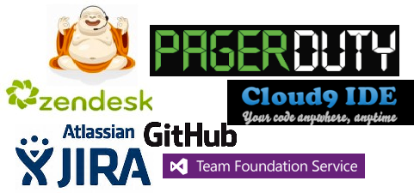
Software as a Service (“SaaS”)
BYO Users (or Dev Team)
Key Concept
And others…
API Power!

Slide 11
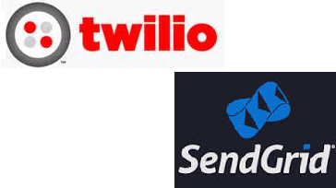
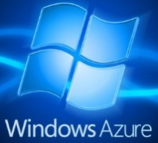



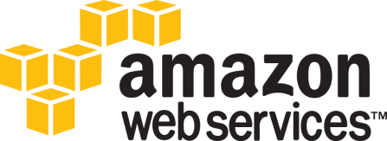
Platform as a Service (“PaaS”)
BYO Apps
Key Concept
And others…
Big Data Services (Hadoop, Storage), Mobile Services, Cloud Services (internet Scale), NoSQL and Relational Databases
Notes:
You don’t worry about hardware, VMs, routing
Focus on APP CODING – like “PHP” rather than “PHP on platform X”
support for LANGUAGES and RUNTIMES such as MOBILE, PHP, Python, Java, NodeJS, .NET, …
Highly: secure automatable reliable auto-scalable robustness
MONITOR IT, BACK IT UP, SCALE IT, OPTIMIZE IT, AUTOMATE EVERYTHING
GLOBAL
SERVICE (SOA)

Slide 12
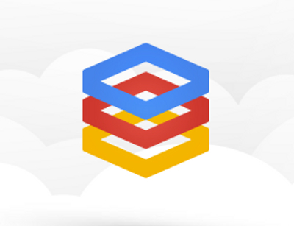
Infrastructure as a Service (“IaaS”)
BYO VMs (and Admins & DBAs)
Key Concept
And others…
Notes:
For running specific workloads – SYSTEM SOFTWARE like DATABASES and SHAREPOINT and LEGACY CODE
VMs can move up & down in the cloud and across data centers

Slide 13
SaaS ⬄ PaaS ⬄ IaaS is a spectrum
Key Concept
How to choose?
Not mutually exclusive.
Platform Services are your friend.
Notes:
SaaS – for “stuff” not core to business
PaaS – sweet spot for most custom app dev core to business – USE SERVICES
IaaS – when you need to for: specialized software, … -- USE SERVICES
Combine SaaS, PaaS, IaaS services

Slide 14
Need Departmental web site
Scenario that can actually happen in the real world ©
(Initial) Requirements:
Public
Static
Small audience
Notes:
Wiki

Slide 15

What happens to Departmental Web Site…
Business Requirements
Public static web site
15 users
Dynamic pages updated by pulling from API
Control access to some pages w/ login
Add database
Open up to whole company of 40k people
Technical Solution
Simple Web App
Shared VM
Need more memory and CPU
Use Federated Authentication
Need backups
Need more resources + monitoring + DR

Slide 16
Demo
Windows Azure Web Sites
Using Azure Web Site Gallery

Slide 17
Demo
Federated Authentication
    ASP.NET + WAAD (if time allows, at end)

Slide 18
Deployment takes too long
Scenario that can actually happen in the real world 
Time from check-in to available for dev/test
Production vs. other environments
Notes:
What if I have non-cloud software?

Slide 19
Demo
Windows Azure Web Sites
Automated Deployment from GitHub
(one of many options)
Notes:
Also applies to TFS and Cloud Services

Slide 20
Need a test instance
Scenario that can actually happen in the real world ™
Potential Customer(s) (kick tires, PoC)
CEO (conference demo)
Marketing (to brag about it)
EVEN for “NON-CLOUD” SOFTWARE…
Notes:
What if I have non-cloud software?

Slide 21
Demo
Windows Azure Virtual Machine
    Use Azure VM Image GALLERY
    Automate with CLI
Notes:
Create Ubuntu image
Mention MY IMAGES and VM DEPO gallery

Slide 22
Flexible VM “Template” Options
Out-of-the-box Vendor Gallery
Curated by Vendor
Community-driven Gallery
Not limited to “cloud stuff”
Azure VM Depot http://vmdepot.msopentech.com/
Amazon AMI Marketplace https://aws.amazon.com/marketplace/
Your own Images
Easy to create within your account
Can keep Private or Share the VM
Sharing with other accounts is out-of-band

Slide 23
Need a Database
Scenario that can actually happen in the real world 
Experiment, Prototype, New Dev, Test, Prod, …
IaaS vs. PaaS &
Vendor vs. 3rd Party:
Windows Azure SQL Database, SQL Server, RDS, MySQL, Oracle, Mongo, Azure Tables, SimpleDB, and many more…
Notes:
What if I have non-cloud software?

Slide 24
Demo
1. Show IaaS and PaaS and Partner
(Store/Marketplace) Options
2. Example PaaS database:
Windows Azure SQL Database

Slide 25
Need to Share Files Publicly
(or selectively)
Scenario that can actually happen in the real world 
Videos, Documents, Installations, …
Amazon S3, Azure Blob
CDN-backed, Global, Super-scalable, Crazy-reliable, Inexpensive
Notes:
http://aws.amazon.com/s3/
http://www.windowsazure.com/en-us/develop/net/how-to-guides/blob-storage/

Slide 26

Highly Durable Blob Storage (Azure)
DR DC Region
Primary DC Region
Storage Access (e.g., VHD in VM)
Notes:
The OS and Data Disks are stored in Windows Azure storage. So in addition to the data being persistent you also get the benefits of storage which means your VHD is replicated 3X’s locally and also 3X’s in a separate data center in the same region (geo-replication)

Slide 27
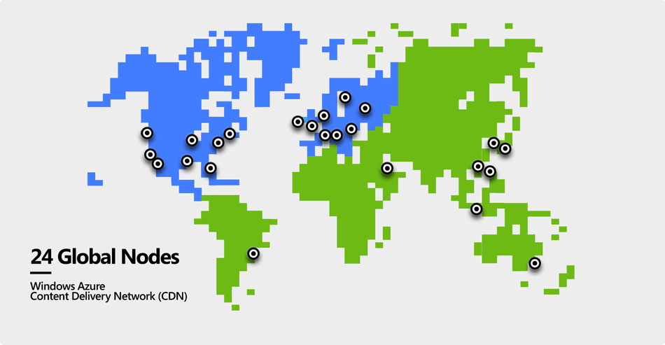
24 CDN Nodes (8 Data Centers)
Image credit: http://wely-lau.net/2012/05/10/an-introduction-to-windows-azure-part-2/

Slide 28
Need a temporary[?] dev environment
Scenario that can actually happen in the real world 
Hire a Short-term Contractor
Need to test on fresh OS
Dev on vaca needs to debug
Or “just because”…
Give a talk or give demos

Slide 29
Demo
Windows Azure Virtual Machines
with MSDN Benefits
(The meta-demo ☺)

Slide 30
download_blob_to_file.py
from azure.storage import *
blob_service = BlobService(
account_name = az_storage_account_name,
account_key = az_storage_account_key)
stream = blob_service.get_blob(
blob_container_name, blob_name)
with open(file_path, 'w') as f:
f.write(stream)

Slide 31
Too many usernames & passwords
Scenario that can actually happen in the real world 
Internal apps
Our customer-facing app requires custom username
Our dev tools are guilty too
Notes:
BizSpark: http://www.windowsazure.com/en-us/offers/ms-azr-0057p/
Activate: http://aws.amazon.com/activate/
MSDN benes: http://msdn.microsoft.com/en-us/subscriptions/aa718661.aspx

Slide 32
Demo
Federated Authentication
ASP.NET + WAAD

Slide 33
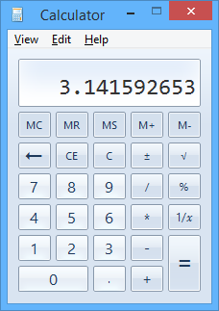
I have a startup or want to learn
Scenario that can actually happen in the real world ∏
Join BizSpark (Microsoft) or AWS Activate (Amazon)
Use the free tier or free trial
GitHub is free for open source
Apply “unused” MSDN credits…
But even “full price” ain’t bad azure aws
Notes:
BizSpark: http://www.windowsazure.com/en-us/offers/ms-azr-0057p/
Activate: http://aws.amazon.com/activate/
MSDN benes: http://msdn.microsoft.com/en-us/subscriptions/aa718661.aspx
Azure Pricing Calculator: http://www.windowsazure.com/en-us/pricing/calculator/
AWS Pricing Calculator:

Slide 34
Customers complain about stability
Scenario that can actually happen in the real world

Slide 35
Monitoring
Alerting
Autoscale

Slide 36
[your scenario here]
Scenario that can actually happen in the real world 
What’s left?
Questions?

Slide 37
Show Credits/Cost &
Turn off Demo VM

Slide 38
Service [or app] needs to scale
Scenario that can actually happen in the real world ≠

Slide 39
Service [or app] needs to really scale
Scenario that can actually happen in the real world ←
Cloud-Native: HA, high resource-efficiency, and high cost-efficiency
Impact is Architectural
Some patterns may help…

Slide 40





Windows Azure Compute Options
Hadoop (HDInsight) – specialized: big data
Mobile Services – specialized: devices
Virtual Machines – most flexible
Web Sites – most convenient
Cloud Services – most scalable, most efficient
Notes:
Speaking Points:
Cloud Services – most scalable, highest uptime, multi-tier – with focus on business processing rather than infrastructure
Cloud Services enable a broader set of workloads then Windows Azure Web Sites, while providing more automated management then Windows Azure Virtual Machines.
The rest of this talk is about Cloud Services

Slide 41









Traditional Architecture (“SOA”)
Load
Balancer
Web Tier
Service Tier
Notes:
Speaking Points:
Direct access to Worker Role Instances is a scalability bottleneck and is less useful than the pattern we are about to show
(Scalability of Web Tier (Web Role Instances) becomes bound to (and limited by) the scalability and reliability of the Service Tier (Worker Role Instances))
There’s a better way
© 2013 Microsoft Corporation. All rights reserved. Except where otherwise noted, content on this site is licensed under a Creative Commons Attribution-NonCommercial 3.0 License.

Slide 42

Cloud-Native Services
Build highly scalable apps and services
Multi-tier, multi-instance architectures
Can be combined with other compute services
Maintain stateless nodes & horizontal scaling approach
Automatable management
Notes:
Speaking Points:
Enables you to build what we sometimes refer to as infinitely scalable applications. They can support thousands of cores.
Support not only web based deployments, but also multi-tier architectures where you might have a combination of front ends, middle tiers, as well as virtual machines running as part of your solution.
Supports automated application management, so it is really easy to deploy, scale out, isolate, and recover from any type of hardware failure.
As well as support for automated updates.
Managed upgrades.
© 2013 Microsoft Corporation. All rights reserved. Except where otherwise noted, content on this site is licensed under a Creative Commons Attribution-NonCommercial 3.0 License.

Slide 43


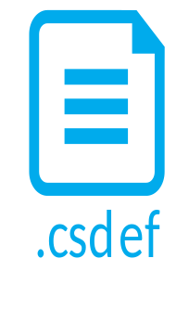
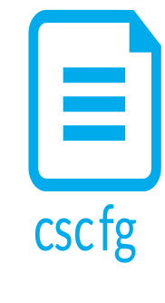
Cloud Services
Web Roles
1+ types
Windows Server
Running IIS
“Service Model”
Deployment Package
Config: VM sizes & instance counts, settings, endpoints, certs…
Worker Roles
1+ types
Windows Server
Could run Tomcat, etc.
Notes:
Speaking Points:
Running Windows OS – so anything that runs on Windows could potentially run here – C++, Java, Python, etc.
Role Instance (VM) Counts are # of VM instances for each Role Type – but is just a starting point – you can scale (or autoscale) after this
Antenna looking thing is an END POINT
© 2013 Microsoft Corporation. All rights reserved. Except where otherwise noted, content on this site is licensed under a Creative Commons Attribution-NonCommercial 3.0 License.

Slide 44

Reliable Queue Services
Rentable – off-the-shelf service
Efficient – resource- and cost-efficient
Reliable – backed by SLA and ops team
Durable – won’t lose your data
Scalable – Internet scale
Approachable – REST + SDKs
Feature rich – support “at least once” and “at most once” delivery guarantees
Examples:
  Azure Service Bus & Storage Queue Services
  Amazon Simple Queue Service (SQS)
Notes:
Speaking Points:
Adding this tool to our arsenal…
Load Leveling is idea that since Service Tier (Worker Role Instances) work is pulled, it and the Web Tier can operate independently (the Service Tier can “fall behind” and then catch up later when the Web Tier volume decreases)
May need to think about Idempotency & Poison Messages
© 2013 Microsoft Corporation. All rights reserved. Except where otherwise noted, content on this site is licensed under a Creative Commons Attribution-NonCommercial 3.0 License.

Slide 45


Scalable Architecture
Web Tier
Service Bus Queue
Service Tier
(“Workers”)
Notes:
Speaking Points:
Queue-Centric Workflow Pattern
Idempotency

Slide 46
Pattern in Action: User Uploads Photo
Web Server
Compute Service
Reliable Queue
Reliable Storage
Notes:
AJAX – orthogonal concern
Worker Role not related to HTML 5 concept of Web Worker

Slide 47
QCW [on Windows Azure]
WE NEED:
Compute (VM) resources to run our code
  Web Roles (IIS) and Worker Roles (w/o IIS)
Reliable Queue to communicate
  Azure Storage Queues
Durable/Persistent Storage
  Azure Storage Blobs & Tables; WASD

Slide 48



Pattern in Action: User Uploads Photo
push
pull
Web
Tier
Service Tier
www.pageofphotos.com
Reliable Queue
Reliable File Storage
UX implications: user does not wait for thumbnail
(architecture!)
Notes:
AJAX – orthogonal concern
Worker Role not related to HTML 5 concept of Web Worker
“Thumbnails” sample code available from http://code.msdn.microsoft.com/windowsazuresamples

Slide 49
Pattern enables Responsive UX
Response to interactive users is as fast as a work request can be persisted
Time consuming work done asynchronously
Comparable total resource consumption, arguably better subjective UX
UX challenge – how to express Async to users?
  Communicate Progress
  Display Final results
  Long Polling/Web Sockets (e.g., SignalR or Node.io)

Slide 50
Pattern supports bi-directional scaling
Decoupled front/back provides insulation
  Blocking is Bane of Scalability
  Order processing partner doing maintenance
  Twitter down
  Email server unreachable
  Internet connectivity interruption
Loosely coupled, concern-independent scaling
  (see next slide)
  Get Scale Units right
  “Scale” in BOTH DIRECTIONS
  Key to optimizing operational CO$T$

Slide 51
General Case:
Many Roles, Many Queues
Worker
Role
Web
Role
(Admin)
Worker
Role
Worker
Role
Queue Type 1
Worker
Role Type 1
Queue Type 1
Web
Role
(Public)
Queue Type 2
Web
Role
(IIS)
Queue Type 2
Web
Role
(IIS)
Worker
Role
Worker
Role
Worker
Role
Queue Type 3
Worker
Role Type 2
Worker
Role Type 2
Worker
Role Type 2
Worker
Role Type 2
Scaling best when Investment α Benefit
Optimize for CO$T EFFICIENCY
  Logical vs. Physical Architecture depends on current scale

Slide 52
Reliable Queue & 2-step Delete
var url = “http://pageofphotos.blob.core.windows.net/up/<guid>.png”;
queue.AddMessage( new CloudQueueMessage( url ) );
Web Tier
Service Tier (Workers)
Queue
var invisibilityWindow = TimeSpan.FromSeconds( 10 );
CloudQueueMessage msg =
queue.GetMessage( invisibilityWindow );
(… do some processing then …)
queue.DeleteMessage( msg );
Notes:
AJAX – orthogonal concern
Worker Role not related to HTML 5 concept of Web Worker

Slide 53
Pattern requires Idempotent
Perform idempotent operation more than once, end result same as if we did it once
Example with Thumbnailing (easy case)
App-specific concerns dictate approaches
  Compensating action, Last write wins, etc.
PARTNERSHIP: division of responsibility between cloud platform & app
  Far cry from database transaction

Slide 54
Pattern expects Poison Messages
A Poison Message cannot be processed
  Error condition for non-transient reason
  Use dequeue count property
Be proactive
  Falling off the queue may kill your system
Determine a Max Retry policy per queue
  Delete, put on “bad” queue, alert human, …

Slide 55
Pattern assumes “Plan for Failure”
VM restarts will happen
  Hardware failure, O/S patching, crash (bug)
Bake in handling of restarts into our apps
  Restarts are routine: system “just keeps working”
  Idempotent support needed important
  Event Sourcing (commonly seen with CQRS) may help
Not an exception case! Expect it!
Consider N+1 Rule
Notes:
Windows Azure: Fabric Controller honors Fault Domains

Slide 56


What’s Up? Reliability as EMERGENT PROPERTY
 | Typical Site | Any 1 Role Inst | Overall System
Operating System Upgrade
Application Code Update
Scale Up, Down, or In
Hardware Failure
Software Failure (Bug)
Security Patch
Notes:
Tech Windows

Slide 57
Aside: Is QCW same as CQRS?
Short answer: “no”
CQRS
  Command Query Responsibility Segregation
Commands change state
Queries ask for current state
Any operation is one or the other
Sometimes includes Event Sourcing
Sometimes modeled using Domain Driven Design (DDD)

Slide 58

What about the DATA?
You: Azure Web Roles and Azure Worker Roles
  Taking user input, dispatching work, doing work
  Follow a decoupled queue-in-the-middle pattern
  Stateless compute nodes
Cloud: “Hard Part”: persistent, scalable data
  Azure Queue & Blob Services
  Three copies of each byte
  Geo-replicated to sister data center
  Busy Signal Pattern

Slide 59
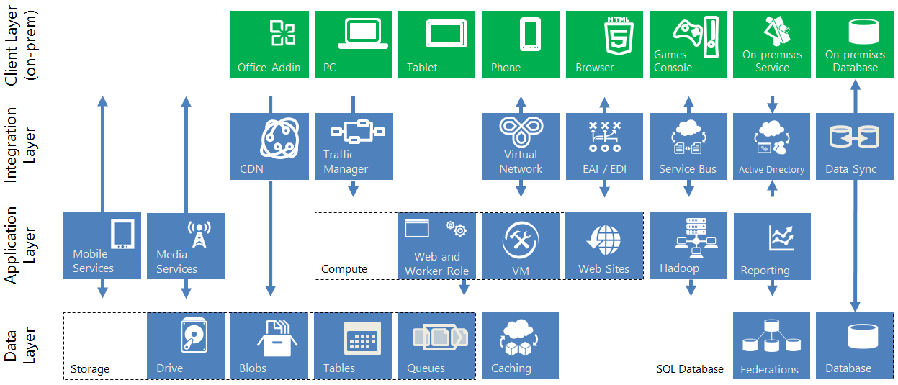
Azure Services

Slide 60
In Closing…
SaaS + APIs
  ALM, user feedback gathering, …
PaaS
  Host entire applications (e.g., Web Sites)
  Make it easier to build applications (leverage Database / Queue / File Storage / VM services)
IaaS
  Also many uses for dev/test
Use services to help you scale cost- and resource-efficiently using Architecture
Enjoy!
The cloud is a fun playground.

Slide 61
Questions?
Comments?
More information?
?

Slide 62

Business Card

Slide 63
BostonAzure.org
Boston Azure cloud user group
  Focused on Microsoft’s Public Cloud Platform
Monthly, 6:00-8:30 PM in Boston area
  Food; wifi; free; great topics; growing community
Follow on Twitter: @bostonazure
More info or to join our Meetup.com group:
http://www.bostonazure.org

Slide 64
Contact Me
Looking for …
consulting help with Windows Azure Platform?
someone to bounce Azure or cloud questions off?
a speaker for your user group or
company technology event?
Just Ask!
Bill Wilder
@codingoutloud
http://blog.codingoutloud.com
community inquiries: codingoutloud@gmail.com
business inquiries: www.devpartners.com
book: www.cloudarchitecturepatterns.com
Find this slide deck here

Slide 65

Notes:
Subliminal … 0.25

Slide 66
Cloud Architecture Patterns book
Primer Chapters
Scalability
Eventual Consistency
Multitenancy and
Commodity Hardware
Network Latency

Slide 67
Cloud Architecture Patterns book
Pattern Chapters
Horizontally Scaling Compute Pattern
Queue-Centric Workflow Pattern
Auto-Scaling Pattern
MapReduce Pattern
Database Sharding Pattern
Busy Signal Pattern
Node Failure Pattern
Colocate Pattern
Valet Key Pattern
CDN Pattern
Multisite Deployment Pattern

Slide 68
DONE

Slide 69
Reality is Resource-Constrained
  “Security is always a tradeoff; it must be balanced with the cost.”
- Bruce Schneier
http://www.schneier.com/essay-207.html
Notes:
http://www.schneier.com/essay-207.html

Slide 70

Members of
Windows Azure
Security Team
Notes:
http://blogs.westword.com/latestword/2009/10/denver_is_smarter_than_every_o.php
http://www.google.com/imgres?imgurl=http://www.watchmoviestreaming.com/pictures/dumbanddumber1.jpg&imgrefurl=http://www.watchmoviestreaming.com/%3Fp%3D424&usg=__UZ1BrJ79mCMa7yueDsmtXOADCHw=&h=267&w=500&sz=24&hl=en&start=7&sig2=IbDrZVdkObZkrsySJqTm-Q&itbs=1&tbnid=Q_EZDCwRAgp15M:&tbnh=69&tbnw=130&prev=/images%3Fq%3Ddumb%2Band%2Bdumber%26hl%3Den%26as_st%3Dy%26tbs%3Disch:1&ei=j-zkS63ZHcO78gaC4qy4Bw

Slide 71

Windows Azure Security Layers
Defense in Depth Approach
Layer
Defense-in-Depth
Data
Strong storage keys for access control
SSL support for data transfers between all parties
Application*
Front-end .NET framework code running under partial trust
Windows account with least privileges
Hardened version of Windows Server 2008 OS for both VM Host and VM Guest operating systems
Host boundaries enforced by external hypervisor
Host
Network
Host firewall limiting traffic to VMs
VLANs and packet filters in routers
World-class physical security
ISO 27001 and SAS 70 Type II certifications for datacenter processes
Physical
Notes:
Key point – Microsoft implements a defense-in-depth approach to protect the infrastructure under its control against security threats.
To provide a secure platform for its customers and protect against the most prevalent security threats, Microsoft implements the following security controls in the stack under its control:
[Note this is NOT an exhaustive list]
At the data layer, access to data stored in Azure is controlled using strong storage access keys that are provisioned to the customer. All access to data can be (and should be) done over SSL to protect the confidentiality and the integrity of the data while in transit over the network.
At the application layer, Azure developers have the choice to run their front-end code under Azure Partial Trust, a “sandbox” that blocks access to native (non-.NET) components and helps ensure the integrity of the platform. All customer code is also run under a low privilege user account, and customers are not given administrative privileges over the operating system.
At host level, Azure virtual machines run a special version of Windows Server 2008 stripped down of all unnecessary components to reduce the attack surface and patch management requirements. Virtual machines boundaries are enforced by a underlying hypervisor and do not depend on the security of the VM Windows operating system.
At network level, all traffic to and from the virtual machines are filtered according to the policy defined by the customer, and enforced by the firewall on the virtual machine as well as a firewall running on the host (root) system. Microsoft also deploys VLANs and packet filters to segregate network access between customers, management systems and the Internet, and uses special devices to protect its infrastructure against distributed denial of service attacks (DDoS).
At the physical layer, Microsoft runs Azure on its own datacenters which implement world-class security controls, whose security controls and information security management systems have been certified under the international ISO/IEC 27001:2005 standard and the AICPA’s SAS 70 Type II standard.

Slide 72
Defenses Inherited by Windows Azure Platform Applications
Spoofing
Tampering/ Disclosure
Repudiation
Denial of Service
Elevation of Privilege
VLANs
Top of Rack Switches
Custom packet filtering
VM switch hardening
Certificate Services
Shared-Access Signatures
HTTPS
Sidechannel protections
Monitoring
Diagnostics Service
Configurable scale-out
Partial Trust Runtime
Hypervisor custom sandboxing
Virtual Service Accounts
Notes:
Key point – Applications hosted on the Windows Azure Platform inherit the security provided by the controls implemented by Microsoft.
This slide shows the security controls implemented by Microsoft organized per the type of vulnerabilities that they mitigate, following the STRIDE (Spoofing, Tampering, Repudiation, Denial of service and Elevation of privilege) classification.
Applications hosted on Windows Azure Platform inherit the security implemented by Microsoft in its hosting platform. When performing a threat modeling exercise, developers can rely on Microsoft applying mitigations to several possible security threats, and can focus on threats that are specific to their applications.

Slide 73
Compliance
Surrogate for “security”
Windows Azure: http://www.windowsazure.com/en-us/support/trust-center/compliance/
Amazon Web Services: http://aws.amazon.com/compliance/

Slide 74
Developer Resources
www.windowsazure.com/develop/ is LOADED with Dev Libraries, Training Kits, How To Guides across:
  Mobile (iOS, Android, Win Phone, Win 8 SDKs)
  .NET, Node.js, Java, PHP, Python, REST
  PowerShell, CLI
Example: Create Node.js web site from Mac CLI
https://www.windowsazure.com/en-us/develop/nodejs/tutorials/create-a-website-(mac)/
Example: Create Linux (CentOS) VM from CLI (Node-based CLI – Windows not required) https://www.windowsazure.com/en-us/develop/php/how-to-guides/command-line-tools/ https://www.windowsazure.com/en-us/develop/nodejs/how-to-guides/command-line-tools/
Example: Install Couchbase + VNet on VM
http://blogs.msdn.com/b/jimoneil/archive/2012/06/16/couchbase-on-azure-a-tour-of-new-windows-azure-features.aspx

Slide 75
PORTAL DEMO www.windowsazure.com manage.windowsazure.com

