Slide 1
ETW, EventSource, SLAB, & Friends for
Logging, Instrumention, and …
Telemetry
HELLO
my name is
NYC Code Camp
14-September-2013
Bill Wilder
Boston Azure User Group
http://www.bostonazure.org
@bostonazure
Bill Wilder
http://blog.codingoutloud.com
@codingoutloud
Notes:
Abstract:
If my application runs on cloud infrastructure, am I done? Not if you wish to truly take advantage of the cloud. The architecture of a cloud-native application is different than the architecture of a traditional application and this talk will explain why. How to scale? How do I overcome failure? How do I build a system that I can manage? And how can I do all this without a huge monthly bill from my cloud vendor? We will examine key architectural patterns that truly unlock cloud benefits. By the end of the talk you should appreciate how cloud architecture differs from what most of use have become accustomed to with traditional applications. You should also understand how to approach building self-healing distributed applications that automatically overcome hardware failures without downtime (really!), scale like crazy, and allow for flexible cost-optimization.

Slide 2
My name is Bill Wilder
HELLO
my name is
Bill Wilder
codingoutloud@gmail.com
blog.codingoutloud.com
@codingoutloud
www.devpartners.com

Slide 3
CONSIDERATIONS
Perf Counters
Activity ID (Correlation)
WCF, …
TOOLS – PerfView (xperf, tracerpt.exe, …), SLAB, .NET 4.5, LogMan, …
SERVICES – Azure Tables
Resources: http://msdn.microsoft.com/en-us/magazine/cc163437.aspx Improve Debugging And Performance Tuning With ETW

Slide 4





Who is Bill Wilder?
www.cloudarchitecturepatterns.com
www.bostonazure.org
www.devpartners.com

Slide 5
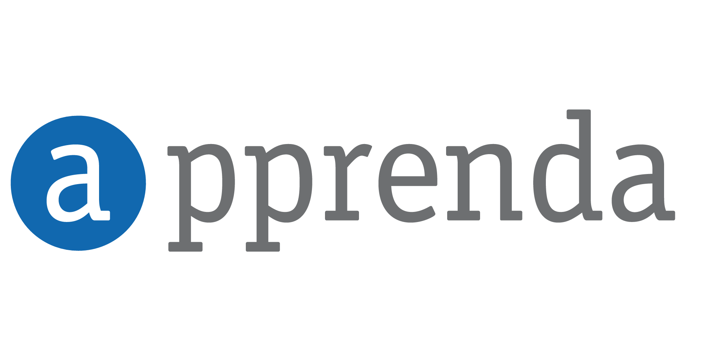
MARQUEE SPONSOR

Slide 6

PLATINUM SPONSOR

Slide 7

PLATINUM SPONSOR

Slide 8

PLATINUM SPONSOR

Slide 9




GOLD SPONSORS

Slide 10

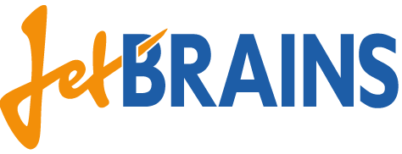






SILVER SPONSORS

Slide 11
Distributed Systems
Cloud Services are Distributed Systems
Gathering and Aggregating information on Distributed Systems is HARD
Insight via telemetry more critical than ever to debug, monitor, diagnose, track QoS (SLA), …

Slide 12
What’s in Store
Status: State of Logging today
From Logging ➔ Telemetry
ETW & SLAB
TDD (Telemetry Style)
Beyond ETW & SLAB
More a Journey than Final Solution
Inspired by CAT member Mark Simms

Slide 13

Practical Azure

Slide 14
Logging Today
The term “cloud” is nebulous…

Slide 15
Most Common Logging Today
int x = foo.DoSomething();
// what could go wrong?

Slide 16
2nd Most Common Logging Today
try
{
int x = foo.DoSomething();
}
catch (Exception ex)
{
// Let's hope this never happens
}

Slide 17
3rd Most Common Logging Today
try
{
int x = foo.DoSomething();
}
catch (Exception ex)
{
// Handle the exception
Logger.Error(ex.ToString());
}

Slide 18
Logging Challenge:
Reactive: something unexpected happened
Not solution-oriented: why am I logging this and what do I hope to learn from it? who is the audience?
The term “cloud” is nebulous…

Slide 19
Proactive Instrumentation (Telemetry?)
var stopwatch = Stopwatch.StartNew();
// … call FooApi
stopwatch.Stop();
var duration = (int)stopwatch.ElapsedMilliseconds;
Logger.Info(
String.Format(
"User {0} accessed method {1} (took {2} ms)",
Thread.CurrentPrincipal.Identity.Name,
"FooApi",
duration);
Can you spot
any problems??

Slide 20
Some Challenges from Prior Slide…
Formatting done at logging site
  Unstructured
  Performance hit
  Not centralized / coordinated
Severity Level decided at logging site
Who is the customer of this logging statement?
Who is using this code? (Distributed System)

Slide 21
Event Tracing for Windows
ETW
The term “cloud” is nebulous…

Slide 22
ETW Background
Integrated into Windows Desktop and Server
Used by Microsoft (.NET, ASP.NET, IIS, …)
  Your data side-by-side (by time, activity id)
Wicked fast (kernel-level buffers)
Semantically rich (time, stack, custom)
Standardized tooling support (more coming)
But…
Hard to use for .NET developers (<= .NET 4.0)

Slide 23


Slide 24
EventSource class (.NET 4.5)
Makes ETW available to .NET developers
  “worth the effort”
Steps to PRODUCE ETW events
Derive class from EventSource
  System.Diagnostics.Tracing namespace
Create methods for each kind of event
  Annotate appropriately
Log through these methods
FAMILIAR: superset of logging frameworks
  e.g, levels (Error, Info, etc.), other attributes

Slide 25
Consuming ETW Events
Custom Code (Event Listener, such as in SLAB)
PerfView tool
Else…
ETW event “fall on the floor”

Slide 26
Demo
Custom EventSource +
PerfView +
Web API Application Scenario +
SLAB Listener +
Unit Test
The term “cloud” is nebulous…
Notes:
Warm up Storage Emulator
Prepare PerfView in its own directory (for files)
Fire up Cerebrata with local Dev Storage
Build Web API sample and log explicitly from Get method
Add hook to log all web methods

Slide 27
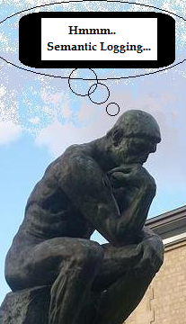
How is this better than log4net?
Log4net
Can log to Azure Table synchronously
Distributed string formatting, severity determination at log location
Encourages variable log formats + parsing
Very Simple
ES + SL + SLAB + Azure
Can do it with buffering, out-of-proc, and with RX
Centralized string formatting, severity determination – more flexible, DRY*
Encourages structured log formats
Just as simple?

Slide 28
How is this WAY BETTER than log4net?
Activity Id
Correlation acoss calls and tiers
Killer ETW feature coming soon to a .NET 4.5.1 near you
(Prerelease on NuGet now)
Notes:
http://msdn.microsoft.com/en-us/library/system.diagnostics.tracing.eventsource.currentthreadactivityid.aspx

Slide 29
Limitations of ETW
Old, but new
Repetitive, boilerplate for EventSource
Finicky! (Keywords, Event Id, …)
  SLAB helps
Limited Data Type - no TimeSpan, no user-defined
Auto-augment with Process Id, Thread Id, Current Principal
Correlation still missing (ActivityId)→.NET 4.5.1

Slide 30
ETW Tips & Tricks
Use >1 EventSource 1:N Event Trace
Use Table vs. File vs. SQL
Consider RX (in-proc only!)
Focus first on ‘seams’ in architecture
Use Activity Id (when avail) and think about correlation across tiers
Continually improve telemetry – see TDD later

Slide 31
Semantic Logging Application Block
SLAB Augments ETW with:
Easy wire-up Listeners to move events somewhere interesting
  Windows Azure NoSQL “Table”
  Windows Azure or SQL Database
  File (JSON)
Unit testing support
  Note “Finicky!” bullet on prior slide

Slide 32
When does
Logging become
Telemetry
The term “cloud” is nebulous…
Notes:
Warm up Storage Emulator
Prepare PerfView in its own directory (for files)
Fire up Cerebrata with local Dev Storage
Build Web API sample and log explicitly from Get method
Add hook to log all web methods

Slide 33
“It is a capital mistake to theorize before one has data.”
Sherlock Holmes, DevOps Team Leader

Slide 34
Telemetry
Automatic transmission and measurement of data from remote sources.
Data
Facts and statistics collected for reference or analysis.
SOURCE: The Internet

Slide 35
TDD
Test-Driven Dev
Need new feature or change in behavior
Bug was reported
So we…
Write a test for it
See the test fail
Then proceed to…
Write code to implement new feature or fix bug
Telemetry-Driven Dev
Need to know how long a Web API call is taking
Need to diagnose error
So we…
Instrument the code
Observe the data
Then proceed to…
Answer questions & explain issues using data

Slide 36
Semantic Logging is a Mindset
Planning – dev, ops, business are all potential customers
Move effort to earlier in development process – better-thought-out logging (instrumentation), rather than more effort in log parsing
Think about what your application requires:
  Pattern: FooStart, FooEnd, FooException

Slide 37
Questions Telemetry Can Answer
How long, on average, do my APIs take?
Are my APIs meeting SLA?
Is my site responding?
How many users are currently on my site?
Is everything going well?
  Code exceptions
Is my current capacity optimal
  Cloud Services

Slide 38
Better-Defined ➔ Automatable
Some questions have answers that can be automated
  SLA performance compliance
  Up or Not
Do X if Y – example, SLA
  SLA violations > 5% in past hour, alert human
  At end of month, create report and apply credit
MUST HAVE STRUCTURED DATA to be possible
  Processing the data exercise for reader ☺

Slide 39
Tools for Answering Questions
ETW, SLAB, PerfView
Windows Azure Diagnostics (WAD)
  (quick demo if there’s time)
Log4net, nlog, Enterprise Library Logging AB
…
But wait – there’s more!

Slide 40
The Right Tool for the Job
Windows Azure Portal
Windows Azure Diagnostics
ELMAH
Glimpse
Google Analytics Real Time
(some for money like…)
AppDyanmics, New Relic, Azure Watch, …

Slide 41
ELMAH email
From: <monitor@pageofphotos.com>
Date: Wed, Sep 11, 2013 at 2:09 PM
Subject: ELMAH-PageOfPhotos-Error
To: codingoutloud@gmail.com
System.Web.HttpException: The controller for path '/create-error' was not found or does not implement IController.
Generated: Wed, 21 Nov 2012 19:08:59 GMT
System.Web.HttpException (0x80004005): The controller for path '/create-error' was not found or does not implement IController. at System.Web.Mvc.DefaultControllerFactory.GetControllerInstance(RequestContext requestContext, Type controllerType) at System.Web.Mvc.DefaultControllerFactory.CreateController(RequestContext requestContext, String controllerName) at System.Web.Mvc.MvcHandler.ProcessRequestInit(HttpContextBase httpContext, IController& controller, IControllerFactory& factory) at System.Web.Mvc.MvcHandler.BeginProcessRequest(HttpContextBase httpContext, AsyncCallback callback, Object state) at System.Web.HttpApplication.CallHandlerExecutionStep.System.Web.HttpApplication.IExecutionStep.Execute() at System.Web.HttpApplication.ExecuteStep(IExecutionStep step, Boolean& completedSynchronously)
Server Variables
Name
Value
ALL_HTTP
HTTP_CONNECTION:keep-alive HTTP_ACCEPT:text/html,application/xhtml+xml,application/xml;q=0.9,*/*;q=0.8 HTTP_ACCEPT_ENCODING:gzip, deflate HTTP_ACCEPT_LANGUAGE:en-US,en;q=0.5 HTTP_COOKIE:ASP.NET_SessionId=ishz5hhymltvtzwvz54gvble HTTP_HOST:pageofphotos.cloudapp.net HTTP_USER_AGENT:Mozilla/5.0 (Windows NT 6.2; WOW64; rv:16.0) Gecko/20100101 Firefox/16.0 HTTP_DNT:1 HTTP_X_CLICKONCESUPPORT:( .NET CLR 3.5.30729; .NET4.0E)
ALL_RAW
Connection: keep-alive Accept: text/html,application/xhtml+xml,application/xml;q=0.9,*/*;q=0.8 Accept-Encoding: gzip, deflate Accept-Language: en-US,en;q=0.5 Cookie: ASP.NET_SessionId=ishz5hhymltvtzwvz54gvble Host: pageofphotos.cloudapp.net User-Agent: Mozilla/5.0 (Windows NT 6.2; WOW64; rv:16.0) Gecko/20100101 Firefox/16.0 DNT: 1 X-ClickOnceSupport: ( .NET CLR 3.5.30729; .NET4.0E)
APPL_MD_PATH
/LM/W3SVC/1273337584/ROOT
APPL_PHYSICAL_PATH
F:\sitesroot\0\
AUTH_TYPE
AUTH_USER
AUTH_PASSWORD
*****
LOGON_USER
… … …
INSTANCE_META_PATH
/LM/W3SVC/1273337584
LOCAL_ADDR
10.207.192.38
PATH_INFO
/create-error
PATH_TRANSLATED
F:\sitesroot\0\create-error
QUERY_STRING
REMOTE_ADDR
108.49.97.48
REMOTE_HOST
108.49.97.48
REMOTE_PORT
7102
REQUEST_METHOD
GET
SCRIPT_NAME
/create-error
SERVER_NAME
pageofphotos.cloudapp.net
SERVER_PORT
80
SERVER_PORT_SECURE
0
SERVER_PROTOCOL
HTTP/1.1
SERVER_SOFTWARE
Microsoft-IIS/8.0
URL
/create-error
HTTP_CONNECTION
keep-alive
HTTP_ACCEPT
text/html,application/xhtml+xml,application/xml;q=0.9,*/*;q=0.8
HTTP_ACCEPT_ENCODING
gzip, deflate
HTTP_ACCEPT_LANGUAGE
en-US,en;q=0.5
HTTP_COOKIE
ASP.NET_SessionId=ishz5hhymltvtzwvz54gvble
HTTP_HOST
pageofphotos.cloudapp.net
HTTP_USER_AGENT
Mozilla/5.0 (Windows NT 6.2; WOW64; rv:16.0) Gecko/20100101 Firefox/16.0
HTTP_DNT
1
HTTP_X_CLICKONCESUPPORT
( .NET CLR 3.5.30729; .NET4.0E)

Slide 42
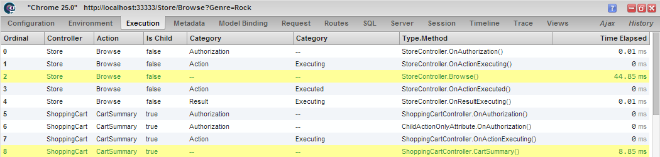
Glimpse
www.getglimpse.com

Slide 43
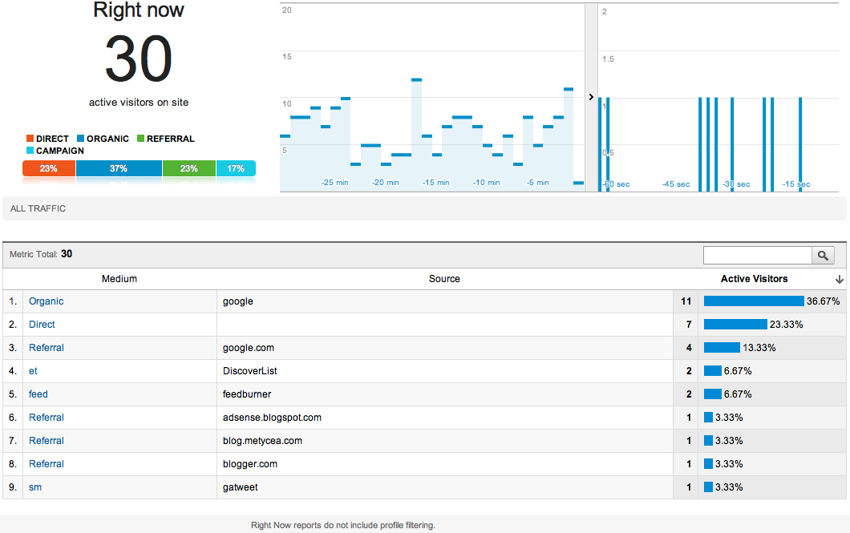
Google Analytics Real Time
Notes:
http://analytics.blogspot.com/2011/09/whats-happening-on-your-site-right-now.html

Slide 44
Bill’s Logging & Telemetry Stack
+
OLD – still used/useful
Log4net, nlog,
entlib logging block
IIS logs
Windows Events
  Event Viewer
Existing logging from existing services
NEWER – distributed apps
Event Tracing for Windows (ETW)
Semantic Logging mindset
TDD (Telemetry-Driven Dev)
  Continual incremental Improvements
SLAB
Platform Services: Windows Azure Portal, Windows Azure Diagnostics
Third-Party Services: ELMAH, Glimpse, Google Analytics Real Time, New Relic, AppDynamics, …

Slide 45
So Now What?
Realize old-school logging will be here for a loooong time
Realize ETW has rough edges, but is still the best we have for holistic analysis, kernel-mode performance, and standardized approach
Embrace Semantic Logging – move the effort to where it has most leverage
Embrace “TDD” and continually elevate your logging to telemetry
Don’t be a snob - use multiple tools if you can

Slide 46
Questions?
Comments?
More information?
?

Slide 47
Resources
EventSource Class (in .NET 4.5) - http://msdn.microsoft.com/en-us/library/system.diagnostics.tracing.eventsource.aspx
SLAB (part of EntLib 6) - http://msdn.microsoft.com/en-us/library/dn169621.aspx
PerfView - http://www.microsoft.com/en-us/download/details.aspx?id=28567
Telemetry defined - http://en.wikipedia.org/wiki/Telemetry
Telemetry Basics from CAT team -
http://social.technet.microsoft.com/wiki/contents/articles/17987.cloud-service-fundamentals.aspx#Telemetry_Basics_and_Troubleshooting
Notes:
http://msdn.microsoft.com/en-us/library/windowsazure/jj853352.aspx

Slide 48
More Resources
Activity Id in.NET 4.5.1
  https://github.com/jonwagner/EventSourceProxy/wiki/Implementing-an-EventSource
TOOL Tutorial: https://github.com/jonwagner/EventSourceProxy/wiki/Using-LogMan-for-ETW-Tracing

Slide 49

Business Card

Slide 50
BostonAzure.org
Boston Azure cloud user group
  Focused on Microsoft’s Public Cloud Platform
Monthly, 6:00-8:30 PM in Boston area
  Food; wifi; free; great topics; growing community
Follow on Twitter: @bostonazure
More info or to join our Meetup.com group:
http://www.bostonazure.org

Slide 51
Contact Me
Looking for …
consulting help with Windows Azure Platform?
someone to bounce Azure or cloud questions off?
a speaker for your user group or
company technology event?
Just Ask!
Bill Wilder
@codingoutloud
http://blog.codingoutloud.com
community inquiries: codingoutloud@gmail.com
business inquiries: www.devpartners.com
book: www.cloudarchitecturepatterns.com
Find this slide deck here

Slide 53
DONE

Slide 54
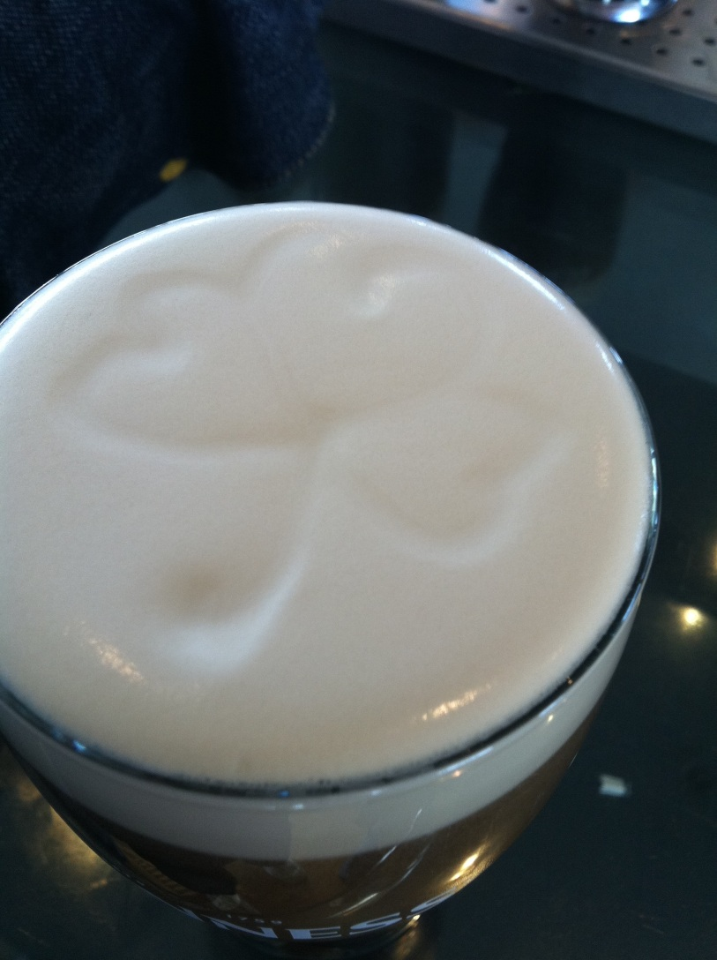
Notes:
Subliminal … 0.25

