Slide 1
What’s New in Windows Azure
A platform overview + how it can fit into my development shop today…
HELLO
my name is
New England Microsoft Dev Group
06-June-2013
(6:30-8:30 PM)
Bill Wilder
Boston Azure User Group
http://www.bostonazure.org
@bostonazure
Bill Wilder
http://blog.codingoutloud.com
@codingoutloud
Notes:
Abstract:
If my application runs on cloud infrastructure, am I done? Not if you wish to truly take advantage of the cloud. The architecture of a cloud-native application is different than the architecture of a traditional application and this talk will explain why. How to scale? How do I overcome failure? How do I build a system that I can manage? And how can I do all this without a huge monthly bill from my cloud vendor? We will examine key architectural patterns that truly unlock cloud benefits. By the end of the talk you should appreciate how cloud architecture differs from what most of use have become accustomed to with traditional applications. You should also understand how to approach building self-healing distributed applications that automatically overcome hardware failures without downtime (really!), scale like crazy, and allow for flexible cost-optimization.

Slide 2
My name is Bill Wilder
HELLO
my name is
Bill Wilder
codingoutloud@gmail.com
blog.codingoutloud.com
@codingoutloud
www.devpartners.com

Slide 3





Who is Bill Wilder?
www.cloudarchitecturepatterns.com
www.bostonazure.org
www.devpartners.com

Slide 4

“Try not.
Do, or do not. There is no try.”
- Yoda
Yoda finally admits he does not understand exception handling...
Notes:
http://en.wikipedia.org/wiki/File:Yoda_Attack_of_the_Clones.png

Slide 5
Code Reuse:
A practice in which other people get to use the code that I wrote.
Notes:
Code Reuse: when other people use code that I wrote.

Slide 6
“There are 2 hard problems in computer science: caching, naming things, and off-by-1 errors…”
- (Source unknown)

Slide 7
I will ass-u-me…
You know what “the cloud” is
You have an inkling about Amazon Web Services and Windows Azure cloud platforms
You understand that such cloud platforms include compute services [like hosted virtual machines (VMs), in both IaaS and PaaS modes], SQL and NoSQL database services, file storage services, messaging, DNS, management, etc.
You are interested in understanding cloud-native applications and why that’s better than deploying my old-school app to the cloud “as is”

Slide 8


Roadmap for rest of talk… …
Overview of Windows Azure Platform
  Multiple programming models
Selectively dig into newer areas
Decide on other topics on the fly ☺
Q&A during talk is okay (time permitting)
Q&A at end with any remaining time
Okay to reach out through email or twitter
?

Slide 9
Windows Azure Portal
General information
http://www.windowsazure.com
Management Portal
http://manage.windowsazure.com

Slide 10
The definition of “Cloud” is nebulous…
The term “cloud” is nebulous…

Slide 11
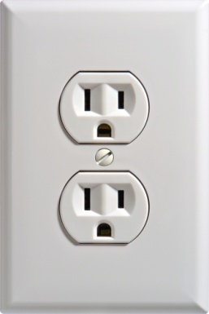

Slide 12
What's different about the cloud?
What is different about the cloud?
public
^
Notes:
^ public

Slide 13
NIST Terminology
Power?
Rigidity
Simplicity
SaaS = Software as a Service (BYO users)
PaaS = Plaform as a Service (BYO apps)
IaaS = Infrastructure as a Service (BYO VMs)
Complexity
Flexibility
Power?
http://csrc.nist.gov/publications/nistpubs/800-145/SP800-145.pdf
Notes:
Power depends on what you are trying to do. Context dependent. Not one-size fits all.

Slide 14
The Windows Azure Model(s)
Cloud Services (most cloud-native)
Windows Azure Web Sites (simplest)
Virtual Machines (most familiar)
Services (SOA)
Hybrid & Pure-Public Cloud
Dev/Test & Production
High automation (WazOps, CI, CD)

Slide 15
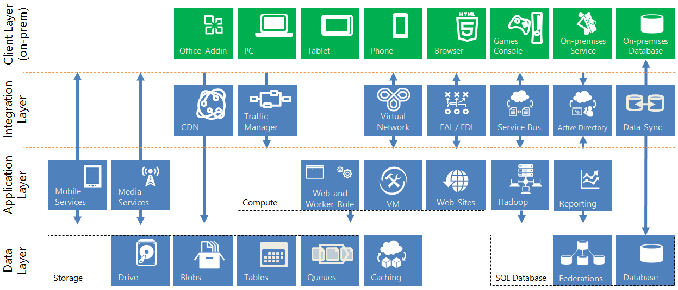
Integrated Surface Area

Slide 16
POSTER

Slide 17
PORTAL

Slide 18
What's different about the cloud?
What is different about the cloud?
public
^
Notes:
^ public

Slide 19


1/9th above water
⬅
=
SOA
TTM &
Sleeping well
Notes:
According to wikipedia (http://en.wikipedia.org/wiki/Iceberg) “typically only one-ninth of the volume of an iceberg is above water”
Iceberg comment not specific to CLOUD NATIVE – but just a reminder to the power of the CLOUD
Photo credit: http://upload.wikimedia.org/wikipedia/commons/a/ac/Iceberg.jpg

Slide 20


MTBF MTTR
Architectural Assumptions
failure is routine
(so you better be good at handling it)
commodity hardware
+ multitenant services
= cost-efficient cloud
Notes:
Photos from Bill Wilder
cloud services are MT, hardware is commodity
Cloud services CAN FAIL – you need to implement Busy Signal Pattern – and YOUR SERVICES CAN FAIL

Slide 21
“Try not.
Do, or do not. There is no try.”
- Yoda
try {
foo.ThisCanThrow();
}
catch (Exception ex) {
// …
}
Yoda not a good cloud developer would make
Notes:
http://en.wikipedia.org/wiki/File:Yoda_Attack_of_the_Clones.png

Slide 22
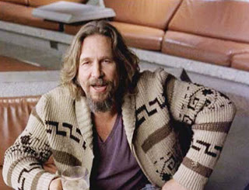
Loosely Coupled &
Eventually Consistent
Data & Workflow
Architecture
Notes:
http://thetrad.blogspot.com/2013/04/the-dude-in-68.html

Slide 23

This bar is always open
*and* has an API
Pay by the Drink
$
Notes:
Photo from Bill Wilder

Slide 24
  ∞
Resource allocation (scaling) is:
  Horizontal
  Bi-directional
  Automatable
The “illusion of infinite resources”
Resource
Allocation

Slide 25
Cloud Architecture Patterns book
Primer Chapters
Scalability
Eventual Consistency
Multitenancy and
Commodity Hardware
Network Latency

Slide 26
Cloud Architecture Patterns book
Pattern Chapters
Horizontally Scaling Compute Pattern
Queue-Centric Workflow Pattern
Auto-Scaling Pattern
MapReduce Pattern
Database Sharding Pattern
Busy Signal Pattern
Node Failure Pattern
Colocate Pattern
Valet Key Pattern
CDN Pattern
Multisite Deployment Pattern

Slide 27
Questions?
Comments?
More information?
?

Slide 28

Business Card

Slide 29
BostonAzure.org
Boston Azure cloud user group
  Focused on Microsoft’s Public Cloud Platform
Monthly, 6:00-8:30 PM in Boston area
  Food; wifi; free; great topics; growing community
Follow on Twitter: @bostonazure
More info or to join our Meetup.com group:
http://www.bostonazure.org

Slide 30
Contact Me
Looking for …
consulting help with Windows Azure Platform?
someone to bounce Azure or cloud questions off?
a speaker for your user group or
company technology event?
Just Ask!
Bill Wilder
@codingoutloud
http://blog.codingoutloud.com
community inquiries: codingoutloud@gmail.com
business inquiries: www.devpartners.com
book: www.cloudarchitecturepatterns.com
Find this slide deck here

Slide 32
DONE

Slide 33
Notes:
Subliminal … 0.25

