Slide 1
Windows Azure in 3 Minutes or Less
Bill Wilder
Mark Eisenberg

Slide 2
This is ME
Cloud and mobile, ummm… Visionary? Evangelist?
Developer by background
Spent 17 years in semiconductor sales most notably with Intel
Joined Microsoft in 2006
  Founding member of the US Windows Azure sales team in 2009
Joined a boutique consulting firm in NYC in 2012
  Plan was to transform the firm in to a cloud and mobile specialist
Currently in search of my next gig
LinkedIn.com/in/mheisenberg & @AzureBizAndTech

Slide 3





Who is Bill Wilder?
www.cloudarchitecturepatterns.com
www.bostonazure.org
www.devpartners.com

Slide 4
Key Differentiators
PaaS + IaaS + Services
OS Independent
Management via:
  Portal
  REST API
  PowerShell Scripts
  System Center, Many Others…
6 Formal SDKs
  4½ are for open source languages

Slide 5
Key Differentiators (cont.)
World-class Datacenters
  Secure (physical and cyber)
  Up to date infrastructure
  Industry certifications
  Geographically distributed
Redundancy at all levels
  Including paired datacenters >500 miles apart
Curated
  Superstar team
  Market-driven
  App Store

Slide 6
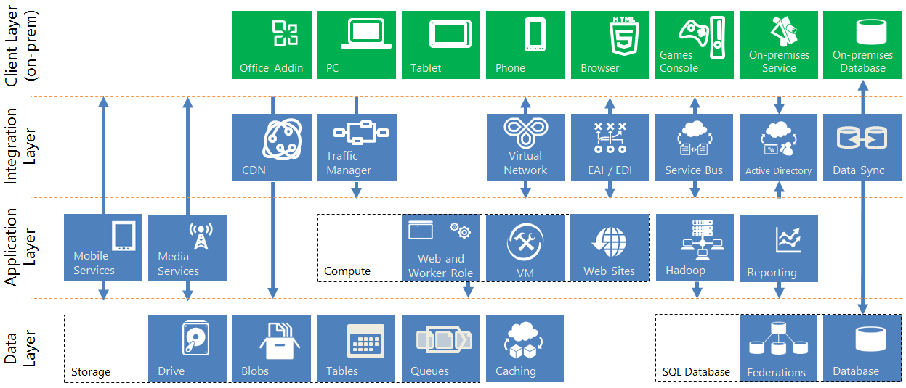
Integrated Surface Area

Slide 7
Curated 3rd-Party Ecosystem
Windows Azure Store
Data Sources (via API)
Monitoring Services
Databases (MySQL, MongoDB, others)

