Slide 1
Architecting for the Cloud
An App in the Cloud
is not
a Cloud-Native App
HELLO
my name is
HELLO
my name is
Joan Wortman
Bill
Wilder
Boston Code Camp #19
08-Mar-2013 (2:50 – 4:00 PM EDT)

Slide 2
Questions for the end
What are the other options?
  VM for Legacy app (can’t change or rearch)
When to know WHEN to go with cloud service vs Web Site
  State, Customization, Scale, Latency, Perf, CDN, Geo-LB – NOT FACTORS: high volume, auto-scaling, monitoring – both are PaaS
How does all this make it more manageable?
  Self-healing (QCW + what Fabric Controller does), Auto-Scale, Fabric Controller helps, Log Gathering & Metrics Dashboard (could use some more work)
  Auto-Scaling Pattern enabled through WASABi or 3rd Party Service or Azure Service in the Azure Store (?)

Slide 3
Answer inline
TTM
Discover how you can successfully architect Windows Azure-based applications to avoid and mitigate performance and reliability issues with our live webinar
Microsoft’s Windows Azure cloud offerings provide you with the ability to build and deliver a powerful cloud-based application in a fraction of the time and cost of traditional on-premise approaches. So what’s the problem? Tried-and-true traditional architectural concepts don’t apply when it comes to cloud-native applications. Building cloud-based applications must factor in answers to such questions as:
• How to scale?
• How to overcome failure? -- QCW
• How to build a manageable system? – Self-healing, Auto-Scale, Fabric Controller helps, PaaS (less for ME to do)
• How to minimize monthly bills from cloud vendors?
If you want to avoid long nights, help-desk calls, frustrated business owners and end-users, then don’t miss this webinar or your chance to learn how to deliver highly-scalable, high-performance cloud applications.
Notes:
Auto-Scale
Busy Signal
lowering latency, ensuring consistently fast

Slide 4





Who is Bill Wilder?
www.cloudarchitecturepatterns.com
www.bostonazure.org
www.devpartners.com

Slide 5


Roadmap for this talk… …
Define relevant “cloud” types from software development point of view
App in the Cloud != Cloud App (or at least not a Cloud-Native App)
What could go wrong?
Consider UX factors
?
Notes:
Consider the value spectrum – and tipping point

Slide 6
The term “cloud” is nebulous…
The term “cloud” is nebulous…

Slide 7
NIST Terminology
Power?
Rigidity
Simplicity
SaaS = Software as a Service (BYO users)
PaaS = Plaform as a Service (BYO apps)
IaaS = Infrastructure as a Service (BYO VMs)
Complexity
Flexibility
Power?
http://csrc.nist.gov/publications/nistpubs/800-145/SP800-145.pdf
Notes:
Power depends on what you are trying to do. Context dependent. Not one-size fits all.

Slide 8



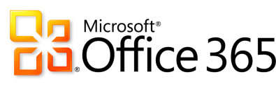



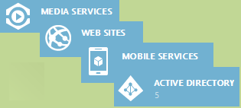


___________________ as a Service
Infrastructure
Software
Platform
Apps,
$/user,
Expertise, SLA
App Services as OpEx,
OS, DBMS, etc.
with patching & upgrades,
Environment Monitoring,
Expertise, SLA
Virtualized Hardware as OpEx, Networking, Automation, Elasticity,
Price Transparency, Global Data Centers, Expertise, SLA
BYO
Users ➔
Public Cloud Rental Models
SaaS
BYO
Apps ➔
PaaS
AppHarbor
BYO
VMs ➔
IaaS
http://csrc.nist.gov/publications/nistpubs/800-145/SP800-145.pdf
Notes:
http://csrc.nist.gov/publications/nistpubs/800-145/SP800-145.pdf

Slide 9
“Bring Your Own” ____ as a Service
BYO
Users
BYO
Applications
BYO
Virtual Machines
SaaS➔
⬅
less
Responsibility &
Flexibility
PaaS➔
more
➔
IaaS➔

Slide 10
What is different about the cloud?
What is different about the cloud?

Slide 11


1/9th above water
⬅
=
TTM &
Sleeping well
Notes:
According to wikipedia (http://en.wikipedia.org/wiki/Iceberg) “typically only one-ninth of the volume of an iceberg is above water”
Iceberg comment not specific to CLOUD NATIVE – but just a reminder to the power of the CLOUD
Photo credit: http://upload.wikimedia.org/wikipedia/commons/a/ac/Iceberg.jpg

Slide 12


MTBF MTTR
multitenant services
+ commodity hardware
= cost-efficient cloud
Notes:
Photos from Bill Wilder
cloud services are MT, hardware is commodity

Slide 13

This bar is always open
*and* has an API
Pay by the Drink
Notes:
Photo from Bill Wilder

Slide 14
  ∞
Resource allocation (scaling) is:
  Horizontal
  Bi-directional
  Automatable
The “illusion of infinite resources”

Slide 15
Cloud-Native Application Characteristics
  Application architecture is aligned with the cloud platform architecture
  uses the platform in the most natural way
  lets the platform do the heavy lifting

Slide 16



Tells: Traditional vs Cloud-Native
⬅ ➔
Which is “best” architecture?
2-tier
Single data center
Vertical scaling
Ignores failure
Hardware or IaaS
3- or N-tier, SOA
Multi-data center
Horizontal scaling
Expects failure
PaaS
TELLS/CLUES
There is no “best” architecture – it is situational, depending on technical and business context.
Not every application should be cloud-native.
Traditional architectures are fine for many apps.
Cloud-native popularity growing in proportion to the shrinking cost and competitive benefits.
Traditional Cloud-Native
Less flexible
More manual/attention
Less reliable (SPoF)
Maintenance window
Less scalable
Agile/faster TTM
Auto-scaling
Self-healing
HA
Geo-LB/FO
CONSEQUENCES
Notes:
Also.. CI, CD, Eventual Consistency, …

Slide 17
Putting the cloud to work
Putting Cloud Services to work

Slide 18
www.pageofphotos.com
Simple idea, simple app
Two-tiers: web tier (one server) + database
What’s the problem?
But… what’s WRONG with this architecture?
Different ≠ WRONG.
Use the right tool for the job. Some apps simply not good fit for cloud.
?

Slide 19
www.pageofphotos.com
Simple idea, simple app
Two-tiers: web tier (one server) + database
What can go wrong
We’ll reexamine
  Scaling the web tier
  Scaling the service tier
  Scaling the data tier
  Handling failure
  Operational efficiency (scale the app, not the team!)

Slide 20
Horizontal Scaling Compute Pattern
pattern 1 of 5

Slide 21
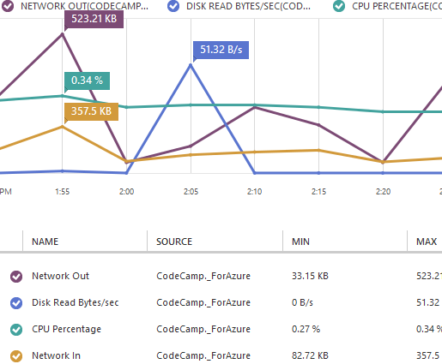

Slide 22
Scale Up (and Scale Down??) vs. Horizontal Resourcing
Common Terminology:
  Scaling Up/Down ⬄ Vertical Scaling
  Scaling Out/In ⬄ Horizontal “Scaling”
  → But really is Horizontal Resource Allocation
Architectural Decision
  Big decision… hard to change

Slide 23
Vertical Scaling (“Scaling Up”)
Resources that can be “Scaled Up”
Memory: speed, amount
CPU: speed, number of CPUs
Disk: speed, size, multiple controllers
Bandwidth: higher capacity pipe
… and it sure is EASY
.
Downsides of Scaling Up
Hard Upper Limit
HIGH END HARDWARE ➔ HIGH END CO$T
Lower value than “commodity hardware”
May have no other choice (architectural)

Slide 24
Scaling Horizontally: Adding Boxes
Autonomous nodes
for scalability
(stateless web servers, shared nothing DBs, your custom code in QCW)
Autonomous nodes
*and*
Homogeneous nodes
for operational simplicity
*and*
Anonymous nodes
don‘t get emotionally involved!
This is how a [public] CLOUD PLATFORM works
*and*
This is how YOUR CLOUD-NATIVE app works

Slide 25
Example: Web Tier www.pageofphotos.com
Managed VMs
(Cloud Service)
“Web Role”
Load Balancer
(Cloud Service)
Notes:
Architectural concerns
N>1
N+1
Reactive

Slide 26
Horizontal Scaling Considerations
Auto-Scale
  Bidirectional
Nodes can fail
Auto-Scale is only one cause
Handle shutdown signals
Stateless (“like a taxi”)
vs. Sticky Sessions
Stateless nodes
vs. Stateless apps
N+1 rule
vs. occasional downtime (UX)
Notes:
Architectural concerns
N>1
N+1
Reactive

Slide 27
What’s the difference between performance and scale?
?
Notes:
SLA, practical reasons

Slide 28
Do Performance and Scale Matter?
System Responsiveness* | Users perception
0.1 Seconds | feeling of instantaneous response
1 Second | user's flow of thought seamless
10 Seconds | start thinking about other things
> 3 seconds 40% of visitors abandon**
* NNG 1993 - http://www.nngroup.com/articles/website-response-times/
** Kissmetrics - http://blog.kissmetrics.com/loading-time/
Notes:
Latency & Availability
Avoid: abandoned pages & no repeat

Slide 29
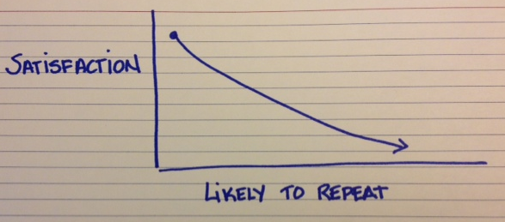
Bottom line for your business
00:00:02
Delay
Lost
Revenue
Reduced Clicks
3.8%
* Kissmetrics - http://blog.kissmetrics.com/loading-time/
Notes:
A less than 2-second increased delay in page responsiveness*
reduced user satisfaction by 3.8%
lost revenue per user of 4.3%
reduced clicks by 4.4%.

Slide 30

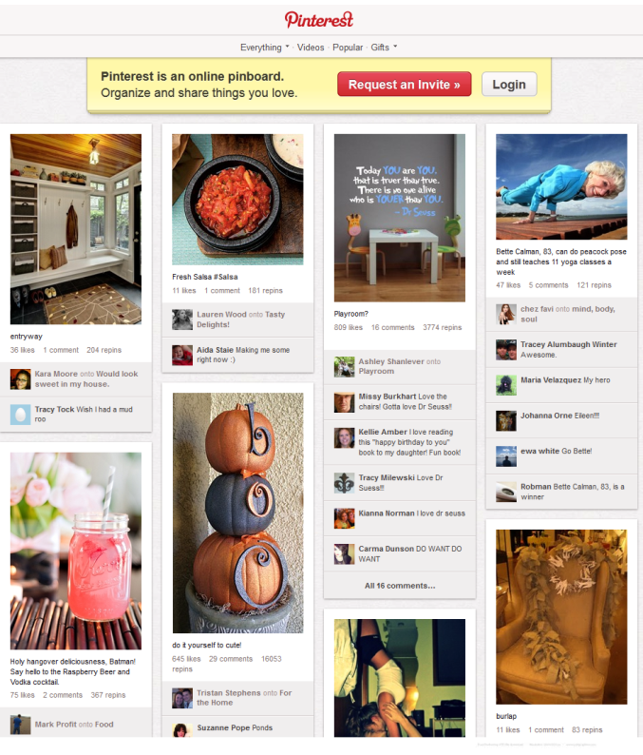
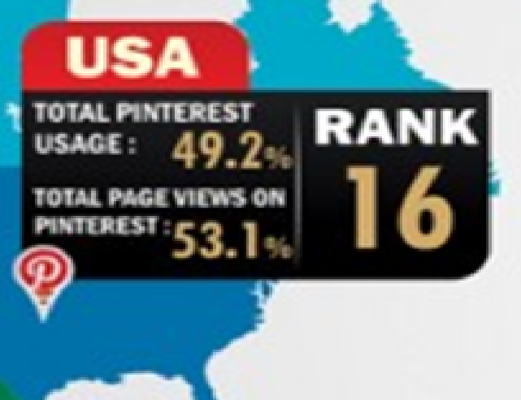
Elastic Scaling
  Peak usage
  Data analysis
Notes:
Pintrest collecting and organizing
Scale Elastically
Add more Servers during peak times of the day
Reduce the number of servers in the evening
When they have big data analysis

Slide 31


During Super Bowl 2013
  Anticipated network spike
  Scaled to 200 clusters
  Millions of tags
After
  Scaled back
Notes:
Shazam – app for identifying, tagging and sharing music, tv and ads

Slide 32


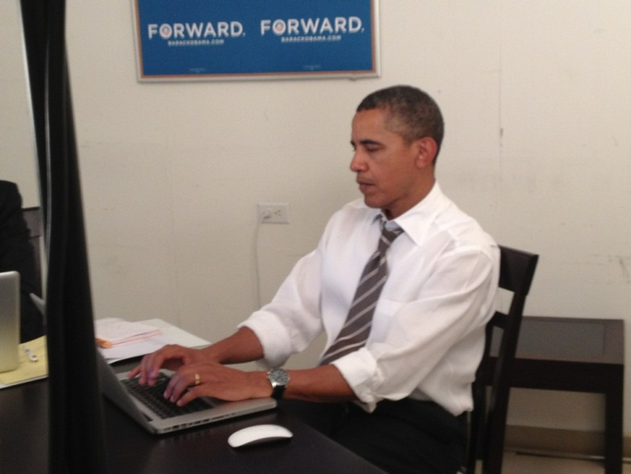
Aug 2012 Obama Ask Me Anything
Spike in traffic crashed the site
2,987,307 page views
30 dedicated servers overwhelmed
http://blog.reddit.com/2012/08/potus-iama-stats.html
Notes:
Megathread
Had to add another 30 servers and still the traffic was slow.

Slide 33
Queue-Centric Workflow Pattern
pattern 2 of 5
(QCW for short)

Slide 34
Extend www.pageofphotos.com example into Service Tier
QCW enables applications where the UI and back-end services are Loosely Coupled
(Compare to CQRS at end if there is interest)

Slide 35
QCW Example: User Uploads Photo www.pageofphotos.com
Web Server
Compute Service
Reliable Queue
Reliable Storage
Notes:
AJAX – orthogonal concern
Worker Role not related to HTML 5 concept of Web Worker

Slide 36
QCW
WE NEED:
Compute (VM) resources to run our code
Reliable Queue to communicate
Durable/Persistent Storage

Slide 37
Where does Windows Azure fit?

Slide 38
QCW [on Windows Azure]
WE NEED:
Compute (VM) resources to run our code
  Web Roles (IIS) and Worker Roles (w/o IIS)
Reliable Queue to communicate
  Azure Storage Queues
Durable/Persistent Storage
  Azure Storage Blobs & Tables; WASD

Slide 39



QCW on Azure: User Uploads a Photo
push
pull
Web
Role
(IIS)
Worker
Role
www.pageofphotos.com
Azure Queue
Azure Blob
UX implications: how does user know thumbnail is ready?
Notes:
AJAX – orthogonal concern
Worker Role not related to HTML 5 concept of Web Worker
“Thumbnails” sample code available from http://code.msdn.microsoft.com/windowsazuresamples

Slide 40
QCW enables Responsive UX
Response to interactive users is as fast as a work request can be persisted
Time consuming work done asynchronously
Comparable total resource consumption, arguably better subjective UX
UX challenge – how to express Async to users?
  Communicate Progress
  Display Final results
  Long Polling/Web Sockets (e.g., SignalR or Node.io)

Slide 41
QCW enables Scalable App
Decoupled front/back provides insulation
  Blocking is Bane of Scalability
  Order processing partner doing maintenance
  Twitter down
  Email server unreachable
  Internet connectivity interruption
Loosely coupled, concern-independent scaling
  (see next slide)
  Get Scale Units right
  Key to optimizing operational CO$T$

Slide 42
General Case:
Many Roles, Many Queues
Worker
Role
Web
Role
(Admin)
Worker
Role
Worker
Role
Queue Type 1
Worker
Role Type 1
Queue Type 1
Web
Role
(Public)
Queue Type 2
Web
Role
(IIS)
Queue Type 2
Web
Role
(IIS)
Worker
Role
Worker
Role
Worker
Role
Queue Type 3
Worker
Role Type 2
Worker
Role Type 2
Worker
Role Type 2
Worker
Role Type 2
Scaling best when Investment α Benefit
Optimize for CO$T EFFICIENCY
  Logical vs. Physical Architecture depends on current scale

Slide 43
Reliable Queue & 2-step Delete
var url = “http://pageofphotos.blob.core.windows.net/up/<guid>.png”;
queue.AddMessage( new CloudQueueMessage( url ) );
(IIS)
Web
Role
Worker
Role
Queue
var invisibilityWindow = TimeSpan.FromSeconds( 10 );
CloudQueueMessage msg =
queue.GetMessage( invisibilityWindow );
(… do some processing then …)
queue.DeleteMessage( msg );
Notes:
AJAX – orthogonal concern
Worker Role not related to HTML 5 concept of Web Worker

Slide 44
QCW requires Idempotent
Perform idempotent operation more than once, end result same as if we did it once
Example with Thumbnailing (easy case)
App-specific concerns dictate approaches
  Compensating action, Last write wins, etc.
PARTNERSHIP: division of responsibility between cloud platform & app
  Far cry from database transaction

Slide 45
QCW expects Poison Messages
A Poison Message cannot be processed
  Error condition for non-transient reason
  Check CloudQueueMessage.DequeueCount property
Falling off the queue may kill your system
Determine a Max Retry policy per queue
  Delete, put on “bad” queue, alert human, …

Slide 46
QCW requires “Plan for Failure”
VM restarts will happen
  Hardware failure, O/S patching, crash (bug)
Bake in handling of restarts into our apps
  Restarts are routine: system “just keeps working”
  Idempotent mindset is key
  Event Sourcing (commonly seen with CQRS) may help
Not an exception case! Expect it!
Consider N+1 Rule
Notes:
Windows Azure: Fabric Controller honors Fault Domains

Slide 47


What’s Up? Reliability as EMERGENT PROPERTY
 | Typical Site | Any 1 Role Inst | Overall System
Operating System Upgrade
Application Code Update
Scale Up, Down, or In
Hardware Failure
Software Failure (Bug)
Security Patch
Notes:
Tech Windows

Slide 48
Aside: Is QCW same as CQRS?
Short answer: “no”
CQRS
  Command Query Responsibility Segregation
Commands change state
Queries ask for current state
Any operation is one or the other
Sometimes includes Event Sourcing
Sometimes modeled using Domain Driven Design (DDD)

Slide 49

What about the Data?
You: Azure Web Roles and Azure Worker Roles
  Taking user input, dispatching work, doing work
  Follow a decoupled queue-in-the-middle pattern
  Stateless compute nodes
Cloud: “Hard Part”: persistent, scalable data
  Azure Queue & Blob Services
  Three copies of each byte
  Blobs are geo-replicated
  Busy Signal Pattern

Slide 50
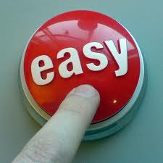
What about the Users?
No direct connection between user’s action and system’s reaction
User Experience Challenge
System Status
Keep user informed about what’s going on
Appropriate feedback in reasonable amount of time
Notes:
Give a brief overview of the presentation. Describe the major focus of the presentation and why it is important.
Introduce each of the major topics.
To provide a road map for the audience, you can repeat this Overview slide throughout the presentation, highlighting the particular topic you will discuss next.

Slide 51
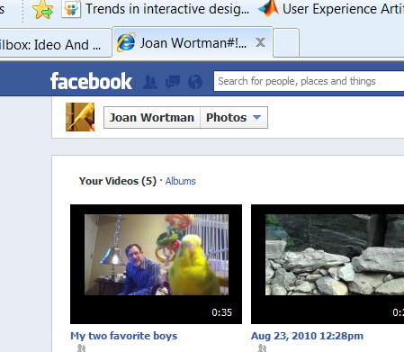
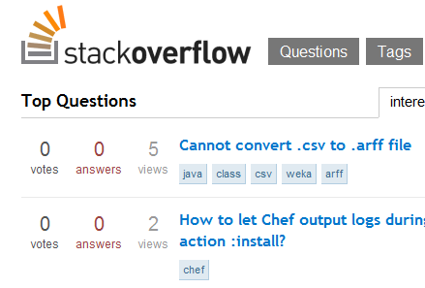
LIE…in a good way
Uploading video files to FB
  Block users w/status indicator
  Upload and conversion
Stack Overflow
  My post is cached
  Delay for others

Slide 52
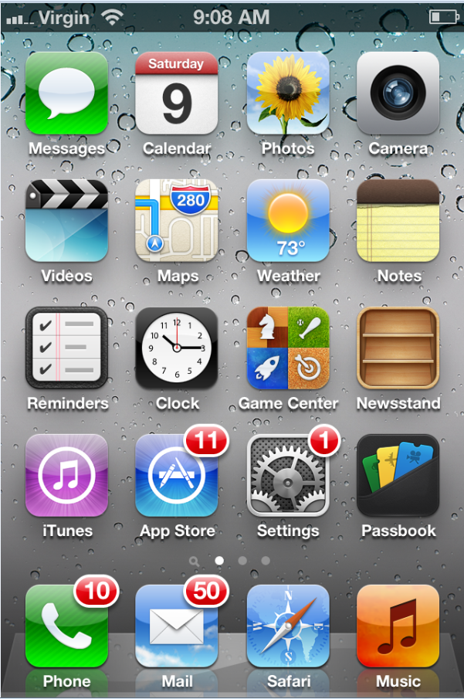
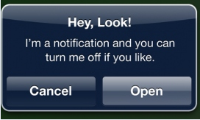
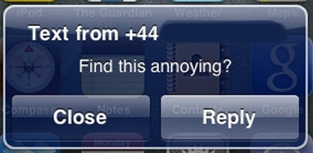
Badges and Notifications

Slide 53
Confirmations
Amazon tells you your order was taken, but doesn’t mean you own it yet…
  They recheck inventory
  Send email confirmation
Credit card/Cell bills
  Post next business day
Airline reservations
  Some will even tell you how many seats left

Slide 54

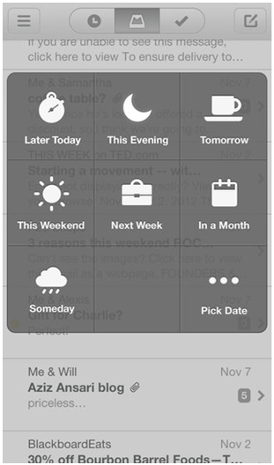
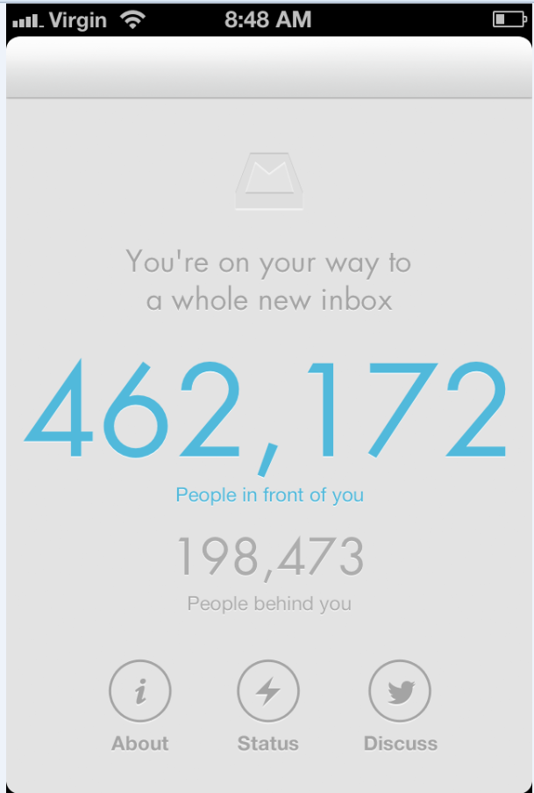
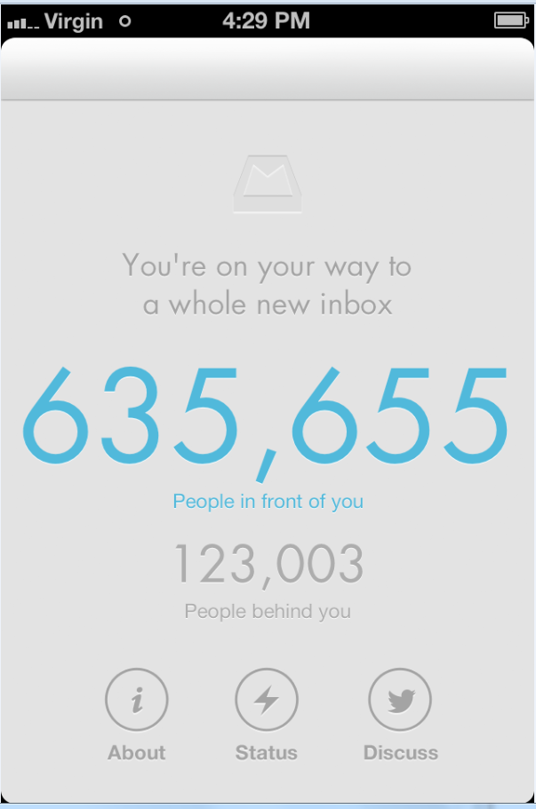
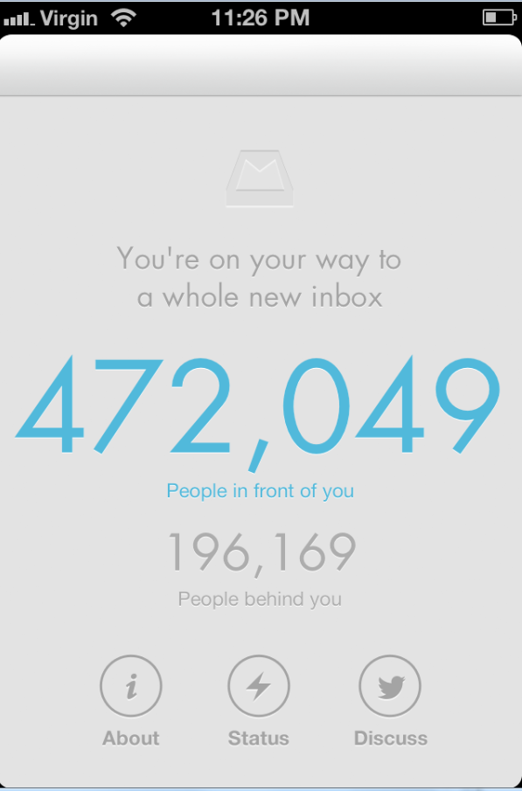
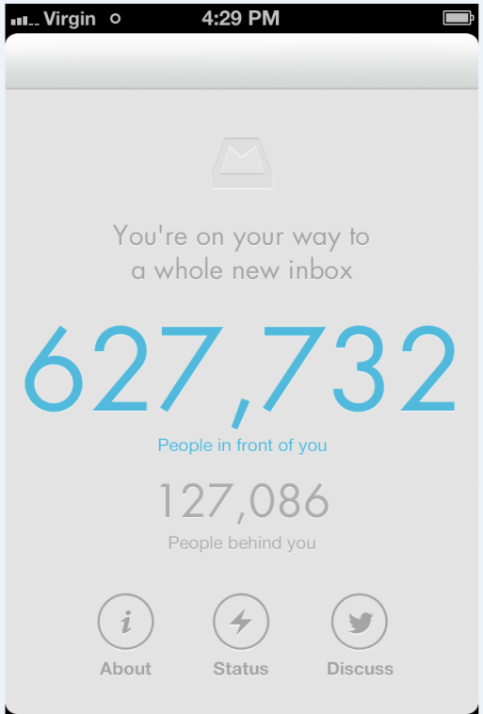
Polling
Notes:
Mailbox
New app for managing inbox

Slide 55
Database Sharding Pattern
pattern 3 of 5

Slide 56
Extend www.pageofphotos.com example into Data Tier
What happens when demands on data tier grow?
The Database Sharding Pattern a little about reliability – a lot about scale and performance

Slide 57

Foursquare is a Social Network

Slide 58

Foursquare #Fail
October 4, 2010 – trouble begins…
After 17 hours of downtime over two days…
  “Oct. 5 10:28 p.m.: Running on pizza and Red Bull. Another long night.”
  WHAT WENT WRONG?
Notes:
Social Check-in Site Foursquare
32 employees (at the time)
10Gen
Small company
Microsoft
BIG COMPANY (how many of the 90k employees work on SQL Server?)
http://blog.foursquare.com/2010/10/05/so-that-was-a-bummer/
http://highscalability.com/blog/2010/10/15/troubles-with-sharding-what-can-we-learn-from-the-foursquare.html

Slide 59
What is Sharding?
Problem: one database can’t handle all the data
  Too big, not performant, needs geo distribution, …
Solution: split data across multiple databases
  One Logical Database, multiple Physical Databases
Each Physical Database Node is a Shard
Most scalable is Shared Nothing design
  May require some denormalization (duplication)
Notes:
[Not same as Data Warehouse or Reporting DB]

Slide 60
All shard have same schema
SHARDS

Slide 61
Sharding is Difficult
What defines a shard? (Where to put stuff?)
  Example – use country of origin: customer_us, customer_fr, customer_cn, customer_ie, …
  Use same approach to find records (can use lookup)
What happens if a shard gets too big?
  Rebalancing shards can get complex
  Foursquare case study is interesting
How to query / join / transact across shards
Cache coherence, connection pool management
  Roll-your-own challenge

Slide 62
Where does Windows Azure fit?

Slide 63
Windows Azure SQL Database (WASD) is SQL Server Except…
SQL Server
Specific
(for now)
WASD
Specific
Limitations
150 GB size limit
Busy Signal Pattern
Extra Capabilities
Managed Service
Highly Available
Rental model
Federations
Common
Full Text Search
Transparent Data Encryption (TDE)
Many more…
“Just change the connection string…”
Additional information on Differences:
    http://msdn.microsoft.com/en-us/library/ff394115.aspx
Notes:
http://social.technet.microsoft.com/wiki/contents/articles/inside-sql-azure.aspx
“Another feature in development is the ability to take control of your backups. Currently, backups are performed in the data centers to protect your data against disk or system problems. However, there is no way currently to control your own backups to provide protection against logical errors and use a RESTORE operation to return to an earlier point in time when a backup was made. The new feature involves the ability to make your own backups of your SQL Azure databases to your own on-premises storage, and the ability to restore those backups either to an on-premises database or to a SQL Azure database. Eventually Microsoft plans to provide the ability to perform SQL Azure backups across data centers and also make log backups so that point-in-time recovery can be implemented.” http://social.technet.microsoft.com/wiki/contents/articles/inside-sql-azure.aspx

Slide 64
Windows Azure SQL Databse Federations for Sharding
Single “master” database
  “Query Fanout” makes partitions transparent
  Instead of customer_us, customer_fr, etc… we are back to customer database
Handles redistributing shards
Handles cache coherence
Simplifies connection pooling
No MERGE (yet); SPLIT only
Bonus feature for Multitenant Applications
USE FEDERATION myfed (myfedkey = 911) WITH FILTERING=ON RESET
http://blogs.msdn.com/b/cbiyikoglu/archive/2011/01/18/sql-azure-federations-robust-connectivity-model-for-federated-data.aspx
Notes:
Greatest fear is Tenant Leakage

Slide 65

Foursquare #Fail
  Foursquare was implementing database sharding in the application layer.
  WASD Federations makes this unnecessary.
  WHAT WENT WRONG?
Notes:
Social Check-in Site Foursquare
32 employees (at the time)
10Gen
Small company
Microsoft
BIG COMPANY (how many of the 90k employees work on SQL Server?)
http://blog.foursquare.com/2010/10/05/so-that-was-a-bummer/
http://highscalability.com/blog/2010/10/15/troubles-with-sharding-what-can-we-learn-from-the-foursquare.html

Slide 66
My database instance is limited to 150 GB.
∞ ∞ ∞
Does that mean the cloud doesn’t really offer the illusion of infinite resources?
?

Slide 67
Busy Signal Pattern
pattern 4 of 5

Slide 68
Auto-Scaling Pattern
pattern 5 of 5

Slide 69
In Conclusion
in conclusion

Slide 70
Pre-Cloud vs. Cloud-Native
Lessons: being | Cloud-Native
1:15,000 | Efficiency
Auto-Scaling via API | Dynamic/∞ Resources
Pay-As-You-Go | Variable/OpEx
Stateless, Autonomous | Horizontal Resourcing
N+1, Idempotent | Minimize MTTR
SQL, NoSQL, Blob | Scenario-specific Storage
VM, Storage, LB, DR | Managed Infrastructure
Notes:
Not shown:
Strong Consistency vs. Eventual Consistency
MINDSET.. CHARACTERISTICS OF PRE-CLOUD vs. CLOUD-NATIVE
Efficiency: electrical grid, virtual machine-based, multi-tenant, commodity hardware - 1:15k (vs. 1:30 or at best 1:150)
Dynamic/∞ Resources: use cloud platform API to allocate or release resources; infinite resources available - but not all at once
Variable/OpEx: stop using, stop paying; pay for expanded use
Horizontal Resourcing: Similar to Scaling Out/Horizontal Scaling, except not just for scale… and bi-directional
Minimize MTTR: Failure is expected, be prepared to deal with it; partnership between CLOUD PLATFORM and YOUR APPLICATION ARCHITECTURE
Scenario-Specific Storage: Relational Database no longer one-size-fits-all. NoSQL, Blobs, CDN, Relational++ (auto-sharding)
Managed Infrastructure: “ManageD” – the “D” on the end changes everything… Want a database? - available on demand, here’s a connection string. Want application services like a Reliable Queue? – here’s its http address, feel free to start using it. LB – ready. Geo-LB – ready (and you may deploy to >1 datacenter too – maybe MANY if you use CDN).
These are REALLY IMPACTFUL DIFFERENCES and an application optimized to live in harmony with properities is CLOUD-NATIVE, and apps in harmony with the old properties is PRE-CLOUD

Slide 71
Know the rules
“Know the rules well, so you can break them effectively.”
- Dalai Lama XIV

Slide 72
Further Information
Windows Azure
http://windowsazure.com/
Boston Azure User Group
http://bostonazure.org/
Cloud Architecture Patterns
http://cloudarchitecturepatterns.com/

Slide 73
Cloud Architecture Patterns book
Primer Chapters
Scalability
Eventual Consistency
Multitenancy and
Commodity Hardware
Network Latency
http://cloudarchitecturepatterns.com/

Slide 74
Cloud Architecture Patterns book
Pattern Chapters
Horizontally Scaling Compute Pattern
Queue-Centric Workflow Pattern
Auto-Scaling Pattern
MapReduce Pattern
Database Sharding Pattern
Busy Signal Pattern
Node Failure Pattern
Colocate Pattern
Valet Key Pattern
CDN Pattern
Multisite Deployment Pattern

Slide 75
BostonAzure.org
Boston Azure Cloud User Group
  Focused on Microsoft’s Public Cloud Platform
  Roles: Architect, Dev, IT Pro, DevOps (“WazOps”)
  Talks, Demos, Tools, Hands-on, special events, …
Monthly, 6:00-8:30 PM in Boston area (free)
Follow on Twitter: @bostonazure
More info or to join our Meetup.com group:
http://www.bostonazure.org

Slide 76
Joan Wortman
User Experience Specialist
17 years experience
Joan.Wortman@gmail.com

Slide 77

Business Card

Slide 78


My name is Bill
Wilder
HELLO
my name is
Bill Wilder
professional
billw@devpartners.com ·· www.devpartners.com
www.cloudarchitecturepatterns.com
community
@bostonazure ·· www.bostonazure.org
@codingoutloud ·· blog.codingoutloud.com ·· codingoutloud@gmail.com

Slide 79
Questions?
Comments?
More information?
?

Slide 81
DONE

Slide 82
Notes:
Subliminal … 0.25

