Slide 1
Architecting to be Cloud Native
On Windows Azure or Otherwise
HELLO
my name is
An App in the Cloud
is not (necessarily)
a Cloud-Native App
Bill
Wilder
BU MET CS755, Cloud Computing, Dino Konstantopoulos
21-Mar-2013 (6:00 – 9:00 PM EDT)

Slide 2





Who is Bill Wilder?
www.cloudarchitecturepatterns.com
www.bostonazure.org
www.devpartners.com

Slide 3


Roadmap for this talk… …
App in the Cloud != Cloud App (or at least not a Cloud-Native App)
Put Cloud-Native in context of cloud platform types from software development point of view
How to keep running when things go wrong?
How to scale?
How to minimize costs?
Assumptions:
  You know what “the cloud” is – so we can focus on application architecture using cloud as a toolbox
  You are interested in understanding cloud-native apps
?
Notes:
Consider the value spectrum – and tipping point
QUESTIONS AT THE END – but ask as we go along
CONCEPTS ARE GENERAL – but technology examples all use Windows Azure

Slide 4
The term “cloud” is nebulous…
The term “cloud” is nebulous…

Slide 5
“Bring Your Own” ____ as a Service
BYO
Users
BYO
Applications
BYO
Virtual Machines
SaaS➔
⬅
less
Responsibility &
Flexibility
PaaS➔
Most productive platforms for Cloud-Native
Apps
more
➔
IaaS➔
NIST: http://csrc.nist.gov/publications/nistpubs/800-145/SP800-145.pdf
Notes:
NIST TERMINOLOGY
Our concern: Custom Applications (which rules out SaaS), and constructed to be Cloud-Native

Slide 6
A public cloud perspective…
The term “cloud” is nebulous…

Slide 7
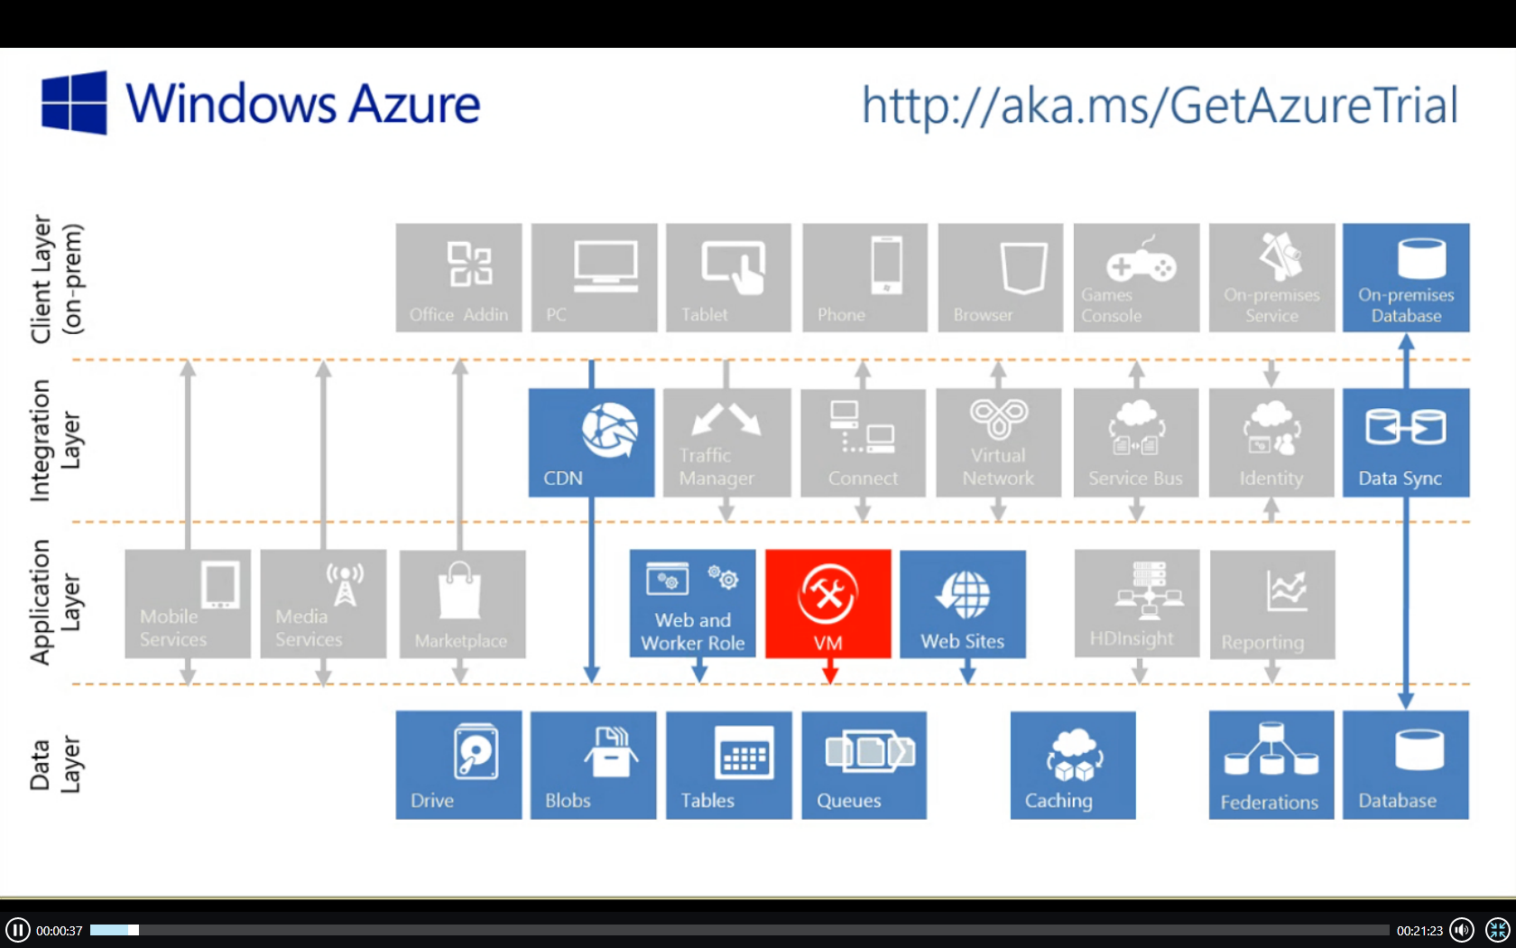
Windows Azure Feature Map

Slide 8
What's different about the cloud?
What is different about the cloud?
public
^
Notes:
^ public

Slide 9


1/9th above water
⬅
=
TTM &
Sleeping well
Notes:
According to wikipedia (http://en.wikipedia.org/wiki/Iceberg) “typically only one-ninth of the volume of an iceberg is above water”
Iceberg comment not specific to CLOUD NATIVE – but just a reminder to the power of the CLOUD
Photo credit: http://upload.wikimedia.org/wikipedia/commons/a/ac/Iceberg.jpg

Slide 10


MTBF MTTR
failure is routine
(so you better be good at handling it)
commodity hardware
+ multitenant services
= cost-efficient cloud
Notes:
Photos from Bill Wilder
cloud services are MT, hardware is commodity
Cloud services CAN FAIL – you need to implement Busy Signal Pattern – and YOUR SERVICES CAN FAIL

Slide 11

This bar is always open
*and* has an API
Pay by the Drink
Notes:
Photo from Bill Wilder

Slide 12
  ∞
Resource allocation (scaling) is:
  Horizontal
  Bi-directional
  Automatable
The “illusion of infinite resources”

Slide 13
Cloud-Native Application Characteristics
  Cloud-Native Applications have their Application Architecture aligned with the Cloud Platform Architecture
  Use the platform in the most natural way
  Let the platform do the heavy lifting where appropriate
  Take responsibility for error handling, self-healing, and some aspects of scaling

Slide 14



Tells: Traditional vs Cloud-Native
⬅ ➔
Which is “best” architecture?
2-tier
Single data center
Vertical scaling
Ignores failure
Hardware or IaaS
3- or N-tier, SOA
Multi-data center
Horizontal scaling
Expects failure
PaaS
TELLS/CLUES
There is no “best” architecture – it is situational, a Technical Business Decision.
Cloud-native popularity growing in proportion to the shrinking cost and competitive benefits.
Traditional Cloud-Native
Less flexible
More manual/attention
Less reliable (SPoF)
Maintenance window
Less scalable, more $$
Agile/faster TTM
Auto-scaling
Self-healing
HA
Geo-LB/FO
CONSEQUENCES
Notes:
Also.. CI, CD, Eventual Consistency, …

Slide 15
Putting the cloud to work
Putting Cloud Services to work

Slide 16

pageofphotos.com
Web Tier
Database
Web Tier
/maura
Original Approach
2-tier architecture
Stateful web nodes
Pros
Well understood
Easy to get working
[Potential] Cons
UX fails for upgrades, hardware failures, app pool recycling
Limited scale
Not Cloud-Native
Notes:
Nothing fundamental changes if we have two nodes in the Web Tier
Still stateful
Now needs sticky sessions (single node is degenerate case)
Non-cloud-native is not WRONG, just DIFFERENT (but is wrong for the PaaS cloud)

Slide 17
pageofphotos.com
Web Tier
Service Tier
Database
Web Tier
Service Tier
Database
/maura
  Scale web tier (stateless)
  Scale service tier (async)
  Scale data tier (shard)
  All while…
  handling failure and optimizing for cost- & operational- efficiency
  Scale the app, not the team!
Notes:
Cost-efficiency – don’t rent hotel rooms when you don’t need them
Operational efficiency – manage many more servers w/o needing much more time

Slide 18
Horizontal Scaling Compute Pattern
pattern 1 of 5

Slide 19
Vertical Scaling vs. Horizontal Scaling
Common Terminology:
  Scaling Up/Down ⬄ Vertical Scaling
  Scaling Out/In ⬄ Horizontal “Scaling”
  → But really is Horizontal Resource Allocation
Architectural Decision
  Big decision… hard to change

Slide 20
What’s the difference between performance and scale?
?
Notes:
SLA, practical reasons

Slide 21
Vertical Scaling (“Scaling Up”)
Resources that can be “Scaled Up”
Memory: speed, amount
CPU: speed, number of CPUs
Disk: speed, size, multiple controllers
Bandwidth: higher capacity pipe
… and it sure is EASY
.
Downsides of Scaling Up
Hard Upper Limit
HIGH END HARDWARE ➔ HIGH END CO$T
Lower value than “commodity hardware”
May have no other choice (architectural)

Slide 22
Horizontal Scaling (“Scaling Out”)
Autonomous nodes
for scalability
(stateless web servers, shared nothing DBs, your custom code in QCW)
Autonomous nodes
*and*
Homogeneous nodes
for operational simplicity
*and*
Anonymous nodes
don‘t get emotionally involved!
This is how a [public] CLOUD PLATFORM works
*and*
This is how YOUR CLOUD-NATIVE app works

Slide 23
Example: Web Tier www.pageofphotos.com
Managed VMs
(Cloud Service)
“Web Role”
Load Balancer
(Cloud Service)
Notes:
Architectural concerns
N>1
N+1
Reactive

Slide 24
Horizontal Scaling Considerations
Auto-Scale
  Bidirectional
Nodes can fail
Releasing VM resources (e.g., via Auto-Scale) is one cause
Handle shutdown signals
Externalize session state
  e.g., see ASP.NET Session State Providers for Azure Tables, Azure Cache
N+1 rule as UX optimization
Notes:
Architectural concerns
N>1
N+1
Reactive
Stateless (“like a taxi”)
vs. Sticky Sessions
Stateless nodes
vs. Stateless apps

Slide 25
How many users does your cloud-native application need before it needs to be able to horizontally scale?
?
Notes:
SLA, practical reasons

Slide 26
Queue-Centric Workflow Pattern
pattern 2 of 5
(QCW for short)

Slide 27
Extend www.pageofphotos.com into a new Service Tier
QCW enables applications where the UI and back-end services are Loosely Coupled
[ Similar to CQRS Pattern ]

Slide 28
pageofphotos.com
Web Tier
Service Tier
Database
Web Tier
Service Tier
/maura
  Add service tier (async)
  Leave Web Tier to do what it’s good at
Notes:
Cost-efficiency – don’t rent hotel rooms when you don’t need them
Operational efficiency – manage many more servers w/o needing much more time

Slide 29
QCW Example: User Uploads Photo www.pageofphotos.com
Web Tier
Service Tier
Reliable Queue
Reliable Storage
Notes:
AJAX – orthogonal concern
Worker Role not related to HTML 5 concept of Web Worker

Slide 30
QCW
WE NEED:
Compute (VM) resources to run our code
Reliable Queue to communicate
Durable/Persistent Storage

Slide 31
Where does Windows Azure fit?

Slide 32
QCW [on Windows Azure]
WE NEED:
Compute (VM) resources to run our code
  Web Roles (IIS – Web Tier)
  Worker Roles (w/o IIS – Service Tier)
Reliable Queue to communicate
  Azure Storage Queues
Durable/Persistent Storage
  Azure Storage Blobs

Slide 33



QCW on Azure: User Uploads a Photo
push
pull
Web
Role
(IIS)
Worker
Role
www.pageofphotos.com
Azure Queue
Azure Blob
UX implications: how does user know thumbnail is ready?
Notes:
AJAX – orthogonal concern
Worker Role not related to HTML 5 concept of Web Worker
“Thumbnails” sample code available from http://code.msdn.microsoft.com/windowsazuresamples

Slide 34
Reliable Queue & 2-step Delete
var url = “http://pageofphotos.blob.core.windows.net/up/<guid>.png”;
queue.AddMessage( new CloudQueueMessage( url ) );
Web
Role
Worker
Role
Queue
var invisibilityWindow = TimeSpan.FromSeconds( 10 );
CloudQueueMessage msg =
queue.GetMessage( invisibilityWindow );
// do all necessary processing…
queue.DeleteMessage( msg );
Notes:
AJAX – orthogonal concern
Worker Role not related to HTML 5 concept of Web Worker

Slide 35
QCW requires Idempotent
Perform idempotent operation more than once, end result same as if we did it once
Example with Thumbnailing (easy case)
App-specific concerns dictate approaches
  Compensating action, Last write wins, etc.
PARTNERSHIP: division of responsibility between cloud platform & app
  ➔ Transaction cannot span database + queue

Slide 36
QCW expects Poison Messages
A Poison Message cannot be processed
  Error condition for non-transient reason
  Check CloudQueueMessage.DequeueCount property
Falling off the queue may kill your system
Determine a Max Retry policy per queue
  Delete, put on “bad” queue, alert human, …

Slide 37
QCW enables Responsive UX
Response to interactive users is as fast as a work request can be persisted
Time consuming work done asynchronously
Comparable total resource consumption, arguably better subjective UX
UX challenge – how to express Async to users?
  Communicate Progress
  Display Final results
  Long Polling/Web Sockets (e.g., SignalR or Node.io)

Slide 38
QCW enables Scalable App
Decoupled front/back provides insulation
  Blocking is Bane of Scalability
  Order processing partner doing maintenance
  Twitter down
  Email server unreachable
  Internet connectivity interruption
Loosely coupled, concern-independent scaling
  (see next slide)
  Get Scale Units right
  Key to optimizing operational CO$T$

Slide 39
QCW requires “Plan for Failure”
VM restarts will happen
  Hardware failure, O/S patching, crash (bug)
Bake in handling of restarts into our apps
  Restarts are routine: system “just keeps working”
  Idempotent mindset is key
  Event Sourcing (commonly seen with CQRS) may help
Not an exception case! Expect it!
Consider N+1 Rule
Notes:
Windows Azure: Fabric Controller honors Fault Domains

Slide 40
Aside: Is QCW same as CQRS?
Short answer: “no”
CQRS
  Command Query Responsibility Segregation
Commands change state
Queries ask for current state
Any operation is one or the other
Sometimes includes Event Sourcing
Sometimes modeled using Domain Driven Design (DDD)

Slide 41
General Case:
Many Roles, Many Queues
Worker
Role
Web
Role
(Admin)
Worker
Role
Worker
Role
Queue Type 1
Worker
Role Type 1
Queue Type 1
Web
Role
(Public)
Queue Type 2
Web
Role
(IIS)
Queue Type 2
Web
Role
(IIS)
Worker
Role
Worker
Role
Worker
Role
Queue Type 3
Worker
Role Type 2
Worker
Role Type 2
Worker
Role Type 2
Worker
Role Type 2
Scaling is best when Investment α Benefit
Optimize for CO$T EFFICIENCY
  Logical vs. Physical Architecture depends on current scale

Slide 42

What about the Data?
You: Azure Web Roles and Azure Worker Roles
  Taking user input, dispatching work, doing work
  Follow a decoupled queue-in-the-middle pattern
  Stateless compute nodes
Cloud: “Hard Part”: persistent, scalable data
  Azure Queue & Blob Services
  Three copies of each byte
  Blobs are geo-replicated
  Busy Signal Pattern

Slide 43
Database Sharding Pattern
pattern 3 of 5

Slide 44
Extend www.pageofphotos.com example into Data Tier
What happens when demands on data tier outgrow one physical database?
Notes:
STATEFUL – need different approach

Slide 45
pageofphotos.com
Web Tier
Service Tier
Database
Web Tier
Service Tier
Database
Database
Database
/maura
  Scale data tier (shard)
Sharding is horizontal scaling for databases.
Unlike compute nodes, databases are not stateless.
Notes:
Cost-efficiency – don’t rent hotel rooms when you don’t need them
Operational efficiency – manage many more servers w/o needing much more time

Slide 46
Database Sharding
Problem: too much for one physical database
  Too much data (e.g., 150 GB limit in WASD)
  Not sufficiently performant
Solution: split data across multiple databases
  One Logical Database, multiple Physical Databases
Each Physical Database Node is a Shard
Goal is a Shared Nothing design & single shard handles most common business operations
  May require some denormalization (duplication)
Notes:
[Not same as Data Warehouse or Reporting DB]

Slide 47
All shards have same schema
SHARDS
Notes:
need SOMETHING to shard --- like CustomerId

Slide 48
Sharding is Difficult
What defines a shard? (Where to put/find stuff?)
  Example – by HOME STATE: customer_ma, customer_ia, customer_co, customer_ri, …
  Design to avoid query / join / transact across shards
What happens if a shard gets too big?
  Rebalancing shards can get complex
  Foursquare case study is interesting
Cache coherence, connection pool management
  Rolling-your-own is complex
Notes:
http://blog.foursquare.com/2010/10/05/so-that-was-a-bummer/
http://highscalability.com/blog/2010/10/15/troubles-with-sharding-what-can-we-learn-from-the-foursquare.html

Slide 49
Where does Windows Azure fit?

Slide 50
Windows Azure SQL Database (WASD) is SQL Server… with a few diffs…
SQL Server
Specific
(for now)
WASD
Specific
Limitations
150 GB size limit
Busy Signal Pattern
Extra Capabilities
Managed Service
Highly Available
Rental model
Federations
Common
Full Text Search
Transparent Data Encryption (TDE)
Many more…
“Just change the connection string…”
Additional information on Differences:
    http://msdn.microsoft.com/en-us/library/ff394115.aspx
Notes:
http://social.technet.microsoft.com/wiki/contents/articles/inside-sql-azure.aspx
“Another feature in development is the ability to take control of your backups. Currently, backups are performed in the data centers to protect your data against disk or system problems. However, there is no way currently to control your own backups to provide protection against logical errors and use a RESTORE operation to return to an earlier point in time when a backup was made. The new feature involves the ability to make your own backups of your SQL Azure databases to your own on-premises storage, and the ability to restore those backups either to an on-premises database or to a SQL Azure database. Eventually Microsoft plans to provide the ability to perform SQL Azure backups across data centers and also make log backups so that point-in-time recovery can be implemented.” http://social.technet.microsoft.com/wiki/contents/articles/inside-sql-azure.aspx

Slide 51
Windows Azure SQL Databse Federations for Sharding
Single “master” database
  “Query Fanout” makes partitions transparent
  Instead of customer_ma, customer_ia, etc… we are back to customer database
Handles redistributing shards
Handles cache coherence and simplifies connection pooling
No MERGE (yet); SPLIT only
Bonus feature for Multitenant Applications
USE FEDERATION myfed (myfedkey = 911) WITH FILTERING=ON RESET
http://blogs.msdn.com/b/cbiyikoglu/archive/2011/01/18/sql-azure-federations-robust-connectivity-model-for-federated-data.aspx
Notes:
Greatest fear is Tenant Leakage

Slide 52

Key Take-away
Database Sharding has historically been an APPLICATION LAYER concern
Windows Azure SQL Database Federations supports sharding lower in the stack as a DATABASE LAYER concern

Slide 53
My database instance is limited to 150 GB.
∞ ∞ ∞
Does that mean the cloud doesn’t really offer the illusion of infinite resources?
?

Slide 54
Busy Signal Pattern
pattern 4 of 5

Slide 55
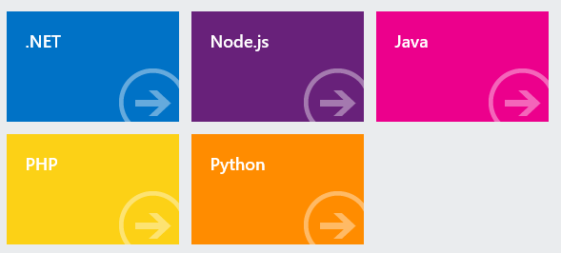
Language/Platform SDKs on www.windowsazure.com
TOPAZ from Microsoft P&P: http://bit.ly/13R7R6A
All have Retry Policies

Slide 56
Auto-Scaling Pattern
pattern 5 of 5

Slide 57
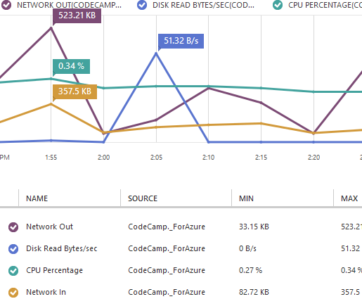
Goal is AUTOSCALING – using a library or services
Microsoft
“WASABi” block from P&P (you run it)
MetricsHub is in the Azure store (very basic service)
Third Party Services
A few SaaS choices for Auto-Scaling and Monitoring
Notes:
WASABi - http://msdn.microsoft.com/en-us/library/hh680892%28v=pandp.50%29.aspx

Slide 58
In Conclusion
in conclusion

Slide 59

Optimize for MTTR (1/2)
Apply Busy Signal Pattern
  Retry transient failures due to issues
  with network, throttling, failovers
  Applies to all cloud services
Apply Node Failure Pattern
  Stateless Nodes, QCW Pattern,
  handle node shutdown signals, covers nodes going away due to scaling action
  Consider N+1 Rule
Detect Poison Messages
  Protect against Bad Data

Slide 60
Optimize for MTTR (2/2)
Prevent Resource Failures
  Environmental-signal-based Auto-Scaling
  (for surprises)
  Proactive Auto-Scaling for known spikes
  (e.g., Superbowl Ad, lunch rush)
  QCW Pattern (allow work to pile up w/o
  blocking users)
Log Everything
  Gather logs with Windows Azure Diagnostics

Slide 61


What’s Up? Reliability as EMERGENT PROPERTY
 | Typical Site | Any 1 Role Inst | Overall System
Operating System Upgrade
Application Code Update
Scale Up, Down, or In
Hardware Failure
Software Failure (Bug)
Security Patch
Notes:
Tech Windows

Slide 62

Optimize for Cost
Operational Efficiency Big Factor
  Human costs can dominate
  Automate (CI & CD and self-healing)
  Simplify: homogeneous nodes
Review costs billed (so transparent!)
  Be on lookout for missed efficiencies
“Watch out for money leaks!”
  Inefficient coding can increase the monthly bill
Prefer to Buy Rent rather than Build
  Save costs (and TTM) of expensive engineering
Notes:
Scale application without scaling team

Slide 63
Optimize for Scale
With the right architecture…
  Scale efficiently (linearly)
  Scale all Application Tiers
  Auto-Scale
  Scale Globally (8/24 data centers)
Use Horizontal Resourcing
Use Stateless Nodes
Upgrade without Downtime, even at scale
Do not need to sacrifice User Experience (UX)
  ∞

Slide 64
Cloud Architecture Patterns book
Primer Chapters
Scalability
Eventual Consistency
Multitenancy and
Commodity Hardware
Network Latency
www.cloudarchitecturepatterns.com

Slide 65
Cloud Architecture Patterns book
Pattern Chapters
Horizontally Scaling Compute Pattern
Queue-Centric Workflow Pattern
Auto-Scaling Pattern
MapReduce Pattern
Database Sharding Pattern
Busy Signal Pattern
Node Failure Pattern
Colocate Pattern
Valet Key Pattern
CDN Pattern
Multisite Deployment Pattern

Slide 66
BostonAzure.org
Boston Azure Cloud User Group
  Focused on Microsoft’s Public Cloud Platform
  Roles: Architect, Dev, IT Pro, DevOps (“WazOps”)
  Talks, Demos, Tools, Hands-on, special events, …
Monthly, 6:00-8:30 PM in Boston area (free)
Follow on Twitter: @bostonazure
More info or to join our Meetup.com group:
http://www.bostonazure.org

Slide 67

Business Card

Slide 68


My name is Bill
Wilder
HELLO
my name is
Find this slide deck here!
Bill Wilder
professional
billw@devpartners.com ·· www.devpartners.com
www.cloudarchitecturepatterns.com
community
@bostonazure ·· www.bostonazure.org
@codingoutloud ·· blog.codingoutloud.com ·· codingoutloud@gmail.com

Slide 69
Windows Azure Feature Map

Slide 70
Questions?
Comments?
More information?
?

