Slide 1

Sorting Out Digital Certificates
··· Boston Azure ··· 13·Dec·2012 ···
Bill Wilder
@codingoutloud
blog.codingoutloud.com
www.cloudarchitecturepatterns.com

Slide 2
Outline
What’s Crypto Good for Anyway?
  Secrecy and beyond
Symmetric Cryptography
  Shared secrets
Crypto Toolbox
  Hashing, signing, encrypting
Asymmetric Cryptography
  Indistinguishable from magic…
Applied to Windows Azure
  Management Certificates, RDP, Publish Profiles, SSL
Goal: grok concepts so Azure “just makes sense”

Slide 3
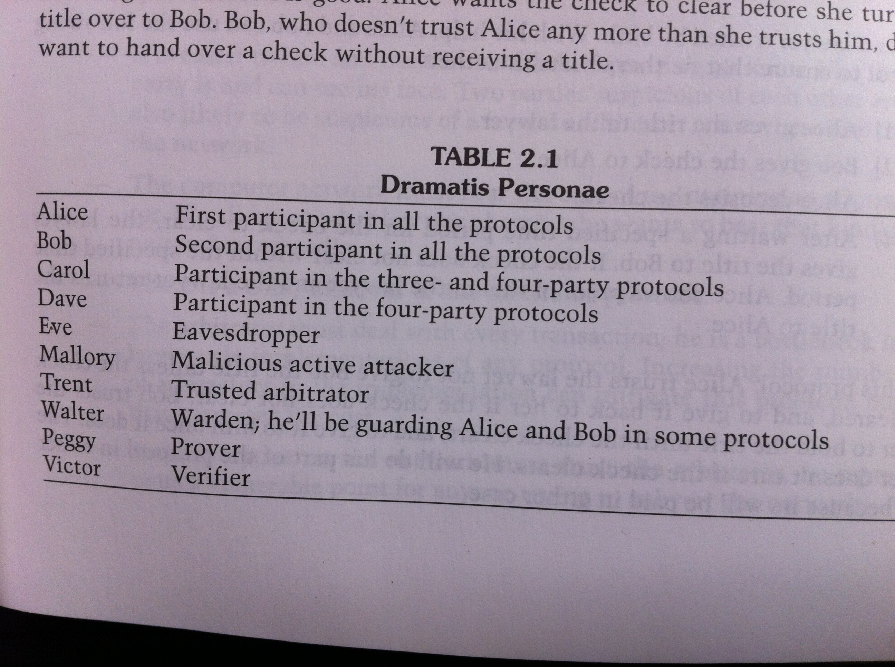
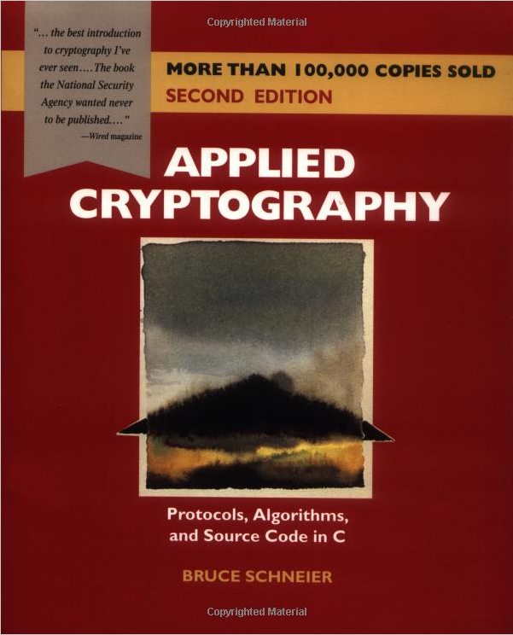
Dramatis Personae
(Bruce Schneier’s book: Applied Cryptography, 2nd Edition)

Slide 4
Four Uses of Cryptography
Authentication – sender of a message is known (Bob knows Alice sent it) or intended recipient of message is known (Alice knows it’s really Bob)
Confidentiality – if a message is intercepted by (eavesdropper) Eve, she cannot read it
Data Integrity – if a message is tampered with by (malicious) Mallory, this will be evident
Non-repudiation – a received message cannot be repudiated (Alice cannot deny having sent it)

Slide 5
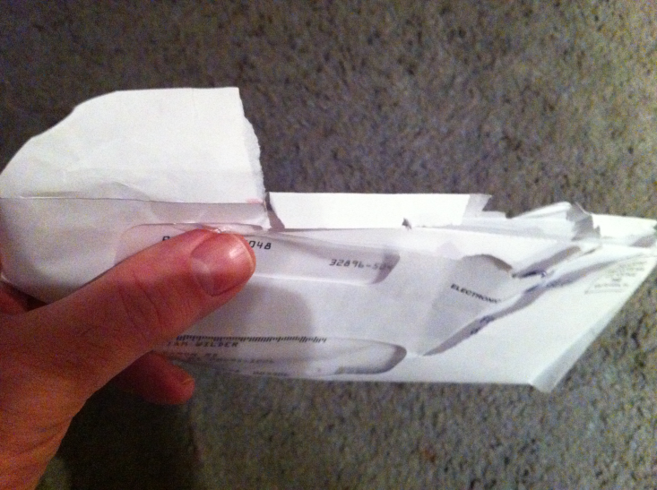
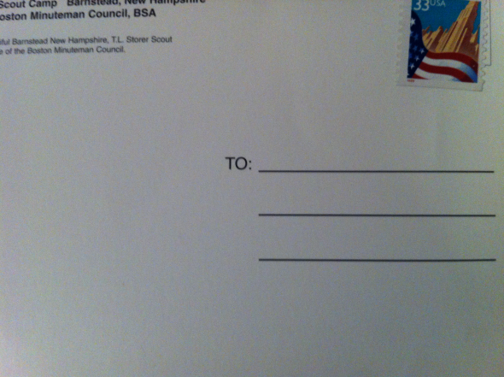
Goal: Secure Communication (type 1)
Alice and Bob know each other and wish to communicate such that:
If someone (like Eve) intercepts the message, the message contents will remain private
If someone (like Mallory) intercepts and modifies the message, Alice or Bob can detect a change has been made
Alice
Bob
Notes:
http://healthmad.com/medicine/tamper-proofing-medicines-examine-your-packages-closely/

Slide 6
Solution (type 1): Shared Secret
Alice and Bob agree on a Secret
  Secret is exchanged securely in advance
Shared Secret is used both to encrypt and decrypt the message
This is symmetric cryptography
Covers privacy directly, tampering indirectly
State-of-the-art for around 4,000 years
Still important (e.g., NIST): DES, 3DES, Rijndael

Slide 7
Goal: Secure Communication (type 2)
Alice and Bob NOT ABLE TO agree on a secret
  There is no opportunity to securely exchange a secret in advance
How to ensure privacy?
How to ensure no tampering?
Before answering these questions, let’s look at a few crypto concepts we’ll need for our toolbox…

Slide 8
Crypto Toolbox: Hashing
Hashing
  Input is text (or binary) of any size
  Output (“the hash”) is fixed size (e.g., 20 bytes)
  Goal: Changing 1 input bit changes ½ the output bits
  “Trap Door” – easy to create from an input, but given a hash, too hard to guess valid input (no collisions)
  No cryptographic keys involved (just an algorithm)
Well-known hashing algorithms: SHA1, MD5
Not unlike .NET’s virtual Object.GetHashCode()
Passwords often stored hashed (salted/stretched)

Slide 9
Crypto Toolbox: Signing
Signing
  Input is any size
  Output (“the signature”) is proportional
  Cryptographic key is involved
Can be cryptographically verified: Tamper Detection
Commonly used in conjunction with Hashing
  Hashing faster than signing
  Signing a hash yields consistent signature size
var msg = text + Sign(Hash(text), key)
var valid = Verify(Hash(text), sig, key)

Slide 10
Crypto Toolbox: Encrypting
Encrypting
  Input is any size
  Output (“the ciphertext”) is proportional
  Cryptographic key is involved
Can be cryptographically reversed: Privacy
Can be used with Singing and Hashing
var data = Encrypt(text, key)
var msg = data + Sign(Hash(data), key)
var valid = Verify(Hash(data), sig, key)
var text = Decrypt(data, key)

Slide 11
Crypto Toolbox: Asymmetric Keys
Asymmetric means that:
  Encryption Key != Decryption Key
  Signing Key != Verification Key
(Pause for effect as minds are blown)
Two kinds of keys, related cryptographically:
  Public Key – intended to be (widely) distributed
    Used for Encrypting and Signature Verification
  Private Key – intended to be secured
    Used for Decryption and Signing
Signing Key == Decryption Key
Encryption Key == Signature Verification Key

Slide 12
Crypto Toolbox: Asymmetric Keys
var ciphertext = Encrypt(plaintext,
publickeyB)
var msg = ciphertext +
Sign(Hash(ciphertext), privatekeyA)
… … … … … … … … … … … … … … … … … …
var valid = Verify(Hash(ciphertext),
publickeyA)
var plaintext = Decrypt(ciphertext,
privatekeyB)
Alice
⬅
Bob

Slide 13
Asymmetric Keys
How could this possibly work?
  Think of a Private Key as a pair of 500 digit primes
  Think of a Public Key as their product – infeasible to factor
  It is a lot easier to multiple together two 500-digit prime numbers than it is to factor the product
  Computationally not happening to factor 1000-digit number into two 500-digit primes
A related Pub/Priv Key pair commonly issued together as a digital certificate

Slide 14
Goal: Secure Communication (type 2)
Alice and Bob NOT ABLE TO agree on a secret
  There is no opportunity to securely exchange a secret in advance
How to ensure privacy?
How to ensure no tampering?
Now we can answer this from our crypto toolbox

Slide 15
Solution (type 2): Digital Certificates
Alice and Bob independently generate certificates
  Public Keys are exchanged openly
  Private Keys are used to Sign and Decrypt
This is asymmetric cryptography
Covers privacy, tampering, non-repudiation
  With PKI could also cover authentication
Internet commerce relies on this
  Alice is Amazon.com, Bob is anyone
State-of-the-art since 1977 (RSA algorithm)
Notes:
For the ability to digitally sign our content, we can thank Ronald L. Rivest, Adi Shamir, and Leonard Adleman who, in 1977 at MIT, invented the algorithms we now use. They later formed the eponymous company RSA (using first initials of their surnames). Their algorithms were based on ideas outlined by Whitfield Diffie and Martin Hellman at Stanford earlier, and at Berkeley before that, where it was first suggested that keys need not be symmetric, and it might be possible for an encryption system to exist that uses keys to sign or encrypt data that are different than the keys used to verify the signature or decrypt the data.

Slide 16
 | Role in Signing | Role in Encryption | File Format | Management API access | RDP Access to Role Instances | Enable HTTPS Endpoints on Cloud Service
Public Key | Verify signature | Encrypt | .CER | Upload to Windows Azure portal into Account | No action needed, though it may happen to be installed in the certificate store of machine from which it is created | Installed in local certificate store for self-signed-cert; no action for PKI certs
Private Key | Sign | Decrypt | .PFX (also contains Public Key) | Installed in local certificate store | Upload to portal; reference in Service Model | Upload to portal; reference in Service Model
Azure Scope |  |  |  | Subscription | Cloud Service | Cloud Service
The .publishprofile simulates account-scope
Notes:
https://windows.azure.com/download/publishprofile.aspx
https://manage.windowsazure.com/publishsettings/index?client=vs&schemaversion=2.0&whr=azure.com

Slide 17

Resources
Using Remote Desktop with Windows Azure Roles http://msdn.microsoft.com/en-us/library/gg443832.aspx
DRM Whitepaper with example of applying some of the principles - http://codingoutloud.files.wordpress.com/2006/10/lifefx_digital_rights_management_whitepaper.pdf
Applied Cryptography: Protocols, Algorithms, and Source Code in C, 2nd Edition by Bruce Schneier

