Slide 1
Architecture Patterns for Building
Cloud-Native Applications
HELLO
my name is
NYC Code Camp 7
15-September-2012
(10:45 – noon)
Bill Wilder
Boston Azure User Group
http://www.bostonazure.org
@bostonazure
Bill Wilder
http://blog.codingoutloud.com
@codingoutloud
Notes:
Crossing the Chasm: Architecting for the Cloud
Pre-cloud and cloud-native applications are based on different assumptions that require different approaches. We will highlight a number of key differences and show how your resulting application architecture will be different.
4:00 - 4:50 pm – eCoast Cloud Summit – Software Track – Bill Wilder: Crossing the Chasm- Architecting for the Cloud
Horizontal Resource Allocation
Horizontal Scale
Shard
Auto-Scale
Fail-Retry
Fail-Recover
QCW
We can run pre-cloud software on cloud infrastructure, but to truly take advantage of the cloud we need to build cloud-native applications. The architecture of a cloud-native application is different than the architecture of a traditional pre-cloud application, and in this talk we will examine several big ideas in software architecture you need to 'grok' if you want to truly leverage the cloud for cost savings, higher availability, and better scalability. We will examine several key architecture patterns that help unlock those cloud-native benefits, spanning computation, database, and resource-focused patterns. By the end of the talk you should appreciate how cloud architecture is more of a partnership with your hardware than it was with pre-cloud applications (fail-retry anyone?), that the cloud may be infinite (but not all at once), and how the cloud enables cost optimization (and is "green").

Slide 2
My name is Bill Wilder
HELLO
my name is
Bill Wilder
codingoutloud@gmail.com
blog.codingoutloud.com
@codingoutloud

Slide 3
NYCC7 is brought to you by…
… a handful of organizers
… a cadre of speakers, and
… a bunch of really great $pon$or$
Be sure to thank them for making NYC Code Camp 7 possible!
Notes:
"The Code Camp would like to thank the following sponsors for their support of this event. For more information on their products and services, please visit their stations and be sure to play sponsor bingo."

Slide 4

MARQUEE SPONSOR

Slide 5
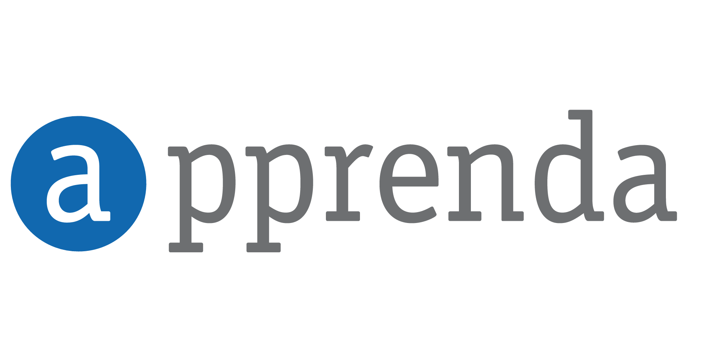
PLATINUM SPONSOR

Slide 6

PLATINUM SPONSOR

Slide 7

PLATINUM SPONSOR

Slide 8
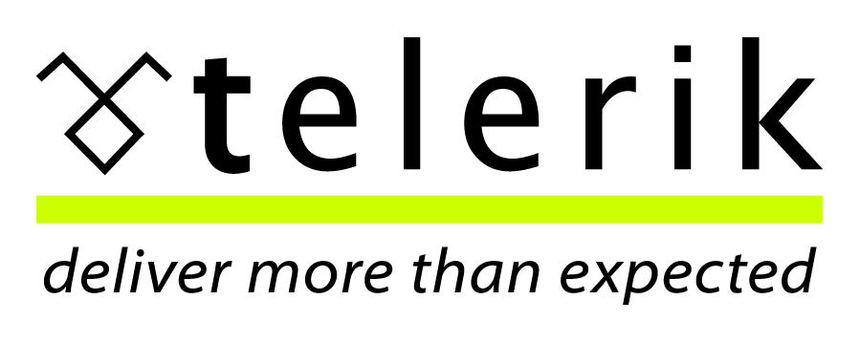
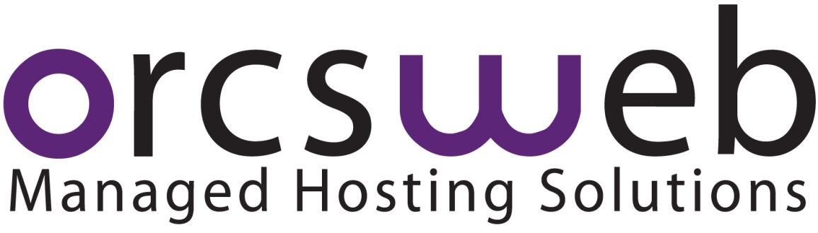
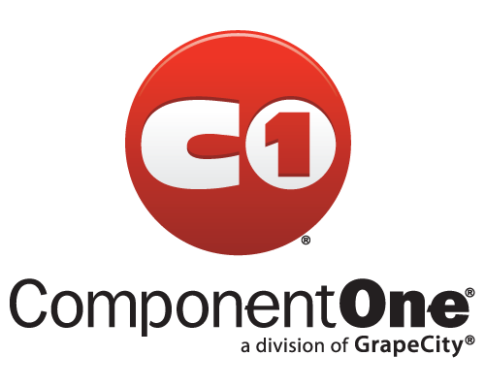

GOLD SPONSORS

Slide 9
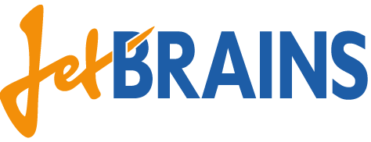



SILVER SPONSORS

Slide 10




Who is Bill Wilder?
www.cloudarchitecturepatterns.com
www.bostonazure.org
www.devpartners.com

Slide 11
I will ass-u-me…
You know what “the cloud” is
You have an inkling about Amazon Web Services and Windows Azure cloud platforms
You understand that such cloud platforms include compute services [like hosted virtual machines (VMs), in both IaaS and PaaS modes], SQL and NoSQL database services, file storage services, messaging, DNS, management, etc.
You are interested in understanding cloud-native applications

Slide 12


Roadmap for rest of talk… …
Give context and definition for cloud-native
Cover three specific patterns for building cloud-native applications
Mention several other patterns
Q&A during talk is okay (time permitting)
Q&A at end with any remaining time
Also feel free to join me for lunch to talk cloud
?

Slide 13
Cloud Platform Characteristics
Scaling – or “resource allocation” – is horizontal
  and ∞ (“illusion of infinite resources”)
Resources are easily added or released
  self-service portal or API; cloud scaling is automatable
Pay only for currently allocated resources
  costs are operational, granular, controllable, and transparent
Optimized for cost-efficiency
  cloud services are MT, hardware is commodity
  MTTR over MTTF
Rich, robust functionality is simply accessible
  like an iceberg

Slide 14

Notes:
According to wikipedia (http://en.wikipedia.org/wiki/Iceberg) “typically only one-ninth of the volume of an iceberg is above water”
Iceberg comment not specific to CLOUD NATIVE – but just a reminder to the power of the CLOUD
Photo credit: http://www.google.com/imgres?um=1&hl=en&sa=N&rlz=1T4LENP_en___US500&authuser=0&biw=891&bih=523&tbm=isch&tbnid=1BxlWrruELYaHM:&imgrefurl=http://en.wikipedia.org/wiki/Iceberg&docid=k523zeCMtANx3M&imgurl=http://upload.wikimedia.org/wikipedia/commons/thumb/a/ac/Iceberg.jpg/170px-Iceberg.jpg&w=170&h=247&ei=MnhTULGpKOq_0AHgz4DQDQ&zoom=1&iact=hc&vpx=110&vpy=2&dur=6205&hovh=197&hovw=136&tx=85&ty=223&sig=111987214859213359670&page=1&tbnh=147&tbnw=104&start=0&ndsp=10&ved=1t:429,r:0,s:0,i:142

Slide 15
Cloud-Native Application Characteristics
  Application architecture is aligned with the cloud platform architecture
  uses the platform in the most natural way
  lets the platform do the heavy lifting
Are loosely coupled
  for scalability, reliability, and flexibility
Scale horizontally, automatically, bidirectionally
  maintaining UX and cost-optimizing
  scale operationally along with capacity
Handle busy signals and node failures
  without unnecessary UX degradation
Use geo-distribution services
  minimize network latency

Slide 16
Know the rules
“If I had asked people what they wanted, they would have said faster horses.”
- Henry Ford
Notes:
CNA is future
(late 1800s) 150,000 horses in NYC each producing 15-30 lbs of manure per day = 3 million pounds of horse manure per day…

Slide 17
Know the rules
“If I had asked IT departments what they wanted, they would have said IaaS.”
- Henry Cloud
Notes:
CNA is future
(late 1800s) 150,000 horses in NYC each producing 15-30 lbs of manure per day = 3 million pounds of horse manure per day…

Slide 18

Use the right tool for the job…
Better on water than
on land…. sorta
“unreliable”when
used on land.
Notes:
Canoe image: http://en.wikipedia.org/wiki/File:Morris-canoe-600.jpg

Slide 19
Modern Application Challenges
Scaling compute
Scaling data
Scaling geographically
Handling failure
… and all while maintaining User Experience (UX)
Example patterns we will review:
  Horizontal Scaling
  Queue-Centric Workflow
  Database Sharding
  Other patterns briefly as time permits

Slide 20
Pre-Cloud vs. Cloud-Native
Old-School vs. | Cloud-Native
Control | Efficiency
Stable/Static Hardware | Dynamic/∞ Resources
Fixed/CapEx | Variable/OpEx
Vertical Scaling | Horizontal Resourcing
Minimize MTBF | Minimize MTTR
Data Storage = RDBMS | Scenario-specific Storage
Manage Infrastructure | Managed Infrastructure
architectural concerns
Notes:
Not shown:
Strong Consistency vs. Eventual Consistency
MINDSET.. CHARACTERISTICS OF PRE-CLOUD vs. CLOUD-NATIVE
Efficiency: electrical grid, virtual machine-based, multi-tenant, commodity hardware - 1:15k (vs. 1:30 or at best 1:150)
Dynamic/∞ Resources: use cloud platform API to allocate or release resources; infinite resources available - but not all at once
Variable/OpEx: stop using, stop paying; pay for expanded use
Horizontal Resourcing: Similar to Scaling Out/Horizontal Scaling, except not just for scale… and bi-directional
Minimize MTTR: Failure is expected, be prepared to deal with it; partnership between CLOUD PLATFORM and YOUR APPLICATION ARCHITECTURE
Scenario-Specific Storage: Relational Database no longer one-size-fits-all. NoSQL, Blobs, CDN, Relational++ (auto-sharding)
Managed Infrastructure: “ManageD” – the “D” on the end changes everything… Want a database? - available on demand, here’s a connection string. Want application services like a Reliable Queue? – here’s its http address, feel free to start using it. LB – ready. Geo-LB – ready (and you may deploy to >1 datacenter too – maybe MANY if you use CDN).
These are REALLY IMPACTFUL DIFFERENCES and an application optimized to live in harmony with properities is CLOUD-NATIVE, and apps in harmony with the old properties is PRE-CLOUD

Slide 21
Horizontal Scaling Compute Pattern
pattern 1 of 3

Slide 22
What’s the difference between performance and scale?
?
Notes:
SLA, practical reasons

Slide 23
Scale Up (and Scale Down??) vs. Horizontal Resourcing
Common Terminology:
  Scaling Up/Down ⬄ Vertical Scaling
  Scaling Out/In ⬄ Horizontal “Scaling”
  → But really is Horizontal Resource Allocation
Architectural Decision
  Big decision… hard to change

Slide 24

Vertical Scaling (“Scaling Up”)
Resources that can be “Scaled Up”
Memory: speed, amount
CPU: speed, number of CPUs
Disk: speed, size, multiple controllers
Bandwidth: higher capacity pipe
… and it sure is EASY
.
Downsides of Scaling Up
Hard Upper Limit
HIGH END HARDWARE ➔ HIGH END CO$T
Lower value than “commodity hardware”
May have no other choice (architectural)

Slide 25
Scaling Horizontally: Adding Boxes
autonomous nodes
for scalability
(stateless web servers, shared nothing DBs, your custom code in QCW)

Slide 26
Example: Web Tier www.pageofphotos.com
Managed VMs
(Cloud Service)
Load Balancer
(Cloud Service)
Notes:
Architectural concerns
N>1
N+1
Reactive

Slide 27
Horizontal Scaling Considerations
Auto-Scale
  Bidirectional
Nodes can fail
Auto-Scale is only one cause
Handle shutdown signals
Stateless (“like a taxi”)
vs. Sticky Sessions
Stateless nodes
vs. Stateless apps
N+1 rule
vs. occasional downtime (UX)
Notes:
Architectural concerns
N>1
N+1
Reactive

Slide 28
How many users does your cloud-native application need before it needs to be able to horizontally scale?
?
Notes:
SLA, practical reasons

Slide 29
Queue-Centric Workflow Pattern
pattern 2 of 3
(QCW for short)

Slide 30
Extend www.pageofphotos.com example into next Tier
QCW enables applications where the UI and back-end services are Loosely Coupled
(Compare to CQRS at the end)

Slide 31
QCW Example: User Uploads Photo www.pageofphotos.com
Web Server
Compute Service
Reliable Queue
Reliable Storage
Notes:
AJAX – orthogonal concern
Worker Role not related to HTML 5 concept of Web Worker

Slide 32
QCW
WE NEED:
Compute (VM) resources to run our code
Reliable Queue to communicate
Durable/Persistent Storage

Slide 33
Where does Windows Azure fit?

Slide 34
QCW [on Windows Azure]
WE NEED:
Compute (VM) resources to run our code
  Web Roles (IIS) and Worker Roles (w/o IIS)
Reliable Queue to communicate
  Azure Storage Queues
Durable/Persistent Storage
  Azure Storage Blobs & Tables; WASD

Slide 35



QCW on Azure: User Uploads a Photo
push
pull
Web
Role
(IIS)
Worker
Role
www.pageofphotos.com
Azure Queue
Azure Blob
UX implications: user does not wait for thumbnail
(architecture!)
Notes:
AJAX – orthogonal concern
Worker Role not related to HTML 5 concept of Web Worker
“Thumbnails” sample code available from http://code.msdn.microsoft.com/windowsazuresamples

Slide 36
QCW enables Responsive UX
Response to interactive users is as fast as a work request can be persisted
Time consuming work done asynchronously
Comparable total resource consumption, arguably better subjective UX
UX challenge – how to express Async to users?
  Communicate Progress
  Display Final results
  Long Polling/Web Sockets (e.g., SignalR or Node.io)

Slide 37
QCW enables Scalable App
Decoupled front/back provides insulation
  Blocking is Bane of Scalability
  Order processing partner doing maintenance
  Twitter down
  Email server unreachable
  Internet connectivity interruption
Loosely coupled, concern-independent scaling
  (see next slide)
  Get Scale Units right

Slide 38
General Case:
Many Roles, Many Queues
Worker
Role
Web
Role
(Admin)
Worker
Role
Worker
Role
Queue Type 1
Worker
Role Type 1
Queue Type 1
Web
Role
(Public)
Queue Type 2
Web
Role
(IIS)
Queue Type 2
Web
Role
(IIS)
Worker
Role
Worker
Role
Worker
Role
Queue Type 3
Worker
Role Type 2
Worker
Role Type 2
Worker
Role Type 2
Worker
Role Type 2
Scaling best when Investment α Benefit
Optimize for CO$T EFFICIENCY
  Logical vs. Physical Architecture

Slide 39
Reliable Queue & 2-step Delete
var url = “http://pageofphotos.blob.core.windows.net/up/<guid>.png”;
queue.AddMessage( new CloudQueueMessage( url ) );
(IIS)
Web
Role
Worker
Role
Queue
var invisibilityWindow = TimeSpan.FromSeconds( 10 );
CloudQueueMessage msg =
queue.GetMessage( invisibilityWindow );
(… do some processing then …)
queue.DeleteMessage( msg );
Notes:
AJAX – orthogonal concern
Worker Role not related to HTML 5 concept of Web Worker

Slide 40
QCW requires Idempotent
Perform idempotent operation more than once, end result same as if we did it once
Example with Thumbnailing (easy case)
App-specific concerns dictate approaches
  Compensating action, Last write wins, etc.
PARTNERSHIP: division of responsibility between cloud platform & app
  Far cry from database transaction

Slide 41
QCW expects Poison Messages
A Poison Message cannot be processed
  Error condition for non-transient reason
  Use dequeue count property
Be proactive
  Falling off the queue may kill your system
Determine a Max Retry policy per queue
  Delete, put on “bad” queue, alert human, …

Slide 42
QCW requires “Plan for Failure”
VM restarts will happen
  Hardware failure, O/S patching, crash (bug)
Bake in handling of restarts into our apps
  Restarts are routine: system “just keeps working”
  Idempotent support needed important
  Event Sourcing (commonly seen with CQRS) may help
Not an exception case! Expect it!
Consider N+1 Rule
Notes:
Windows Azure: Fabric Controller honors Fault Domains

Slide 43


What’s Up? Reliability as EMERGENT PROPERTY
 | Typical Site | Any 1 Role Inst | Overall System
Operating System Upgrade
Application Code Update
Scale Up, Down, or In
Hardware Failure
Software Failure (Bug)
Security Patch
Notes:
Tech Windows

Slide 44
Aside: Is QCW same as CQRS?
Short answer: “no”
CQRS
  Command Query Responsibility Segregation
Commands change state
Queries ask for current state
Any operation is one or the other
Sometimes includes Event Sourcing
Sometimes modeled using Domain Driven Design (DDD)

Slide 45
What about the DATA?
You: Azure Web Roles and Azure Worker Roles
  Taking user input, dispatching work, doing work
  Follow a decoupled queue-in-the-middle pattern
  Stateless compute nodes
Cloud: “Hard Part”: persistent, scalable data
  Azure Queue & Blob Services
  Three copies of each byte
  Blobs are geo-replicated
  Busy Signal Pattern

Slide 46
Database Sharding Pattern
pattern 3 of 3

Slide 47

Foursquare is a Social Network

Slide 48

Foursquare #Fail
October 4, 2010 – trouble begins…
After 17 hours of downtime over two days…
  “Oct. 5 10:28 p.m.: Running on pizza and Red Bull. Another long night.”
  WHAT WENT WRONG?
Notes:
Social Check-in Site Foursquare
32 employees (at the time)
10Gen
Small company
Microsoft
BIG COMPANY (how many of the 90k employees work on SQL Server?)
http://blog.foursquare.com/2010/10/05/so-that-was-a-bummer/
http://highscalability.com/blog/2010/10/15/troubles-with-sharding-what-can-we-learn-from-the-foursquare.html

Slide 49
What is Sharding?
Problem: one database can’t handle all the data
  Too big, not performant, needs geo distribution, …
Solution: split data across multiple databases
  One Logical Database, multiple Physical Databases
Each Physical Database Node is a Shard
Most scalable is Shared Nothing design
  May require some denormalization (duplication)
Notes:
[Not same as Data Warehouse or Reporting DB]

Slide 50
All shard have same schema
SHARDS

Slide 51
Sharding is Difficult
What defines a shard? (Where to put stuff?)
  Example – use country of origin: customer_us, customer_fr, customer_cn, customer_ie, …
  Use same approach to find records
What happens if a shard gets too big?
  Rebalancing shards can get complex
  Foursquare case study is interesting
Query / join / transact across shards
Cache coherence, connection pool management

Slide 52
Where does Windows Azure fit?

Slide 53
Windows Azure SQL Database (WASD) is SQL Server Except…
SQL Server
Specific
(for now)
WASD
Specific
Limitations
150 GB size limit
Busy Signal Pattern
Colocation Pattern
New Capabilities
Managed Service
Highly Available
Rental model
Federations
Common
Full Text Search
Native Encryption
Many more…
“Just change the connection string…”
Additional information on Differences:
    http://msdn.microsoft.com/en-us/library/ff394115.aspx
Notes:
http://social.technet.microsoft.com/wiki/contents/articles/inside-sql-azure.aspx
“Another feature in development is the ability to take control of your backups. Currently, backups are performed in the data centers to protect your data against disk or system problems. However, there is no way currently to control your own backups to provide protection against logical errors and use a RESTORE operation to return to an earlier point in time when a backup was made. The new feature involves the ability to make your own backups of your SQL Azure databases to your own on-premises storage, and the ability to restore those backups either to an on-premises database or to a SQL Azure database. Eventually Microsoft plans to provide the ability to perform SQL Azure backups across data centers and also make log backups so that point-in-time recovery can be implemented.” http://social.technet.microsoft.com/wiki/contents/articles/inside-sql-azure.aspx

Slide 54
Windows Azure SQL Databse Federations for Sharding
Single “master” database
  “Query Fanout” makes partitions transparent
  Instead of customer_us, customer_fr, etc… we are back to customer database
Handles redistributing shards
Handles cache coherence
Simplifies connection pooling
No MERGE, only SPLIT currently
http://blogs.msdn.com/b/cbiyikoglu/archive/2011/01/18/sql-azure-federations-robust-connectivity-model-for-federated-data.aspx
Notes:
http://blogs.msdn.com/b/cbiyikoglu/archive/2011/01/18/sql-azure-federations-robust-connectivity-model-for-federated-data.aspx

Slide 55
Foursquare #Fail
  Foursquare was implementing database sharding in the application layer.
  WASD Federations makes this unnecessary.
  WHAT WENT WRONG?
Notes:
Social Check-in Site Foursquare
32 employees (at the time)
10Gen
Small company
Microsoft
BIG COMPANY (how many of the 90k employees work on SQL Server?)
http://blog.foursquare.com/2010/10/05/so-that-was-a-bummer/
http://highscalability.com/blog/2010/10/15/troubles-with-sharding-what-can-we-learn-from-the-foursquare.html

Slide 56
My database instance is limited to 150 GB.
∞ ∞ ∞
Does that mean the cloud doesn’t really offer the illusion of infinite resources?
?

Slide 57
Pre-Cloud vs. Cloud-Native
Lessons: being | Cloud-Native
1:15,000 | Efficiency
Auto-Scaling via API | Dynamic/∞ Resources
Pay-As-You-Go | Variable/OpEx
Stateless, Autonomous | Horizontal Resourcing
N+1, Idempotent | Minimize MTTR
SQL, NoSQL, Blob | Scenario-specific Storage
VM, Storage, LB, DR | Managed Infrastructure
Notes:
Not shown:
Strong Consistency vs. Eventual Consistency
MINDSET.. CHARACTERISTICS OF PRE-CLOUD vs. CLOUD-NATIVE
Efficiency: electrical grid, virtual machine-based, multi-tenant, commodity hardware - 1:15k (vs. 1:30 or at best 1:150)
Dynamic/∞ Resources: use cloud platform API to allocate or release resources; infinite resources available - but not all at once
Variable/OpEx: stop using, stop paying; pay for expanded use
Horizontal Resourcing: Similar to Scaling Out/Horizontal Scaling, except not just for scale… and bi-directional
Minimize MTTR: Failure is expected, be prepared to deal with it; partnership between CLOUD PLATFORM and YOUR APPLICATION ARCHITECTURE
Scenario-Specific Storage: Relational Database no longer one-size-fits-all. NoSQL, Blobs, CDN, Relational++ (auto-sharding)
Managed Infrastructure: “ManageD” – the “D” on the end changes everything… Want a database? - available on demand, here’s a connection string. Want application services like a Reliable Queue? – here’s its http address, feel free to start using it. LB – ready. Geo-LB – ready (and you may deploy to >1 datacenter too – maybe MANY if you use CDN).
These are REALLY IMPACTFUL DIFFERENCES and an application optimized to live in harmony with properities is CLOUD-NATIVE, and apps in harmony with the old properties is PRE-CLOUD

Slide 58
Know the rules
“Know the rules well, so you can break them effectively.”
- Dalai Lama XIV

Slide 59
Cloud Architecture Patterns book
Primer Chapters
Scalability
Eventual Consistency
Multitenancy and Commodity Hardware
Network Latency

Slide 60
Cloud Architecture Patterns book
Pattern Chapters
Horizontally Scaling Compute Pattern
Queue-Centric Workflow Pattern
Auto-Scaling Pattern
MapReduce Pattern
Database Sharding Pattern
Busy Signal Pattern
Node Failure Pattern
Colocate Pattern
Valet Key Pattern
CDN Pattern
Multisite Deployment Pattern

Slide 61
Questions?
Comments?
More information?
?

Slide 62
BostonAzure.org
Boston Azure cloud user group
  Focused on Microsoft’s PaaS cloud platform
Monthly, 6:00-8:30 PM in Boston area
  Food; wifi; free; great topics; growing community
Follow on Twitter: @bostonazure
More info or to join our Meetup.com group:
http://www.bostonazure.org

Slide 63
Contact Me
Looking for …
consulting help with Windows Azure Platform?
someone to bounce Azure or cloud questions off?
a speaker for your user group or company technology event?
Just Ask!
Bill Wilder
@codingoutloud
http://blog.codingoutloud.com
community inquiries: codingoutloud@gmail.com
business inquiries: www.devpartners.com

Slide 65
DONE

Slide 66

Notes:
Subliminal … 0.25

