Slide 1
Cloud-Native Architecture Patterns
(Or… why your pre-cloud architecture won’t work so well in the cloud)
Examples drawn from Windows Azure cloud platform
Azure Florida Association
28-March-2012
Boston Azure User Group
http://www.bostonazure.org
@bostonazure
Bill Wilder
http://blog.codingoutloud.com
@codingoutloud
Notes:
We can run pre-cloud software on cloud infrastructure, but to truly take advantage of the cloud we need to build cloud-native applications. The architecture of a cloud-native application is different than the architecture of a traditional pre-cloud application, and in this talk we will examine several big ideas in software architecture you need to 'grok' if you want to truly leverage the cloud for cost savings, higher availability, and better scalability. We will examine several key architecture patterns that help unlock those cloud-native benefits, spanning computation, database, and resource-focused patterns. By the end of the talk you should appreciate how cloud architecture is more of a partnership with your hardware than it was with pre-cloud applications (fail-retry anyone?), that the cloud may be infinite (but not all at once), and how the cloud enables cost optimization (and is "green").

Slide 2



Bill Wilder
Boston Azure User Group Founder
Windows Azure Consultant
http://blog.codingoutloud.com
@codingoutloud
Windows Azure MVP
Cloud Architecture Patterns book (due 2012)

Slide 3
The Big Ideas
Horizontal over Vertical
MTTR over MTBF
Eventual over Strong
Where Azure Fits
Notes:
Scaling Data
SQL Azure != SQL Server – 5 minutes
Query Fanout – 5 minutes
NoSQL, Table Storage – 10 minutes (mention Eventual Consistency)
Scaling Compute
Roles & Queues – 5 minutes
Scalability Pattern – 10 minutes (mention scale unit)

Slide 4
What’s the Big Idea?
scale compute

Slide 5
What does it mean to Scale?
  Scale != Performance
    Scalable iff Performance constant as it grows
  Scale the Number of Users
  … Volume of Data
  … Across Geography
  Scale can be bi-directional (more or less)
  Investment α Benefit
Notes:
Same performance when system is managing x units as with 10x, 100x, 1000x …
Scale ⬄ availability, durability (failures will happen), throughput, and capacity

Slide 6
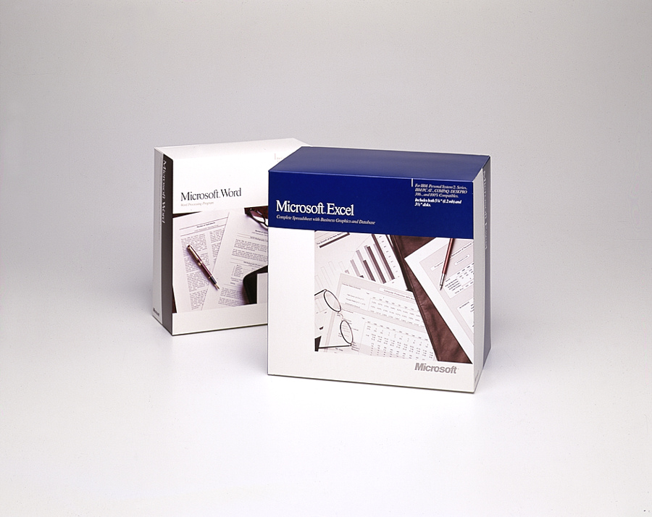
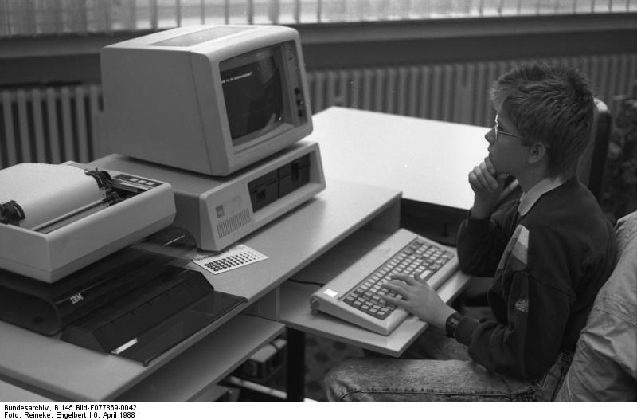
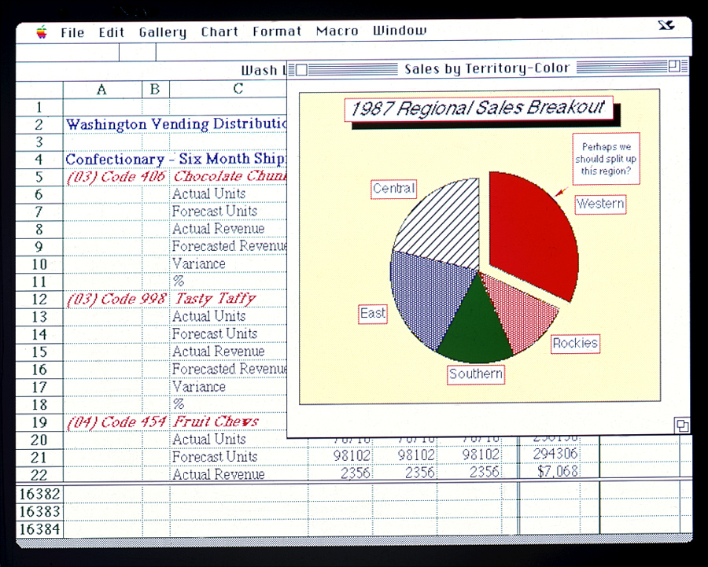
Old School Excel and Word
Notes:
Image credits/sources:
http://www.flickr.com/photos/microsoftsweden/5394688397/
http://en.wikipedia.org/wiki/File:Bundesarchiv_B_145_Bild-F077869-0042,_Jugend-Computerschule_mit_IBM-PC.jpg
http://www.flickr.com/photos/microsoftsweden/5395284268/

Slide 7
Options: Scale Up (and Scale Down) or Scale Out (and Scale In)
Terminology:
  Scaling Up/Down == Vertical Scaling
  Scaling Out/In == Horizontal Scaling
Architectural Decision
  Big decision… hard to change

Slide 8

Scaling Up: Scaling the Box
.

Slide 9
Scaling Out: Adding Boxes
autonomous nodes
scale best

Slide 10
How do I Choose???? ??????
.
Scale Up
(Vertically)
Scale Out
(Horizontally)
…
Not either/or!
Part business, part technical decision (requirements and strategy)
Consider Reliability (and SLA in Azure)
Target VM size that meets min or optimal CPU, bandwidth, space

Slide 11
Where does Azure fit?
scale compute

Slide 12
Queue-Centric Workflow Pattern
Enables systems where the UI and back-end services are Loosely Coupled
(Compare to CQRS at the end)

Slide 13
QCW in Windows Azure
WE NEED:
Compute resource to run our code
  Web Roles (IIS) and Worker Roles (w/o IIS)
Reliable Queue to communicate
  Azure Storage Queues
Durable/Persistent Storage
  Azure Storage Blobs & Tables; SQL Azure

Slide 14
QCW in Action
Web Server
Compute Service
Reliable Queue
Reliable Storage
Notes:
AJAX – orthogonal concern
Worker Role not related to HTML 5 concept of Web Worker

Slide 15



Familiar Example: Thumbnailer
Web
Role
(IIS)
Worker
Role
Azure Queue
Azure Blob
UX implications: user does not wait for thumbnail
Notes:
AJAX – orthogonal concern
Worker Role not related to HTML 5 concept of Web Worker
“Thumbnails” sample code available from http://code.msdn.microsoft.com/windowsazuresamples

Slide 16
QCW enables Responsive
Response to interactive users is as fast as a work request can be persisted
Time consuming work done asynchronously
Comparable total resource consumption, arguably better subjective UX
UX challenge – how to express Async to users?
  Communicate Progress
  Display Final results

Slide 17
QCW enables Scalable
Loosely coupled, concern-independent scaling
  Get Scale Units right
Blocking is Bane of Scalability
  Decoupled front/back ends insulate from other system issues if…
    Order processing partner doing maintenance
    Twitter down
    Email server unreachable
    Internet connectivity interruption

Slide 18
General Case:
Many Roles, Many Queues
Worker
Role
Worker
Role
Worker
Role
Queue Type 1
Worker
Role Type 1
Web
Role
(IIS)
Queue Type 1
Web
Role
(IIS)
Web
Role
(IIS)
Queue Type 2
Queue Type 2
Worker
Role
Worker
Role
Worker
Role
Queue Type 3
Worker
Role Type 2
Worker
Role Type 2
Worker
Role Type 2
Worker
Role Type 2
Remember: Investment α Benefit
Optimize for CO$T EFFICIENCY
  Logical vs. Physical Architecture

Slide 19

QCW enables Distribution
  Scale out systems better suited than monolithic for geographic distribution
  More granular → flexible
  Reduce latency via geographic distribution
  Failure need not be binary
Notes:
Chainsaw: http://commons.wikimedia.org/wiki/File:Chainsaw_cutting_tree.jpg

Slide 20
From QCW ➔ CQRS
CQRS
  Command Query Responsibility Segregation
Commands change state
Queries ask for current state
Any operation is one or the other
Usually includes Event Sourcing
Usually modeled using Domain Driven Design (DDD)

Slide 21
What’s the Big Idea?
#fail

Slide 22


MTBF… vs. MTTR…
Notes:
Boots from posterous.wilderclan.com
Sneakers: http://www.flickr.com/photos/pinksherbet/3504943955/

Slide 23
Degrees of Failure
My Virtual Machine
  Hardware failure
  Software failure
  Restart
[Cloud] Service or Service Network
  Retry
Datacenter
  Recover (?)

Slide 24
Where does Azure fit?
#fail

Slide 25
Familiar Example: Thumbnailer
Web
Role
(IIS)
Worker
Role
Azure Queue
Azure Blob
UX implications: user does not wait for thumbnail
Notes:
AJAX – orthogonal concern
Worker Role not related to HTML 5 concept of Web Worker
“Thumbnails” sample code available from http://code.msdn.microsoft.com/windowsazuresamples

Slide 26
Reliable Queue & 2-step Delete
var url = “http://myphotoacct.blob.core.windows.net/up/<guid>.png”;
queue.AddMessage( new CloudQueueMessage( url ) );
(IIS)
Web
Role
Worker
Role
Queue
var invisibilityWindow = TimeSpan.FromSeconds( 10 );
CloudQueueMessage msg =
queue.GetMessage( invisibilityWindow );
queue.DeleteMessage( msg );
Notes:
AJAX – orthogonal concern
Worker Role not related to HTML 5 concept of Web Worker

Slide 27
QCW requires Idempotent
Perform idempotent operation more than once, end result same as if we did it once
Example with Thumbnailing (easy case)
App-specific concerns dictate approaches
  Compensating transactions
  Last in wins
  Many others possible – hard to say

Slide 28
QCW expects Poison Messages
A Poison Message cannot be processed
  Error condition for non-transient reason
  Detect via CloudQueueMessage.DequeueCount property
Be proactive
  Falling off the queue may kill your system
    Message TTL = 7 days by default in Azure
Determine a Max Retry policy
  May differ by queue object type or other criteria
  Then what? Delete, move to “bad” queue, alert human, …

Slide 29
CQRS requires “Plan for Failure”
There will be VM (or Azure role) restarts
  Hardware failure, O/S patching, crash (bug)
Fabric Controller honors Fault Domains
Bake in handling of restarts into our apps
  Restarts are routine: system “just keeps working”
  Idempotent support important again
Not an exception case! Expect it!

Slide 30


What’s Up? Reliability as EMERGENT PROPERTY
 | Typical Site | Any 1 Role Inst | Overall System
Operating System Upgrade
Application Code Update
Scale Up, Down, or In
Hardware Failure
Software Failure (Bug)
Security Patch
Notes:
Tech Windows

Slide 31
What about the DATA?
You: Azure Web Roles and Azure Worker Roles
  Taking user input, dispatching work, doing work
  Follow a decoupled queue-in-the-middle pattern
  Stateless compute nodes
“Hard Part”: persistent data, scalable data
  Azure Queue, Blob, Table, SQL Azure
  Three copies of each byte
  Blobs and Tables geo-replicated
  Retry and Throttle!

Slide 32
Retrying
Retry Logic for Transient Failures in SQL Azure
http://social.technet.microsoft.com/wiki/contents/articles/retry-logic-for-transient-failures-in-sql-azure.aspx
Overview of Retry Policies in .NET SDK
http://blogs.msdn.com/b/windowsazurestorage/archive/2011/02/03/overview-of-retry-policies-in-the-windows-azure-storage-client-library.aspx
http://msdn.microsoft.com/en-us/library/microsoft.windowsazure.storageclient.cloudblobclient.retrypolicy.aspx

Slide 33
What’s the Big Idea?
scale data

Slide 34

Foursquare #Fail
October 4, 2010 – trouble begins…
After 17 hours of downtime over two days…
  “Oct. 5 10:28 p.m.: Running on pizza and Red Bull. Another long night.”
  WHAT WENT WRONG?
Notes:
Social Check-in Site Foursquare
32 employees (at the time)
10Gen
Small company
Microsoft
BIG COMPANY (how many of the 90k employees work on SQL Server?)
http://blog.foursquare.com/2010/10/05/so-that-was-a-bummer/
http://highscalability.com/blog/2010/10/15/troubles-with-sharding-what-can-we-learn-from-the-foursquare.html

Slide 35
What is Sharding?
Problem: one database can’t handle all the data
  Too big, not performant, needs geo distribution, …
Solution: split data across multiple databases
  One Logical Database, multiple Physical Databases
Each Physical Database Node is a Shard
Most scalable is Shared Nothing design
  May require some denormalization (duplication)
Notes:
[Not same as Data Warehouse or Reporting DB]

Slide 36
Sharding is Difficult
What defines a shard? (Where to put stuff?)
  Example by geography: customer_us, customer_fr, customer_cn, customer_ie, …
  Use same approach to find records
What happens if a shard gets too big?
  Rebalancing shards can get complex
  Foursquare case study is interesting
Query / join / transact across shards
Cache coherence, connection pool management

Slide 37
Where does Azure fit?
scale data

Slide 38
SQL Azure is SQL Server Except…
SQL Server
Specific
(for now)
SQL Azure
Specific
Limitations
150 GB size limit
New Capabilities
Highly Available
Rental model
Coming: Backups & point-in-time recovery
SQL Azure Federations
More…
Common
Full Text Search
Native Encryption
Many more…
“Just change the connection string…”
Additional information on Differences:
    http://msdn.microsoft.com/en-us/library/ff394115.aspx
Notes:
http://social.technet.microsoft.com/wiki/contents/articles/inside-sql-azure.aspx
“Another feature in development is the ability to take control of your backups. Currently, backups are performed in the data centers to protect your data against disk or system problems. However, there is no way currently to control your own backups to provide protection against logical errors and use a RESTORE operation to return to an earlier point in time when a backup was made. The new feature involves the ability to make your own backups of your SQL Azure databases to your own on-premises storage, and the ability to restore those backups either to an on-premises database or to a SQL Azure database. Eventually Microsoft plans to provide the ability to perform SQL Azure backups across data centers and also make log backups so that point-in-time recovery can be implemented.” http://social.technet.microsoft.com/wiki/contents/articles/inside-sql-azure.aspx

Slide 39
SQL Azure Federations for Sharding
Single “master” database
  “Query Fanout” makes partitions transparent
  Instead of customer_us, customer_fr, etc… we are back to customer database
Handles redistributing shards
Handles cache coherence
Simplifies connection pooling
Recently released!
http://blogs.msdn.com/b/cbiyikoglu/archive/2011/01/18/sql-azure-federations-robust-connectivity-model-for-federated-data.aspx
Notes:
http://blogs.msdn.com/b/cbiyikoglu/archive/2011/01/18/sql-azure-federations-robust-connectivity-model-for-federated-data.aspx

Slide 40
What’s the Big Idea?
big data

Slide 41

Five exabytes of data created every two days
- Eric Schmidt
(CEO Google at the time)
As much as from the dawn of civilization up until 2003
Notes:
Photo of Eric Schmidt from wikipedia page: http://en.wikipedia.org/wiki/File:Eric_Schmidt_at_the_37th_G8_Summit_in_Deauville_037.jpg
Quote about data from http://techcrunch.com/2010/08/04/schmidt-data/

Slide 42









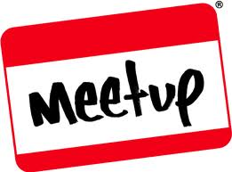
“Big Data” Challenge
Three Vs
Volume → lots of it already
Velocity → more of it every day
Variety → many sources, many formats

Slide 43

Short History of Hadoop //////
1. Inspired by:
Google Map/Reduce paper
  http://research.google.com/archive/mapreduce.html
Google File System (GFS)
  Goals: distributed, fault tolerant, fast enough
2. Born in: Lucene Nutch project
Built in Java
Hadoop cluster appears as single über-machine

Slide 44
Hadoop: batch processing, big data
Batch, not real-time or transactional
Scale out with commodity hardware
Big customers like LinkedIn and Yahoo!
  Clusters with 10s of Petabytes
    (pssst… these fail… daily)
Import data from Azure Blob, Data Market , S3
  Or from files, like we will do in our example

Slide 45
Where does Azure fit?
big data

Slide 46
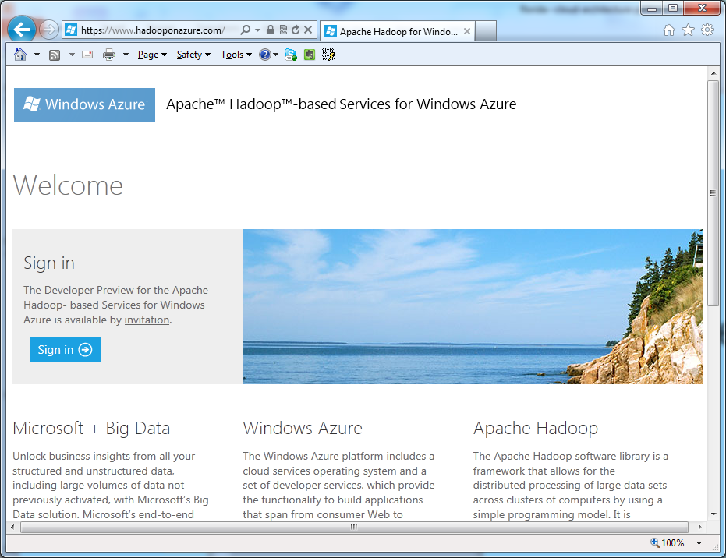
Hadoop on Azure

Slide 47
Hadoop on Azure
http://www.hadooponazure.com/

Slide 48
done
questions

Slide 49
Questions?
Comments?
More information?
?

Slide 50
Bill Wilder
Boston Azure User Group Founder
Windows Azure Consultant
http://blog.codingoutloud.com
@codingoutloud
Windows Azure MVP
Cloud Architecture Patterns book (due 2012)

Slide 51
done
done
(really done)

Slide 52
done
done
(really done)

Slide 54
Questions?
Comments?
More information?
?

Slide 55
BostonAzure.org
Boston Azure cloud user group
  Focused on Microsoft’s PaaS cloud platform
Late Thursday, monthly, 6:00-8:30 PM at NERD
  Food; wifi; free; great topics; growing community
Boston Azure Boot Camp: June 2012 (planning)
Follow on Twitter: @bostonazure
More info or to join our Meetup.com group:
http://www.bostonazure.org

Slide 56
Contact Me
Looking for …
consulting help with Windows Azure Platform?
someone to bounce Azure or cloud questions off?
a speaker for your user group or company technology event?
Just Ask!
Bill Wilder
@codingoutloud
http://blog.codingoutloud.com

