Slide 1

Big Ideas in Software Architecture (in cloud or otherwise)
Examples drawn from Windows Azure cloud platform
14-December-2011
Boston Azure User Group
http://www.bostonazure.org
@bostonazure
Bill Wilder
http://blog.codingoutloud.com
@codingoutloud

Slide 2
Topics
Quickly introduce myself (10 minutes ☺)
Cloud in Context (5 min + ?)
Quick Windows Azure Overview (5 min + ?)
Big Ideas in Cloud Architecture (45 min + ?)

Slide 3


Bill Wilder
Boston Azure User Group Founder
Windows Azure Consultant
Windows Azure MVP

Slide 4
“Bring Your Own” ____ as a Service
BYO
Users
BYO
Applications
BYO
Virtual Machines
SaaS➔
PaaS➔
IaaS➔

Slide 5
NIST – Cloud Platform Taxonomy
Public Cloud
Deployment Models
Hybrid Cloud
Community Cloud
Private Cloud
Essential Characteristics
Infrastructure as a Service
Platform as a Service
Broad network
access
Rapid Elasticity
Service Models
Software as a Service
Resource Pooling
On-demand self-service
Measured service
Notes:
From Jim O’Neil’s presentation to Boston Azure user group on Sept 29, 2011
http://csrc.nist.gov/publications/drafts/800-145/Draft-SP-800-145_cloud-definition.pdf

Slide 6
“Bring Your Own” ____ as a Service
BYO
Users
BYO
Applications
BYO
Virtual Machines
SaaS➔
⬅
less
Responsibility &
Choice
PaaS➔
more
➔
IaaS➔

Slide 7
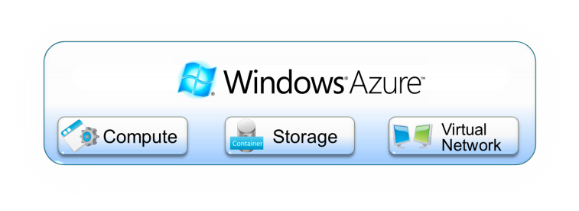

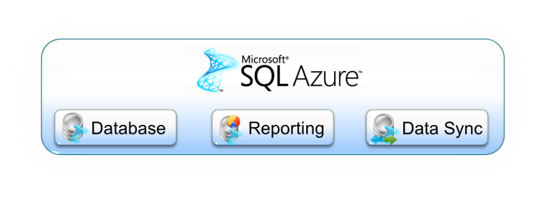



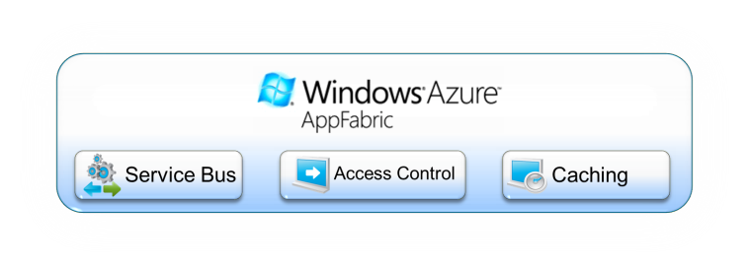



Windows Azure is Feature Rich
iOS Toolkit
Android Toolkit
Windows Phone Toolkit
Notes:
Whether an application runs in the cloud, uses services provided by the cloud, or both, some kind of application platform is required. Viewed broadly, an application platform can be thought of as anything that provides developer-accessible services for creating applications. In the local, on-premises Windows world, for example, this includes technologies such as the .NET Framework, SQL Server, and more. To let applications exploit the cloud, cloud application platforms must also exist. And because there are a variety of ways for applications to use cloud services, different kinds of cloud platforms are useful in different situations. Microsoft’s Windows Azure platform is a group of cloud technologies, each providing a specific set of services to application developers. The Windows Azure platform can be used both by applications running in the cloud and by applications running on local systems.
The components of the Windows Azure platform can be used by local applications running on a variety of systems, including various flavors of Windows, mobile devices, and others. Those components include:
■ Windows Azure: Provides a Windows-based environment for running applications and storing data on servers in Microsoft data centers.
■ Microsoft SQL Azure: Provides data services in the cloud based on SQL Server.
■ Microsoft Azure platform App Fabric: Offers distributed infrastructure services to cloud-based and local applications.
Each component of the Windows Azure platform has its own role to play. This overview describes all four, first at a high level, then in a bit more detail.

Slide 8
Windows Azure is Feature Rich
iOS Toolkit
Android Toolkit
Windows Phone Toolkit
Notes:
Whether an application runs in the cloud, uses services provided by the cloud, or both, some kind of application platform is required. Viewed broadly, an application platform can be thought of as anything that provides developer-accessible services for creating applications. In the local, on-premises Windows world, for example, this includes technologies such as the .NET Framework, SQL Server, and more. To let applications exploit the cloud, cloud application platforms must also exist. And because there are a variety of ways for applications to use cloud services, different kinds of cloud platforms are useful in different situations. Microsoft’s Windows Azure platform is a group of cloud technologies, each providing a specific set of services to application developers. The Windows Azure platform can be used both by applications running in the cloud and by applications running on local systems.
The components of the Windows Azure platform can be used by local applications running on a variety of systems, including various flavors of Windows, mobile devices, and others. Those components include:
■ Windows Azure: Provides a Windows-based environment for running applications and storing data on servers in Microsoft data centers.
■ Microsoft SQL Azure: Provides data services in the cloud based on SQL Server.
■ Microsoft Azure platform App Fabric: Offers distributed infrastructure services to cloud-based and local applications.
Each component of the Windows Azure platform has its own role to play. This overview describes all four, first at a high level, then in a bit more detail.

Slide 9
Compute Instance Size
Selectable Size defines CPU Cores, RAM, Local Storage, and Pricing
  Size configured in the Service Definition prior to packaging
Key considerations
  Don’t just throw big VMs at every problem
  Scale out architectures have natural parallelism
  More small instances == more redundancy
  Some scenarios will benefit from more cores
Size | CPU | Memory | Local Storage | I/O Performance | Cost/Hour
Extra Small | 1.0 GHz | 768 MB | 20 GB | Low | $0.04
Small | 1 x 1.6 GHz | 1.75 GB | 225 GB | Moderate | $0.12
Medium | 2 x 1.6 GHz | 3.5 GB | 490 GB | High | $0.24
Large | 4 x 1.6 GHz | 7 GB | 1,000 GB | High | $0.48
Extra Large | 8 x 1.6 GHz | 14 GB | 2,040 GB | High | $0.96

Slide 10


Role Types
Worker Role
Web Role
General purpose host for executing code or an executable
Implement code in a Run method
Similar to a Windows Service
Host your own web server, encoder, etc.
Typically used for background processing
Designed for web sites/services accessible using HTTP
Provides all features of a worker role and IIS 7 or 7.5
Execute ASP.NET, WCF, PHP, etc.
Can include multiple web sites in the same role
Optionally implement RoleEntryPoint

Slide 11
Hello Windows Azure
demo

Slide 12

Packaging & Deployment
Service Definition
Service Configuration
Service Package
Compute
Your Code

Slide 13

Service, Roles, and Instances
A service is a logical set of roles (up to 5)
Defined in the Service Definition at development time
Assigned a public URL (i.e. foo.cloudapp.net) at deployment
Service
Roles
Role defines the type of Virtual Machine that will be used to run each component of your application
Defined in the Service Definition at development time
An instance is a dedicated virtual machine instance that is running your code with your configuration
Instances are created by the Windows Azure fabric at runtime based on the roles defined in the service definition
Instances

Slide 14
Service Definition & Configuration
Operating System
  OS Family: Windows Server 2008 SP2 or Server 2008 R2
  OS Version: Specific version or automatically updated
Config Settings
  Name/value settings for a role
  <Setting name="WorkerSleepTime" value="2000" />
Endpoints
  Define network endpoints for inbound connectivity into a role
  <InputEndpointname="HttpIn" protocol="http" port="80" />
Startup Tasks
  Execute a script or exe to configure a role instance at startup
  <Task commandLine="InstallPHP.cmd" executionContext="elevated" taskType="simple"/>

Slide 15
Upgrading Your Application
VIP Swap
  Uses Staging and Production environments
  Allows to quickly swap environments
  Simply changes which deployment the load balancer uses to service requests
In-Place Upgrade
  Performs a rolling upgrade on live service
  Entire service or a single role
  Manual or Automatic across update domains

Slide 16
Windows Azure Storage Abstractions
Blobs: Simple named files along with metadata for the file
Drives: Durable NTFS volumes for Windows Azure applications to use. Based on Blobs.
Tables: Structured storage. A Table is a set of entities; an entity is a set of properties
Queues: Reliable storage and delivery of messages for an application

Slide 17
Now for some big ideas…

Slide 18
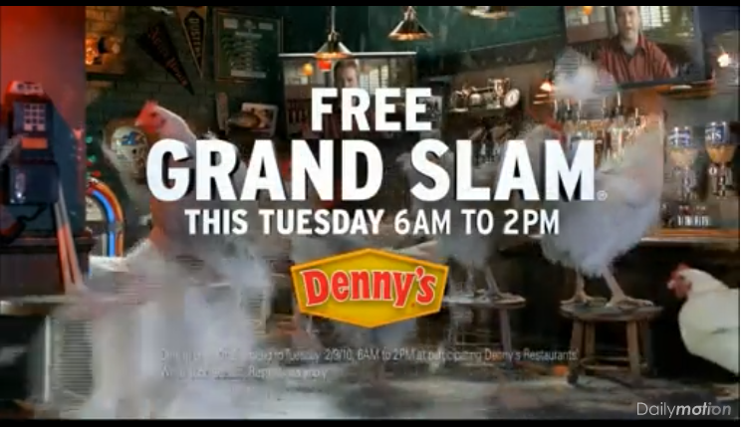
Superbowl Lessons
Dominos Pizza
Denny’s Restaurant
http://www.dailymotion.com/video/xc79z4_dennys-chickens-get-outta-town-supe_fun
Notes:
Denny’s:
http://www.thekmiecs.com/marketing-advertising/guest-post-the-impact-of-an-unavailable-web-site-dennyscom-superbowl/
http://www.planetc1.com/cgi-bin/n/v.cgi?c=1&id=1233547996

Slide 19

Notes:
http://en.wikipedia.org/wiki/File:Buzz_salutes_the_U.S._Flag.jpg

Slide 20
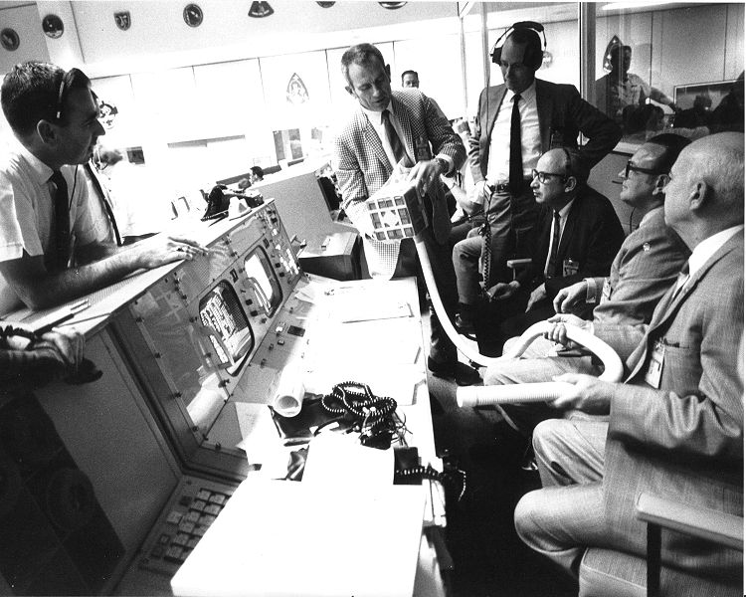
Failure IS an Option
Notes:
http://en.wikipedia.org/wiki/File:Apollo_13_Mailbox_at_Mission_Control.jpg

Slide 21
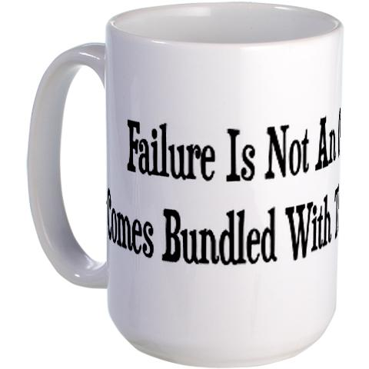
http://www.cafepress.com/+failure_is_not_an_option_large_mug,92179166?cmp=knc-pla-92179166&utm_term=92179166&utm_medium=cpc&pid=3607873&utm_source=google&utm_campaign=sem_product_feed&gclid=CLeK2ZXxiKwCFeUEQAodYi7n5Q
Notes:
http://www.cafepress.com/+failure_is_not_an_option_large_mug,92179166?cmp=knc-pla-92179166&utm_term=92179166&utm_medium=cpc&pid=3607873&utm_source=google&utm_campaign=sem_product_feed&gclid=CLeK2ZXxiKwCFeUEQAodYi7n5Q

Slide 22

Notes:
http://en.wikipedia.org/wiki/File:Mission_Control_celebrates_successful_splashdown_of_Apollo_13.jpg

Slide 23


Failure actually *is* an option…
MTBF -or- MTTR
Notes:
Boots from posterous.wilderclan.com
Sneakers: http://www.flickr.com/photos/pinksherbet/3504943955/

Slide 24
Failure actually *is* an option…
http://stackoverflow.com/questions/31466/does-amazon-s3-fail-sometimes
Perhaps “easier” than not failing?
Does not take team of “rocket scientists” to avoid failure
Some architecture patterns enable all at once: RESILIENCE, SCALE OUT, and a CLEAN SEPARATION of CONCERNS
Notes:
Q: How many times will a subscriber receive each message?Although most of the time each message will be delivered to your application exactly once, the distributed nature of Amazon SNS and transient network conditions could result in occasional, duplicate messages at the subscriber end. Developers should design their applications such that processing a message more than once does not create any errors or inconsistencies.
http://aws.amazon.com/sns/faqs/

Slide 25
Consistency
“A foolish consistency is the hobgoblin of little minds”
- Ralph Waldo Emerson, Self-Reliance Essay

Slide 26
Superbowl Lessons
Dominos Pizza
Denny’s Restaurant
http://www.dailymotion.com/video/xc79z4_dennys-chickens-get-outta-town-supe_fun
Notes:
Danny’s: http://www.thekmiecs.com/marketing-advertising/guest-post-the-impact-of-an-unavailable-web-site-dennyscom-superbowl/

Slide 27
What’s the Big Idea?
What is Scalability?
Scaling Data
Scaling Compute
Q&A
Notes:
Scaling Data
SQL Azure != SQL Server – 5 minutes
Query Fanout – 5 minutes
NoSQL, Table Storage – 10 minutes (mention Eventual Consistency)
Scaling Compute
Roles & Queues – 5 minutes
Scalability Pattern – 10 minutes (mention scale unit)

Slide 28
Key Concepts & Patterns
GENERAL
Scale vs. Performance
Scale Up vs. Scale Out
Shared Nothing
Design for Failure
DATABASE ORIENTED
ACID vs. BASE
Eventually Consistent
Sharding
Optimistic Locking
COMPUTE ORIENTED
CQRS Pattern
Poison Messages
Idempotency

Slide 29
Key Terms
Scale Up
Scale Out
Horizontal Scale
Vertical Scale
Scale Unit
ACID
CAP
Eventual Consistency
Strong Consistency
Multi-tenancy
NoSQL
Sharding
Denormalized
Poison Message
Idempotent
CQRS
Performance
Scale
Optimistic Locking
Shared Nothing
Load Balancing
Design for Failure

Slide 30
Overview of Scalability Topics
What is Scalability?
Scaling Data
Scaling Compute
Q&A
Notes:
Scaling Data
SQL Azure != SQL Server – 5 minutes
Query Fanout – 5 minutes
NoSQL, Table Storage – 10 minutes (mention Eventual Consistency)
Scaling Compute
Roles & Queues – 5 minutes
Scalability Pattern – 10 minutes (mention scale unit)

Slide 31
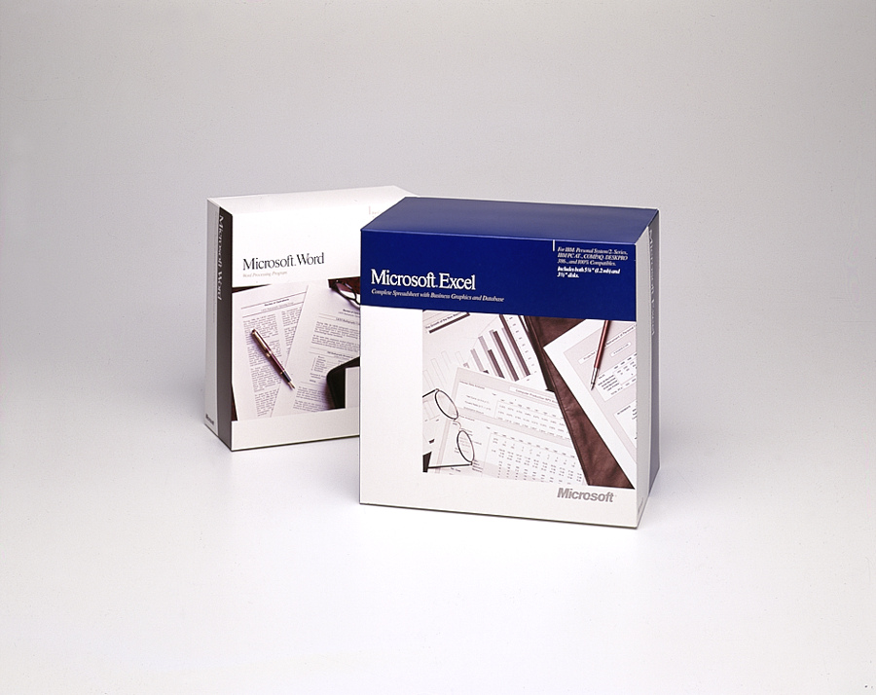
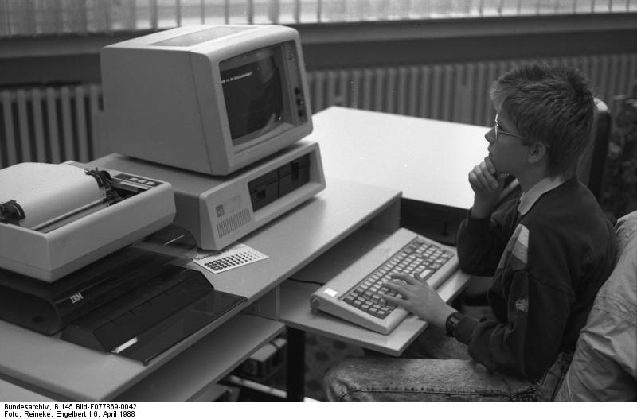
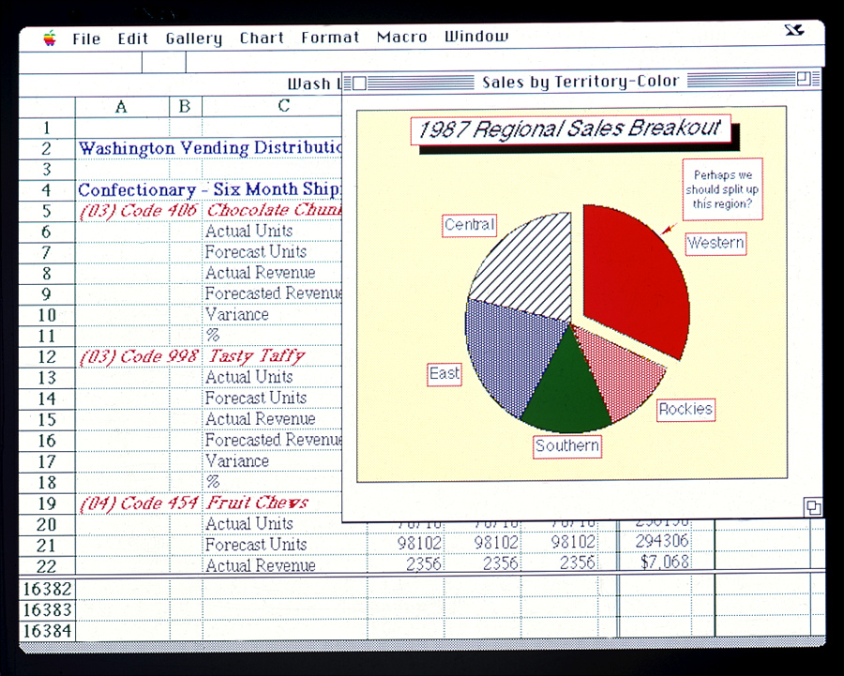
Old School Excel and Word
Notes:
Image credits/sources:
http://www.flickr.com/photos/microsoftsweden/5394688397/
http://en.wikipedia.org/wiki/File:Bundesarchiv_B_145_Bild-F077869-0042,_Jugend-Computerschule_mit_IBM-PC.jpg
http://www.flickr.com/photos/microsoftsweden/5395284268/

Slide 32
What does it mean to Scale?
  Scale != Performance
    Scalable iff Performance constant as it grows
  Scale the Number of Users
  … Volume of Data
  … Across Geography
  Scale can be bi-directional (more or less)
  Investment α Benefit
Notes:
Same performance when system is managing x units as with 10x, 100x, 1000x …
Scale ⬄ availability, durability (failures will happen), throughput, and capacity

Slide 33
Options: Scale Up (and Scale Down) or Scale Out (and Scale In)
Terminology:
  Scaling Up/Down == Vertical Scaling
  Scaling Out/In == Horizontal Scaling
Architectural Decision
  Big decision… hard to change

Slide 34

Scaling Up: Scaling the Box
.

Slide 35
Scaling Out: Adding Boxes
autonomous nodes
scale best

Slide 36
How do I Choose???? ??????
.
Scale Up
(Vertically)
Scale Out
(Horizontally)
…
Not either/or!
Part business, part technical decision (requirements and strategy)
Consider Reliability (and SLA in Azure)
Target VM size that meets min or optimal CPU, bandwidth, space

Slide 37
Essential Scale Out Patterns
Data Scaling Patterns
  Sharding: Logical database comprised of multiple physical databases, if data too big for single physical db
  NoSQL: “Not Only SQL” – a family of approaches using simplified database model
Computational Scaling Patterns
  CQRS:
  Command Query Responsibility Segregation
Notes:
Talk will focus on how specific Scale Out Patterns can be realized using the Windows Azure Platform, though concepts are generally applicable to other cloud platforms and non-cloud systems…
Not ACID, thus addressing CAP theorem limitations
Uses concepts of sharding
Not discussing MAP/REDUCE, Warehouse, …

Slide 38
Overview of Scalability Topics
What is Scalability?
Scaling Data
  Sharding
  NoSQL
Scaling Compute
Q&A
Notes:
Scaling Data
SQL Azure != SQL Server – 5 minutes
Query Fanout – 5 minutes
NoSQL, Table Storage – 10 minutes (mention Eventual Consistency)
Scaling Compute
Roles & Queues – 5 minutes
Scalability Pattern – 10 minutes (mention scale unit)

Slide 39

Foursquare #Fail
October 4, 2010 – trouble begins…
After 17 hours of downtime over two days…
  “Oct. 5 10:28 p.m.: Running on pizza and Red Bull. Another long night.”
  WHAT WENT WRONG?
Notes:
Social Check-in Site Foursquare
32 employees (at the time)
10Gen
Small company
Microsoft
BIG COMPANY (how many of the 90k employees work on SQL Server?)
http://blog.foursquare.com/2010/10/05/so-that-was-a-bummer/
http://highscalability.com/blog/2010/10/15/troubles-with-sharding-what-can-we-learn-from-the-foursquare.html

Slide 40
What is Sharding?
Problem: one database can’t handle all the data
  Too big, not performant, needs geo distribution, …
Solution: split data across multiple databases
  One Logical Database, multiple Physical Databases
Each Physical Database Node is a Shard
Most scalable is Shared Nothing design
  May require some denormalization (duplication)
Notes:
[Not same as Data Warehouse or Reporting DB]

Slide 41
Sharding is Difficult
What defines a shard? (Where to put stuff?)
  Example by geography: customer_us, customer_fr, customer_cn, customer_ie, …
  Use same approach to find records
What happens if a shard gets too big?
  Rebalancing shards can get complex
  Foursquare case study is interesting
Query / join / transact across shards
Cache coherence, connection pool management

Slide 42
SQL Azure is SQL Server Except…
SQL Server
Specific
(for now)
SQL Azure
Specific
Limitations
50 GB size limit
New Capabilities
Highly Available
Rental model
Coming: Backups & point-in-time recovery
SQL Azure Federations
More…
Common
Full Text Search
Native Encryption
Many more…
“Just change the connection string…”
Additional information on Differences:
    http://msdn.microsoft.com/en-us/library/ff394115.aspx
Notes:
http://social.technet.microsoft.com/wiki/contents/articles/inside-sql-azure.aspx
“Another feature in development is the ability to take control of your backups. Currently, backups are performed in the data centers to protect your data against disk or system problems. However, there is no way currently to control your own backups to provide protection against logical errors and use a RESTORE operation to return to an earlier point in time when a backup was made. The new feature involves the ability to make your own backups of your SQL Azure databases to your own on-premises storage, and the ability to restore those backups either to an on-premises database or to a SQL Azure database. Eventually Microsoft plans to provide the ability to perform SQL Azure backups across data centers and also make log backups so that point-in-time recovery can be implemented.” http://social.technet.microsoft.com/wiki/contents/articles/inside-sql-azure.aspx

Slide 43
SQL Azure Federations for Sharding
Single “master” database
  “Query Fanout” makes partitions transparent
  Instead of customer_us, customer_fr, etc… we are back to customer database
Handles redistributing shards
Handles cache coherence
Simplifies connection pooling
Not yet a released product
  But coming soon to an Azure Data Center near you!
http://blogs.msdn.com/b/cbiyikoglu/archive/2011/01/18/sql-azure-federations-robust-connectivity-model-for-federated-data.aspx
Notes:
http://blogs.msdn.com/b/cbiyikoglu/archive/2011/01/18/sql-azure-federations-robust-connectivity-model-for-federated-data.aspx

Slide 44
Overview of Scalability Topics
What is Scalability? (10 minutes)
Scaling Data (20 minutes)
  Sharding
  NoSQL
Scaling Compute (15 minutes)
Q&A (15 minutes)
Notes:
Scaling Data
SQL Azure != SQL Server – 5 minutes
Query Fanout – 5 minutes
NoSQL, Table Storage – 10 minutes (mention Eventual Consistency)
Scaling Compute
Roles & Queues – 5 minutes
Scalability Pattern – 10 minutes (mention scale unit)

Slide 45
Persistent Storage Services – Azure
Type of Data | Traditional | Azure Way
Relational | SQL Server | SQL Azure
BLOB (“Binary Large Object”) | File System, SQL Server | Azure Blobs
File | File System | (Azure Drives) Azure Blobs
Logs | File System, SQL Server, etc. | Azure Blobs Azure Tables
Non-Relational |  | Azure Tables
NoSQL ?

Slide 46


Not Only SQL
Notes:
http://www.cloudave.com/695/nosql-is-not-sql-and-thats-a-problem/
http://notonlysql.com/

Slide 47

NoSQL Databases (simplified!!!)
, CouchDB: JSON Document Stores
Amazon Dynamo, Azure Tables: Key Value Stores
  Dynamo: Eventually Consistent
  Azure Tables: Strongly Consistent
Cassandra, Azure Tables: Wide Column Stores
  Yeah, I know Azure Tables is listed twice…
Many others!
Faster, Cheaper
Scales Out
“Simpler” … better benefit/$
Notes:
http://en.wikipedia.org/wiki/NoSQL
Amazon Dynamo is inspiration for other popular NoSQLs like Riak and Cassandra

Slide 48
Eventual Consistency
Property of a system such that not all records of state guaranteed to agree at any given point in time.
  Applicable to whole systems or parts of systems (such as a database)
As opposed to Strongly Consistent (or Instantly Consistent)
Eventual Consistency is natural characteristic of a useful, scalable distributed systems

Slide 49
Why Eventual Consistency? #1
ACID Guarantees:
  Atomicity, Consistency, Isolation, Durability
  SQL insert vs read performance?
    How do we make them BOTH fast?
    Optimistic Locking and “Big Oh” math
BASE Semantics:
  Basically Available, Soft state, Eventual consistency
From: http://en.wikipedia.org/wiki/ACID and http://en.wikipedia.org/wiki/Eventual_consistency

Slide 50
Why Eventual Consistency? #2
CAP Theorem – Choose only two guarantees
Consistency: all nodes see the same data at the same time
Availability: a guarantee that every request receives a response about whether it was successful or failed
Partition tolerance: the system continues to operate despite arbitrary message loss
From: http://en.wikipedia.org/wiki/CAP_theorem

Slide 51

Cache is King
Facebook has “28 terabytes of memcached data on 800 servers.” http://highscalability.com/blog/2010/9/30/facebook-and-site-failures-caused-by-complex-weakly-interact.html
Eventual Consistency at work!
Notes:
Facebook image: http://www.flickr.com/photos/69805768@N00/3292553947/

Slide 52
Relational (SQL Azure) vs. NoSQL (Azure Tables)
Approach | Relational (e.g., SQL Azure) | NoSQL (e.g., Azure Tables)
Normalization | Normalized | Denormalized
(Duplication) | (No duplication) | (Duplication okay)
Transactions | Distributed | Limited scope
Structure | Schema | Flexible
Responsibility | DBA/Database | Developer/Code
Knobs | Many | Few
Scale | Up (or Sharding) | Out
Notes:
http://en.wikipedia.org/wiki/NoSQL

Slide 53
NoSQL Storage
Suitable for granular, semi-structured data (Key/Value stores)
Document-oriented data (Document stores)
No rigid database schema
Weak support for complex joins or complex transaction
Usually optimized to Scale Out
NoSQL databases generally not managed with same tooling as for SQL databases

Slide 54
Overview of Scalability Topics
What is Scalability?
Scaling Data
Scaling Compute
  CQRS
Q&A
Notes:
Scaling Data
SQL Azure != SQL Server – 5 minutes
Query Fanout – 5 minutes
NoSQL, Table Storage – 10 minutes (mention Eventual Consistency)
Scaling Compute
Roles & Queues – 5 minutes
Scalability Pattern – 10 minutes (mention scale unit)

Slide 55
Queue-based Architecture Pattern
CQRS
  Command Query Responsibility Segregation
Commands change state
Queries ask for current state
Any operation is one or the other
Enables systems where the UI and back-end services are Loosely Coupled

Slide 56
CQRS in Windows Azure
WE NEED:
Compute resource to run our code
  Web Roles (IIS) and Worker Roles (w/o IIS)
Reliable Queue to communicate
  Azure Storage Queues
Durable/Persistent Storage
  Azure Storage Blobs & Tables; SQL Azure

Slide 57
CQRS in Action
Web Server
Compute Service
Reliable Queue
Reliable Storage
Notes:
AJAX – orthogonal concern
Worker Role not related to HTML 5 concept of Web Worker

Slide 58



Familiar Example: Thumbnailer
Web
Role
(IIS)
Worker
Role
Azure Queue
Azure Blob
UX implications: user does not wait for thumbnail
Notes:
AJAX – orthogonal concern
Worker Role not related to HTML 5 concept of Web Worker
“Thumbnails” sample code available from http://code.msdn.microsoft.com/windowsazuresamples

Slide 59
Reliable Queue & 2-step Delete
var url = “http://myphotoacct.blob.core.windows.net/up/<guid>.png”;
queue.AddMessage( new CloudQueueMessage( url ) );
(IIS)
Web
Role
Worker
Role
Queue
var invisibilityWindow = TimeSpan.FromSeconds( 10 );
CloudQueueMessage msg =
queue.GetMessage( invisibilityWindow );
queue.DeleteMessage( msg );
Notes:
AJAX – orthogonal concern
Worker Role not related to HTML 5 concept of Web Worker

Slide 60
General Case:
Many Roles, Many Queues
Worker
Role
Worker
Role
Worker
Role
Web
Role
(IIS)
Queue Type 1
Worker
Role Type 1
Web
Role
(IIS)
Queue Type 1
Web
Role
(IIS)
Web
Role
(IIS)
Queue Type 2
Queue Type 2
Worker
Role
Worker
Role
Queue Type 3
Worker
Role
Queue Type 3
Worker
Role Type 2
Queue Type 3
Queue Type 3
Remember: Investment α Benefit
Watch your scale units!
  Logical vs. Physical Architecture

Slide 61
CQRS requires Idempotent
Perform idempotent operation more than once, end result same as if we did it once
Example with Thumbnailing (easy case)
App-specific concerns dictate approaches
  Compensating transactions
  Last in wins
  Many others possible – hard to say

Slide 62
CQRS expects Poison Messages
A Poison Message cannot be processed
  Error condition for non-transient reason
  Detect via CloudQueueMessage.DequeueCount property
Be proactive
  Falling off the queue may kill your system
    Message TTL = 7 days by default in Azure
Determine a Max Retry policy
  May differ by queue object type or other criteria
  Then what? Delete, move to “bad” queue, alert human, …

Slide 63
CQRS enables Responsive
Response to interactive users is as fast as a work request can be persisted
Time consuming work done asynchronously
Comparable total resource consumption, arguably better subjective UX
UX challenge – how to express Async to users?
  Communicate Progress
  Display Final results

Slide 64
CQRS enables Scalable
Loosely coupled, concern-independent scaling
  Get Scale Units right
Blocking is Bane of Scalability
  Decoupled front/back ends insulate from other system issues if…
    Order processing partner doing maintenance
    Twitter down
    Email server unreachable
    Internet connectivity interruption

Slide 65

CQRS enables Distribution
  Scale out systems better suited than monolithic for geographic distribution
  More granular → flexible
  Reduce latency via geographic distribution
  Failure need not be binary
Notes:
Chainsaw: http://commons.wikimedia.org/wiki/File:Chainsaw_cutting_tree.jpg

Slide 66
MTBF… vs. MTTR…
Notes:
Boots from posterous.wilderclan.com
Sneakers: http://www.flickr.com/photos/pinksherbet/3504943955/

Slide 67
CQRS requires “Plan for Failure”
There will be VM (or Azure role) restarts
  Hardware failure, O/S patching, crash (bug)
Fabric Controller honors Fault Domains
Bake in handling of restarts into our apps
  Restarts are routine: system “just keeps working”
  Idempotent support important again
Not an exception case! Expect it!

Slide 68


What’s Up? Reliability as EMERGENT PROPERTY
 | Typical Site | Any 1 Role Inst | Overall System
Operating System Upgrade
Application Code Update
Scale Up, Down, or In
Hardware Failure
Software Failure (Bug)
Security Patch
Notes:
Tech Windows

Slide 69
What about the DATA?
Azure Web Roles and Azure Worker Roles
  Taking user input, dispatching work, doing work
  Follow a decoupled queue-in-the-middle pattern
  Stateless compute nodes
“Hard Part” – persistent data, scalable data
  Azure Queue, Blob, Table, SQL Azure
  Three copies of each byte
  Blobs and Tables geo-replicated
  Retry and Throttle!

Slide 70


Division of Labor
Client-facing code dealing with #fail
Backoffice code dealing with #Fail
Reliable Queuing
Reliable Storage
#fail, #Fail, #EpicFail
Notes:
AJAX – orthogonal concern
Worker Role not related to HTML 5 concept of Web Worker

Slide 71
PaaS and cloud make strong security accessible to mere mortals
Less complex, more cost-effective, competitive pressure (“everyone’s doing it”)
Notes:
http://blogs.westword.com/latestword/2009/10/denver_is_smarter_than_every_o.php
http://www.google.com/imgres?imgurl=http://www.watchmoviestreaming.com/pictures/dumbanddumber1.jpg&imgrefurl=http://www.watchmoviestreaming.com/%3Fp%3D424&usg=__UZ1BrJ79mCMa7yueDsmtXOADCHw=&h=267&w=500&sz=24&hl=en&start=7&sig2=IbDrZVdkObZkrsySJqTm-Q&itbs=1&tbnid=Q_EZDCwRAgp15M:&tbnh=69&tbnw=130&prev=/images%3Fq%3Ddumb%2Band%2Bdumber%26hl%3Den%26as_st%3Dy%26tbs%3Disch:1&ei=j-zkS63ZHcO78gaC4qy4Bw

Slide 72
Big Brains in high impact positions
Notes:
http://blogs.westword.com/latestword/2009/10/denver_is_smarter_than_every_o.php
http://www.google.com/imgres?imgurl=http://www.watchmoviestreaming.com/pictures/dumbanddumber1.jpg&imgrefurl=http://www.watchmoviestreaming.com/%3Fp%3D424&usg=__UZ1BrJ79mCMa7yueDsmtXOADCHw=&h=267&w=500&sz=24&hl=en&start=7&sig2=IbDrZVdkObZkrsySJqTm-Q&itbs=1&tbnid=Q_EZDCwRAgp15M:&tbnh=69&tbnw=130&prev=/images%3Fq%3Ddumb%2Band%2Bdumber%26hl%3Den%26as_st%3Dy%26tbs%3Disch:1&ei=j-zkS63ZHcO78gaC4qy4Bw

Slide 73
Overview of Scalability Topics
What is Scalability?
Scaling Data
Scaling Compute
Q&A
  Summary
  Questions? Feedback? Stay in touch
Notes:
Scaling Data
SQL Azure != SQL Server – 5 minutes
Query Fanout – 5 minutes
NoSQL, Table Storage – 10 minutes (mention Eventual Consistency)
Scaling Compute
Roles & Queues – 5 minutes
Scalability Pattern – 10 minutes (mention scale unit)

Slide 74
4 Big Ideas to Take Home
Code for #fail ; architect for #Fail; architect (or not!) for #EpicFail!
Consider flexibility of Scale Out architecture
  Scalable, Resilient, Testable, Cost-appropriate
  Computation: Queues, Storage, CQRS
  Data: SQL Azure Federations, NoSQL (Azure Tables)
Look for Eventual Consistency opportunities
  Caching, CDN, CQRS, Non-transactional Data Updates, Optimistic Locking
Embrace platforms with affordances for future-looking architecture
  e.g., Windows Azure Platform (PaaS)

Slide 75
Questions?
Comments?
More information?
?

Slide 76
BostonAzure.org
Boston Azure cloud user group
  Focused on Microsoft’s PaaS cloud platform
Last Thursday, monthly, 6:00-8:30 PM at NERD
  Food; wifi; free; great topics; growing community
Boston Azure Boot Camp: June 2012 (planning)
Follow on Twitter: @bostonazure
More info or to join our Meetup.com group:
http://www.bostonazure.org

Slide 77
Contact Me
Looking for …
consulting help with Windows Azure Platform?
someone to bounce Azure or cloud questions off?
a speaker for your user group or company technology event?
Just Ask!
Bill Wilder
@codingoutloud
http://blog.codingoutloud.com

