Slide 1
Big Ideas in Software Architecture (in cloud or otherwise)
Examples drawn from Windows Azure cloud platform
Boston Azure User Group
27-October-2011
Boston Azure User Group
http://www.bostonazure.org
@bostonazure
Bill Wilder
http://blog.codingoutloud.com
@codingoutloud

Slide 2
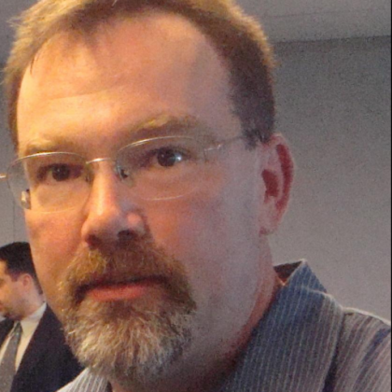

Bill Wilder
Bill Wilder
Independent Windows Azure consultant
Founder/Leader of
Boston Azure user group
Recognized by Microsoft
as Windows Azure MVP

Slide 3
Bill Wilder
Boston Azure User Group Founder
Windows Azure Consultant
Windows Azure MVP

Slide 4
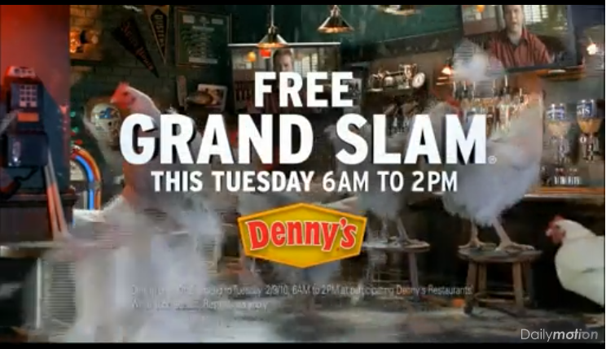
Superbowl Lessons
Dominos Pizza
Denny’s Restaurant
http://www.dailymotion.com/video/xc79z4_dennys-chickens-get-outta-town-supe_fun
Notes:
Denny’s:
http://www.thekmiecs.com/marketing-advertising/guest-post-the-impact-of-an-unavailable-web-site-dennyscom-superbowl/
http://www.planetc1.com/cgi-bin/n/v.cgi?c=1&id=1233547996

Slide 5

Notes:
http://en.wikipedia.org/wiki/File:Buzz_salutes_the_U.S._Flag.jpg

Slide 6
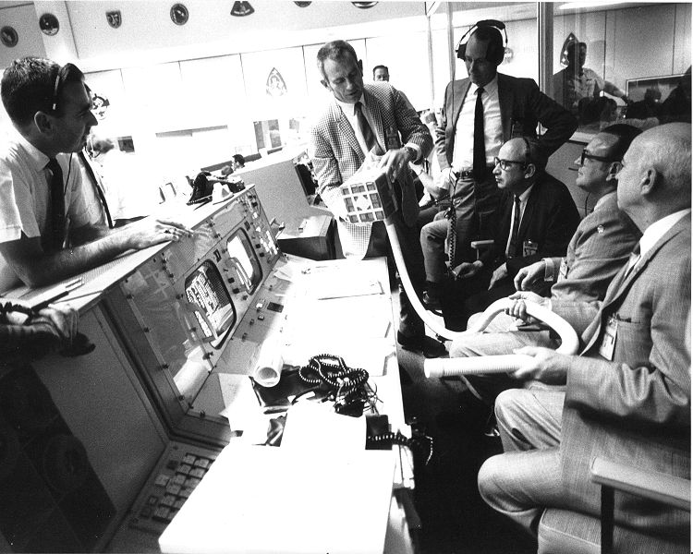
Failure IS an Option
Notes:
http://en.wikipedia.org/wiki/File:Apollo_13_Mailbox_at_Mission_Control.jpg

Slide 7
Failure is not an option

Slide 8
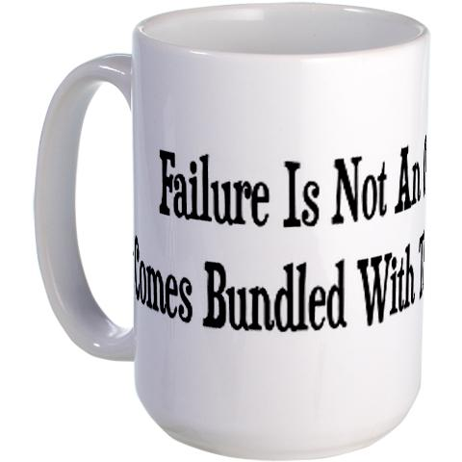
http://www.cafepress.com/+failure_is_not_an_option_large_mug,92179166?cmp=knc-pla-92179166&utm_term=92179166&utm_medium=cpc&pid=3607873&utm_source=google&utm_campaign=sem_product_feed&gclid=CLeK2ZXxiKwCFeUEQAodYi7n5Q
Notes:
http://www.cafepress.com/+failure_is_not_an_option_large_mug,92179166?cmp=knc-pla-92179166&utm_term=92179166&utm_medium=cpc&pid=3607873&utm_source=google&utm_campaign=sem_product_feed&gclid=CLeK2ZXxiKwCFeUEQAodYi7n5Q

Slide 9

Notes:
http://en.wikipedia.org/wiki/File:Mission_Control_celebrates_successful_splashdown_of_Apollo_13.jpg

Slide 10


Failure actually *is* an option…
MTBF -or- MTTR
Notes:
Boots from posterous.wilderclan.com
Sneakers: http://www.flickr.com/photos/pinksherbet/3504943955/

Slide 11
Failure actually *is* an option…
http://stackoverflow.com/questions/31466/does-amazon-s3-fail-sometimes
Perhaps “easier” than not failing?
Does not take team of “rocket scientists” to avoid failure
Some architecture patterns enable all at once: RESILIENCE, SCALE OUT, and a CLEAN SEPARATION of CONCERNS
Notes:
Q: How many times will a subscriber receive each message?Although most of the time each message will be delivered to your application exactly once, the distributed nature of Amazon SNS and transient network conditions could result in occasional, duplicate messages at the subscriber end. Developers should design their applications such that processing a message more than once does not create any errors or inconsistencies.
http://aws.amazon.com/sns/faqs/

Slide 12
Consistency
“A foolish consistency is the hobgoblin of little minds”
- Ralph Waldo Emerson, Self-Reliance Essay

Slide 13
Superbowl Lessons
Dominos Pizza
Denny’s Restaurant
http://www.dailymotion.com/video/xc79z4_dennys-chickens-get-outta-town-supe_fun
Notes:
Danny’s: http://www.thekmiecs.com/marketing-advertising/guest-post-the-impact-of-an-unavailable-web-site-dennyscom-superbowl/

Slide 14
Why NoSQL
Cost for performance better with NoSQL over relational
Other strategies: cache, index, then to tune queries, then… before nosql… buy a bigger box.
Fusion IO optimcal (?)
5.1 TB, 1.2MIOPS, $100k
Cloud challenge: “random problems” – but great sandbox – why am I in the cloud?
NoSQL lets you use skills instead of dollars
Master-Slave replication has some challenges
CAP Theorem – don’t worry about it…

Slide 15
Choosing a NoSQL
Distribution and Performance
Performance ➔ how fast can I do a database read or write – influenced by data/query model and disk structure
Choosing RDBMS:
  MOON Methodology
Three options: Dynamo, Master-Slave, Master-Master (peer-to-peer)

Slide 16
Query Model
Some are Map/Reduce
Key/Value

Slide 17
Disk Structure
Such as Cassandra with column-oriented

Slide 18
Couchdb: master-master, doc + persistent m/r, append-only b+ tree – small scale, static queries, if api good fit
CouchBase 2.0: master-slave, k/v + persistent m/r
BigCouch: dynamo, doc + pers m/r, -- same as couchdb but bigger scale
Cassandra: dynamo, column families, log + sstable – very fast writes, immature (?) – but NetFlix and Facebook use (custom versions of?) it
Riak: multi-doc dynamo, k/v + m/r + 2ary, log-struct.hash table & others
MongoDB: master-slave, docs + m/r + 2ary, log + b-tree – ideal is prototyping (performance sucks when data not entirely in memory)
Redis: master-slave (?), many, log + many (?) – good for application glue (cache, other uses), durability trade-off like with mongodb
Neo4j: master-slave, OO + REST, custom graph structure – lots of self-joins is sweet spot for graph databases

Slide 19
Instrumenting your stack
Any advanced distributed system will seem like a black box – how to do better…
Testing good, but measuring better
e.g., percentage response times, and error rates
Normal http fail rate is 1/1000 (Amazon S3 documentation talks about this)
Memory usage and stack depth
CPU usage and ..
Disk usage and IOPS
Watch perf graphs over long periods of time
“metrology” is a dark art – need good people – not just systems

Slide 20
www.NoSQLHandbook.com coming

Slide 21
CouchDB
Fault tolerant, doc-oriented, can write a function for m/r that will create a secondary index
Killer feature: incremental multi-master replication, even after long periods of disconnectedness
Cloudant BigCouch - HA

Slide 22
BigCouch – good decisions
Copy on Write – New pattern in data updates – copy on write - always write a new version (say in file system), then later garbage collect the old bits – but if something goes wrong, we have a reference to rebuild consistency
CouchDB uses this in a B-tree-like data structure, append-only (?)
So you never have to lock! – go to end of the file and look for the copy
Need to do vacuuming (Postgress) or compaction (CouchDB) to reclaim space
Durable, supports multiple readers and writers

Slide 23
fsync

Slide 24
Distributed concurrency
Your word against mine!
Strategies to identify and correct divergent revisions
Version vectors
Vector clocks (Riak) – actors are known
Hash histories (CouchDB) – like a distributed version control system like Git – actor not required
Version stamps
Interval tree clocks

Slide 25
DNS
The original nosql database!
Multi-master, HA, never down!
It is a cache-friendly nosql configuration db
  Stuff a little config data in there
  There are specs for this! (udp packet size limits ought to be honored)
  DNS Service Record specs have notions of priority and other stuffz
  Quote of the Day text record in DNS

Slide 26
riak
Based on Dynamo
Distributed for: availability, durability (failures will happen), throughput, and capacity
REST and Protocol Buffer (PB) API
Data model: key/value, plus (beyond Dynamo) secondary indexes, full text search (using solr), mapreduce (javascript or erlang), large files (they will chunk them for you), links (closest thing to relationships in distributed system)
Eventually consistent
Tunable consistency (like cassandra)

Slide 27
Can’t be avail and consistent
Physics
CAP theorem – ignore the “P” we need that in a distributed system with high uptime
Concurrency control
Choose between available and consistent
- riak chooses available

Slide 28
Eventual consistency examples
DNS - ttl
Async replication
Memcached
http caching (sometimes)

Slide 29
How to manage/control consistency
Formalize consistency
Logical time (not wall time) – vector clocks
Read-your-writes when you want it
Choose availability over consistency when you want

Slide 30
MTTR v MTBF
Yugo vs. Rolls Royce
Sneakers that dry fast vs. “waterproof” boots
What to OPTIMIZE for?
  This is a big question for the cloud!
  MTTI vs MTTR vs MTBF
    How do you know what to watch?
    You have Graphite, StatsD, but what about alerts?
    Nagios good for alerting, just not ad hoc alerts
    Graphite-Tattle is a proof-of-concept from wayfair

Slide 31
NoSQL : RDBMS as #fail : #nofail
MySQL vs No SQL

Slide 32
What’s the Big Idea?
What is Scalability?
Scaling Data
Scaling Compute
Q&A
Notes:
Scaling Data
SQL Azure != SQL Server – 5 minutes
Query Fanout – 5 minutes
NoSQL, Table Storage – 10 minutes (mention Eventual Consistency)
Scaling Compute
Roles & Queues – 5 minutes
Scalability Pattern – 10 minutes (mention scale unit)

Slide 33
Key Concepts & Patterns
GENERAL
Scale vs. Performance
Scale Up vs. Scale Out
Shared Nothing
Design for Failure
DATABASE ORIENTED
ACID vs. BASE
Eventually Consistent
Sharding
Optimistic Locking
COMPUTE ORIENTED
CQRS Pattern
Poison Messages
Idempotency

Slide 34
Key Terms
Scale Up
Scale Out
Horizontal Scale
Vertical Scale
Scale Unit
ACID
CAP
Eventual Consistency
Strong Consistency
Multi-tenancy
NoSQL
Sharding
Denormalized
Poison Message
Idempotent
CQRS
Performance
Scale
Optimistic Locking
Shared Nothing
Load Balancing
Design for Failure

Slide 35
Overview of Scalability Topics
What is Scalability?
Scaling Data
Scaling Compute
Q&A
Notes:
Scaling Data
SQL Azure != SQL Server – 5 minutes
Query Fanout – 5 minutes
NoSQL, Table Storage – 10 minutes (mention Eventual Consistency)
Scaling Compute
Roles & Queues – 5 minutes
Scalability Pattern – 10 minutes (mention scale unit)

Slide 36
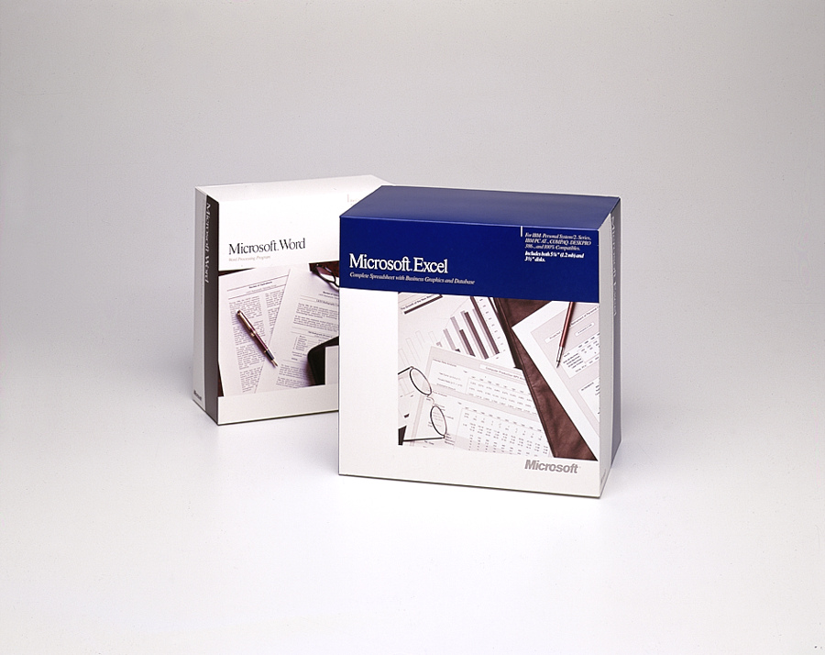
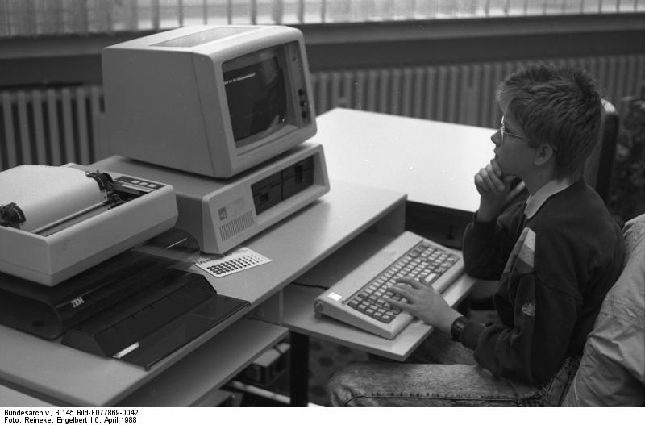
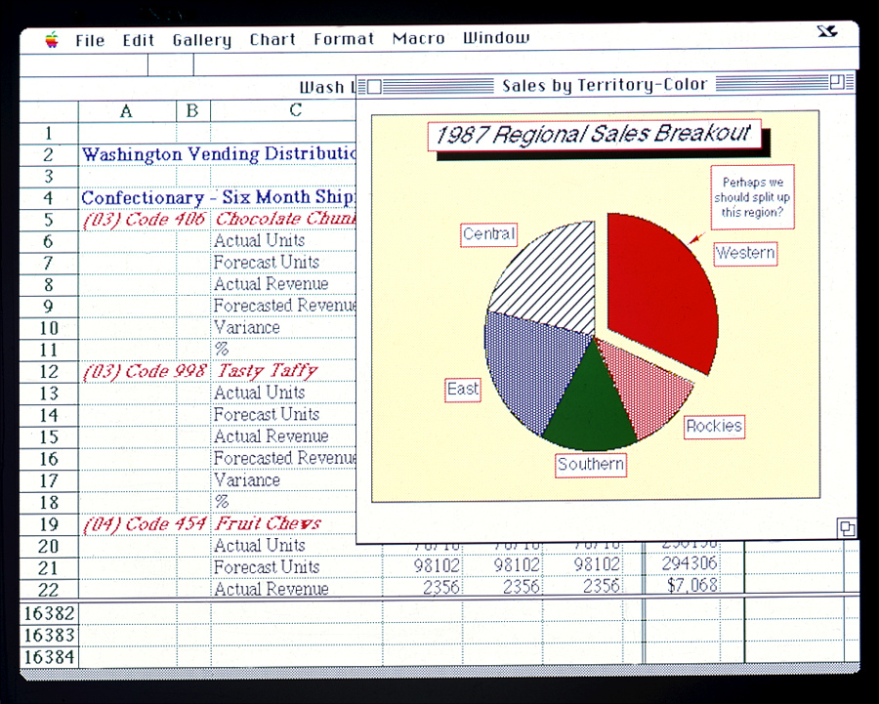
Old School Excel and Word
Notes:
Image credits/sources:
http://www.flickr.com/photos/microsoftsweden/5394688397/
http://en.wikipedia.org/wiki/File:Bundesarchiv_B_145_Bild-F077869-0042,_Jugend-Computerschule_mit_IBM-PC.jpg
http://www.flickr.com/photos/microsoftsweden/5395284268/

Slide 37
What does it mean to Scale?
  Scale != Performance
    Scalable iff Performance constant as it grows
  Scale the Number of Users
  … Volume of Data
  … Across Geography
  Scale can be bi-directional (more or less)
  Investment α Benefit
Notes:
Same performance when system is managing x units as with 10x, 100x, 1000x …
Scale ⬄ availability, durability (failures will happen), throughput, and capacity

Slide 38
Options: Scale Up (and Scale Down) or Scale Out (and Scale In)
Terminology:
  Scaling Up/Down == Vertical Scaling
  Scaling Out/In == Horizontal Scaling
Architectural Decision
  Big decision… hard to change

Slide 39

Scaling Up: Scaling the Box
.

Slide 40
Scaling Out: Adding Boxes
“Shared nothing” scales best

Slide 41
How do I Choose???? ??????
.
Scale Up
(Vertically)
Scale Out
(Horizontally)
…
Not either/or!
Part business, part technical decision (requirements and strategy)
Consider Reliability (and SLA in Azure)
Target VM size that meets min or optimal CPU, bandwidth, space

Slide 42
Essential Scale Out Patterns
Data Scaling Patterns
  Sharding: Logical database comprised of multiple physical databases, if data too big for single physical db
  NoSQL: “Not Only SQL” – a family of approaches using simplified database model
Computational Scaling Patterns
  CQRS:
  Command Query Responsibility Segregation
Notes:
Talk will focus on how specific Scale Out Patterns can be realized using the Windows Azure Platform, though concepts are generally applicable to other cloud platforms and non-cloud systems…
Not ACID, thus addressing CAP theorem limitations
Uses concepts of sharding
Not discussing MAP/REDUCE, Warehouse, …

Slide 43
Overview of Scalability Topics
What is Scalability?
Scaling Data
  Sharding
  NoSQL
Scaling Compute
Q&A
Notes:
Scaling Data
SQL Azure != SQL Server – 5 minutes
Query Fanout – 5 minutes
NoSQL, Table Storage – 10 minutes (mention Eventual Consistency)
Scaling Compute
Roles & Queues – 5 minutes
Scalability Pattern – 10 minutes (mention scale unit)

Slide 44

Foursquare #Fail
October 4, 2010 – trouble begins…
After 17 hours of downtime over two days…
  “Oct. 5 10:28 p.m.: Running on pizza and Red Bull. Another long night.”
  WHAT WENT WRONG?
Notes:
Social Check-in Site Foursquare
32 employees (at the time)
10Gen
Small company
Microsoft
BIG COMPANY (how many of the 90k employees work on SQL Server?)
http://blog.foursquare.com/2010/10/05/so-that-was-a-bummer/
http://highscalability.com/blog/2010/10/15/troubles-with-sharding-what-can-we-learn-from-the-foursquare.html

Slide 45
What is Sharding?
Problem: one database can’t handle all the data
  Too big, not performant, needs geo distribution, …
Solution: split data across multiple databases
  One Logical Database, multiple Physical Databases
Each Physical Database Node is a Shard
Most scalable is Shared Nothing design
  May require some denormalization (duplication)
Notes:
[Not same as Data Warehouse or Reporting DB]

Slide 46
Sharding is Difficult
What defines a shard? (Where to put stuff?)
  Example by geography: customer_us, customer_fr, customer_cn, customer_ie, …
  Use same approach to find records
What happens if a shard gets too big?
  Rebalancing shards can get complex
  Foursquare case study is interesting
Query / join / transact across shards
Cache coherence, connection pool management

Slide 47
SQL Azure is SQL Server Except…
SQL Server
Specific
(for now)
SQL Azure
Specific
Limitations
50 GB size limit
New Capabilities
Highly Available
Rental model
Coming: Backups & point-in-time recovery
SQL Azure Federations
More…
Common
Full Text Search
Native Encryption
Many more…
“Just change the connection string…”
Additional information on Differences:
    http://msdn.microsoft.com/en-us/library/ff394115.aspx
Notes:
http://social.technet.microsoft.com/wiki/contents/articles/inside-sql-azure.aspx
“Another feature in development is the ability to take control of your backups. Currently, backups are performed in the data centers to protect your data against disk or system problems. However, there is no way currently to control your own backups to provide protection against logical errors and use a RESTORE operation to return to an earlier point in time when a backup was made. The new feature involves the ability to make your own backups of your SQL Azure databases to your own on-premises storage, and the ability to restore those backups either to an on-premises database or to a SQL Azure database. Eventually Microsoft plans to provide the ability to perform SQL Azure backups across data centers and also make log backups so that point-in-time recovery can be implemented.” http://social.technet.microsoft.com/wiki/contents/articles/inside-sql-azure.aspx

Slide 48
SQL Azure Federations for Sharding
Single “master” database
  “Query Fanout” makes partitions transparent
  Instead of customer_us, customer_fr, etc… we are back to customer database
Handles redistributing shards
Handles cache coherence
Simplifies connection pooling
Not yet a released product
  But coming soon to an Azure Data Center near you!
http://blogs.msdn.com/b/cbiyikoglu/archive/2011/01/18/sql-azure-federations-robust-connectivity-model-for-federated-data.aspx
Notes:
http://blogs.msdn.com/b/cbiyikoglu/archive/2011/01/18/sql-azure-federations-robust-connectivity-model-for-federated-data.aspx

Slide 49
Overview of Scalability Topics
What is Scalability? (10 minutes)
Scaling Data (20 minutes)
  Sharding
  NoSQL
Scaling Compute (15 minutes)
Q&A (15 minutes)
Notes:
Scaling Data
SQL Azure != SQL Server – 5 minutes
Query Fanout – 5 minutes
NoSQL, Table Storage – 10 minutes (mention Eventual Consistency)
Scaling Compute
Roles & Queues – 5 minutes
Scalability Pattern – 10 minutes (mention scale unit)

Slide 50
Persistent Storage Services – Azure
Type of Data | Traditional | Azure Way
Relational | SQL Server | SQL Azure
BLOB (“Binary Large Object”) | File System, SQL Server | Azure Blobs
File | File System | (Azure Drives) Azure Blobs
Logs | File System, SQL Server, etc. | Azure Blobs Azure Tables
Non-Relational |  | Azure Tables
NoSQL ?

Slide 51


Not Only SQL
Notes:
http://www.cloudave.com/695/nosql-is-not-sql-and-thats-a-problem/
http://notonlysql.com/

Slide 52

NoSQL Databases (simplified!!!)
, CouchDB: JSON Document Stores
Amazon Dynamo, Azure Tables: Key Value Stores
  Dynamo: Eventually Consistent
  Azure Tables: Strongly Consistent
Many others!
Faster, Cheaper
Scales Out
“Simpler”
Notes:
http://en.wikipedia.org/wiki/NoSQL
Amazon Dynamo is inspiration for other popular NoSQLs like Riak and Cassandra

Slide 53
Eventual Consistency
Property of a system such that not all records of state guaranteed to agree at any given point in time.
  Applicable to whole systems or parts of systems (such as a database)
As opposed to Strongly Consistent (or Instantly Consistent)
Eventual Consistency is natural characteristic of a useful, scalable distributed systems

Slide 54
Why Eventual Consistency? #1
ACID Guarantees:
  Atomicity, Consistency, Isolation, Durability
  SQL insert vs read performance?
    How do we make them BOTH fast?
    Optimistic Locking and “Big Oh” math
BASE Semantics:
  Basically Available, Soft state, Eventual consistency
From: http://en.wikipedia.org/wiki/ACID and http://en.wikipedia.org/wiki/Eventual_consistency

Slide 55
Why Eventual Consistency? #2
CAP Theorem – Choose only two guarantees
Consistency: all nodes see the same data at the same time
Availability: a guarantee that every request receives a response about whether it was successful or failed
Partition tolerance: the system continues to operate despite arbitrary message loss
From: http://en.wikipedia.org/wiki/CAP_theorem

Slide 56

Cache is King
Facebook has “28 terabytes of memcached data on 800 servers.” http://highscalability.com/blog/2010/9/30/facebook-and-site-failures-caused-by-complex-weakly-interact.html
Eventual Consistency at work!
Notes:
Facebook image: http://www.flickr.com/photos/69805768@N00/3292553947/

Slide 57
Relational (SQL Azure) vs. NoSQL (Azure Tables)
Approach | Relational (e.g., SQL Azure) | NoSQL (e.g., Azure Tables)
Normalization | Normalized | Denormalized
(Duplication) | (No duplication) | (Duplication okay)
Transactions | Distributed | Limited scope
Structure | Schema | Flexible
Responsibility | DBA/Database | Developer/Code
Knobs | Many | Few
Scale | Up (or Sharding) | Out
Notes:
http://en.wikipedia.org/wiki/NoSQL

Slide 58
NoSQL Storage
Suitable for granular, semi-structured data (Key/Value stores)
Document-oriented data (Document stores)
No rigid database schema
Weak support for complex joins or complex transaction
Usually optimized to Scale Out
NoSQL databases generally not managed with same tooling as for SQL databases

Slide 59
Overview of Scalability Topics
What is Scalability?
Scaling Data
Scaling Compute
  CQRS
Q&A
Notes:
Scaling Data
SQL Azure != SQL Server – 5 minutes
Query Fanout – 5 minutes
NoSQL, Table Storage – 10 minutes (mention Eventual Consistency)
Scaling Compute
Roles & Queues – 5 minutes
Scalability Pattern – 10 minutes (mention scale unit)

Slide 60
CQRS Architecture Pattern
Command Query Responsibility Segregation
Based on notion that actions which Update our system (“Commands”) are a separate architectural concern than those actions which ask for data (“Query”)
Leads to systems where the Front End (UI) and Backend (Business Logic) are Loosely Coupled

Slide 61
CQRS in Windows Azure
WE NEED:
Compute resource to run our code
  Web Roles (IIS) and Worker Roles (w/o IIS)
Reliable Queue to communicate
  Azure Storage Queues
Durable/Persistent Storage
  Azure Storage Blobs & Tables; SQL Azure

Slide 62
CQRS in Action
Web Server
Compute Service
Reliable Queue
Reliable Storage
Notes:
AJAX – orthogonal concern
Worker Role not related to HTML 5 concept of Web Worker

Slide 63


Canonical Example: Thumbnails
Web
Role
(IIS)
Worker
Role
Azure Queue
Azure Blob
Key Point: at first, user does not get the thumbnail
(UX implications)
Notes:
AJAX – orthogonal concern
Worker Role not related to HTML 5 concept of Web Worker
“Thumbnails” sample code available from http://code.msdn.microsoft.com/windowsazuresamples

Slide 64
Reliable Queue & 2-step Delete
queue.AddMessage(
new CloudQueueMessage(
urlToMediaInBlob));
(IIS)
Web
Role
Worker
Role
Queue
CloudQueueMessage msg =
queue.GetMessage(
TimeSpan.FromSeconds(10));
… queue.DeleteMessage(msg);
Notes:
AJAX – orthogonal concern
Worker Role not related to HTML 5 concept of Web Worker

Slide 65
General Case:
Many Roles, Many Queues
Worker
Role
Worker
Role
Worker
Role
Web
Role
(IIS)
Queue Type 1
Worker
Role Type 1
Web
Role
(IIS)
Queue Type 1
Web
Role
(IIS)
Web
Role
(IIS)
Queue Type 2
Queue Type 2
Worker
Role
Worker
Role
Queue Type 3
Worker
Role
Queue Type 3
Worker
Role Type 2
Queue Type 3
Queue Type 3
Remember: Investment α Benefit
Watch your scale units!
  Logical vs. Physical Architecture

Slide 66
CQRS requires Idempotent
If we perform idempotent operation more than once, end result same as if we did it once
Example with Thumnailing (easy case)
App-specific concerns dictate approaches
  Compensating transactions
  Last in wins
  Many others possible – hard to say

Slide 67
CQRS expects Poison Messages
A Poison Message cannot be processed
  Error condition for non-transient reason
  Queue feature: know your dequeue count
    CloudQueueMessage.DequeueCount property in Azure
Be proactive
  Falling off the queue may kill your system
    Message TTL = 7 days by default in Azure
Determine a max Retry policy
  May differ by queue object type or other criteria
  Delete, Move to Special Queue

Slide 68
CQRS enables Responsive
Response to interactive users is as fast as a work request can be persisted
Time consuming work done off-line
Comparable total resource consumption, arguably better subjective UX
UX challenge – how to express Async to users?
  Communicate Progress
  Display Final results

Slide 69
CQRS enables Scalable
Loosely coupled, concern-independent scaling
  Getting Scale Units right
Blocking is Bane of Scalability
  Decoupled front/back ends insulate from other system issues if…
  Twitter down
  Email server unreachable
  Order processing partner doing maintenance
  Internet connectivity interruption

Slide 70

CQRS enables Distribution
  Scale out systems better suited for geographic distribution
  More efficient and flexible because more granular
  Hard for a mega-machine to be in more than one place
  Failure need not be binary
Notes:
Chainsaw: http://commons.wikimedia.org/wiki/File:Chainsaw_cutting_tree.jpg

Slide 71
CQRS requires Plan for Failure
There will be VM (or Azure role) restarts
  Hardware failure, O/S patching, crash (bug)
Bake in handling of restarts
  Idempotent
Not an exception case! Expect it!
Restarts are routine, system “just keeps working”

Slide 72


What’s Up?
Aspirin-free Reliability as EMERGENT PROPERTY
 | Typical Site | Any 1 Role Inst | Overall System
Operating System Upgrade
Application Update / Deploy
Change Topology
Hardware Failure
Software Bug / Crash / Failure
Security Patch
Notes:
Tech Windows

Slide 73
CQRS enables Resilient
And Requires that you “Plan for failure”
There will be VM (or Azure role) restarts
Bake in handling of restarts
  Not an exception case! Expect it!
  Restarts are routine, system “just keeps working”
If you follow the pattern, the payoff is substantial…

Slide 74
What about the DATA?
Azure Web Roles and Azure Worker Roles
  Taking user input, dispatching work, doing work
  Follow CQRS pattern
  Stateless compute nodes
“Hard Part” – persistent data, scalable data
  Azure Queue, Blob, Table, SQL Azure
  3x copies of each byte
  Blobs and Tables geo-replicated
  Retry and Throttle!

Slide 75


Division of Labor
Client-facing code dealing with #fail
Backoffice code dealing with #Fail
Reliable Queuing
Reliable Storage
#fail, #Fail, #EpicFail
Notes:
AJAX – orthogonal concern
Worker Role not related to HTML 5 concept of Web Worker

Slide 76
PaaS and cloud make strong security accessible to mere mortals
Less complex, more cost-effective, competitive pressure (“everyone’s doing it”)
Notes:
http://blogs.westword.com/latestword/2009/10/denver_is_smarter_than_every_o.php
http://www.google.com/imgres?imgurl=http://www.watchmoviestreaming.com/pictures/dumbanddumber1.jpg&imgrefurl=http://www.watchmoviestreaming.com/%3Fp%3D424&usg=__UZ1BrJ79mCMa7yueDsmtXOADCHw=&h=267&w=500&sz=24&hl=en&start=7&sig2=IbDrZVdkObZkrsySJqTm-Q&itbs=1&tbnid=Q_EZDCwRAgp15M:&tbnh=69&tbnw=130&prev=/images%3Fq%3Ddumb%2Band%2Bdumber%26hl%3Den%26as_st%3Dy%26tbs%3Disch:1&ei=j-zkS63ZHcO78gaC4qy4Bw

Slide 77
Big Brains in high impact positions
Notes:
http://blogs.westword.com/latestword/2009/10/denver_is_smarter_than_every_o.php
http://www.google.com/imgres?imgurl=http://www.watchmoviestreaming.com/pictures/dumbanddumber1.jpg&imgrefurl=http://www.watchmoviestreaming.com/%3Fp%3D424&usg=__UZ1BrJ79mCMa7yueDsmtXOADCHw=&h=267&w=500&sz=24&hl=en&start=7&sig2=IbDrZVdkObZkrsySJqTm-Q&itbs=1&tbnid=Q_EZDCwRAgp15M:&tbnh=69&tbnw=130&prev=/images%3Fq%3Ddumb%2Band%2Bdumber%26hl%3Den%26as_st%3Dy%26tbs%3Disch:1&ei=j-zkS63ZHcO78gaC4qy4Bw

Slide 78
Overview of Scalability Topics
What is Scalability?
Scaling Data
Scaling Compute
Q&A
  Summary
  Questions? Feedback? Stay in touch
Notes:
Scaling Data
SQL Azure != SQL Server – 5 minutes
Query Fanout – 5 minutes
NoSQL, Table Storage – 10 minutes (mention Eventual Consistency)
Scaling Compute
Roles & Queues – 5 minutes
Scalability Pattern – 10 minutes (mention scale unit)

Slide 79
4 Big Ideas to Take Home
Code for #fail ; architect for #Fail; architect (or not!) for #EpicFail!
Consider flexibility of Scale Out architecture
  Scalable, Resilient, Testable, Cost-appropriate
  Computation: Queues, Storage, CQRS
  Data: SQL Azure Federations, NoSQL (Azure Tables)
Look for Eventual Consistency opportunities
  Caching, CDN, CQRS, Non-transactional Data Updates, Optimistic Locking
Embrace platforms with affordances for future-looking architecture
  e.g., Windows Azure Platform (PaaS)

Slide 80
Questions?
Comments?
More information?
?

Slide 81
BostonAzure.org
Boston Azure cloud user group
  Focused on Microsoft’s PaaS cloud platform
Last Thursday, monthly, 6:00-8:30 PM at NERD
  Food; wifi; free; great topics; growing community
Boston Azure Boot Camp: 2012 (in planning)
Follow on Twitter: @bostonazure
More info or to join our Meetup.com group:
http://www.bostonazure.org

Slide 82
Contact Me
Looking for …
consulting help with Windows Azure Platform?
someone to bounce Azure or cloud questions off?
a speaker for your user group or company technology event?
Just Ask!
Bill Wilder
@codingoutloud
http://blog.codingoutloud.com

