Slide 1
Securely Running Applications in the Cloud (and why it is inevitable)
Examples drawn from Windows Azure cloud platform
OWASP Boston
08-October-2011
Boston Azure User Group
http://www.bostonazure.org
@bostonazure
Bill Wilder
http://blog.codingoutloud.com
@codingoutloud

Slide 2

Bill Wilder
Bill Wilder has been a software
professional for over 20 years. In 2009
he founded the Boston Azure User Group,
an in-person cloud community which gets
together monthly to learn about the
Windows Azure platform through prepared talks and hands-on coding. Bill is a Windows Azure MVP, an active speaker, blogger (blog.codingoutloud.com), and tweeter (@codingoutloud) on technology matters and soft skills for technologists, a member of Boston West Toastmasters, and has a day job as a .NET-focused enterprise architect.

Slide 3
Proposition
Big-vendor public cloud offerings will emerge as the most secure platforms available – more secure than vast majority of non-cloud datacenters

Slide 4
Overview
Leverage enjoyed by public cloud vendors
Quick definition of Cloud terms
Quick overview of Windows Azure Platform
As we go, ways the public cloud “got it right” from security point of view (with examples mostly drawn from Windows Azure)

Slide 5

Big Brains in high impact positions
Notes:
http://blogs.westword.com/latestword/2009/10/denver_is_smarter_than_every_o.php
http://www.google.com/imgres?imgurl=http://www.watchmoviestreaming.com/pictures/dumbanddumber1.jpg&imgrefurl=http://www.watchmoviestreaming.com/%3Fp%3D424&usg=__UZ1BrJ79mCMa7yueDsmtXOADCHw=&h=267&w=500&sz=24&hl=en&start=7&sig2=IbDrZVdkObZkrsySJqTm-Q&itbs=1&tbnid=Q_EZDCwRAgp15M:&tbnh=69&tbnw=130&prev=/images%3Fq%3Ddumb%2Band%2Bdumber%26hl%3Den%26as_st%3Dy%26tbs%3Disch:1&ei=j-zkS63ZHcO78gaC4qy4Bw

Slide 6
Reality is Resource-Constrained
  “Security is always a tradeoff; it must be balanced with the cost.”
- Bruce Schneier
http://www.schneier.com/essay-207.html
Notes:
http://www.schneier.com/essay-207.html

Slide 7
NIST – Cloud Platform Taxonomy
Private Cloud
Deployment Models
Community Cloud
Public Cloud
Hybrid Cloud
Essential Characteristics
Infrastructure as a Service
Platform as a Service
Broad network
access
Rapid Elasticity
Service Models
Software as
a Service
Resource Pooling
On-demand self-service
Measured service
Notes:
From Jim O’Neil’s presentation to Boston Azure user group on Sept 29, 2011
http://csrc.nist.gov/publications/drafts/800-145/Draft-SP-800-145_cloud-definition.pdf

Slide 8











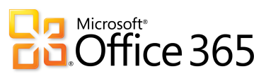

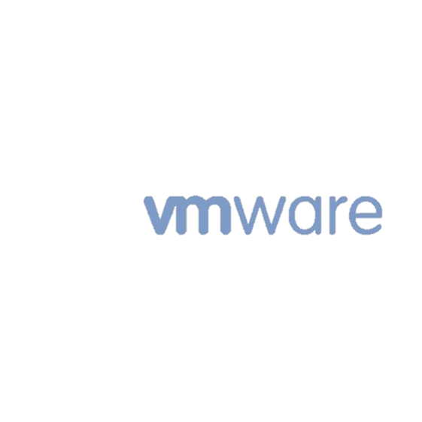





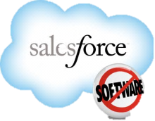


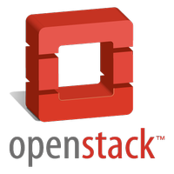


Some of the Players
PaaS
SaaS
AppHarbor
com
IaaS
Notes:
From Jim O’Neil’s presentation to Boston Azure user group on Sept 29, 2011

Slide 9
“Bring Your Own” ____ as a Service
BYO
Users
BYO
Applications
BYO
Virtual Machines
SaaS➔
PaaS➔
IaaS➔

Slide 10
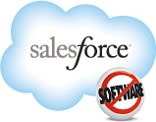


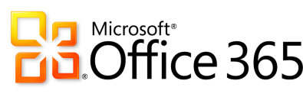
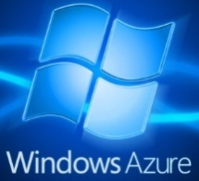

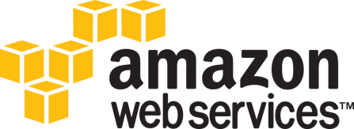
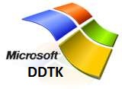
___________________ as a Service
Infrastructure
Software
Platform
Apps,
$/user, LDAP,
Expertise, SLA
System Software OpEx,
Auto Scale Out, Geo LB,
Failover, HA, OS Patching,
Monitoring, Monitoring,
Backup, Expertise, SLA
Hardware OpEx, Networking, DB/OS Licenses, Virtualization, Automation,
Geo Distribution, CDN, Geo Replication,
Elasticity, Managed Facility, Expertise, SLA
BYO
Users ➔
Public Cloud Rental Models
SaaS
BYO
Apps ➔
PaaS
BYO
VMs ➔
IaaS
Notes:
DDTK = Dynamic Datacenter ToolKit … Dan will go into more detail on this in a few minutes
Iceberg or Pyramid?

Slide 11

Application Ownership Simplified with PaaS
Stuff We Like
Stuff We Might
Rather Not Deal With
Data Center Management
High Availability
Computational Scalability
Hardware Provisioning
Network Load Balancing
Fault Tolerance
OS updates & Patches
Application Development
Staging / Production
Storage Scalability
OS Installation
Network Addressing
Hardware Repair

Slide 12
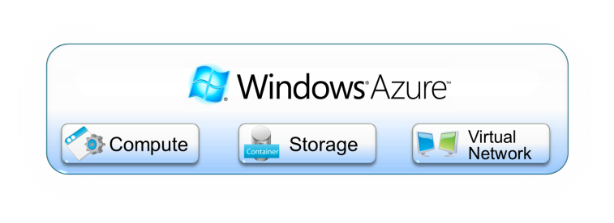

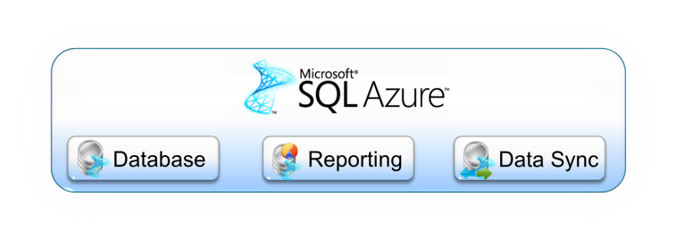






Windows Azure Overview
Notes:
Whether an application runs in the cloud, uses services provided by the cloud, or both, some kind of application platform is required. Viewed broadly, an application platform can be thought of as anything that provides developer-accessible services for creating applications. In the local, on-premises Windows world, for example, this includes technologies such as the .NET Framework, SQL Server, and more. To let applications exploit the cloud, cloud application platforms must also exist. And because there are a variety of ways for applications to use cloud services, different kinds of cloud platforms are useful in different situations. Microsoft’s Windows Azure platform is a group of cloud technologies, each providing a specific set of services to application developers. The Windows Azure platform can be used both by applications running in the cloud and by applications running on local systems.
The components of the Windows Azure platform can be used by local applications running on a variety of systems, including various flavors of Windows, mobile devices, and others. Those components include:
■ Windows Azure: Provides a Windows-based environment for running applications and storing data on servers in Microsoft data centers.
■ Microsoft SQL Azure: Provides data services in the cloud based on SQL Server.
■ Microsoft Azure platform App Fabric: Offers distributed infrastructure services to cloud-based and local applications.
Each component of the Windows Azure platform has its own role to play. This overview describes all four, first at a high level, then in a bit more detail.

Slide 13
PaaS in Azure also adds…
(Just examples…)
Key Management for Compute
(more) Homogenous Platform
  Ability to specify base OS + patch level
  “one throad”
  Alternative: Amazon lists 1000+ AMI images: http://aws.amazon.com/amis

Slide 14
Azure Data Storage…
Access Controls
  Storage keys, with rollover
  Shared Access Signatures (Blobs)
  Container-level Access Policies (Blobs)
Strong Consistency in Data Access
  Eventual Consistency challenges: Privacy settings, deletion of sensitive data
No automatic, at-rest encryption
  Amazon offers this

Slide 15









Reach: How
Cloud | Identity | Connectivity
 | Identity and Access Management (IAM) | Amazon Virtual Private Cloud AWS Direct Connect
 | AppFabric Access Control Service (SAML, OAuth) | App Fabric Service Bus Windows Azure Connect (CTP) Windows Azure Traffic Manager (CTP)
 | Google Account Google Apps for domain Open ID | Google Secure Data Connector
 | Salesforce infrastructure Delegated authentication Federated authentication (SAML)
 | Amazon hosted
 | AppCloud: Amazon hosted | xCloud: Private Virtual LAN
 | OneLogin is highlighted option on Rackspace site | RackConnect
app engine
Notes:
From Jim O’Neil’s presentation to Boston Azure user group on Sept 29, 2011

Slide 16
Remember Me?
BYO
Users
BYO
Applications
BYO
Virtual Machines
SaaS➔
PaaS➔
IaaS➔

Slide 17
Public ⬄ Hybrid ⬄ Private
 | Public Cloud Platform | My Data Center
Public Cloud
Hybrid Cloud
Private Cloud

Slide 18
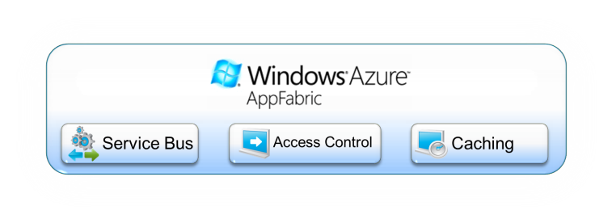
Windows Azure Overview
Notes:
Whether an application runs in the cloud, uses services provided by the cloud, or both, some kind of application platform is required. Viewed broadly, an application platform can be thought of as anything that provides developer-accessible services for creating applications. In the local, on-premises Windows world, for example, this includes technologies such as the .NET Framework, SQL Server, and more. To let applications exploit the cloud, cloud application platforms must also exist. And because there are a variety of ways for applications to use cloud services, different kinds of cloud platforms are useful in different situations. Microsoft’s Windows Azure platform is a group of cloud technologies, each providing a specific set of services to application developers. The Windows Azure platform can be used both by applications running in the cloud and by applications running on local systems.
The components of the Windows Azure platform can be used by local applications running on a variety of systems, including various flavors of Windows, mobile devices, and others. Those components include:
■ Windows Azure: Provides a Windows-based environment for running applications and storing data on servers in Microsoft data centers.
■ Microsoft SQL Azure: Provides data services in the cloud based on SQL Server.
■ Microsoft Azure platform App Fabric: Offers distributed infrastructure services to cloud-based and local applications.
Each component of the Windows Azure platform has its own role to play. This overview describes all four, first at a high level, then in a bit more detail.

Slide 19





Windows Azure Platform Data Centers
North America Region
Europe Region
Asia Pacific Region
N. Europe
N. Central – U.S.
W. Europe
S. Central – U.S.
E. Asia
S.E. Asia
  6 datacenters across 3 continents
Simply select your data center of choice when deploying an application
Notes:
Slide Objective
Understand that Microsoft has a long history in running data centres and online applications. Bing, Live, Hotmail etc….
Understand the huge amount of innovation going on at the data center level
Speaking Points:
Microsoft is one of the largest operators of datacenters in the world
Years of Experience
Large scale trustworthy environments
Driving for cost and environmental efficiently
Windows Azure runs in 3 regions and 6 datacenters today
Data center innovation is driving improved reliability and efficiency
PUE = Power Usage Effectiveness = Total Facility power/IT Systems Power = Indication of efficiency of DC
Under 1.8 is very good, modern cloud DCs approaching 1.2
Multi-billion dollar datacenter investment
700,000+ square foot Chicago and the 300,000+ square foot Dublin, Ireland data centers
Microsoft cloud services provide the reliability and security you expect for your business: 99.9% uptime SLA, 24/7 support.
Microsoft understands the needs of businesses with respect to security, data privacy, compliance and risk management, and identity and access control. Microsoft datacenters are ISO 27001:2005 accredited, with SAS 70 Type I and Type II attestations.
Notes:
http://www.globalfoundationservices.com/
http://blogs.msdn.com/the_power_of_software/archive/2008/06/20/microsoft-s-pue-experience-years-of-experience-reams-of-data.aspx
http://blogs.msdn.com/the_power_of_software/archive/2008/06/27/part-2-why-is-energy-efficiency-important.aspx

Slide 20

Windows Azure Security Layers
Defense in Depth Approach
Layer
Defenses
Data
Strong storage keys for access control
SSL support for data transfers between all parties
Application
Front-end .NET framework code running under partial trust
Windows account with least privileges
Hardened version of Windows Server 2008 OS
Host boundaries enforced by external hypervisor
Host
Network
Host firewall limiting traffic to VMs
VLANs and packet filters in routers
World-class physical security
ISO 27001 and SAS 70 Type II certifications for datacenter processes
Physical
Notes:
Key point – Microsoft implements a defense-in-depth approach to protect the infrastructure under its control against security threats.
To provide a secure platform for its customers and protect against the most prevalent security threats, Microsoft implements the following security controls in the stack under its control:
[Note this is NOT an exhaustive list]
At the data layer, access to data stored in Azure is controlled using strong storage access keys that are provisioned to the customer. All access to data can be (and should be) done over SSL to protect the confidentiality and the integrity of the data while in transit over the network.
At the application layer, Azure developers have the choice to run their front-end code under Azure Partial Trust, a “sandbox” that blocks access to native (non-.NET) components and helps ensure the integrity of the platform. All customer code is also run under a low privilege user account, and customers are not given administrative privileges over the operating system.
At host level, Azure virtual machines run a special version of Windows Server 2008 stripped down of all unnecessary components to reduce the attack surface and patch management requirements. Virtual machines boundaries are enforced by a underlying hypervisor and do not depend on the security of the VM Windows operating system.
At network level, all traffic to and from the virtual machines are filtered according to the policy defined by the customer, and enforced by the firewall on the virtual machine as well as a firewall running on the host (root) system. Microsoft also deploys VLANs and packet filters to segregate network access between customers, management systems and the Internet, and uses special devices to protect its infrastructure against distributed denial of service attacks (DDoS).
At the physical layer, Microsoft runs Azure on its own datacenters which implement world-class security controls, whose security controls and information security management systems have been certified under the international ISO/IEC 27001:2005 standard and the AICPA’s SAS 70 Type II standard.

Slide 21
Defenses Inherited by Windows Azure Platform Applications
Spoofing
Tampering/ Disclosure
Repudiation
Denial of Service
Elevation of Privilege
VLANs
Top of Rack Switches
Custom packet filtering
VM switch hardening
Certificate Services
Shared-Access Signatures
HTTPS
Sidechannel protections
Monitoring
Diagnostics Service
Configurable scale-out
Partial Trust Runtime
Hypervisor custom sandboxing
Virtual Service Accounts
Notes:
Key point – Applications hosted on the Windows Azure Platform inherit the security provided by the controls implemented by Microsoft.
This slide shows the security controls implemented by Microsoft organized per the type of vulnerabilities that they mitigate, following the STRIDE (Spoofing, Tampering, Repudiation, Denial of service and Elevation of privilege) classification.
Applications hosted on Windows Azure Platform inherit the security implemented by Microsoft in its hosting platform. When performing a threat modeling exercise, developers can rely on Microsoft applying mitigations to several possible security threats, and can focus on threats that are specific to their applications.

Slide 22
Hybrid Cloud & Windows Azure Platform
Connectivity
  Azure AppFabric Connect (VPN)
  Azure Message Bus (Secure Message Relay, Pub/Sub)
Identity / SSO / Claims-based AuthZ
  Access Control Service
  Active Directory Federation Services

Slide 23
data more secure in cloud
compute more secure
More homogenous than iaas clouds
ACS
Mature virtualization stack
Mature SQL
Mature Windows Server 2008 OS
Partial Trust compute available
Internal & External endpoints
3 copies x 2 geo
http://download.microsoft.com/download/7/3/E/73E4EE93-559F-4D0F-A6FC-7FEC5F1542D1/SecurityBestPracticesWindowsAzureApps.docx
Developers also should not store private keys associated with SSL/TLS certificates in Windows Azure Storage. Instead, upload them through the Developer Portal and access them via thumbprint references in the Service Configuration. Windows Azure will not only store these certificates encrypted at all times, but also securely provision them into the certificate stores of the service’s web roles upon boot. Developers should not attempt to store certificates anywhere on their own as these actions would constitute re-inventing a protection already supplied by the platform.

Slide 24

PaaS and cloud make strong security accessible to mere mortals
Less complex, more cost-effective, competitive pressure (“everyone’s doing it”)
Notes:
http://blogs.westword.com/latestword/2009/10/denver_is_smarter_than_every_o.php
http://www.google.com/imgres?imgurl=http://www.watchmoviestreaming.com/pictures/dumbanddumber1.jpg&imgrefurl=http://www.watchmoviestreaming.com/%3Fp%3D424&usg=__UZ1BrJ79mCMa7yueDsmtXOADCHw=&h=267&w=500&sz=24&hl=en&start=7&sig2=IbDrZVdkObZkrsySJqTm-Q&itbs=1&tbnid=Q_EZDCwRAgp15M:&tbnh=69&tbnw=130&prev=/images%3Fq%3Ddumb%2Band%2Bdumber%26hl%3Den%26as_st%3Dy%26tbs%3Disch:1&ei=j-zkS63ZHcO78gaC4qy4Bw

Slide 25
Simplified Security
Interesting matrix Appendix B: http://download.microsoft.com/download/7/3/E/73E4EE93-559F-4D0F-A6FC-7FEC5F1542D1/SecurityBestPracticesWindowsAzureApps.docx

