Slide 1
Cloud Architecture Patterns for Mere Mortals
Examples drawn from Windows Azure cloud platform
Vermont Code Camp III
10-September-2011
Boston Azure User Group
http://www.bostonazure.org
@bostonazure
Bill Wilder
http://blog.codingoutloud.com
@codingoutloud

Slide 2

“These go to eleven” –Nigel Tufnel
11 is just better than 10…
Notes:
http://discussion.autodesk.com/forums/thread.jspa?threadID=479556

Slide 3

Bill Wilder
Bill Wilder has been a software
professional for over 20 years. In 2009
he founded the Boston Azure User Group,
an in-person cloud community which gets
together monthly to learn about the
Windows Azure platform through prepared talks and hands-on coding. Bill is a Windows Azure MVP, an active speaker, blogger (blog.codingoutloud.com), and tweeter (@codingoutloud) on technology matters and soft skills for technologists, a member of Boston West Toastmasters, and has a day job as a .NET-focused enterprise architect.

Slide 4
11 Scalability Concepts
What is Scalability?
Scaling Data
Scaling Compute
Q&A
Notes:
Scaling Data
SQL Azure != SQL Server – 5 minutes
Query Fanout – 5 minutes
NoSQL, Table Storage – 10 minutes (mention Eventual Consistency)
Scaling Compute
Roles & Queues – 5 minutes
Scalability Pattern – 10 minutes (mention scale unit)

Slide 5
Key Concepts & Patterns
GENERAL
Scale vs. Performance
Scale Up vs. Scale Out
Shared Nothing
Scale Unit
DATABASE ORIENTED
ACID vs. BASE
Eventually Consistent
Sharding
Optimistic Locking
COMPUTE ORIENTED
CQRS Pattern
Poison Messages
Idempotency

Slide 6
Key Terms
Scale Up
Scale Out
Horizontal Scale
Vertical Scale
Scale Unit
ACID
CAP
Eventual Consistency
Strong Consistency
Multi-tenancy
NoSQL
Sharding
Denormalized
Poison Message
Idempotent
CQRS
Performance
Scale
Optimistic Locking
Shared Nothing
Load Balancing

Slide 7
Overview of Scalability Topics
What is Scalability?
Scaling Data
Scaling Compute
Q&A
Notes:
Scaling Data
SQL Azure != SQL Server – 5 minutes
Query Fanout – 5 minutes
NoSQL, Table Storage – 10 minutes (mention Eventual Consistency)
Scaling Compute
Roles & Queues – 5 minutes
Scalability Pattern – 10 minutes (mention scale unit)

Slide 8
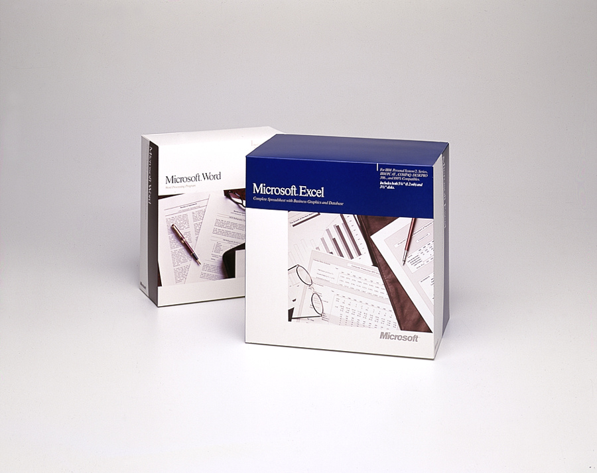

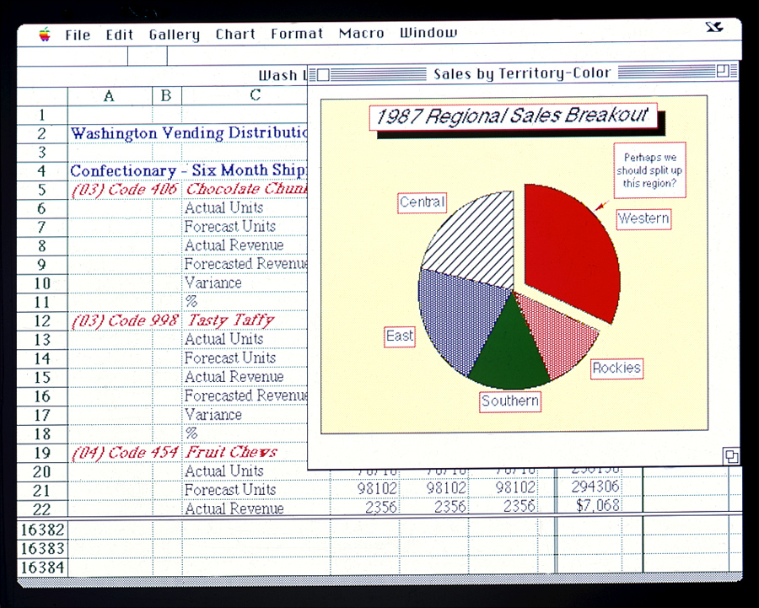
Old School Excel and Word
Notes:
Image credits/sources:
http://www.flickr.com/photos/microsoftsweden/5394688397/
http://en.wikipedia.org/wiki/File:Bundesarchiv_B_145_Bild-F077869-0042,_Jugend-Computerschule_mit_IBM-PC.jpg
http://www.flickr.com/photos/microsoftsweden/5395284268/

Slide 9
What does it mean to Scale?
  Scale != Performance
    Scalable iff Performance constant as it grows
  Scale the Number of Users
  … Volume of Data
  … Across Geography
  Scale can be bi-directional (more or less)
  Investment α Benefit
Notes:
Same performance when system is managing x units as with 10x, 100x, 1000x …

Slide 10
Options: Scale Up (and Scale Down) or Scale Out (and Scale In)
Terminology:
  Scaling Up/Down == Vertical Scaling
  Scaling Out/In == Horizontal Scaling
Architectural Decision
  Big decision… hard to change

Slide 11

Scaling Up: Scaling the Box
.

Slide 12
Scaling Out: Adding Boxes
“Shared nothing” scales best

Slide 13
How do I Choose???? ??????
.
Scale Up
(Vertically)
Scale Out
(Horizontally)
…
Not either/or!
Part business, part technical decision (requirements and strategy)
Consider Reliability (and SLA in Azure)
Target VM size that meets min or optimal CPU, bandwidth, space

Slide 14
Essential Scale Out Patterns
Data Scaling Patterns
  Sharding: Logical database comprised of multiple physical databases, if data too big for single physical db
  NoSQL: “Not Only SQL” – a family of approaches using simplified database model
Computational Scaling Patterns
  CQRS:
  Command Query Responsibility Segregation
Notes:
Talk will focus on how specific Scale Out Patterns can be realized using the Windows Azure Platform, though concepts are generally applicable to other cloud platforms and non-cloud systems…
Not ACID, thus addressing CAP theorem limitations
Uses concepts of sharding
Not discussing MAP/REDUCE, Warehouse, …

Slide 15
Overview of Scalability Topics
What is Scalability?
Scaling Data
Scaling Compute
Q&A
Notes:
Scaling Data
SQL Azure != SQL Server – 5 minutes
Query Fanout – 5 minutes
NoSQL, Table Storage – 10 minutes (mention Eventual Consistency)
Scaling Compute
Roles & Queues – 5 minutes
Scalability Pattern – 10 minutes (mention scale unit)

Slide 16
Overview of Scalability Topics
What is Scalability?
Scaling Data
  Sharding
  NoSQL
Scaling Compute
Q&A
Notes:
Scaling Data
SQL Azure != SQL Server – 5 minutes
Query Fanout – 5 minutes
NoSQL, Table Storage – 10 minutes (mention Eventual Consistency)
Scaling Compute
Roles & Queues – 5 minutes
Scalability Pattern – 10 minutes (mention scale unit)

Slide 17

Foursquare #Fail
October 4, 2010 – trouble begins…
After 17 hours of downtime over two days…
  “Oct. 5 10:28 p.m.: Running on pizza and Red Bull. Another long night.”
  WHAT WENT WRONG?
Notes:
Social Check-in Site Foursquare
32 employees (at the time)
10Gen
Small company
Microsoft
BIG COMPANY (how many of the 90k employees work on SQL Server?)
http://blog.foursquare.com/2010/10/05/so-that-was-a-bummer/
http://highscalability.com/blog/2010/10/15/troubles-with-sharding-what-can-we-learn-from-the-foursquare.html

Slide 18
What is Sharding?
Problem: one database can’t handle all the data
  Too big, not performant, needs geo distribution, …
Solution: split data across multiple databases
  One Logical Database, multiple Physical Databases
Each Physical Database Node is a Shard
Most scalable is Shared Nothing design
  May require some denormalization (duplication)
Notes:
[Not same as Data Warehouse or Reporting DB]

Slide 19
Sharding is Difficult
What defines a shard? (Where to put stuff?)
  Example by geography: customer_us, customer_fr, customer_cn, customer_ie, …
  Use same approach to find records
What happens if a shard gets too big?
  Rebalancing shards can get complex
  Foursquare case study is interesting
Query / join / transact across shards
Cache coherence, connection pool management

Slide 20
SQL Azure is SQL Server Except…
SQL Server
Specific
(for now)
SQL Azure
Specific
Limitations
50 GB size limit
New Capabilities
Highly Available
Rental model
Coming: Backups & point-in-time recovery
SQL Azure Federations
More…
Common
Full Text Search
Native Encryption
Many more…
“Just change the connection string…”
Additional information on Differences:
    http://msdn.microsoft.com/en-us/library/ff394115.aspx
Notes:
http://social.technet.microsoft.com/wiki/contents/articles/inside-sql-azure.aspx
“Another feature in development is the ability to take control of your backups. Currently, backups are performed in the data centers to protect your data against disk or system problems. However, there is no way currently to control your own backups to provide protection against logical errors and use a RESTORE operation to return to an earlier point in time when a backup was made. The new feature involves the ability to make your own backups of your SQL Azure databases to your own on-premises storage, and the ability to restore those backups either to an on-premises database or to a SQL Azure database. Eventually Microsoft plans to provide the ability to perform SQL Azure backups across data centers and also make log backups so that point-in-time recovery can be implemented.” http://social.technet.microsoft.com/wiki/contents/articles/inside-sql-azure.aspx

Slide 21
SQL Azure Federations for Sharding
Single “master” database
  “Query Fanout” makes partitions transparent
  Instead of customer_us, customer_fr, etc… we have just customer database
Handles redistributing shards
Handles cache coherence
Simplifies connection pooling
Not a released product offering at this time
http://blogs.msdn.com/b/cbiyikoglu/archive/2011/01/18/sql-azure-federations-robust-connectivity-model-for-federated-data.aspx
Notes:
http://blogs.msdn.com/b/cbiyikoglu/archive/2011/01/18/sql-azure-federations-robust-connectivity-model-for-federated-data.aspx

Slide 22
Overview of Scalability Topics
What is Scalability? (10 minutes)
Scaling Data (20 minutes)
  Sharding
  NoSQL
Scaling Compute (15 minutes)
Q&A (15 minutes)
Notes:
Scaling Data
SQL Azure != SQL Server – 5 minutes
Query Fanout – 5 minutes
NoSQL, Table Storage – 10 minutes (mention Eventual Consistency)
Scaling Compute
Roles & Queues – 5 minutes
Scalability Pattern – 10 minutes (mention scale unit)

Slide 23
Persistent Storage Services – Azure
Type of Data | Traditional | Azure Way
Relational | SQL Server | SQL Azure
BLOB (“Binary Large Object”) | File System, SQL Server | Azure Blobs
File | File System | (Azure Drives) Azure Blobs
Logs | File System, SQL Server, etc. | Azure Blobs Azure Tables
Non-Relational |  | Azure Tables
NoSQL ?

Slide 24


Not Only SQL
Notes:
http://www.cloudave.com/695/nosql-is-not-sql-and-thats-a-problem/
http://notonlysql.com/

Slide 25

NoSQL Databases (simplified!!!)
, CouchDB: JSON Document Stores
Amazon Dynamo, Azure Tables: Key Value Stores
  Dynamo: Eventually Consistent
  Azure Tables: Strongly Consistent
Many others!
Faster, Cheaper
Scales Out
“Simpler”
Notes:
http://en.wikipedia.org/wiki/NoSQL
Amazon Dynamo is inspiration for other popular NoSQLs like Riak and Cassandra

Slide 26
Eventual Consistency
Property of a system such that not all records of state guaranteed to agree at any given point in time.
  Applicable to whole systems or parts of systems (such as a database)
As opposed to Strongly Consistent (or Instantly Consistent)
Eventual Consistency is natural characteristic of a useful, scalable distributed systems

Slide 27
Why Eventual Consistency? #1
ACID Guarantees:
  Atomicity, Consistency, Isolation, Durability
  SQL insert vs read performance?
    How do we make them BOTH fast?
    Optimistic Locking and “Big Oh” math
BASE Semantics:
  Basically Available, Soft state, Eventual consistency
From: http://en.wikipedia.org/wiki/ACID and http://en.wikipedia.org/wiki/Eventual_consistency

Slide 28
Why Eventual Consistency? #2
CAP Theorem – Choose only two guarantees
Consistency: all nodes see the same data at the same time
Availability: a guarantee that every request receives a response about whether it was successful or failed
Partition tolerance: the system continues to operate despite arbitrary message loss
From: http://en.wikipedia.org/wiki/CAP_theorem

Slide 29

Cache is King
Facebook has “28 terabytes of memcached data on 800 servers.” http://highscalability.com/blog/2010/9/30/facebook-and-site-failures-caused-by-complex-weakly-interact.html
Eventual Consistency at work!
Notes:
Facebook image: http://www.flickr.com/photos/69805768@N00/3292553947/

Slide 30
Relational (SQL Azure) vs. NoSQL (Azure Tables)
Approach | Relational (e.g., SQL Azure) | NoSQL (e.g., Azure Tables)
Normalization | Normalized | Denormalized
(Duplication) | (No duplication) | (Duplication okay)
Transactions | Distributed | Limited scope
Structure | Schema | Flexible
Responsibility | DBA/Database | Developer/Code
Knobs | Many | Few
Scale | Up (or Sharding) | Out
Notes:
http://en.wikipedia.org/wiki/NoSQL

Slide 31
NoSQL Storage
Suitable for granular, semi-structured data (Key/Value stores)
Document-oriented data (Document stores)
No rigid database schema
Weak support for complex joins or complex transaction
Usually optimized to Scale Out
NoSQL databases generally not managed with same tooling as for SQL databases

Slide 32
Overview of Scalability Topics
What is Scalability?
Scaling Data
Scaling Compute
  CQRS
Q&A
Notes:
Scaling Data
SQL Azure != SQL Server – 5 minutes
Query Fanout – 5 minutes
NoSQL, Table Storage – 10 minutes (mention Eventual Consistency)
Scaling Compute
Roles & Queues – 5 minutes
Scalability Pattern – 10 minutes (mention scale unit)

Slide 33
CQRS Architecture Pattern
Command Query Responsibility Segregation
Based on notion that actions which Update our system (“Commands”) are a separate architectural concern than those actions which ask for data (“Query”)
Leads to systems where the Front End (UI) and Backend (Business Logic) are Loosely Coupled

Slide 34
CQRS in Windows Azure
WE NEED:
Compute resource to run our code
  Web Roles (IIS) and Worker Roles (w/o IIS)
Reliable Queue to communicate
  Azure Storage Queues
Durable/Persistent Storage
  Azure Storage Blobs & Tables; SQL Azure

Slide 35
Key Pattern: Roles + Queues
Web Server
Compute Service
Reliable Queue
Reliable Storage
Notes:
AJAX – orthogonal concern
Worker Role not related to HTML 5 concept of Web Worker

Slide 36


Canonical Example: Thumbnails
Web
Role
(IIS)
Worker
Role
Azure Queue
Azure Blob
Key Point: at first, user does not get the thumbnail
(UX implications)
Notes:
AJAX – orthogonal concern
Worker Role not related to HTML 5 concept of Web Worker
“Thumbnails” sample code available from http://code.msdn.microsoft.com/windowsazuresamples

Slide 37
Reliable Queue & 2-step Delete
queue.AddMessage(
new CloudQueueMessage(
urlToMediaInBlob));
(IIS)
Web
Role
Worker
Role
Queue
CloudQueueMessage msg =
queue.GetMessage(
TimeSpan.FromSeconds(10));
… queue.DeleteMessage(msg);
Notes:
AJAX – orthogonal concern
Worker Role not related to HTML 5 concept of Web Worker

Slide 38
General Case:
Many Roles, Many Queues
Worker
Role
Worker
Role
Worker
Role
Web
Role
(IIS)
Queue Type 1
Worker
Role Type 1
Web
Role
(IIS)
Queue Type 1
Web
Role
(IIS)
Web
Role
(IIS)
Queue Type 2
Queue Type 2
Worker
Role
Worker
Role
Queue Type 3
Worker
Role
Queue Type 3
Worker
Role Type 2
Queue Type 3
Queue Type 3
Remember: Investment α Benefit
Watch your scale units!
  Logical vs. Physical Architecture

Slide 39
CQRS requires Idempotent
If we perform idempotent operation more than once, end result same as if we did it once
Example with Thumnailing (easy case)
App-specific concerns dictate approaches
  Compensating transactions
  Last in wins
  Many others possible – hard to say

Slide 40
CQRS expects Poison Messages
A Poison Message cannot be processed
  Error condition for non-transient reason
  Queue feature: know your dequeue count
    CloudQueueMessage.DequeueCount property in Azure
Be proactive
  Falling off the queue may kill your system
    Message TTL = 7 days by default in Azure
Determine a max Retry policy
  May differ by queue object type or other criteria
  Delete, Move to Special Queue

Slide 41
CQRS enables Responsive
Response to interactive users is as fast as a work request can be persisted
Time consuming work done off-line
Comparable total resource consumption, arguably better subjective UX
UX challenge – how to express Async to users?
  Communicate Progress
  Display Final results

Slide 42
CQRS enables Scalable
Loosely coupled, concern-independent scaling
  Getting Scale Units right
Blocking is Bane of Scalability
  Decoupled front/back ends insulate from other system issues if…
  Twitter down
  Email server unreachable
  Order processing partner doing maintenance
  Internet connectivity interruption

Slide 43

CQRS enables Distribution
  Scale out systems better suited for geographic distribution
  More efficient and flexible because more granular
  Hard for a mega-machine to be in more than one place
  Failure need not be binary
Notes:
Chainsaw: http://commons.wikimedia.org/wiki/File:Chainsaw_cutting_tree.jpg

Slide 44
CQRS enables Resilient
And Requires that you “Plan for failure”
There will be VM (or Azure role) restarts
Bake in handling of restarts
  Not an exception case! Expect it!
  Restarts are routine, system “just keeps working”
If you follow the pattern, the payoff is substantial…

Slide 45


What’s Up?
Aspirin-free Reliability as EMERGENT PROPERTY
 | Typical Site | Any 1 Role Inst | Overall System
Operating System Upgrade
Application Update / Deploy
Change Topology
Hardware Failure
Software Bug / Crash / Failure
Security Patch
Notes:
Tech Windows

Slide 46
Overview of Scalability Topics
What is Scalability?
Scaling Data
Scaling Compute
Q&A
  Summary
  Questions? Feedback? Stay in touch
Notes:
Scaling Data
SQL Azure != SQL Server – 5 minutes
Query Fanout – 5 minutes
NoSQL, Table Storage – 10 minutes (mention Eventual Consistency)
Scaling Compute
Roles & Queues – 5 minutes
Scalability Pattern – 10 minutes (mention scale unit)

Slide 47
3 Big Ideas to Take Home
Consider flexibility of Scale Out architecture
  Scalable, Resilient, Testable, Cost-appropriate
  Computation: Queues, Storage, CQRS
  Data: SQL Azure Federations, NoSQL (Azure Tables)
Look for Eventual Consistency opportunities
  Caching, CDN, CQRS, Non-transactional Data Updates, Optimistic Locking
Embrace platforms with appropriate affordances for future-looking architecture
  e.g., Windows Azure Platform (PaaS)

Slide 48
Questions?
Comments?
More information?
?

Slide 49
BostonAzure.org
Boston Azure cloud user group
  Focused on Microsoft’s cloud platform
Last Thursday, monthly, 6:00-8:30 PM at NERD
  Food; wifi; free; great topics; growing community
Special Waltham meeting on Wed Sept 21
Boston Azure Boot Camp: Fri 9/30-Sat 10/1
Follow on Twitter: @bostonazure
More info or to join our email list:
http://www.bostonazure.org

Slide 50
Contact Me
I may be able to speak at your technology event
Just Ask!
Bill Wilder
@codingoutloud
http://blog.codingoutloud.com

