Slide 1
Summary
To fully leverage cloud computing we need to understand both the strengths and weaknesses of the cloud. In this talk, we will demonstrate how the strengths and weaknesses of the cloud map naturally into specific programming practices in Windows Azure. We will focus on Azure Roles and Queues as enabling technologies, show how to combine them using cloud-friendly design patterns, and how it becomes possible for mere mortals to build highly reliable applications that scale. The concepts discussed in this talk are relevant for developers and architects building systems for the cloud today, or who want to be prepared to move to the cloud in the future.
Notes:
To fully leverage cloud computing we need to understand both the strengths and weaknesses of the cloud. In this talk, we will demonstrate how the strengths and weaknesses of the cloud map naturally into specific programming practices in Windows Azure. We will focus on Azure Roles and Queues as enabling technologies, show how to combine them using cloud-friendly design patterns, and how it becomes possible for mere mortals to build highly available applications that scale. The concepts discussed in this talk are relevant for developers and architects building systems for the cloud today, or who want to be prepared to move to the cloud in the future.

Slide 2
Bill Wilder – brief bio
Bill Wilder has been a professional software developer for more than 20 years. Last year he founded the Boston Azure User Group, an in-person cloud computing community which gets together monthly to learn about Windows Azure through prepared talks and hands-on coding. Bill is especially excited about the Boston Azure Project, a collaborative Windows Azure coding project just starting up in the Boston Azure community. Bill is an active community speaker, blogger (blog.codingoutloud.com), and tweeter (@codingoutloud) on technology matters and soft skills for technologists, and is also a member of Boston West Toastmasters. Separately, Bill has a day job as an enterprise architect focusing on .NET.
Notes:
Bill Wilder has been a professional software developer for more than 20 years. Last year he founded the <a href="http://bostonazure.org/">Boston Azure User Group</a>, an in-person cloud computing community which gets together monthly to learn about Windows Azure through prepared talks and hands-on coding. Bill is especially excited about the <a
href="http://blog.codingoutloud.com/2010/06/02/introducing-the-boston-azure-project/">Boston Azure Project</a>, a collaborative Windows Azure coding project just starting up in the Boston Azure community. Bill is an active community speaker, blogger (<a href="http://blog.codingoutloud.com">blog.codingoutloud.com</a>), and tweeter (<a href="http://twitter.com/codingoutloud">@codingoutloud</a>) on technology matters and soft skills for technologists, and is also a member of Boston West Toastmasters. Separately, Bill has a day job as an enterprise architect focusing on .NET.

Slide 3
Queue can be created by either Web Role or Worker Role
  “guard” code in both – don’t know start order
  Queue will go away when empty???

Slide 4
DO SOME MATH
- birthday problem (24 people?)
- look at stats for 1 machine
  Deliberate takedowns not “random”
  Do the math on reliability
Networks and other areas can be unreliable
  Software too!

Slide 5
Two Roles a Queue
Building Cloud-Native Applications:
Web Roles, Worker Roles, and Queues
AzureUG.NET
14-July-2010
Boston Azure User Group
http://bostonazure.org
@bostonazure
Bill Wilder
http://blog.codingoutloud.com
@codingoutloud
Boston West Toastmasters http://bwtoastmasters.com
Not here with my day job
Only Bill’s personal views
Usually release via Creative Commons, but have some stuff I “borrowed”
Notes:
Not representing my day job
Several slides stolen borrowed from http://www.meetup.com/Boston-cloud-services/files/ (http://files.meetup.com/1460349/azure.ppt – Jim O’Neil’s Windows Azure presentation from March 17, 2010 meetup) + from Chris Bowen’s “roadshow” talk (March 2010)

Slide 6
Two Roles a Queue
Building Cloud-Native Applications:
Web Roles, Worker Roles, and Queues
AzureUG.NET
14-July-2010
Boston Azure User Group
http://bostonazure.org
@bostonazure
Bill Wilder
http://blog.codingoutloud.com
@codingoutloud
Boston West Toastmasters http://bwtoastmasters.com
Not here with my day job
Only Bill’s personal views
Notes:
Not representing my day job
Several slides stolen borrowed (with permission) from http://www.meetup.com/Boston-cloud-services/files/ (http://files.meetup.com/1460349/azure.ppt – Jim O’Neil’s Windows Azure presentation from March 17, 2010 meetup) + from Chris Bowen’s “roadshow” talk (March 2010)

Slide 7
Cloud-Native Applications
Effort focuses on business functionality
  Development is highly productive
  Time-to-market is short
  Modification is straight-forward
Infrastructure is not a limiting factor
  Cost structure is a good fit
  Downtime is not necessary
  Scale is efficient
Innovation / experimentation is enabled

Slide 8
Agenda for Roles & Queues
Understand Roles, Understand Queues
The Most Important Architectural Design Pattern: Combining Roles and Queues
Why R^{n}⬄Q^{n}⬄R^{n} is a game-changer
What to watch out for
Helping mere mortals build highly reliable applications that scale…

Slide 9
Key Concepts
Roles
  Web Roles
  Worker Roles
Queues

Slide 10



Web Roles vs. Worker Roles
 | Web Role | Worker Role
Runs in IIS 7 (always listening)
Built using ASP.NET, MVC
Good to handle interactive users
Addressable over Internet
Good for hosting Web API (WCF)
Runs Continuously
Notes:
Smarx “The only difference between a web role and a worker role is that in the web role, IIS (actually Hosted Web Core) gets started and pointed at your app data directory. You can still put code in WebRole.cs that does exactly the same thing as you would do in your worker role, so the decision should really be "Do you want IIS?" If so, use a web role. If not, use a worker role.”
One is always running, one is always listening

Slide 11
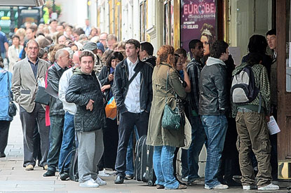
Queue
Notes:
http://www.google.com/imgres?imgurl=http://i.thisislondon.co.uk/i/pix/2008/09/hamlet-queue-415x275.jpg&imgrefurl=http://www.thisislondon.co.uk/standard/article-23554957-fans-queue-at-box-office-for-david-tennants-hamlet.do&usg=__MmvCdA0aI9YfR3UaV-DXzzNgenU=&h=275&w=415&sz=51&hl=en&start=18&sig2=nIloA1Q8lveL1tTj8TQZRQ&um=1&itbs=1&tbnid=QX8ur12fYUtSBM:&tbnh=83&tbnw=125&prev=/images%3Fq%3Dqueue%26um%3D1%26hl%3Den%26sa%3DG%26rls%3Dcom.microsoft:en-us%26rlz%3D1I7ADFA_en%26as_st%3Dy%26tbs%3Disch:1&ei=1vHkS-6KHcL-8AaYw-DBDg

Slide 12
Key Pattern: Roles + Queues
Web
Role
(IIS)
Worker
Role
Queues
Blobs
Tables
Notes:
AJAX – orthogonal concern
Worker Role not related to HTML 5 concept of Web Worker

Slide 13

Canonical Example: Thumbnails
Web
Role
(IIS)
Worker
Role
Queues
Blobs
Tables
Notes:
AJAX – orthogonal concern
Worker Role not related to HTML 5 concept of Web Worker

Slide 14


Adding to Queue - Conceptual
Queue Name: “thumbnailer-7”
http://thumbnailer-7.queue.core.windows.net/

Slide 15
Adding to Queue - Actual
314159
979323
265358
Azure Blob Storage
314159
265358
979323
Notes:
3.14159 265358 979323 846264 338327 950288 419716 939937 510582 097494 459230

Slide 16
Key Pattern: Roles + Queues
Simplify and Focus
Web
Role
(IIS)
Worker
Role
Queues
Notes:
AJAX – orthogonal concern
Worker Role not related to HTML 5 concept of Web Worker

Slide 17
Roles + Queues: API
queue.AddMessage(
new CloudQueueMessage(
statusUpdateMessage));
Web
Role
(IIS)
Worker
Role
Queues
CloudQueueMessage
statusUpdateMessage =
queue.GetMessage(
TimeSpan.FromSeconds(10));
… queue.DeleteMessage(statusUpdateMessage);
Notes:
AJAX – orthogonal concern
Worker Role not related to HTML 5 concept of Web Worker

Slide 18
Web App vs. Web Role
Consider ASP.NET Web App (e.g., hosted at ISP)
Consider Web Role hosted on Azure
Scale

Slide 19
Azure RUNTIME STACK

Slide 20
Azure Development Tool Stack
Visual Studio
C#, VB.NET, F#, …
.NET Runtime
Dev Fabric, Azure Toolkit , Azure SDK
Plus…
Could be non-Visual Studio, non-.NET-based
REST access to all Azure Services
Notes:
System Center

Slide 21
Pre-Azure Server Stack
.NET Runtime (3.5)
Windows Server 2008, IIS 7
Windows Communication Foundation (WCF)
-------------------------------------------------------------
SQL Server
SQL Server
MSMQ
ASP.NET, ASP.NET MVC
Windows Services
Notes:
System Center

Slide 22
Azure Server Stack
.NET Runtime (3.5)
Windows Server 2008, IIS 7
Windows Communication Foundation (WCF)
-------------------------------------------------------------
SQL Server ➔ SQL Azure
SQL Server ➔ Azure Blobs
null ➔ Azure Table Storage
MSMQ ➔ Azure Queues
ASP.NET, ASP.NET MVC ➔ Azure Web Role
Windows Services ➔ Worker Roles
Notes:
System Center

Slide 23
Pre-Azure Operational Concerns
Buying hardware
CapEx
Provisioning Servers
Configuring Servers and Services
Patching the Operating System
(Human) Ops Resource Intensive

Slide 24
Azure Operational Concerns
Buying hardware ➔ null
CapEx ➔ Variable cost / Utility pricing
Provisioning Servers ➔ null
Configuring Servers and Services ➔ null
Patching the Operating System ➔ null
(Human) Ops Resource Intensive ➔ null
  + Communication paths reduced

Slide 25
Pre-Azure Operational Concerns
Buying hardware
CapEx
(Human) Ops Resource Intensive

Slide 26
Azure Operational Concerns
Buying hardware ➔ null
CapEx ➔ Variable cost / Utility pricing
(Human) Ops Resource Intensive ➔ null
  + Communication paths reduced

Slide 27

Concerns for App Owner
Stuff We Like
Stuff We Might
Rather Not Deal With
Data Center Management
High Availability
Computational Scalability
Hardware Provisioning
Network Load Balancing
As long as we follow certain
Architectural Design Patterns
“Cloud-Native”
Fault Tolerance
OS updates & Patches
Application Development
Staging / Production
Storage Scalability
OS Installation
Network Addressing
Hardware Repair

Slide 28







Compute Services
Web
Role
Worker
Role
Web
Role
(IIS)
Worker
Role
LB
HTTP/HTTPS
Web Role
  Hosted in IIS (Web Server)
  Public facing service
Worker Role
  Background process
  Can be public facing
Language agnostic

Slide 29
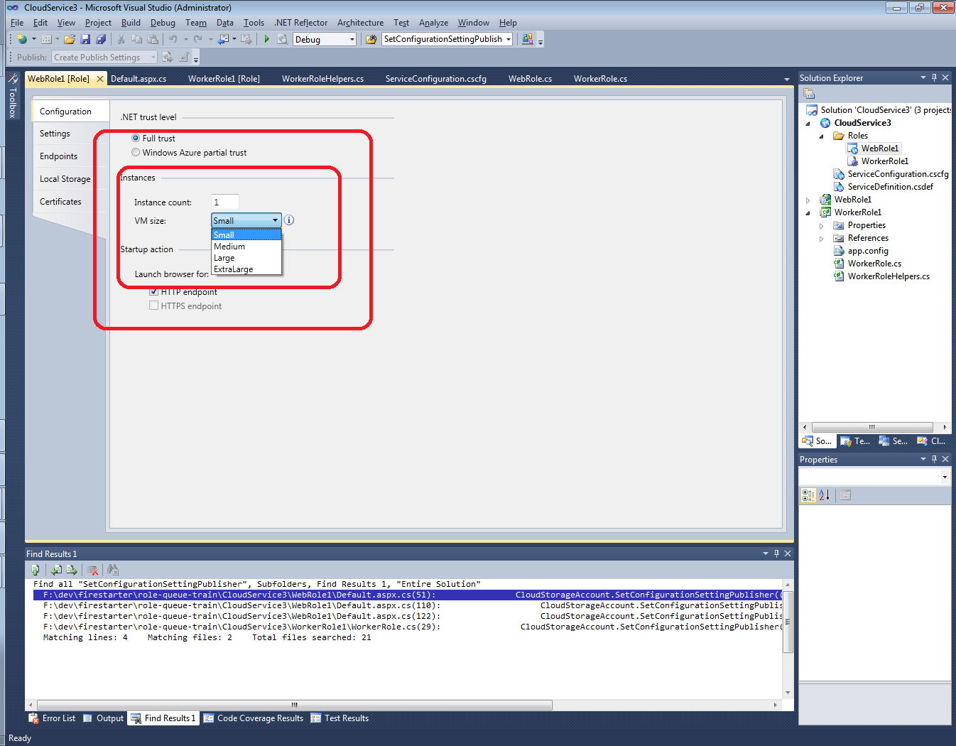
“Out” is the New “Up”
Scaling Out has hard limits at CPU, Memory
  Architecturally more limiting

Slide 30
Key Windows Azure Design Pattern…
TWO ROLES AND A QUEUE

Slide 31
General Case: Roles^{n} + Queues^{n}
R^{n}⬄Q^{n}⬄R^{n}
Worker
Role
Web
Role
(IIS)
Worker
Role
Web
Role
(IIS)
Worker
Role
Web
Role
(IIS)
Worker
Role Type 1
Web
Role
(IIS)
Worker
Role
Queues
Worker
Role
Worker
Role
Worker
Role Type 2
Notes:
AJAX – orthogonal concern
Worker Role not related to HTML 5 concept of Web Worker

Slide 32
Key Metric
Queue length (and trend) is key data point for tuning Role deployment numbers
  Available programmatically for monitoring
  May vary across queue types

Slide 33
Azure Queues by the Numbers
100% = Reliability of message delivery
7 days = default TTL for item to stay in queue
30 seconds = default “invisibility window”
8 KB = max size of a queued item
500 = approx number of transactions a queue can handle per second
  Beware of “spinning” – may get throttled, disabled
N = number of queues you can have (N >> 1)

Slide 34
Example: Lesson 7: Work Offline
“Lesson 7: Work Offline.” from 7 Lessons Learned While Building Reddit to 270 Million Page Views a Month
http://highscalability.com/blog/2010/5/17/7-lessons-learned-while-building-reddit-to-270-million-page.html
Lesson 7: Work Offline
The essence of this lesson is: do the minimal amount of work on the backend and tell the user you are done.
If you need to do something do it while the user isn’t waiting for you. Put it in a queue. When a user votes on Reddit that updates listings, a user’s Karma, and lots of other stuff. So on a vote the database is updated to know that the vote happened, then a job is put in the queue, the job knows the 20 things that need to be updated. When the user comes back everything has been precached for them.
Work they do offline: 1. Precompute listings 2. Fetch thumbnails 3. Detect cheating. 4. Remove spam 5. Compute awards 6. Update search index .
There's no need to do these things while the user is waiting on you. For example, the incentive to cheat is higher now as Reddit has grown larger, so they spend a lot of time in the backend while people are voting to detect cheating. But they do it live in the background so it doesn’t slow down the user experience. The diagram of the architecture from the presentation is:
The blue arrows are what happens when a request comes in. Say someone submits a link or vote, it goes to the cache, master database, and job queue. Then they return to the user. Then the rest happens offline, those are represented by the pink arrows. Services like Spam, Precomputer, and Thumnailer read from the queue, do the work, and update database as required. Key piece of technology is RabbitMQ.
Notes:
http://highscalability.com/blog/2010/5/17/7-lessons-learned-while-building-reddit-to-270-million-page.html

Slide 35
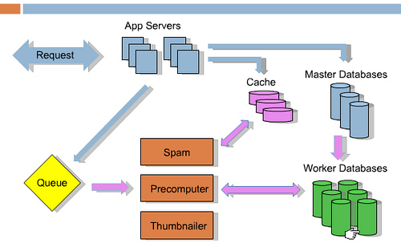
“Do it while the user isn’t waiting for you.”
“Put it in a queue.”
Notes:
http://highscalability.com/blog/2010/5/17/7-lessons-learned-while-building-reddit-to-270-million-page.html

Slide 36
R^{n}⬄Q^{n}⬄R^{n} enables Responsive
Response to interactive users is as fast as a work request can be persisted
Time consuming work done off-line
Same total resource consumption, better subjective experience
UX challenge – how to express Async to users?
  Communicate Progress
  Display Final results

Slide 37
R^{n}⬄Q^{n}⬄R^{n} enables Scalable
Loosely coupled, concern-independent scaling
Blocking is Bane of Scalability
  Decoupled front/back ends insulate from other system issues if…
  Twitter down
  Email server unreachable
  Order processing partner doing maintenance
  Internet connectivity interruption

Slide 38

R^{n}⬄Q^{n}⬄R^{n} enables Distribution
  Scale out systems better suited for geographic distribution
  More efficient and flexible because more granular
  Hard for a mega-machine to be in more than one place
  Failure need not be binary
Notes:
Chainsaw: http://commons.wikimedia.org/wiki/File:Chainsaw_cutting_tree.jpg

Slide 39
Optimization is optional
Individual role utilization may be low
  Role is a VM – lots of resources
  You pay by instance, not resource use within
Make sure VM instances are “right sized”
  Small, Medium, Large, XL
Make sure enough roles for uptime
  SLA requires minimum of 2 instances
Business Trade-Off for further optimizations
  Optimize for CPU utilization (multiple threads)
  Combine types of processing into fewer role types

Slide 40
Common Operational Challenges
Hard to upgrade without downtime
Wasteful to provision for peak load
Time consuming to add more dev or test environments

Slide 41
R^{n}⬄Q^{n}⬄R^{n} requires Idempotent
If we do a task twice, end result same as if we did it once
App-specific concerns dictate approaches
  Compensating transactions
  Last in wins
  Many others possible – hard to say
Example with Thumnailing

Slide 42
R^{n}⬄Q^{n}⬄R^{n} requires Poison Message Strategy
A Poison Message cannot be processed
  Error condition
  Non-transient reason
Strategy One:
  Fall off the queue (TTL)
  Message stays in queue for 7 days (default)
Strategy Two:
  Specify retry threshold
  Remove poison messages

Slide 43
R^{n}⬄Q^{n}⬄R^{n} enables Resilient
And Requires that you “Plan for failure”
There will be role restarts
Bake in handling of restarts
  Not an exception case! Expect it!
  Restarts are routine, system “just keeps working”
If you follow the pattern, the payoff is substantial…

Slide 44
What’s Up?
Aspirin-free Reliability as EMERGENT PROPERTY
 | Typical Site | Any Azure Role | Overall System
Operating System Upgrade
Application Update / Deploy
Change Topology
Hardware Failure
Software Bug / Crash / Failure
Security Patch
Notes:
Tech Windows

Slide 45
Why Now?
Internet is “always on” – customer expectations
Cheap, commodity computers that are pretty dang good – Moore’s Law
Internet is distributed
Cost focus due to global economy
Innovation driven – fiercely competitive space

Slide 46
Organizational Drivers
Global Workforce: Cloud Roles offer logical separation for purposes of development + test by distributed development teams
Agile: Smaller teams, Lower friction, Shorter cycle times

Slide 47
Data Centers are BIG
Recently we crossed the threshold where power consumed by data centers in the US now exceeds 2% of all power used - and for any data center, power accounts for more than all other costs combined.
  Pat Helland, a Microsoft cloud architect
Data centers are sucking more juice than all US color TVs combined.
  http://royal.pingdom.com/2008/07/25/us-data-centers-consuming-as-much-power-as-5-million-houses/

Slide 48
Data Centers are Global
Let your Cloud provider deal with …
  Global distribution / synchronization
  Geographic load balancing / tuning
  Providing CDN
  Roles and Queues pattern still works

Slide 49
No Holds Barred
“[Google’s] custom-designed server hardware includes a 12-volt battery that functions as an uninterruptible power supply. This obviates the need for a central data center UPS, which turns out to be less reliable than on-board batteries.” –Information Week
http://i.i.com.com/cnwk.1d/i/bto/20090401/GoogleServerLarge.jpg
Notes:
http://bmighty.informationweek.com/ebusiness/showArticle.jhtml?articleID=216500267&pgno=1

Slide 50
Azure’s Abstraction
Code that knows about failover, other computers, environments, …
  Does. Not. Exist. in your application code
Azure’s AppFabric handles
So Roles support many properties – Azure allows for a clean implementation or Roles

Slide 51
These capabilities are not all new… right?
Notes:
http://blogs.westword.com/latestword/2009/10/denver_is_smarter_than_every_o.php
http://www.google.com/imgres?imgurl=http://www.watchmoviestreaming.com/pictures/dumbanddumber1.jpg&imgrefurl=http://www.watchmoviestreaming.com/%3Fp%3D424&usg=__UZ1BrJ79mCMa7yueDsmtXOADCHw=&h=267&w=500&sz=24&hl=en&start=7&sig2=IbDrZVdkObZkrsySJqTm-Q&itbs=1&tbnid=Q_EZDCwRAgp15M:&tbnh=69&tbnw=130&prev=/images%3Fq%3Ddumb%2Band%2Bdumber%26hl%3Den%26as_st%3Dy%26tbs%3Disch:1&ei=j-zkS63ZHcO78gaC4qy4Bw

Slide 52

Not new, but…
Notes:
http://blogs.westword.com/latestword/2009/10/denver_is_smarter_than_every_o.php
http://www.google.com/imgres?imgurl=http://www.watchmoviestreaming.com/pictures/dumbanddumber1.jpg&imgrefurl=http://www.watchmoviestreaming.com/%3Fp%3D424&usg=__UZ1BrJ79mCMa7yueDsmtXOADCHw=&h=267&w=500&sz=24&hl=en&start=7&sig2=IbDrZVdkObZkrsySJqTm-Q&itbs=1&tbnid=Q_EZDCwRAgp15M:&tbnh=69&tbnw=130&prev=/images%3Fq%3Ddumb%2Band%2Bdumber%26hl%3Den%26as_st%3Dy%26tbs%3Disch:1&ei=j-zkS63ZHcO78gaC4qy4Bw

Slide 53

Accessible to mere mortals
Less complex, more cost-effective → competitive pressure …
Your competitors are going to be doing it
Notes:
http://blogs.westword.com/latestword/2009/10/denver_is_smarter_than_every_o.php
http://www.google.com/imgres?imgurl=http://www.watchmoviestreaming.com/pictures/dumbanddumber1.jpg&imgrefurl=http://www.watchmoviestreaming.com/%3Fp%3D424&usg=__UZ1BrJ79mCMa7yueDsmtXOADCHw=&h=267&w=500&sz=24&hl=en&start=7&sig2=IbDrZVdkObZkrsySJqTm-Q&itbs=1&tbnid=Q_EZDCwRAgp15M:&tbnh=69&tbnw=130&prev=/images%3Fq%3Ddumb%2Band%2Bdumber%26hl%3Den%26as_st%3Dy%26tbs%3Disch:1&ei=j-zkS63ZHcO78gaC4qy4Bw

Slide 54
Summary
Use the Roles and Queues
  Everything flows from this
Code for retries – Plan to fail
Handle Poison Messages
Think through the UX

Slide 55
Advanced Worker Role Topics
Full utilization of a WR instance is more work
  Message stays in queue for 7 days
  You pay by instance, not resource use within
Tactics…
  Read >1 message from queue at a time
  Have multiple message types handled in one worker role
  Build multi-threaded Worker Role
Build simple “scale with the config file” systems
  Is time-to-market more imp than deployment / run costs?
  Trade off scale efficiency, maintainability, time-to-market
Business Decisions!

Slide 56
http://queue.core.windows.net
“If you are running in the development fabric on your desktop computer you can configure it with the well-known development storage connection string UseDevelopmentStorage=true. This well-known string provides all of the data necessary to connect with the local instance of development storage.” –Azure in Action p. 349

Slide 57
Imagine a Train…
Designed to support the maximum/peak load
Made all the needed stops
Ran once per day
WE DON’T DO THAT
Many small trains
No “SPoF”
Put all your eggs in the one basket and – WATCH THAT BASKET. – Mark Twain

Slide 58
Silver Bullet?
Question: Does Azure make my application scale automatically?

Slide 59
☺

Slide 60
Closing thought
Do we really need “the cloud” for all these great properties?
Does (cloud == scalability + operational simplicity + cost savings + fast time-to-market)?
Notes:
http://discussion.autodesk.com/forums/thread.jspa?threadID=479556

Slide 61

“These go to eleven” –Nigel Tufnel
The cloud is an amplifier – emerging as best system of software services + patterns + tools + ecosystem for tomorrow’s systems
Notes:
http://discussion.autodesk.com/forums/thread.jspa?threadID=479556

Slide 62
Self-Signed Certs
Why not all the ceremony of a Verisign Digital Certificate
  PKI not needed here
  I don’t need to know that “Company X really issued this cert”
  If you have it, you are cool
    I trust “me”
  Not the same über-trust scenario that PKI solves; not a “can I trust this party” situation

Slide 63
BostonAzure.org
Boston Azure cloud user group
Focused on Microsoft’s cloud solution
Next meeting: 6-8 PM Thurs July 22nd 2010
  Hacking on “Boston Azure Project”
Meetings usually 4th Thursday of month
  No cost; food; great topics; growing community
Join email list: http://bostonazure.org
Follow on Twitter: @bostonazure

Slide 64
Slides available from Bill’s blog
http://blog.codingoutloud.com
hmbl.me is URL shortener running on Azure:
http://hmbl.me/2FPW3L
http://blog.codingoutloud.com/2010/07/14/key-architectural-design-pattern-for-cloud-native-azure-apps

Slide 65
Bill Wilder
@codingoutloud
http://blog.codingoutloud.com

