Slide 1
Summary
To fully leverage cloud computing we need to understand both the strengths and weaknesses of the cloud. In this talk, we will demonstrate how the strengths and weaknesses of the cloud map naturally into specific programming practices in Windows Azure. We will focus on Azure Roles and Queues as enabling technologies, show how to combine them using cloud-friendly design patterns, and how it becomes possible for mere mortals to build highly reliable applications that scale. The concepts discussed in this talk are relevant for developers and architects building systems for the cloud today, or who want to be prepared to move to the cloud in the future.
Notes:
To fully leverage cloud computing we need to understand both the strengths and weaknesses of the cloud. In this talk, we will demonstrate how the strengths and weaknesses of the cloud map naturally into specific programming practices in Windows Azure. We will focus on Azure Roles and Queues as enabling technologies, show how to combine them using cloud-friendly design patterns, and how it becomes possible for mere mortals to build highly available applications that scale. The concepts discussed in this talk are relevant for developers and architects building systems for the cloud today, or who want to be prepared to move to the cloud in the future.

Slide 2
Bill Wilder – brief bio
Bill Wilder has been a professional software developer for more than 20 years. Last year he founded the Boston Azure User Group, an in-person cloud computing community which gets together monthly to learn about Windows Azure through prepared talks and hands-on coding. Bill is especially excited about the Boston Azure Project, a collaborative Windows Azure coding project just starting up in the Boston Azure community. Bill is an active community speaker, blogger (blog.codingoutloud.com), and tweeter (@codingoutloud) on technology matters and soft skills for technologists, and is also a member of Boston West Toastmasters. Separately, Bill has a day job as an enterprise architect focusing on .NET.
Notes:
Bill Wilder has been a professional software developer for more than 20 years. Last year he founded the <a href="http://bostonazure.org/">Boston Azure User Group</a>, an in-person cloud computing community which gets together monthly to learn about Windows Azure through prepared talks and hands-on coding. Bill is especially excited about the <a
href="http://blog.codingoutloud.com/2010/06/02/introducing-the-boston-azure-project/">Boston Azure Project</a>, a collaborative Windows Azure coding project just starting up in the Boston Azure community. Bill is an active community speaker, blogger (<a href="http://blog.codingoutloud.com">blog.codingoutloud.com</a>), and tweeter (<a href="http://twitter.com/codingoutloud">@codingoutloud</a>) on technology matters and soft skills for technologists, and is also a member of Boston West Toastmasters. Separately, Bill has a day job as an enterprise architect focusing on .NET.

Slide 3
Queue can be created by either Web Role or Worker Role
  “guard” code in both – don’t know start order
  Queue will go away when empty???

Slide 4
http://MyAzureStorage.com

Slide 5
DO SOME MATH
- birthday problem (24 people?)
- look at stats for 1 machine
  Deliberate takedowns not “random”
  Do the math on reliability
Networks and other areas can be unreliable
  Software too!

Slide 6
Q
Q-tips
Q-ball
Q Explorer – aqe
Q Fiddler

Slide 7
Two Roles a Queue
Azure Web Roles, Worker Roles, and Queues
Hartford Code Camp #3
19-June-2010
Boston Azure User Group
http://bostonazure.org
@bostonazure
Bill Wilder
http://blog.codingoutloud.com
@codingoutloud
Boston West Toastmasters http://bwtoastmasters.com
Not here with my day job
Only Bill’s personal views
Usually release via Creative Commons, but have some stuff I “borrowed”
Notes:
Not representing my day job
Several slides stolen borrowed from http://www.meetup.com/Boston-cloud-services/files/ (http://files.meetup.com/1460349/azure.ppt – Jim O’Neil’s Windows Azure presentation from March 17, 2010 meetup) + from Chris Bowen’s “roadshow” talk (March 2010)

Slide 8
Two Roles a Queue
Azure Web Roles, Worker Roles, and Queues
Hartford Code Camp #3
19-June-2010
Boston Azure User Group
http://bostonazure.org
@bostonazure
Bill Wilder
http://blog.codingoutloud.com
@codingoutloud
Boston West Toastmasters http://bwtoastmasters.com
Not here with my day job
Only Bill’s personal views
Notes:
Not representing my day job
Several slides stolen borrowed from http://www.meetup.com/Boston-cloud-services/files/ (http://files.meetup.com/1460349/azure.ppt – Jim O’Neil’s Windows Azure presentation from March 17, 2010 meetup) + from Chris Bowen’s “roadshow” talk (March 2010)

Slide 9
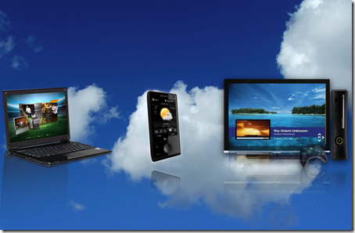
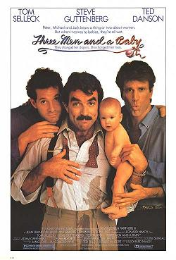
Three
(____) and a
(____)
Notes:
http://blogs.msdn.com/b/stevecla01/archive/2009/05/21/three-screens-and-a-cloud.aspx
http://en.wikipedia.org/wiki/File:Three_men_and_a_baby_p.jpg

Slide 10
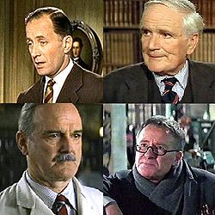
Who are these guys?
http://en.wikipedia.org/wiki/Q_(James_Bond)
Notes:
http://en.wikipedia.org/wiki/Q_(James_Bond)

Slide 11
Goal: Build software systems where…
Time-to-market is short
Effort focuses on business functionality
Development is highly productive
Cost structure is a good fit
Downtime is not necessary
Scale is efficient
Modification is straight-forward
Infrastructure is not a limiting factor

Slide 12
Agenda for Roles & Queues
What are Roles and Queues?
What tools are needed?
Why are Roles important?
Why are Queues important?
Why does R^{n}⬄Q^{n}⬄R^{n} matter?
How do I Build, Debug, and Deploy?
Helping mere mortals build highly reliable applications that scale…

Slide 13
Two Key Concepts
Roles
  Web Roles
  Worker Roles
Queues

Slide 14



Web Roles are a lot like Web Pages
 | ASP.NET Page | Web Role | Worker Role
Build using ASP.NET, MVC
Runs in IIS 7
Visible to Internet
Good to handle interactive users
Good for hosting Web API (WCF)
Language Agnostic
Notes:
Smarx “The only difference between a web role and a worker role is that in the web role, IIS (actually Hosted Web Core) gets started and pointed at your app data directory. You can still put code in WebRole.cs that does exactly the same thing as you would do in your worker role, so the decision should really be "Do you want IIS?" If so, use a web role. If not, use a worker role.”

Slide 15
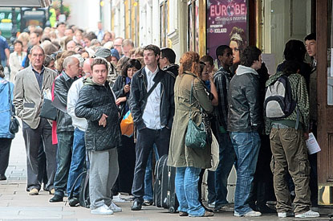
Queue
Notes:
http://www.google.com/imgres?imgurl=http://i.thisislondon.co.uk/i/pix/2008/09/hamlet-queue-415x275.jpg&imgrefurl=http://www.thisislondon.co.uk/standard/article-23554957-fans-queue-at-box-office-for-david-tennants-hamlet.do&usg=__MmvCdA0aI9YfR3UaV-DXzzNgenU=&h=275&w=415&sz=51&hl=en&start=18&sig2=nIloA1Q8lveL1tTj8TQZRQ&um=1&itbs=1&tbnid=QX8ur12fYUtSBM:&tbnh=83&tbnw=125&prev=/images%3Fq%3Dqueue%26um%3D1%26hl%3Den%26sa%3DG%26rls%3Dcom.microsoft:en-us%26rlz%3D1I7ADFA_en%26as_st%3Dy%26tbs%3Disch:1&ei=1vHkS-6KHcL-8AaYw-DBDg

Slide 16
Key Pattern: Roles + Queues
Web
Role
(IIS)
Worker
Role
Queues
Blobs
Tables
Notes:
AJAX – orthogonal concern
Worker Role not related to HTML 5 concept of Web Worker

Slide 17

Canonical Example: Thumbnails
Web
Role
(IIS)
Worker
Role
Queues
Blobs
Tables
Notes:
AJAX – orthogonal concern
Worker Role not related to HTML 5 concept of Web Worker

Slide 18


Adding to Queue - Conceptual
Queue Name: “thumbnailer-7”
bostonazure.queue.cloudapp.net

Slide 19
Adding to Queue - Actual
314159
979323
265358
Azure Blob Storage
314159
265358
979323
Notes:
3.14159 265358 979323 846264 338327 950288 419716 939937 510582 097494 459230

Slide 20
Key Pattern: Roles + Queues
Simplify and Focus
Web
Role
(IIS)
Worker
Role
Queues
Notes:
AJAX – orthogonal concern
Worker Role not related to HTML 5 concept of Web Worker

Slide 21
Key Pattern: Roles + Queues
queue.AddMessage(
new CloudQueueMessage(
statusUpdateMessage));
Web
Role
(IIS)
Worker
Role
Queues
CloudQueueMessage
statusUpdateMessage =
queue.GetMessage(
TimeSpan.FromSeconds(10));
… queue.DeleteMessage(statusUpdateMessage);
Notes:
AJAX – orthogonal concern
Worker Role not related to HTML 5 concept of Web Worker

Slide 22
Web App vs. Web Role
Consider ASP.NET Web App (e.g., hosted at ISP)
Consider Web Role hosted on Azure
Scale

Slide 23
Default.aspx.cs
public partial class _Default : System.Web.UI.Page
{
protected void Page_Load(…)
{
if (Page.IsPostBack)
{
throw new Exception(
"goodbye cloud");
}
}

Slide 24
Global.asax.cs
static int x = 0;
protected void Application_Error(object sender, EventArgs e)
{ Exception ex = Server.GetLastError();
if (ex.GetType() == typeof(HttpException)) { … }
Response.Write(ex.Message);
Server.ClearError();
if (x % 3 == 0) Response.Redirect("default.aspx");
}
http://crashtestdummy.cloudapp.net/

Slide 25
The Windows Azure …
TOOL and RUNTIME STACKS

Slide 26
Azure Development Tool Stack
Visual Studio
C#, VB.NET, F#, …
.NET Runtime
Dev Fabric, Azure Toolkit , Azure SDK
Plus…
Could be non-Visual Studio, non-.NET-based
REST access to all Azure Services
Notes:
System Center

Slide 27
Pre-Azure Server Stack
.NET Runtime (3.5)
Windows Server 2008, IIS 7
Windows Communication Foundation (WCF)
SQL Server
SQL Server
MSMQ
ASP.NET, ASP.NET MVC
Windows Services
Notes:
System Center

Slide 28
Azure Server Stack
.NET Runtime (3.5)
Windows Server 2008, IIS 7
Windows Communication Foundation (WCF)
SQL Server ➔ SQL Azure
SQL Server ➔ Azure Blobs
null ➔ Azure Table Storage
MSMQ ➔ Azure Queues
ASP.NET, ASP.NET MVC ➔ Azure Web Role
Windows Services ➔ Worker Roles
Notes:
System Center

Slide 29
Pre-Azure Operational Concerns
Buying hardware
CapEx
Provisioning Servers
Configuring Servers and Services
Patching the Operating System
(Human) Ops Resource Intensive

Slide 30
Azure Operational Concerns
Buying hardware ➔ null
CapEx ➔ Variable cost / Utility pricing
Provisioning Servers ➔ null
Configuring Servers and Services ➔ null
Patching the Operating System ➔ null
(Human) Ops Resource Intensive ➔ null
  + Communication paths reduced

Slide 31
Pre-Azure Operational Concerns
Buying hardware
CapEx
(Human) Ops Resource Intensive

Slide 32
Azure Operational Concerns
Buying hardware ➔ null
CapEx ➔ Variable cost / Utility pricing
(Human) Ops Resource Intensive ➔ null
  + Communication paths reduced

Slide 33

Concerns for App Owner
Stuff We Like
Stuff We Might
Rather Not Deal With
Data Center Management
High Availability
Computational Scalability
Hardware Provisioning
Network Load Balancing
Fault Tolerance
OS updates & Patches
Application Development
Staging / Production
Storage Scalability
OS Installation
Network Addressing
Hardware Repair

Slide 34







Compute Services
Web
Role
Worker
Role
Web
Role
(IIS)
Worker
Role
LB
HTTP/HTTPS
Web Role
  Hosted in IIS (Web Server)
  Public facing service
Worker Role
  Background process
  Can be public facing
Language agnostic

Slide 35
Key Windows Azure Design Pattern…
TWO ROLES AND A QUEUE

Slide 36
Key Pattern: Roles + Queues
Web
Role
(IIS)
Worker
Role
Queues
Notes:
AJAX – orthogonal concern
Worker Role not related to HTML 5 concept of Web Worker

Slide 37
Key Pattern: Roles^{n} + Queues^{n}
R^{n}⬄Q^{n}⬄R^{n}
Worker
Role
Web
Role
(IIS)
Worker
Role
Web
Role
(IIS)
Worker
Role
Web
Role
(IIS)
Worker
Role Type 1
Web
Role
(IIS)
Worker
Role
Queues
Worker
Role
Worker
Role
Worker
Role Type 2
Notes:
AJAX – orthogonal concern
Worker Role not related to HTML 5 concept of Web Worker

Slide 38
Roles and Queue
Allow loosely coupled workflow between roles
Messages not processed strictly FIFO
Queue length (and trend) is key metric for tuning Role deployment numbers

Slide 39
Azure Queues by the Numbers
100% = Reliability of message delivery
30 seconds = default “invisibility window”
8 KB = max size of a queued item
7 days = max length an item can stay on queue
500 = approx number of transactions a queue can handle per second
N = number of queues you can have (N >> 1)

Slide 40
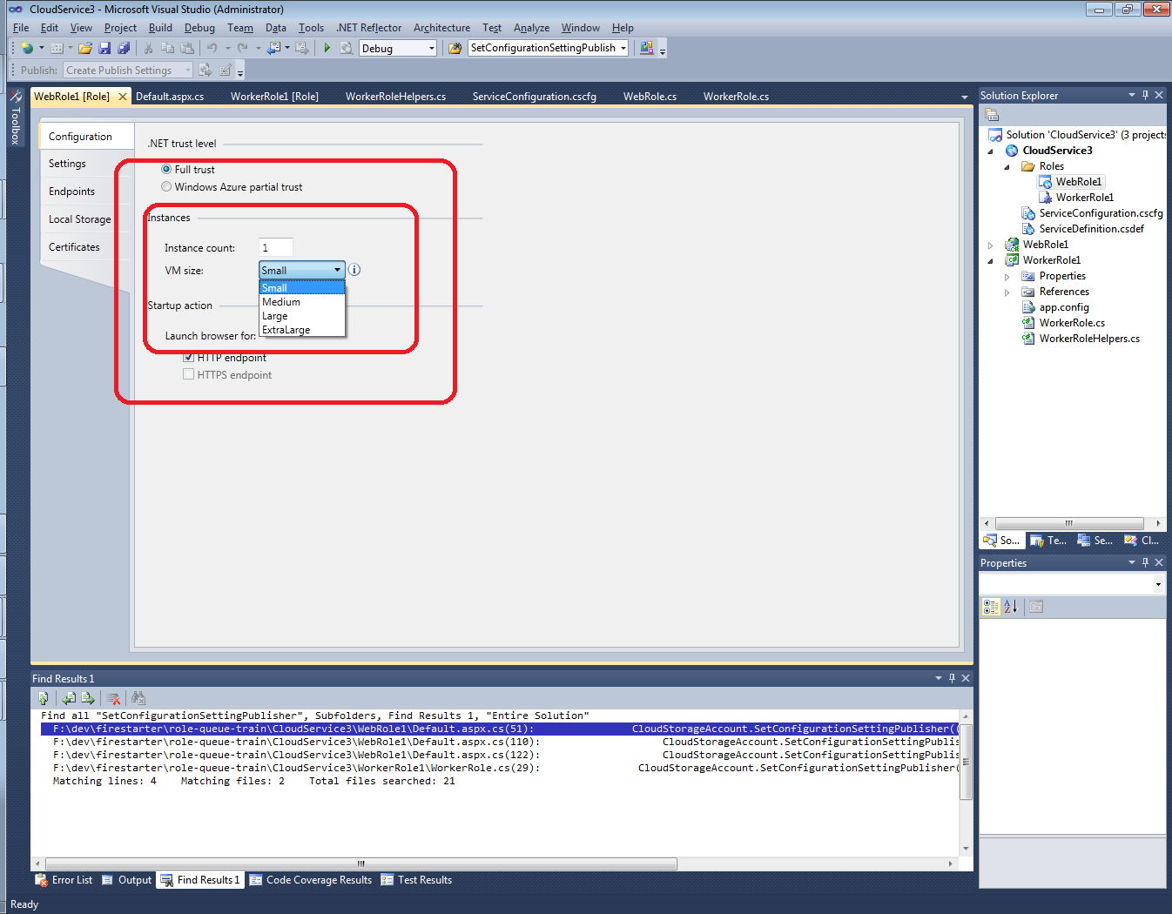
“Out” is the New “Up”
Scaling Out has hard limits at CPU, Memory
  Architecturally more limiting

Slide 41
Example: Lesson 7: Work Offline
“Lesson 7: Work Offline.” from 7 Lessons Learned While Building Reddit to 270 Million Page Views a Month
http://highscalability.com/blog/2010/5/17/7-lessons-learned-while-building-reddit-to-270-million-page.html
Lesson 7: Work Offline
The essence of this lesson is: do the minimal amount of work on the backend and tell the user you are done.
If you need to do something do it while the user isn’t waiting for you. Put it in a queue. When a user votes on Reddit that updates listings, a user’s Karma, and lots of other stuff. So on a vote the database is updated to know that the vote happened, then a job is put in the queue, the job knows the 20 things that need to be updated. When the user comes back everything has been precached for them.
Work they do offline: 1. Precompute listings 2. Fetch thumbnails 3. Detect cheating. 4. Remove spam 5. Compute awards 6. Update search index .
There's no need to do these things while the user is waiting on you. For example, the incentive to cheat is higher now as Reddit has grown larger, so they spend a lot of time in the backend while people are voting to detect cheating. But they do it live in the background so it doesn’t slow down the user experience. The diagram of the architecture from the presentation is:
The blue arrows are what happens when a request comes in. Say someone submits a link or vote, it goes to the cache, master database, and job queue. Then they return to the user. Then the rest happens offline, those are represented by the pink arrows. Services like Spam, Precomputer, and Thumnailer read from the queue, do the work, and update database as required. Key piece of technology is RabbitMQ.
Notes:
http://highscalability.com/blog/2010/5/17/7-lessons-learned-while-building-reddit-to-270-million-page.html

Slide 42
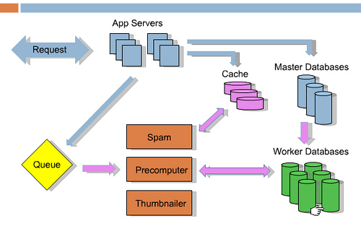
“Do it while the user isn’t waiting for you.”
“Put it in a queue.”
Notes:
http://highscalability.com/blog/2010/5/17/7-lessons-learned-while-building-reddit-to-270-million-page.html

Slide 43
R^{n}⬄Q^{n}⬄R^{n} requires Idempotent
If we do a task twice, end result same as if we did it once

Slide 44
R^{n}⬄Q^{n}⬄R^{n} enables Responsive
Response to interactive users is as fast as a work request can be persisted
Time consuming work done off-line
Same total resource consumption, better subjective experience

Slide 45
R^{n}⬄Q^{n}⬄R^{n} enables Scalable
Loosely coupled, concern-independent scaling
Blocking is Bane of Scalability
  Decoupled front/back ends insulate from other system issues if…
  Twitter down
  Email server unreachable
  Order processing partner doing maintenance
  Internet connectivity interruption

Slide 46
R^{n}⬄Q^{n}⬄R^{n} enables Resilient
“Plan for failure”
There will be role restarts
Bake in handling of restarts
  Not an exception!
  Restarts are routine, system “just keeps working”
Change the “service” topology by adding or removing role instances…
  Without service interruption

Slide 47
Common Operational Challenges
Hard to upgrade without downtime
Wasteful to provision for peak load
Time consuming to add more dev or test environments

Slide 48
What’s Up?
(and what’s going down!)
 | Typical Site | An Azure Role | Azure Site
Operating System Upgrade
Application Update / Deploy
Change Topology
Hardware Failure
Software Bug / Crash / Failure
Security Patch
Notes:
Tech Windows

Slide 49
Why Now?
Internet is “always on” – customer expectations
Cheap, commodity computers that are pretty dang good – Moore’s Law
Internet is distributed
Cost focus due to global economy
Innovation driven – fiercely competitive space

Slide 50
Organizational Drivers
Global Workforce: Cloud Roles offer logical separation for purposes of development + test by distributed development teams
Agile: Smaller teams, Lower friction, Shorter cycle times

Slide 51
Data Centers are BIG
Recently we crossed the threshold where power consumed by data centers in the US now exceeds 2% of all power used - and for any data center, power accounts for more than all other costs combined.
  Pat Helland, a Microsoft cloud architect
Data centers are sucking more juice than all US color TVs combined.
  http://royal.pingdom.com/2008/07/25/us-data-centers-consuming-as-much-power-as-5-million-houses/

Slide 52
Data Centers are Global
Let your Cloud provider deal with …
  Global distribution / synchronization
  Geographic load balancing / tuning
  Providing CDN
  Roles and Queues pattern still works

Slide 53

Scale Out easier to Spread Out
  Scale out systems better suited for geographic distribution
  More efficient and flexible because more granular
  Hard for a mega-machine to be in more than one place
  Failure need not be binary
Notes:
Chainsaw: http://commons.wikimedia.org/wiki/File:Chainsaw_cutting_tree.jpg

Slide 54
No Holds Barred
“[Google’s] custom-designed server hardware includes a 12-volt battery that functions as an uninterruptible power supply. This obviates the need for a central data center UPS, which turns out to be less reliable than on-board batteries.” –Information Week
http://i.i.com.com/cnwk.1d/i/bto/20090401/GoogleServerLarge.jpg
Notes:
http://bmighty.informationweek.com/ebusiness/showArticle.jhtml?articleID=216500267&pgno=1

Slide 55
Azure’s Abstraction
Code that knows about failover, other computers, environments, …
  Does. Not. Exist. in your application code
Azure’s AppFabric handles
So Roles support many properties – Azure allows for a clean implementation or Roles

Slide 56
These capabilities are not all new… right?
Notes:
http://blogs.westword.com/latestword/2009/10/denver_is_smarter_than_every_o.php
http://www.google.com/imgres?imgurl=http://www.watchmoviestreaming.com/pictures/dumbanddumber1.jpg&imgrefurl=http://www.watchmoviestreaming.com/%3Fp%3D424&usg=__UZ1BrJ79mCMa7yueDsmtXOADCHw=&h=267&w=500&sz=24&hl=en&start=7&sig2=IbDrZVdkObZkrsySJqTm-Q&itbs=1&tbnid=Q_EZDCwRAgp15M:&tbnh=69&tbnw=130&prev=/images%3Fq%3Ddumb%2Band%2Bdumber%26hl%3Den%26as_st%3Dy%26tbs%3Disch:1&ei=j-zkS63ZHcO78gaC4qy4Bw

Slide 57

Not new, but…
Notes:
http://blogs.westword.com/latestword/2009/10/denver_is_smarter_than_every_o.php
http://www.google.com/imgres?imgurl=http://www.watchmoviestreaming.com/pictures/dumbanddumber1.jpg&imgrefurl=http://www.watchmoviestreaming.com/%3Fp%3D424&usg=__UZ1BrJ79mCMa7yueDsmtXOADCHw=&h=267&w=500&sz=24&hl=en&start=7&sig2=IbDrZVdkObZkrsySJqTm-Q&itbs=1&tbnid=Q_EZDCwRAgp15M:&tbnh=69&tbnw=130&prev=/images%3Fq%3Ddumb%2Band%2Bdumber%26hl%3Den%26as_st%3Dy%26tbs%3Disch:1&ei=j-zkS63ZHcO78gaC4qy4Bw

Slide 58

Accessible to us mere mortals
Less complex, more cost-effective, competitive pressure: everyone’s doing it
Notes:
http://blogs.westword.com/latestword/2009/10/denver_is_smarter_than_every_o.php
http://www.google.com/imgres?imgurl=http://www.watchmoviestreaming.com/pictures/dumbanddumber1.jpg&imgrefurl=http://www.watchmoviestreaming.com/%3Fp%3D424&usg=__UZ1BrJ79mCMa7yueDsmtXOADCHw=&h=267&w=500&sz=24&hl=en&start=7&sig2=IbDrZVdkObZkrsySJqTm-Q&itbs=1&tbnid=Q_EZDCwRAgp15M:&tbnh=69&tbnw=130&prev=/images%3Fq%3Ddumb%2Band%2Bdumber%26hl%3Den%26as_st%3Dy%26tbs%3Disch:1&ei=j-zkS63ZHcO78gaC4qy4Bw

Slide 59
Advanced Queue Topics
Code for retries – Plan to fail
Poison Messages
Exception handling
Fully utilize Roles – complexity trade-off
Async notification of new Queue items

Slide 60
Advanced Worker Role Topics
Full utilization of a WR instance is more work
  Message stays in queue for 7 days
  You pay by instance, not resource use within
Tactics…
  Read >1 message from queue at a time
  Have multiple message types handled in one worker role
  Build multi-threaded Worker Role
Build simple “scale with the config file” systems
  Is time-to-market more imp than deployment / run costs?
  Trade off scale efficiency, maintainability, time-to-market
Business Decisions!

Slide 61
http://queue.core.windows.net
“If you are running in the development fabric on your desktop computer you can configure it with the well-known development storage connection string UseDevelopmentStorage=true. This well-known string provides all of the data necessary to connect with the local instance of development storage.” –Azure in Action p. 349

Slide 62
Imagine a Train…
Designed to support the maximum/peak load
Made all the needed stops
Ran once per day
WE DON’T DO THAT
Many small trains
No “SPoF”
Put all your eggs in the one basket and – WATCH THAT BASKET. – Mark Twain

Slide 63
Silver Bullet?
Question: Does Azure make my application scale automatically?

Slide 64
☺

Slide 65
Queue API set
  Create a CloudQueueClient using account and credentials
  Create a CloudQueue using the client and GetQueueReference - queue name
  CreateIfNotExist to create it if not there
  Create a CloudQueueMessage with content
  Use CloudQueue.AddMessage to add it to the queue
  Use CloudQueue.GetMessage to get it out (passing invisibility time)

Slide 66
Topics
Cmdlets, Certificates, Storage Tools, Diagnostics <⬅ REALLY – ALL THESE?
Why Roles and Queues matter
Dev Tools – what are you using today?
Visual Studio 2010, C#, CloudService Template
  Code, Object Model walk through
Demo building a simple application
LAB: build, debug, deploy

Slide 67
Closing thought
Do we really need “the cloud” for all these great properties?
Does (cloud == scalability + operational simplicity + cost savings + fast time-to-market)?
Notes:
http://discussion.autodesk.com/forums/thread.jspa?threadID=479556

Slide 68

“These go to eleven” –Nigel Tufnel
The cloud is an amplifier – emerging as best system of software services + patterns + tools + ecosystem for tomorrow’s systems
Notes:
http://discussion.autodesk.com/forums/thread.jspa?threadID=479556

Slide 69
Self-Signed Certs
Why not all the ceremony of a Verisign Digital Certificate
  PKI not needed here
  I don’t need to know that “Company X really issued this cert”
  If you have it, you are cool
    I trust “me”
  Not the same über-trust scenario that PKI solves; not a “can I trust this party” situation

Slide 70
BostonAzure.org
Boston Azure cloud user group
Focused on Microsoft’s cloud solution
Next meeting: 6-8 PM Thurs June 24th 2010
  Hacking on “Boston Azure Project”
Meetings usually 4th Thursday of month
  No cost; food; great topics; growing community
Join email list: http://bostonazure.org
Follow on Twitter: @bostonazure

Slide 71
Slides
Link from my talk abstract:
http://thedevcommunity.org
Link from my blog:
http://blog.codingoutloud.com

Slide 72
Bill Wilder
@codingoutloud
http://blog.codingoutloud.com

