Slide 1
Commodity apps
- business vs email
Culture + business need + law + tech + business model
Utility compute

Slide 2
Bill Wilder – brief bio
Bill Wilder has been a professional software developer for more than 20 years. Last year he founded the Boston Azure User Group, an in-person cloud computing community which gets together monthly to learn about Windows Azure through prepared talks and hands-on coding. Bill is especially excited about the Boston Azure Project, a collaborative Windows Azure coding project just starting up in the Boston Azure community. Bill is an active community speaker, blogger (blog.codingoutloud.com), and tweeter (@codingoutloud) on technology matters and soft skills for technologists, and is also a member of Boston West Toastmasters. Separately, Bill has a day job as an enterprise architect focusing on .NET.
Notes:
Bill Wilder has been a professional software developer for more than 20 years. Last year he founded the <a href="http://bostonazure.org/">Boston Azure User Group</a>, an in-person cloud computing community which gets together monthly to learn about Windows Azure through prepared talks and hands-on coding. Bill is especially excited about the <a
href="http://blog.codingoutloud.com/2010/06/02/introducing-the-boston-azure-project/">Boston Azure Project</a>, a collaborative Windows Azure coding project just starting up in the Boston Azure community. Bill is an active community speaker, blogger (<a href="http://blog.codingoutloud.com">blog.codingoutloud.com</a>), and tweeter (<a href="http://twitter.com/codingoutloud">@codingoutloud</a>) on technology matters and soft skills for technologists, and is also a member of Boston West Toastmasters. Separately, Bill has a day job as an enterprise architect focusing on .NET.

Slide 3
Cloud Computing…
Microsoft style! with Windows Azure
New Hampshire Code Camp #2
05-June-2010
Boston Azure User Group
http://bostonazure.org
@bostonazure
Bill Wilder
http://blog.codingoutloud.com
@codingoutloud
Boston West Toastmasters http://bwtoastmasters.com
Not here with my day job
Only Bill’s personal views
Usually release via Creative Commons, but have some stuff I “borrowed”
Notes:
Not representing my day job
Several slides stolen borrowed from http://www.meetup.com/Boston-cloud-services/files/ (http://files.meetup.com/1460349/azure.ppt – Jim O’Neil’s Windows Azure presentation from March 17, 2010 meetup) + from Chris Bowen’s “roadshow” talk (March 2010)

Slide 4
Cloud Computing…
Microsoft style! with Windows Azure
New Hampshire Code Camp #2
05-June-2010
Boston Azure User Group
http://bostonazure.org
@bostonazure
Bill Wilder
http://blog.codingoutloud.com
@codingoutloud
Boston West Toastmasters http://bwtoastmasters.com
Not here with my day job
Only Bill’s personal views
Notes:
Not representing my day job
Several slides stolen borrowed from http://www.meetup.com/Boston-cloud-services/files/ (http://files.meetup.com/1460349/azure.ppt – Jim O’Neil’s Windows Azure presentation from March 17, 2010 meetup) + from Chris Bowen’s “roadshow” talk (March 2010)

Slide 5
Goal: Build software systems where…
Time-to-market is short
Effort focuses on business functionality
Development is highly productive
Cost structure is a good fit
Downtime is not necessary
Scale is efficient
Modification is straight-forward
Infrastructure is not a limiting factor

Slide 6
Cloud Computing might be…
Same as it ever was
Marketing Hype
  cloud == vendor’s product
A Fad
The Next Big Thing
Notes:
SOA buzziness has faded, but patterns have value

Slide 7
The Cloud Opportunity
Replace “your” infrastructure with “their” infrastructure
Save money, shift risk, shorten time-to-market

Slide 8
The Cloud Provides…
Efficient Scalability
Elasticity on Demand
Complexity Reduction through Abstraction
A few new challenges

Slide 9
The Cloud is …
EFFICIENTLY SCALABLE

Slide 10







History Lesson
Notes:
We know how to scale

Slide 11
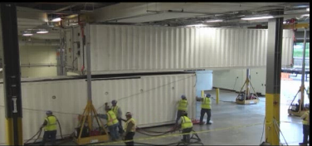
Containers!
http://www.microsoft.com/showcase/en/us/details/36db4da6-8777-431e-aefb-316ccbb63e4e

Slide 12
Global investment in Data Centers
Vendors build out – so you don’t have to
(increasingly…) “Containers” packed with
Fast, multi-core processors
Cheap, commodity hardware (memory, disk)
  Google’s famously bare-bones hardware
Locations selected for efficiency considering
  Cheap cooling, Cheap electricity
  Geographical coverage
Competitive bidding optimizes for Containers
  Delivery “ready to plug-in” & “ready to unplug”

Slide 13



Most $$$ part of Software System?

Slide 14

Massive Automation, Efficiency
Cross-Data Center Monitoring
Software and Hardware Virtualization
Automated Deployment (across Data Centers)

Slide 15
Massive Automation, Efficiency
Cross-Data Center Monitoring
Software and Hardware Virtualization
Automated Deployment (across Data Centers)
HUGE win for customers lowering real costs
  Operational efficiency – you ➔ them
  100:1 ➔ 10,000:1

Slide 16
The Cloud is…
ELASTIC ON DEMAND
Notes:
LifeFX

Slide 17
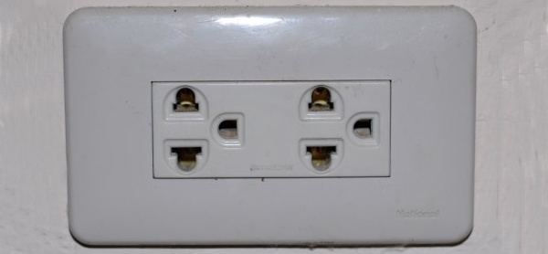

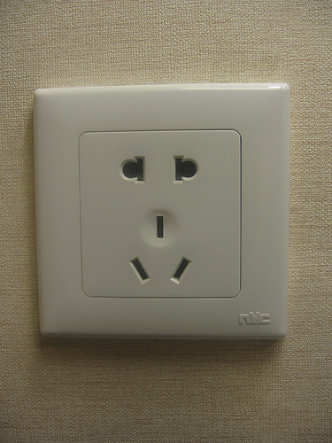
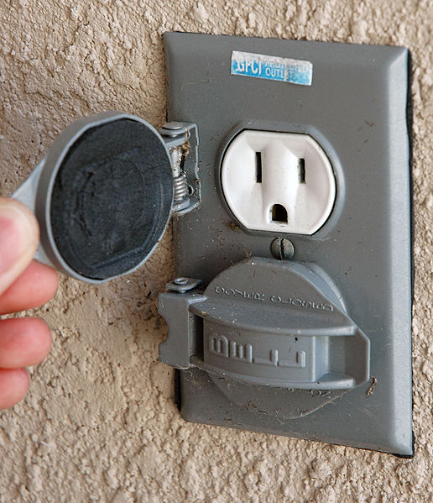
Utility Computing
http://commons.wikimedia.org/wiki/File:Thai_plug.jpg
Notes:
http://commons.wikimedia.org/wiki/File:Thai_plug.jpg (Thai)
http://www.flickr.com/photos/terralance/204793738/ (American, English and continental European plugs all in one! – CC Some rights reserved)
http://commons.wikimedia.org/wiki/File:American_outdoor_electrical_outlet.jpg
http://www.flickr.com/photos/onetreehillstudios/2958752337/ (Elecrical plug – CC Some rights reserved)

Slide 18
Business Model Innovation
DIFFERENTIATOR is business model that permits bursting system capacity up and down on demand without penalty
  Just like electricity (without the brownouts?)
Avoids need for Elasticity of Customer’s Work Force
  No such thing as hire/fire at Internet speed

Slide 19
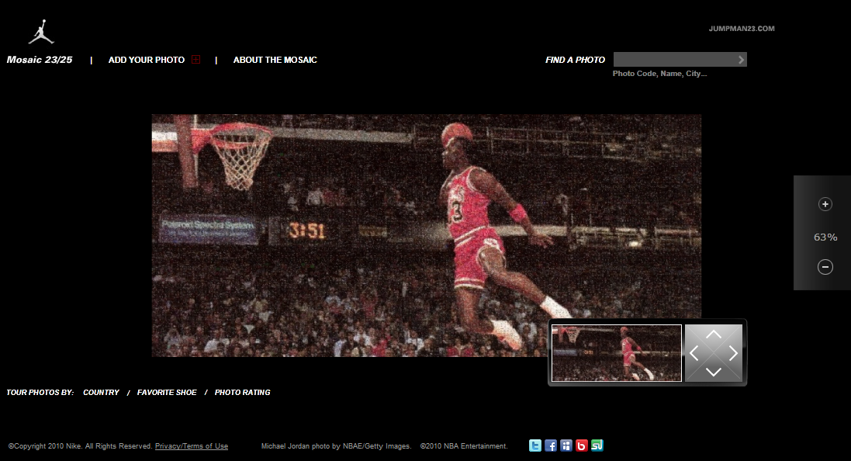
Air Jordan Site
http://www.jumpman23mosaic.com/
Notes:
The Web application was built on the Windows Azure platform to implement the mosaic because Windows Azure is able to easily calibrate the number of Web Role instances needed to support unpredictable traffic bursts, and it can also separately scale out back-end Worker Role instances to support a rapid regeneration of the mosaic based on new photo uploads from consumers. By employing up to 40 backend (and parallel) Worker Role instances, a new mosaic can be regenerated in approximately 10 minutes to include new photos that were uploaded since the last mosaic was constructed. Considering that a typical mosaic is more than 5 gigapixels and, if just a single instance were used it would take approximately 5 hours to generate, this speed underscores the benefit to scaling out processing in a linear fashion.

Slide 20
Air Jordan Site
Mosaic regeneration was 5 hours
Reduced to approx 10 minutes using Azure
  40 concurrent Worker Role instances
Typical mosaic > 5 gigapixels

Slide 21
Other “Usual Suspects”
Dominoes
WordPress
Pharma
Ticketing
Online retailers
Census

Slide 22
Intuit + Azure
http://alexbarnett.net/blog/archive/2010/01/20/connecting-clouds-intuit-partner-platform-and-windows-azure.aspx
Facebook + Azure
http://facebookazuretoolkit.codeplex.com/
http://www.facebook.com/windowsazure

Slide 23

Azure Compute Pricing
http://www.microsoft.com/windowsazure/pricing/
$0.12 / hour
  $2.88 / day
  $1051 / year
Per Role
Storage = $0.15 / GB stored / month
Storage transactions = $0.01 / 10K
Data transfers = $0.10 in / $0.15 out / GB

Slide 24
Azure Data Pricing
http://www.microsoft.com/windowsazure/pricing/
Storage = $0.15 / GB / month
Storage transactions = $0.01 / 10K
Data transfers = $0.10 in / $0.15 out / GB
No cost for data access within the data center

Slide 25

SQL Azure Pricing
Separate offering from Windows Azure
Web Edition: Up to 1 GB relational database = $10 / month
Business Edition: Up to 10 GB relational database = $100 / month
Data transfers = $0.10 in / $0.15 out / GB
50 GB version coming

Slide 26
What about “the little guy”
Just want a simple web site
  ISP might be better for now
  No elasticity, slow failover may be fine
Want database, more robustness?
  1 GB SQL Azure in the cloud getting cost-competitive
  Or forced sharding
Microsoft working on shared-VMs
  Will lower the price-points

Slide 27
The Cloud…
REDUCES COMPLEXITY
THROUGH ABSTRACTION

Slide 28

Application Ownership
Stuff We Like
Stuff We Might
Rather Not Deal With
Data Center Management
High Availability
Computational Scalability
Hardware Provisioning
Network Load Balancing
Fault Tolerance
OS updates & Patches
Application Development
Staging / Production
Storage Scalability
OS Installation
Network Addressing
Hardware Repair

Slide 29
SaaS = Software as a Service
  Salesforce.com, Google Apps, Bing
PaaS = Platform as a Service
  Azure, Google App Engine, Salesforce
IaaS = Infrastructure as a Service
  Amazon, many smaller players

Slide 30
Many layers of Abstraction
Network model
    Internet Plumbing
Hardware model
    Commodity hardware
Process model
    Virtualization big role today
Programming model
  This is where you want to be!

Slide 31
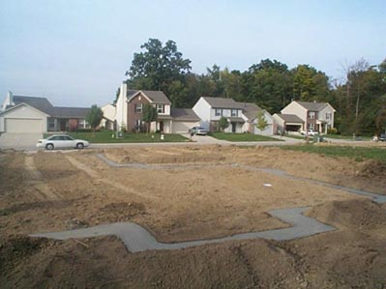
Infrastructure as a Service (IaaS)
http://z.about.com/d/architecture/1/5/K/J/hudson-house1008f.jpg
Notes:
http://picasaweb.google.com/lh/photo/CGxbah7Cec5qbMJ2II3q0g

Slide 32
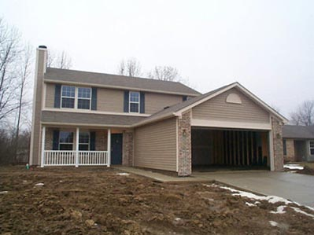
Platform as a Service (PaaS)

Slide 33
Where’s the highest value?
SaaS
PaaS
IaaS
Notes:
The higher up the stack, the better – easier on newer technologies

Slide 34









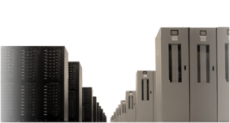


aaS You Were
Software-as-a-service
Platform-as-a-Service
Infrastructure-as-a-Service

Slide 35
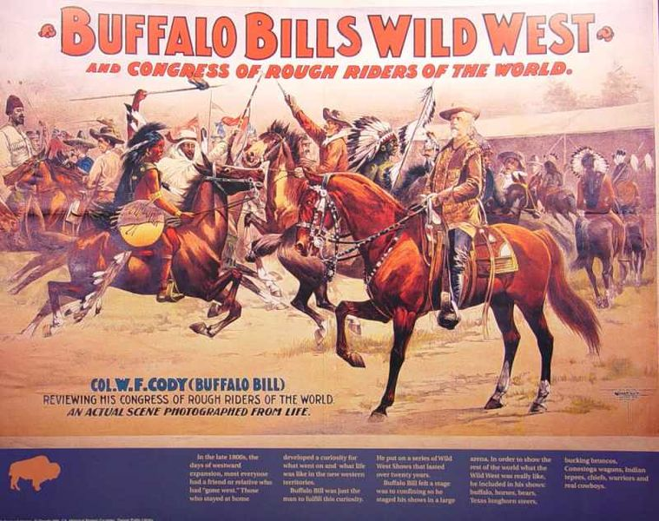
Dallas: Data as a Service (DaaS)
Notes:
Image from http://fr.wikipedia.org/wiki/Fichier:Buffalo-bill-cowboy-art.jpg
Creative Commons no commercial
http://images.google.com/imgres?imgurl=http://upload.wikimedia.org/wikipedia/fr/c/cd/Buffalo-bill-cowboy-art.jpg&imgrefurl=http://fr.wikipedia.org/wiki/Fichier:Buffalo-bill-cowboy-art.jpg&usg=__SkDrcX7Hb94WWEBgZYfKeKOEI4Y=&h=632&w=800&sz=67&hl=en&start=51&sig2=zHYoV2Yxg4SdIw-qvg-MDQ&um=1&itbs=1&tbnid=vcAPok0xf_CBsM:&tbnh=113&tbnw=143&prev=/images%3Fq%3Dcowboy%26start%3D36%26um%3D1%26hl%3Den%26sa%3DN%26as_rights%3D(cc_publicdomain%257Ccc_attribute%257Ccc_sharealike%257Ccc_noncommercial%257Ccc_nonderived)%26as_st%3Dy%26imgtbs%3Dr%26ndsp%3D18%26tbs%3Disch:1&ei=_futS8TAG8WBlAfH14yRAQ

Slide 36
Key Difference to Software Devs
Scale Up vs. Scale Out
  Vertical Scaling vs. Horizontal Scaling
    Like Mainframe vs. Distributed Systems
Perfect storm of:
  Cheap, commodity hardware
  Internet scale (if needed)
  Fault tolerance
  Supporting patterns for Software Architecture

Slide 37

Storage Services
HTTP/HTTPS
Blobs
Queues
Drives
Tables
Blobs – file/container storage
Tables - non-schematized data
Queues – inter-role communication
Drives – durable storage (in beta)

Slide 38






Compute Services
Web
Role
Worker
Role
Web
Role
(IIS)
Worker
Role
LB
HTTP/HTTPS
Web Role
  Hosted in IIS (Web Server)
  Public facing service
Worker Role
  Background process
  Can be public facing
Language agnostic

Slide 39
Key Pattern: Roles + Queues
Web
Role
(IIS)
Worker
Role
Queues
Blobs
Tables

Slide 40
The Windows Azure Cloud is…
FAMILIAR

Slide 41
Key Pattern: Table Storage
Consider your non-Relational Data that you store in SQL
Can it go in Table storage?
Lose some transactional scope and data integrity enforcement
  No “schema”
Gain “simplicity”
Gain scale

Slide 42
Algorithmic Considerations
Assume parallelism is available
Does your architecture assume serial processing?
Old school good examples:
SETI @ Home and GIMPS

Slide 43
Pre-Azure Development Tool Stack
Visual Studio
C#, VB.NET, F#, …
.NET Runtime
Notes:
System Center
WHO ARE YOU – WHAT DOES AUDIENCE KNOW ABOUT .NET? AZURE? Visual Studio? C# - or other?

Slide 44
Azure Development Tool Stack
Visual Studio
C#, VB.NET, F#, …
.NET Runtime
Dev Fabric, Azure Toolkit , Azure SDK
Plus…
Could be non-Visual Studio, non-.NET-based
REST access to all Azure Services
Notes:
System Center

Slide 45
Pre-Azure Server Stack
.NET Runtime (3.5)
Windows Server 2008, IIS 7
Windows Communication Foundation (WCF)
SQL Server
SQL Server
MSMQ
ASP.NET, ASP.NET MVC
Notes:
System Center

Slide 46
Azure Server Stack
.NET Runtime (3.5)
Windows Server 2008, IIS 7
Windows Communication Foundation (WCF)
SQL Server ➔ SQL Azure
SQL Server ➔ Azure Blobs
null ➔ Azure Table Storage
MSMQ ➔ Azure Queues
ASP.NET, ASP.NET MVC ➔ Azure Web Role
null ➔ Worker Roles
Notes:
System Center

Slide 47
Miami 311
Non-emergency issue resolution
http://miami311.cloudapp.net/
2 developers for 8 days (for a Gov’t project! ☺)
“.. 4,500 issues in progress - not represented as a ‘list', but located on a map in relation to other projects in their neighborhood..”
Notes:
http://port25.technet.com/archive/2010/03/04/miami-311.aspx

Slide 48
The Cloud is…
A MATURING SOLUTION

Slide 49

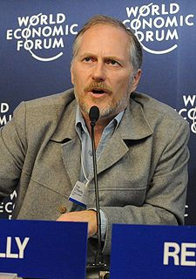
"The future is here. It's just not evenly distributed yet."
Notes:
William Gibson image from wikipedia: http://upload.wikimedia.org/wikipedia/commons/thumb/a/a4/William_Gibson_60th_birthday_portrait.jpg/240px-William_Gibson_60th_birthday_portrait.jpg
Tim O’Reilly image from wikipedia: http://upload.wikimedia.org/wikipedia/commons/thumb/4/4f/Tim_O%27Reilly2.jpg/225px-Tim_O%27Reilly2.jpg

Slide 50
The Future Will Come
Safety of data in the cloud
Design patterns for cloud dev
Database implementation

Slide 51
Key Challenges
Data Privacy
  Legal challenges
  Laws lagging?
Back-ups
  “3 copies in 2 data centers?”
Trust
  Patching, Security, “World Class Admins”
Confidence - SLA
Can I just “buy your cloud solution”

Slide 52
Security Standards Compliance
Data Center Compliance
  SAS 70 Type I and Type II attestations
  ISO/IEC 27001:2005
http://bit.ly/SecuringMicrosoftsCloud

Slide 53


Service Level Agreements
  Compute
  connectivity
  Instance
  health
  Storage
  availability
  SQL Azure
  availability
  AppFabric
  availability
Service is connected and reachable via web
Internet facing roles have external connectivity
All running roles continuously monitored
If role is unhealthy, detect/initiate corrective action
Storage service available/
reachable (connectivity)
Storage requests processed successfully
Database is connected to the internet gateway
Databases continuously monitored
Endpoints have external connectivity
Message operation requests processed successfully
  >99.95%
  >99.9%
  >99.9%
  >99.9%
  >99.9%
Notes:
SLA kicks in with >= 2 instances

Slide 54
BostonAzure.org
Boston Azure cloud user group
Focused on Microsoft’s cloud solution
Next meeting: 6-8 PM Thurs June 24th 2010
  Hacking on “Boston Azure Project”
Meetings usually 4th Thursday of month
  No cost; food; great topics; growing community
Join email list: http://bostonazure.org
Follow on Twitter: @bostonazure

Slide 55
Slides
Link from my talk abstract:
http://thedevcommunity.org
Link from my blog:
http://blog.codingoutloud.com

Slide 56
Bill Wilder
@codingoutloud
http://blog.codingoutloud.com

