Slide 1
PDC 2009 Highlights
Microsoft Corporation

Slide 2
Microsoft PDC 2009 Highlights
What was announced?
Commercial Availability of Windows Azure!
  Multiple price plans announced
PinPoint: http://pinpoint.microsoft.com/en-US/
  Online directory and marketplace
  Applications, Experts and IT Services
Project “Dallas”
    Access to multi-million dollar datasets and web services
    One marketplace & billing relationship
    Use from anywhere .NET, PHP, Java, iPhone
App Fabric
Project “Sydney” announced & Geneva = ADFS 2.0
VHD Deployment Announced

Slide 3
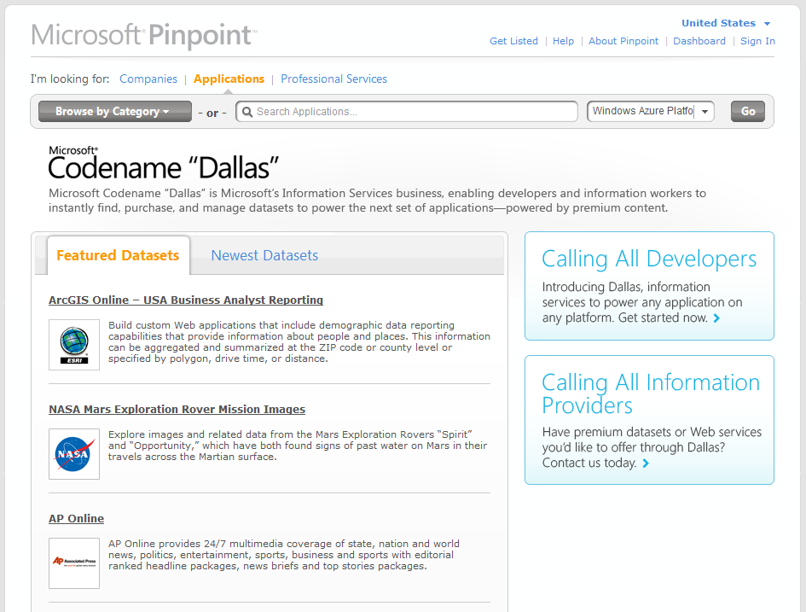
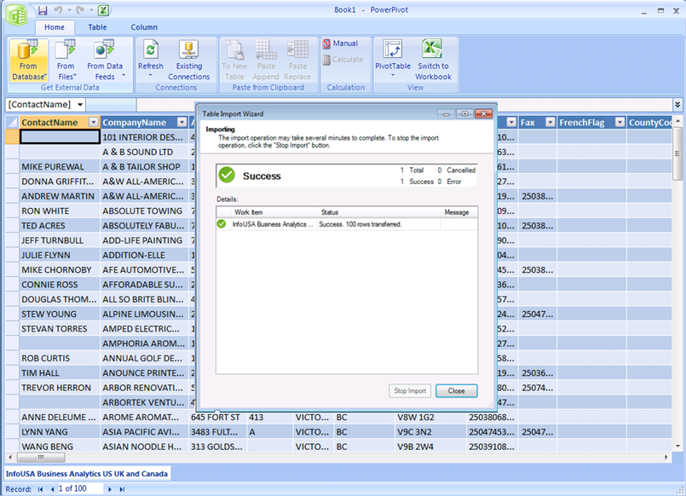
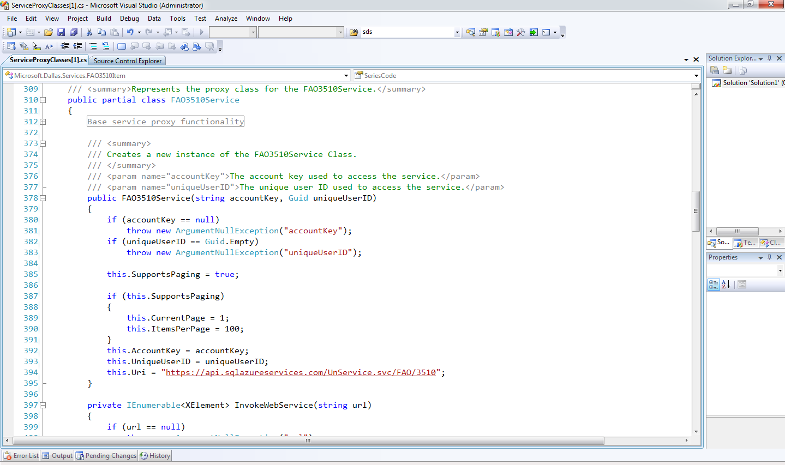
Microsoft Codename “Dallas”
Information Service
Marketplace
Standardized APIs
Analytics and Reporting
All powered by the Windows Azure platform

Slide 4
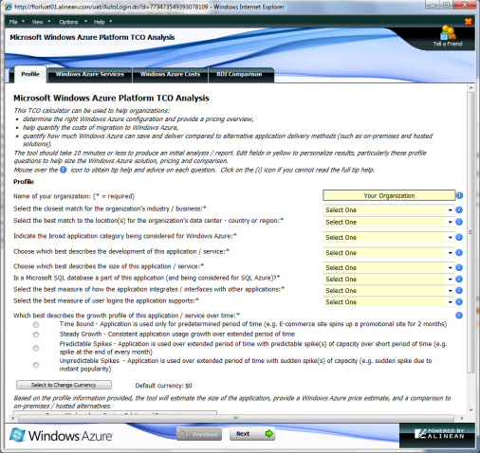
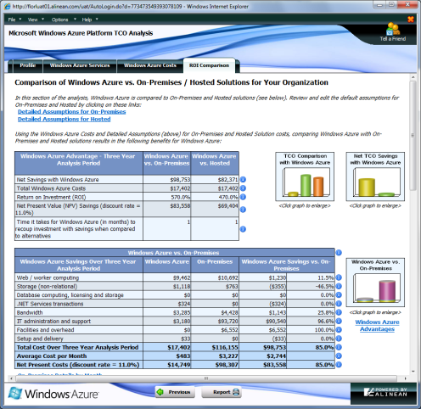

TCO Analyzer Tool
  Quickly determine “quantitative” value of using Windows Azure Platform services
  TCO of development and running Windows Azure Platform vs. traditional delivery channels
  Estimation “of” and conversion “to” on-premise solution to Windows Azure Platform services
TCO tool available today
http://www.microsoft.com/windowsazure/tco/

Slide 5



Windows Azure Platform Purchasing Models
Consumption
Subscription
Additional Licensing
“Pay as you go and grow”
“Value for a commitment“
“Coordinated purchasing”
Available Jan 2010
Select offers available Jan 2010
Planned for post PDC
Low barrier to entry & flexibility
Optimized for cloud elasticity
Discounts for commitment
Plans for payment predictability
Centralized purchasing experience
Introduction to volume discounts
Promotional
Offers
Development
Pricing
Partner
Discount
Integration with
Programs

Slide 6


Windows Azure Platform Consumption Prices
  Pay as you go and grow for only what you use when you use it
Elastic, scalable, secure, & highly available automated service platform
Highly available, scalable, and self managed distributed database service
  Compute
  Storage
  Web Edition
  Business Edition
Per service hour
$9.99/month
(up to 1 GB DB/month)
$99.99/month
(up to 10 GB DB/month)
Per GB stored & transactions
Per database/month
Per database/month
$0.12/hour
+ Variable Instance Sizes
$0.15 GB/month
$0.01/10K transactions
Windows Azure platform AppFabric Service Bus & Access Control
Scalable, automated, highly available services for secure connectivity
  Access Control
  Service Bus
$0.015/10k Message Operations
$0.015/10k Message Operations
Per Message Operation
Per Message Operation
Prices shown in USD only
International prices are available

